Slide 1

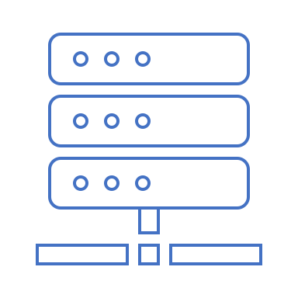






Stripe.js
Shopify API
Buyer Client
Merchant Client
Buyer Wallet
Backend
Merchant Wallet
Coin.sol
Controller.sol
Discount.sol

