Slide 1
System Software: Introduction & The Processor
Andrew Harn
University of Central Florida

Slide 2
What is Systems Software?
“Systems Software consists of a set of programs that support the operation of a computer system and help the programmer to simplify the programming process and create an environment to run applications software efficiently.”
In layman’s terms: “Systems software are programs that help you write and run programs.”

Slide 3
Types of Systems Software
Two kinds of environments that Systems Software is geared towards
Program Development
Text Editor
Compiler
Assembler
Static Linker
Run-Time
Loader
Program Libraries
Dynamic Linker
Operating System

Slide 4
Software for the Program Development Environment
Text Editor: Facilitates the creation and editing of text files, usually of a high-level language.
Compiler: Translates a high-level language to a lower-level language (usually assembly language).
Assembler: Translates an assembly language to object code (machine language binary).
Static Linker: Combines relocatable machine code that references each other. Required for creating executable code.
Many applications for developers include some or even all of these parts and are known as an integrated development environment (IDE).

Slide 5
Software for the Run-Time Environment
Loader: Loads executable code and starts its execution
Libraries: Precompiled programs that create a set of commonly used functions for use by other programs
Dynamic Linker: Loads and links shared libraries at run-time
Operating System: An event driven program that:
Represents an abstraction of the computer system
Handles resources efficiently
Creates the environment for applications to run
Provides a friendly interface between user and system

Slide 6
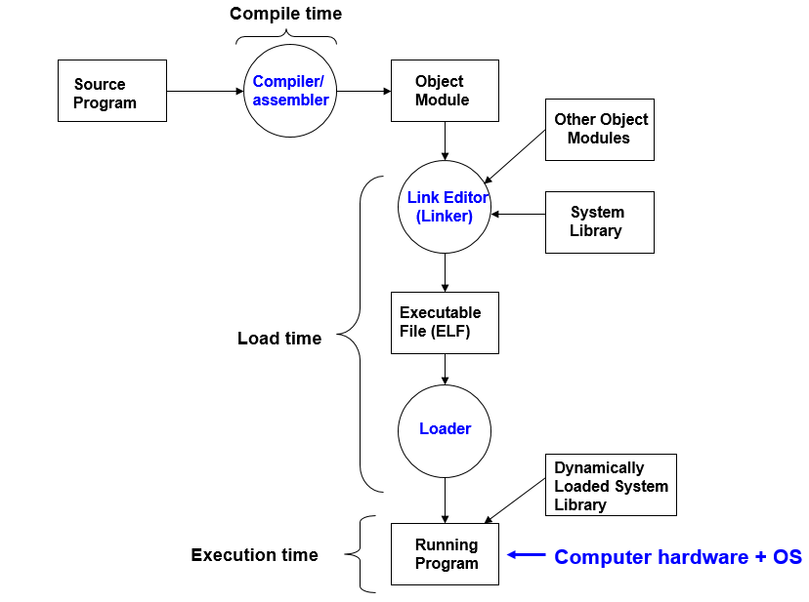

Slide 7
The Processor: As an Instruction Interpreter
We assume various properties about the system to simplify the concept of a processor
There is only one program running
There is only one memory unit
A basic machine architecture that follows these restrictions would be the Von-Neumann Machine (VN)

Slide 8
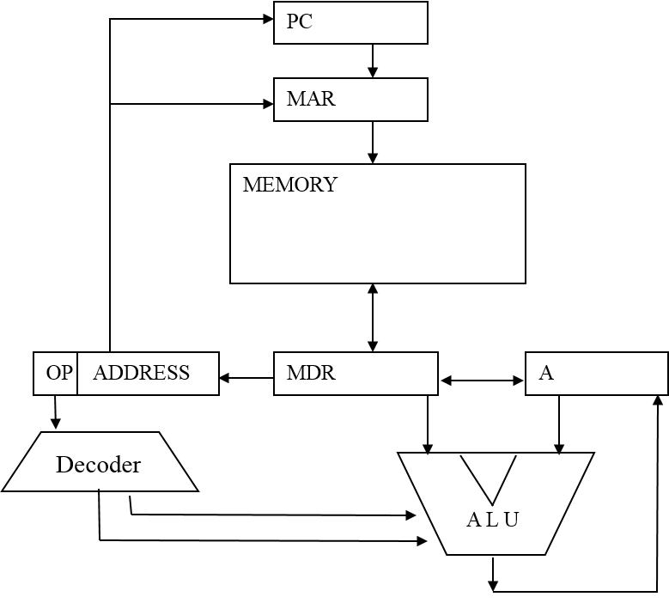
Von-Neumann Machine (VN)

Slide 9
All the Acronyms
Program Counter (PC) is a register that holds the address of the next instruction to be executed
Instruction Register (IR) is a register that stores the instruction to be executed by the processor
Arithmetic Logic Unit (ALU) is used to execute mathematical instructions such as ADD or SUB
DECODER is a circuit that translates the instruction into what the processor should execute
It reads from the Instruction Register as input and outputs a signal to the ALU as to want to do
Accumulator (A) is used to store data to be used as input to the ALU

Slide 10
All the Acronyms (Continued)
Main Storage (MEM) is used to store programs and data.
Random Access Memory (RAM) is an implementation of main storage.
Memory Address Register (MAR) is a register used to store the address to a specific memory location in Main Storage so that data can be written to/read from that location
Memory Data Register (MDR) is a register used to store data that is being written to/read from the Main Storage
Data can either be instructions or something simpler (such as an integer)

Slide 11
Instruction Cycle
Also known as the Machine Cycke
For the Von-Neumann Machine, there are two steps in the cycle:
Fetch Step: Instruction is retrieved from memory
Execution Cycle: Instruction is executed
A simple Hardware Description Language (HDL) will be used in order to understand how this cycle works in VN
An HDL simply is a language to describe the actions of the processor over time
The one used for this presentation is intended to be overly intuitive and should require minimal explaining

Slide 12
HDL: Data Movement, Example #1
PC
Suppose we wish to transfer the contents of the Program Counter into the Memory Address Register.
This transfer of data can be described as such:
MAR⬅PC
MAR
MEMORY
OP ADDRESS
MDR
A
Decoder
A L U

Slide 13
HDL: Data Movement, Example #2
To transfer data from memory to the memory data register, we use the following statement:
MDR⬅MEM[MAR]
The enclosing brackets are used to indicate where in the memory access should be made
For this instruction to be relevant, the memory address register should be set to a meaningful value
PC
MAR
MEMORY(MEM)
MEM[MAR]
OP ADDRESS
MDR
A
Decoder
A L U

Slide 14
HDL: Data Movement, Example #2 (Continued)
To transfer direction, which would be from the memory data register to a location in memory, the operands are simply switched:
MEM [MAR] ⬅MDR
As with the previous instruction, the memory address register must be set prior to this instruction.

Slide 15
HDL: Data Movement, Example #3
Transferring the contents of the memory data register to the instruction register is simply as follows:
IR⬅MDR
Note that this transfer of data breaks the data into two parts: Operation (OP) and Address
Fields are accessed with the “.” operator
PC
MAR
MEMORY
OP ADDRESS
MDR
A
Decoder
A L U

Slide 16
HDL: Data Movement, Example #4
Suppose we wish to move the Operation portion of the instruction register to the Decoder. This is done by using:
DECODER⬅IR.OP
The value transferred to the Decoder is used to determine what action the processor should take
If the value in the Decoder is set to a special value (Decoder==00), then it means that the fetch step of the machine cycle should be executed

Slide 17
Instruction Set Architecture
An instruction set is the art of the machine that pertains to programming
Examples include MIPS, ARM, and x86
For the Von-Neumann machine, the decoder uses only two fields, the Operation and the Address
What the processor should do is determined by the Operation field
Where the memory should be referenced for the operation is in the Address field

Slide 18
00: Fetch Instruction
1.MAR ⬅PC
2.MDR ⬅MEM[MAR]
3.IR ⬅MDR
4.PC ⬅PC+1
5.DECODER ⬅IR.OP
Copy contents of PC into MAR
Load content of memory location into MDR
Copy value stored in MDR to IR
Increment PC Register
Set the Decoder to the operation from the IR

Slide 19
01: LOAD
MAR ⬅IR.ADDR
MDR ⬅MEM[MAR]
A ⬅MDR
DECODER ⬅00
Copy the IR address value field into MAR
Load the content of a memory location into MDR
Copy content of MDR into A register
Set Decoder to execute Fetch

Slide 20
02: ADD
MAR ⬅IR.ADDR
MDR ⬅MEM[MAR]
A ⬅A + MDR
DECODER ⬅00
Copy the IR address value field into MAR
Load content of memory location to MDR
Add contents of MDR and A register and store result into A
Set Decoder to execute Fetch

Slide 21
03: STORE
MAR ⬅IR.ADDR
MDR ⬅A
MEM[MAR] ⬅MDR
DECODER ⬅00
Copy the IR address value field into MAR
Copy A register contents into MDR
Copy content of MDR into a memory location
Set Decoder to execute Fetch

Slide 22
More Instructions
04: SUB
Similar to ADD, but it subtracts from the Accumulator instead
05: IN
Retrieves a value from a specified input device
06: OUT
Prints out a value to a specified output device
07: HALT
Stops the execution of the program
08: JMP
Causes an unconditional branch to a specified address.
09: SKIPZ
Skips the next instruction if the contents of the Accumulator is 0

Slide 23
SKIPZ: Implementing the condition for the skip
PC
MAR
MEMORY
Z =Condition Code
OP ADDRESS
MDR
A
0
Z is set to 1 if A == 0
Decoder
A L U
A = 0
Z

Slide 24
ISA Overview for the VN Machine
opcode mnemonic meaning
0001 LOAD <x> A ← Mem[x]
0010 ADD <x> A ← A + Mem[x]
0011 STORE <x> Mem[x] ← A
0100 SUB <x> A ← A – Mem[x]
0101 IN <Device_#> A ← read from Device
0110 OUT <Device_#> A → output to Device
0111 HALT Stop
1000 JMP <x> PC ← x
1001 SKIPZ If Z = 1, Skip next instruction

Slide 25
Programming Language example
Suppose we had an instruction in a high-level programming language such as:
C := X + Y;
To translate this into a list of instructions in the ISA, we must assign memory locations (which may be temporary) to each variable name:
C: 000
X: 002
Y: 001

Slide 26
Programming Language example
With the labels, we can set up the memory with the following values.
After execution, MEM[002] will hold 3000
Memory
000 1245
001 1755
002 0000
003 Load <000>
004 Add <001>
005 Store <002>
006 Halt

Slide 27
The Assembler: Translating to executable code (binary)
Assembly Language
003 Load <000>
004 Add <001>
005 Store <002>
006 Halt
01 → LOAD 06 → OUT
02 → ADD 07 → HALT
03 → STORE 08 → JMP
04 → SUB 09 → SKIPZ
05 → IN
In binary
003 0001 0000 0000 0000
004 0010 0000 0000 0001
005 0011 0000000000010
006 0111 0000000000000
Assembler

Slide 28
Organizing the Assembly Code: Directives
To improve the language’s readability, we incorporate directives, which are essentially pseudo-ops
They do not generate code, but inform the assembler of things to do
We use three directives for the program examples:
.begin – Where the program starts
.data – Line is reserved to store memory
.end – Where the program ends
In addition, we introduce the concept of labels, which are used to mark memory locations.

Slide 29
Example of directives and labels
Label opcode address
start .begin
in x005
store a
in x005
store b
load a
sub TWO
add b
out x009
halt
a .data 0
b .data 0
TWO .data 2
.end
Text section (code)
Data section

Slide 30
Load/Store Architecture
Includes another portion of memory labeled the “register file”
Faster execution and shorter assembly code, but requires more complex instructions
Three formats, as listed below
OP
ADDRESS
JMP <address>
OP
R_{i}
ADDRESS
Load R3, <address>
OP
R _{i}
R _{j}
R _{k}
Add R3, R2, R1

Slide 31
Load/Store Architecture (Continued)
PC
INPUT/OUT
MAR
MEMORY
R0
R1
R2
R3
OP
MDR
Decoder
A L U
₊

Slide 32
Multiplying Two Numbers
Label opcode address
start .begin
in x005
store a
in x005
store b
here load result
add a
store result
load b
sub ONE
store b
skipz
jmp here
load result
out x009
halt
a .data 0
b .data 0
ONE .data 1
result .data 0
.end start
One address Architecture
(six memory access inside the loop)
Label opcode address
start .begin
in x005
store R0, a
in x005
store R0, b
load R2, result
load R3, a
load R0, b
load R1, ONE
here add R2, R2, R3
sub R0, R0, R1
skipz
jmp here
store R2, result
load R0, result
out x009
halt
a .data 0
b .data 0
ONE .data 1
result .data 0
.end start
Load/Store architecture
(no memory access inside the loop)

