Slide 1
CDA 3103
Recitation 10 – Memory

Slide 2
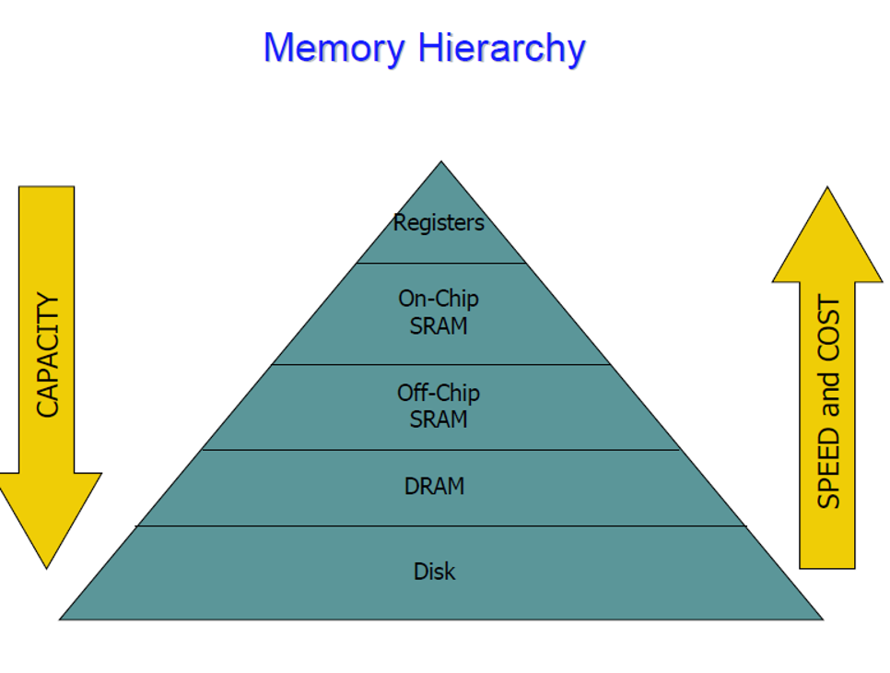

Slide 3
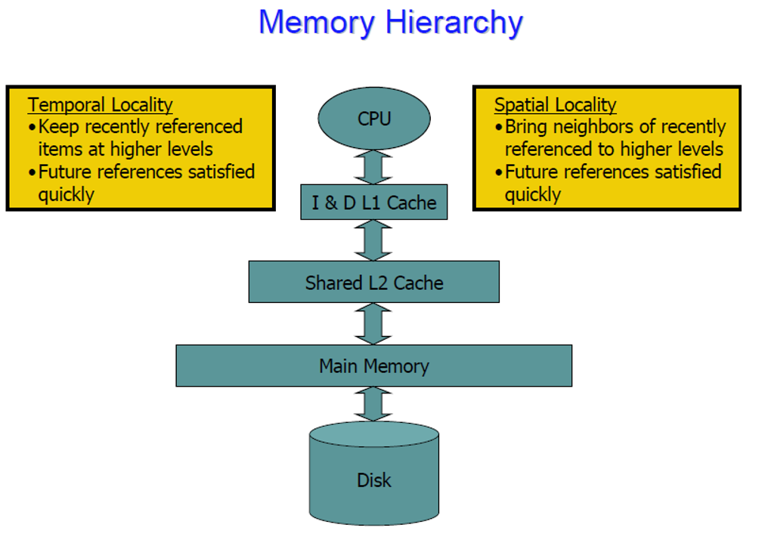

Slide 4
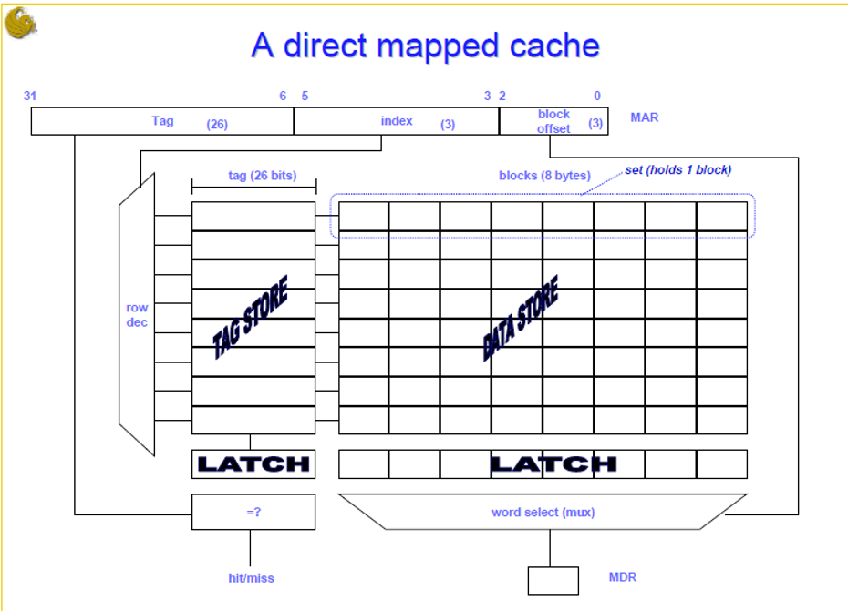

Slide 5
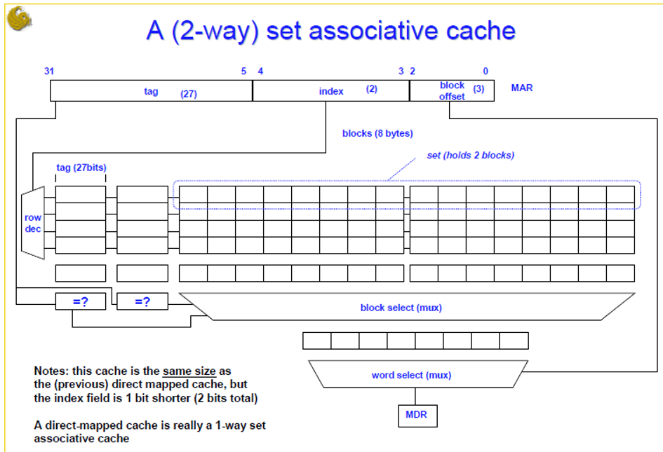

Slide 6
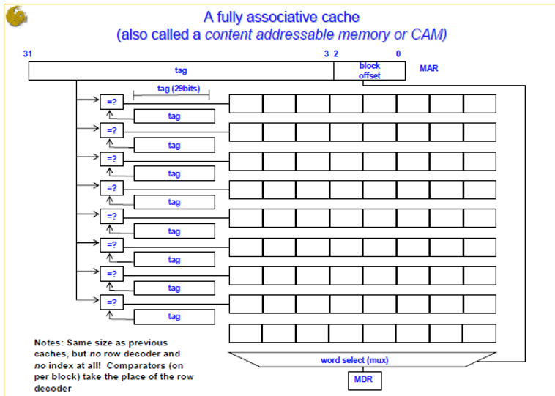

Slide 7

Data Placement and Identification
Total bits = 32
#bits for block offset = log₂(block size) = m
#bits for index = log₂(# cache lines) = n
#tag bits = 32 - m - n

Slide 8
Write Policy
Write through: The information is written to both the block in the cache and to the block in the lower-level memory.
Write back: The information is written only to the block in the cache. The modified cache block is written to main memory only when it is replaced.
Is block clean or dirty?
Pros and Cons of each:
WT: read misses do not need to write back evicted line contents
WB: no writes of repeated writes

Slide 9
Cache Recap
Caches create an illusion of large amounts of fast memory
Cache Details
Organization: direct mapped, set associative, fully associative
Write policy: write-through vs. write-back
Replacement policy: direct, LRU, random

Slide 10
Cache Example
Assume we have a 2-way set associative cache, with 16 blocks. Each block is one word in width. Show the result (hit/miss) for the following address access sequence and show the final contents of the cache
2, 3, 11, 16, 21, 13, 11, 3, 22, 4, 5, 11
These are word addresses
No block offset is needed

Slide 11
Cache Example
Address | Tag | Index | Result
2
3
11
16
21
13
11
3
22
4
5
11
 | Set 0 | Set 1
0
1
2
3
4
5
6
7

Slide 12
Cache Example
Address | Tag | Index | Result
2 | 00 | 010 | Miss
3
11
16
21
13
11
3
22
4
5
11
 | Set 0 | Set 1
0
1
2 | Mem[2]
3
4
5
6
7

Slide 13
Cache Example
Address | Tag | Index | Result
2 | 00 | 010 | Miss
3 | 00 | 011 | Miss
11
16
21
13
11
3
22
4
5
11
 | Set 0 | Set 1
0
1
2 | Mem[2]
3 | Mem[3]
4
5
6
7

Slide 14
Cache Example
Address | Tag | Index | Result
2 | 00 | 010 | Miss
3 | 00 | 011 | Miss
11 | 01 | 011 | Miss
16
21
13
11
3
22
4
5
11
 | Set 0 | Set 1
0
1
2 | Mem[2]
3 | Mem[3] | Mem[11]
4
5
6
7

Slide 15
Cache Example
Address | Tag | Index | Result
2 | 00 | 010 | Miss
3 | 00 | 011 | Miss
11 | 01 | 011 | Miss
16 | 10 | 000 | Miss
21
13
11
3
22
4
5
11
 | Set 0 | Set 1
0 | Mem[16]
1
2 | Mem[2]
3 | Mem[3] | Mem[11]
4
5
6
7

Slide 16
Cache Example
Address | Tag | Index | Result
2 | 00 | 010 | Miss
3 | 00 | 011 | Miss
11 | 01 | 011 | Miss
16 | 10 | 000 | Miss
21 | 10 | 101 | Miss
13
11
3
22
4
5
11
 | Set 0 | Set 1
0 | Mem[16]
1
2 | Mem[2]
3 | Mem[3] | Mem[11]
4
5 | Mem[21]
6
7

Slide 17
Cache Example
Address | Tag | Index | Result
2 | 00 | 010 | Miss
3 | 00 | 011 | Miss
11 | 01 | 011 | Miss
16 | 10 | 000 | Miss
21 | 10 | 101 | Miss
13 | 01 | 101 | Miss
11
3
22
4
5
11
 | Set 0 | Set 1
0 | Mem[16]
1
2 | Mem[2]
3 | Mem[3] | Mem[11]
4
5 | Mem[21] | Mem[13]
6
7

Slide 18
Cache Example
Address | Tag | Index | Result
2 | 00 | 010 | Miss
3 | 00 | 011 | Miss
11 | 01 | 011 | Miss
16 | 10 | 000 | Miss
21 | 10 | 101 | Miss
13 | 01 | 101 | Miss
11 | 01 | 011 | Hit
3
22
4
5
11
 | Set 0 | Set 1
0 | Mem[16]
1
2 | Mem[2]
3 | Mem[3] | Mem[11]
4
5 | Mem[21] | Mem[13]
6
7

Slide 19
Cache Example
Address | Tag | Index | Result
2 | 00 | 010 | Miss
3 | 00 | 011 | Miss
11 | 01 | 011 | Miss
16 | 10 | 000 | Miss
21 | 10 | 101 | Miss
13 | 01 | 101 | Miss
11 | 01 | 011 | Hit
3 | 00 | 011 | Hit
22
4
5
11
 | Set 0 | Set 1
0 | Mem[16]
1
2 | Mem[2]
3 | Mem[3] | Mem[11]
4
5 | Mem[21] | Mem[13]
6
7

Slide 20
Cache Example
Address | Tag | Index | Result
2 | 00 | 010 | Miss
3 | 00 | 011 | Miss
11 | 01 | 011 | Miss
16 | 10 | 000 | Miss
21 | 10 | 101 | Miss
13 | 01 | 101 | Miss
11 | 01 | 011 | Hit
3 | 00 | 011 | Hit
22 | 10 | 110 | Miss
4
5
11
 | Set 0 | Set 1
0 | Mem[16]
1
2 | Mem[2]
3 | Mem[3] | Mem[11]
4
5 | Mem[21] | Mem[13]
6 | Mem[22]
7

Slide 21
Cache Example
Address | Tag | Index | Result
2 | 00 | 010 | Miss
3 | 00 | 011 | Miss
11 | 01 | 011 | Miss
16 | 10 | 000 | Miss
21 | 10 | 101 | Miss
13 | 01 | 101 | Miss
11 | 01 | 011 | Hit
3 | 00 | 011 | Hit
22 | 10 | 110 | Miss
4 | 00 | 100 | Miss
5
11
 | Set 0 | Set 1
0 | Mem[16]
1
2 | Mem[2]
3 | Mem[3] | Mem[11]
4 | Mem[4]
5 | Mem[21] | Mem[13]
6 | Mem[22]
7

Slide 22
Cache Example
Address | Tag | Index | Result
2 | 00 | 010 | Miss
3 | 00 | 011 | Miss
11 | 01 | 011 | Miss
16 | 10 | 000 | Miss
21 | 10 | 101 | Miss
13 | 01 | 101 | Miss
11 | 01 | 011 | Hit
3 | 00 | 011 | Hit
22 | 10 | 110 | Miss
4 | 00 | 100 | Miss
5 | 00 | 101 | Miss
11
 | Set 0 | Set 1
0 | Mem[16]
1
2 | Mem[2]
3 | Mem[3] | Mem[11]
4 | Mem[4]
5 | Mem[5] | Mem[13]
6 | Mem[22]
7

Slide 23
Cache Example
Address | Tag | Index | Result
2 | 00 | 010 | Miss
3 | 00 | 011 | Miss
11 | 01 | 011 | Miss
16 | 10 | 000 | Miss
21 | 10 | 101 | Miss
13 | 01 | 101 | Miss
11 | 01 | 011 | Hit
3 | 00 | 011 | Hit
22 | 10 | 110 | Miss
4 | 00 | 100 | Miss
5 | 00 | 101 | Miss
11 | 01 | 011 | Hit
 | Set 0 | Set 1
0 | Mem[16]
1
2 | Mem[2]
3 | Mem[3] | Mem[11]
4 | Mem[4]
5 | Mem[5] | Mem[13]
6 | Mem[22]
7

Slide 24
Cache Performance
Suppose we have a system where the instruction cache has a miss rate of 3% and the miss penalty for the data cache is 20 cycles.
Compare the relative performance of our system to one with an ideal cache and one without caching, where memory access requires 35 cycles
Assume a base CPI of 1.

Slide 25
Cache Performance
Suppose we have a system where the instruction cache has a miss rate of 3% and the miss penalty for the data cache is 20 cycles.
Compare the relative performance of our system to one with an ideal cache and one without caching, where memory access requires 35 cycles.
Assume a base CPI of 1.
With an ideal cache the cpu time is
IC*CPI*CC
= IC*1*CC

Slide 26
Cache Performance
Suppose we have a system where the instruction cache has a miss rate of 3% and the miss penalty for the data cache is 20 cycles.
Compare the relative performance of our system to one with an ideal cache and one without caching, where memory access requires 35 cycles.
Assume a base CPI of 1.
With an ideal cache the cpu time is IC*CC.
With our instruction cache, the effective CPI is (1 + .03*20) = 1.6. The cpu time is IC*CC*1.6

Slide 27
Cache Performance
Suppose we have a system where the instruction cache has a miss rate of 3% and the miss penalty for the data cache is 20 cycles.
Compare the relative performance of our system to one with an ideal cache and one without caching, where memory access requires 35 cycles.
Assume a base CPI of 1.
With an ideal cache the cpu time is IC*CC.
With our instruction cache, the effective CPI is (1 + .03*20) = 1.6. The cpu time is IC*CC*1.6
Without a cache, the effective CPI is 35. The cpu time is IC*CC*35.

Slide 28
Cache Performance
Suppose we have a system where the instruction cache has a miss rate of 3% and the miss penalty for the data cache is 20 cycles.
Compare the relative performance of our system to one with an ideal cache and one without caching, where memory access requires 35 cycles.
Assume a base CPI of 1.
With an ideal cache the cpu time is IC*CC.
With our instruction cache, the effective CPI is (1 + .03*20) = 1.6. The cpu time is IC*CC*1.6
Without a cache, the effective CPI is 35. The cpu time is IC*CC*35.
The ideal cache is 1.6 times better than our cache.
Our cache is 21.875 times better than a system without a cache.

Slide 29
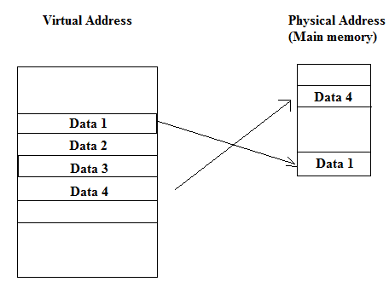
Virtual Memory
The address used by a programmer will be called a logical address
An address in main memory is called a physical address

Slide 30
Virtual Memory
Only part of the program needs to be in memory for execution
Logical address space can therefore be much larger than physical address space
Allows for more efficient process creation

Slide 31
Virtual Memory
The term page refers to groups of address space of the same size
For example: if auxiliary memory contains 1024K and main memory contains 32K and page size equals to 1K, then auxiliary memory has 1024 pages and main memory has 32 pages

Slide 32
Paging
Each process has its own page table
Each page table entry contains the frame number of the corresponding page in main memory
A bit is needed to indicate whether the page is in main memory or not

Slide 33
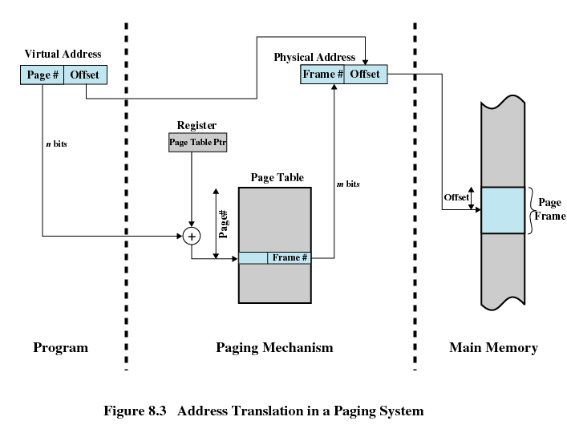

Slide 34
Translation Lookaside Buffer
Each virtual memory reference can cause two physical memory accesses
One to fetch the page table
One to fetch the data
To overcome this problem a high-speed cache is set up for page table entries
Called a Translation Lookaside Buffer (TLB)

Slide 35
Translation Lookaside Buffer
Contains page table entries that have been most recently used
Given a virtual address, processor examines the TLB
If page table entry is present (TLB hit), the frame number is retrieved and the real address is formed
If page table entry is not found in the TLB (TLB miss), the page number is used to index the process page table

Slide 36
Translation Lookaside Buffer
First checks if page is already in main memory
If not in main memory a page fault is issued
The TLB is updated to include the new page entry

Slide 37
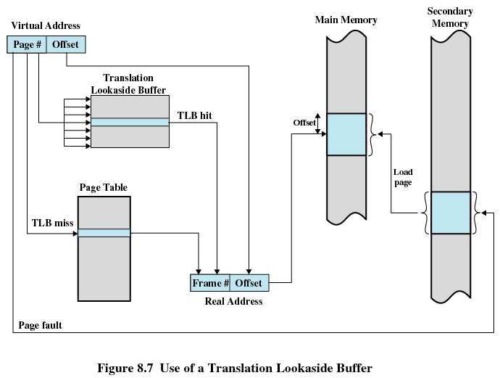

Slide 38
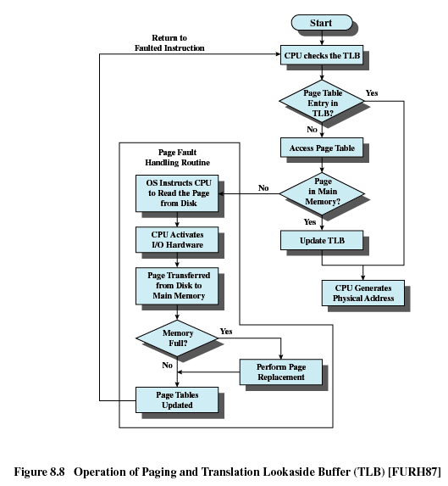

Slide 39
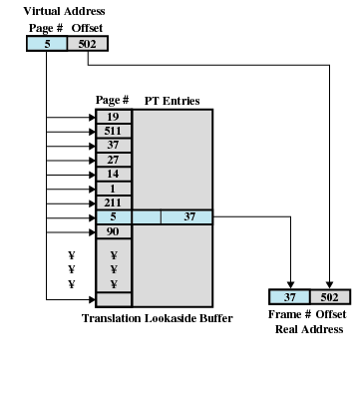

Slide 40
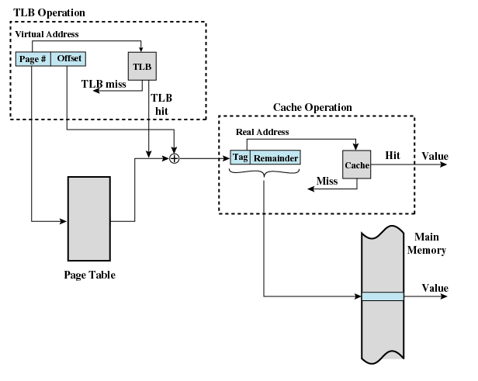

Slide 41
Questions?

