Slide 1
CDA 3103
Recitation 4 – Logic Design

Slide 2
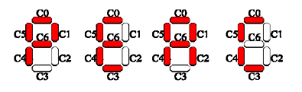
Combinational Circuits
Design a logic network that can display the characters in “PEACE” on a seven-segment display unit. Write the truth table for the output functions C0-C6, minimize them by using a Karnaugh Map, and implement using discrete logic gates.
Character “A” will be displayed if segments (C0, C1, C2, C4, C5, C6) of a 7-segment display are turned on and segment (C3) is turned off. Since only 4 characters will be displayed, input of 2 bits to encode them will be needed for the given design. Call those inputs X0 and X1.

Slide 3
Sequential Circuits
You have a vending machine with a single coin slot. This machine accepts 5 and 10 cent coins. This machine vends when 15 cents has been put in the machine.
Show the state diagram and state transition table. The state transition table shows the functions to determine the next state and output of the system. Use the states shown below. Possible inputs are N (nickels, 5 cents) or D (dimes, 10 cents).
Q1 Q0 | State 0 0 | 0 cents 0 1 | 5 cents 1 0 | 10 cents 1 1 | 15 cents

Slide 4
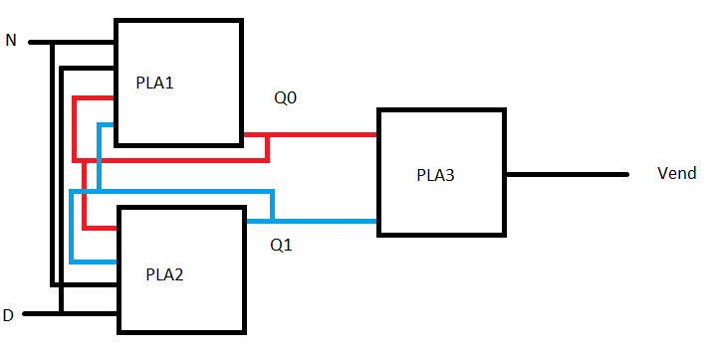
Sequential Circuits Continued
Reduce the outputs of the state transition table (Q1next, Q0next, Vend?) to their minimal sum of products form. Show the gate level implementation that fits this circuit.

