Slide 1
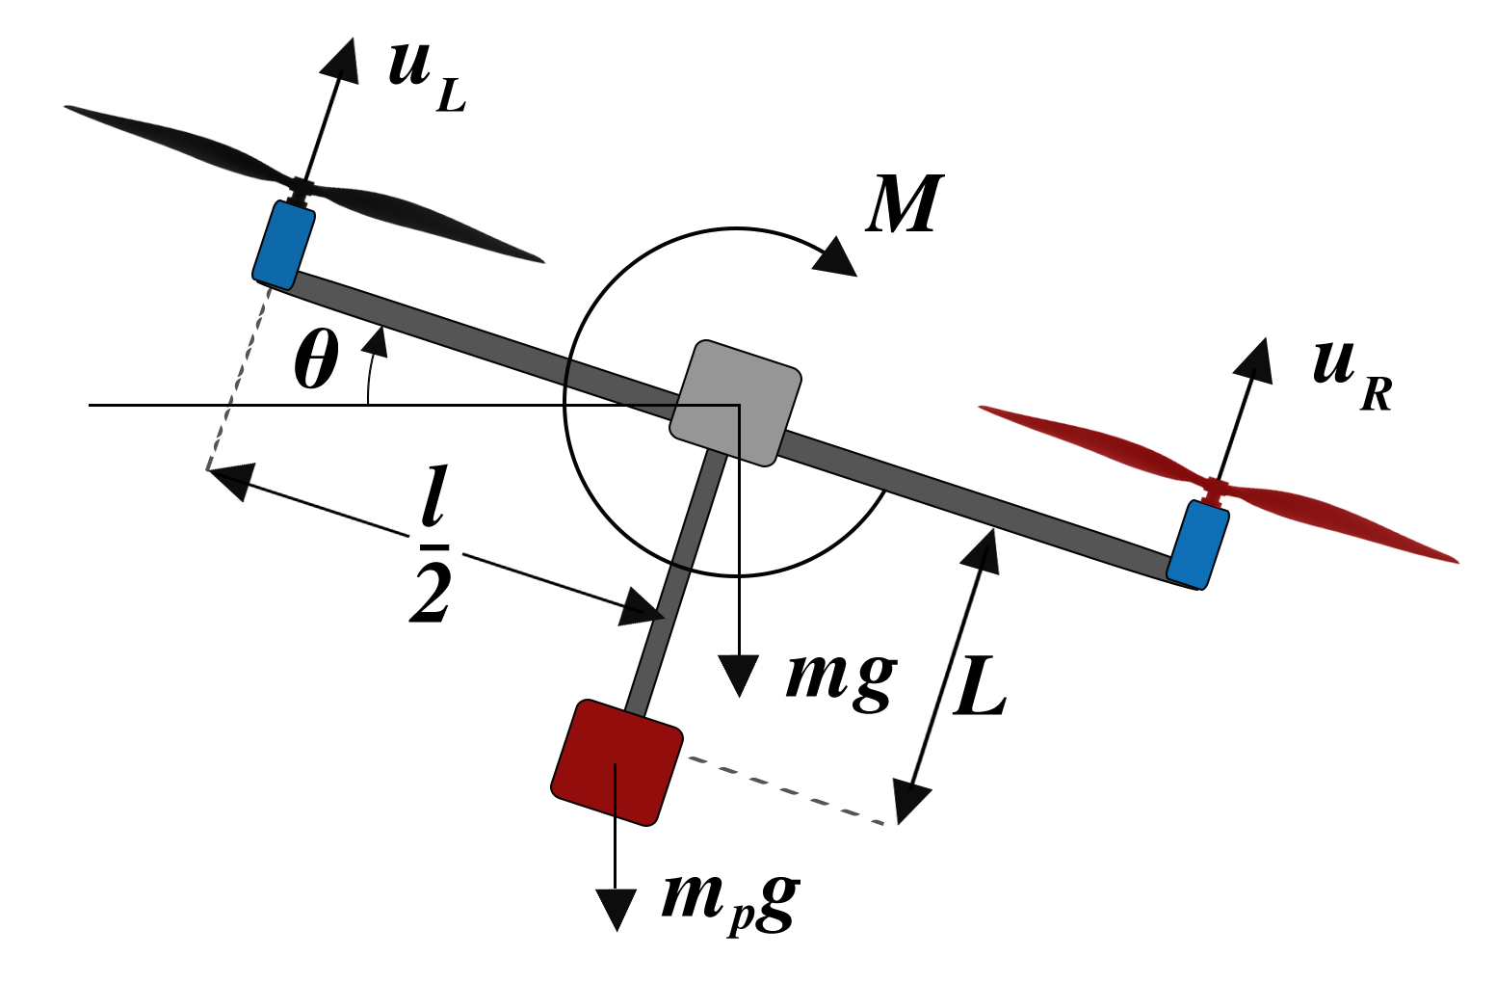
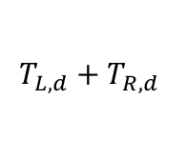

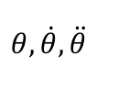
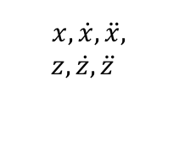
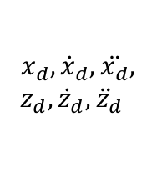

Kinodynamic Motion Planner
Online estimates of dynamics
$$x_{d}, {\dot{x}}_{d}, \ddot{x_{d}},$$
$$z_{d}, {\dot{z}}_{d}, {\ddot{z}}_{d}$$
Adaptive Sliding Force Control
$$T_{L,d}+T_{R,d}$$
UAV
(including
unmodeled
actuator
dynamics)
Adaptive Sliding
Moment Control
$$x, \dot{x}, \ddot{x},$$
$$z, \dot{z}, \ddot{z}$$
$$θ_{d}, {\dot{θ}}_{d}$$
$$T_{L,d}−$$
$$T_{R,d}$$
$${θ, \dot{θ}, \ddot{θ}}_{ }$$

