Slide 1

CSEE5590/490: Web/Mobile Programming
Mobile App Development

Slide 2

Overview
Introduction to Android
Getting Started with Android Studio
Android Programming

Slide 3
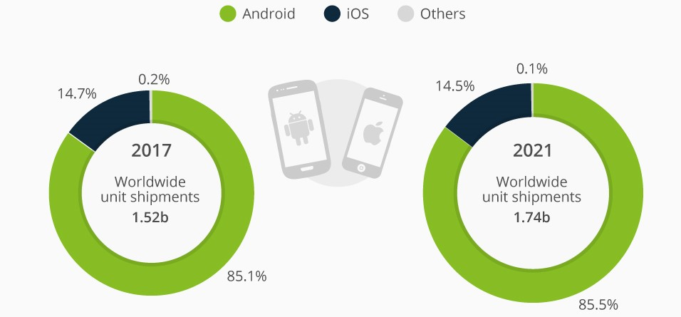
Introduction to Android
Popular mobile operating system
Android Inc. was founded in Palo Alto, California, in October 2003 by Andy Rubin, Rich Miner, Nick Sears, and Chris White.
In July 2005, Google acquired Android Inc.
Android has beaten Apple iOS, being the leading mobile operating system from first quarter of 2011 worldwide
Source: https://www.statista.com/chart/9628/smartphone-platform-market-share-forecast/

Slide 4
Android Versions
Code Name | Version Number | Initial release date | API level
(No codename) | 1 | 23-Sep-08 | 1
Petit Four | 1.1 | 9-Feb-09 | 2
Cupcake | 1.5 | 27-Apr-09 | 3
Donut | 1.6 | 15-Sep-09 | 4
Éclair | 2.0 – 2.1 | 26-Oct-09 | 5 – 7
Froyo | 2.2 – 2.2.3 | 20-May-10 | 8
Gingerbread | 2.3 – 2.3.7 | 6-Dec-10 | 9 – 10
Honeycomb | 3.0 – 3.2.6 | 22-Feb-11 | 11 – 13
Ice Cream Sandwich | 4.0 – 4.0.4 | 18-Oct-11 | 14 – 15
Jelly Bean | 4.1 – 4.3.1 | 9-Jul-12 | 16 – 18
KitKat | 4.4 – 4.4.4 | 31-Oct-13 | 19 – 20
Lollipop | 5.0 – 5.1.1 | 12-Nov-14 | 21 – 22
Marshmallow | 6.0 – 6.0.1 | 5-Oct-15 | 23
Nougat | 7.0 – 7.1.2 | 22-Aug-16 | 24 – 25
Oreo | 8.0 – 8.1 | 21-Aug-17 | 26 – 27
Pie | 9 | 6-Aug-18 | 28

Slide 5
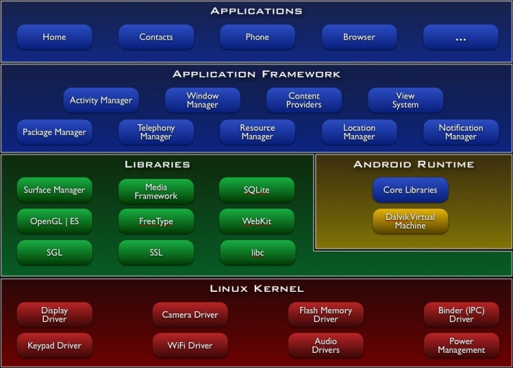
Android Architecture

Slide 6
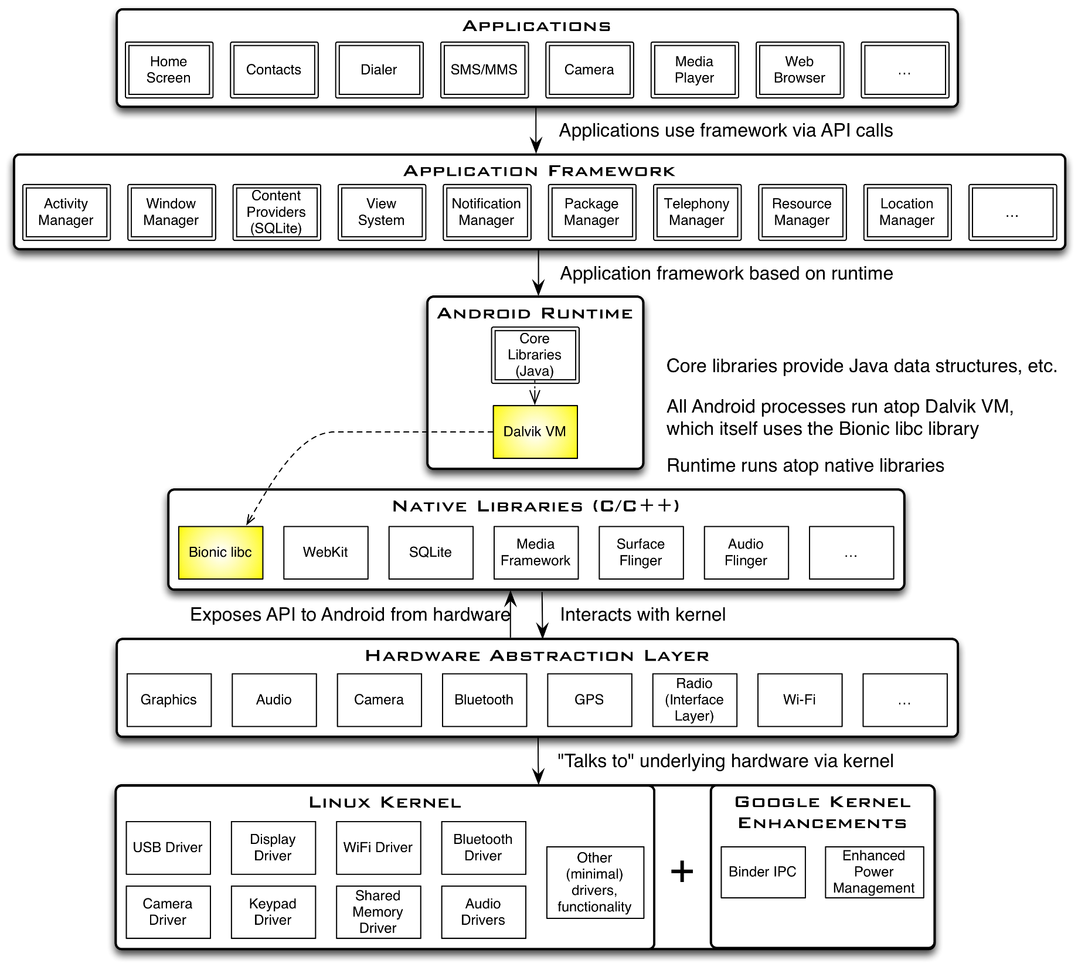
Android Architecture

Slide 7
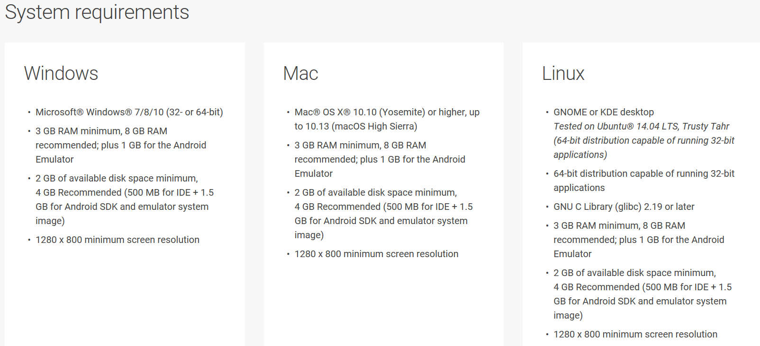
Getting Started

Slide 8
Getting Started
Need to install Java Development Kit (JDK) to write Java (and Android) programs
Do not install Java Runtime Environment (JRE); JDK and JRE are different!
Can download the JDK for your OS at http://java.oracle.com
Alternatively, for OS X, Linux:
OS X:
Open /Applications/Utilities/Terminal.app
Type javac at command line
Install Java when prompt appears
Linux:
Type sudo apt–get install default–jdk at command line (Debian, Ubuntu)
After installing JDK, download Android SDK from https://developer.android.com/studio/index.html
Simplest: download and install Android Studio bundle (including Android SDK) for your OS

Slide 9
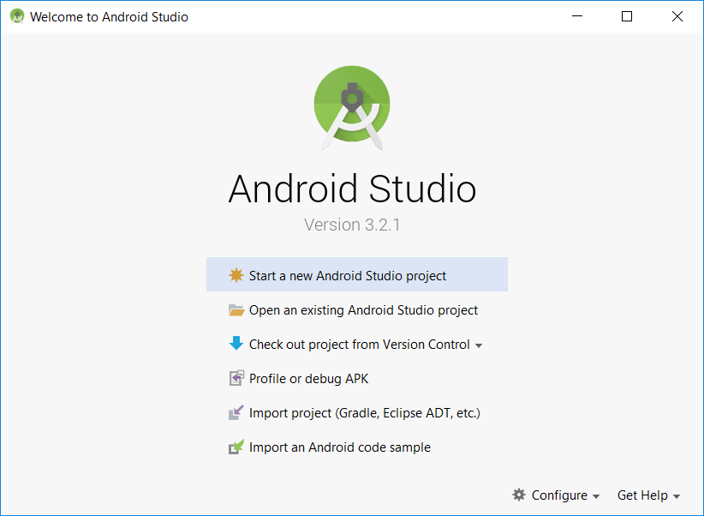
Getting Started
Follow the default instructions while android studio installation. However, below are the reference screenshots for Windows OS
After installation, you should see below screen:

Slide 10
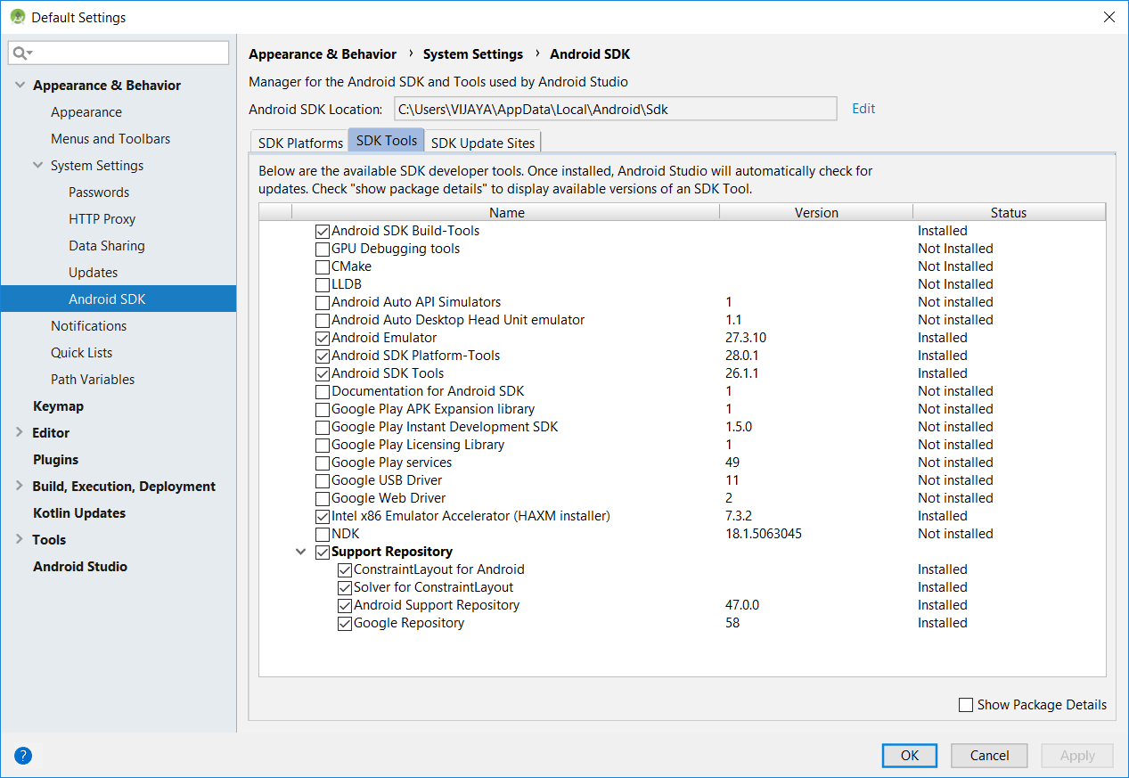
Getting Started
Strongly recommend testing with real Android device
Android emulator: very slow
Install USB drivers for your Android device!
Bring up the Android SDK Manager
Recommended: Install Latest Android APIs
Do not worry about Intel x86 Atom, MIPS system images
Now you're ready for Android development!

Slide 11
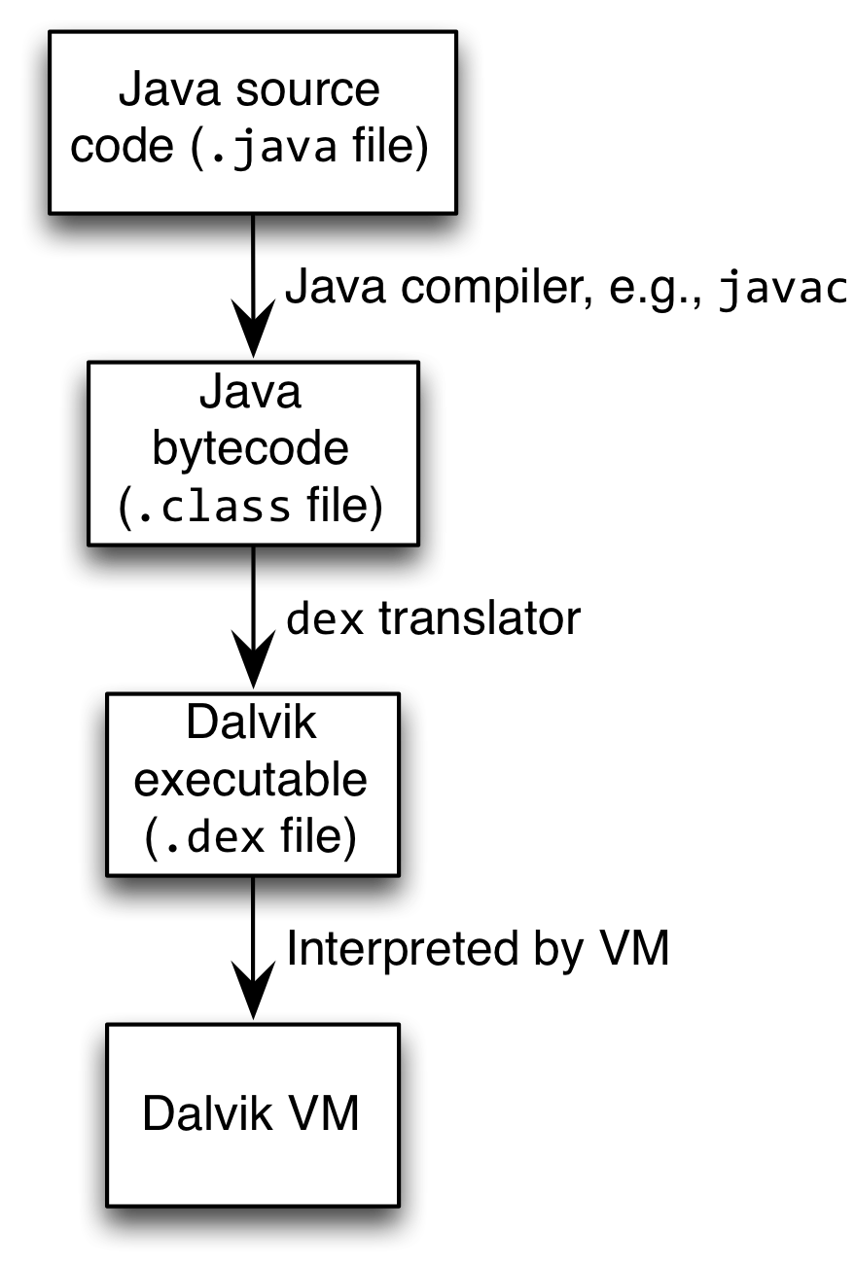
How Android Works?
Android apps execute on Dalvik VM, a "clean-room" implementation of JVM
Dalvik optimized for efficient execution
Dalvik: register-based VM, unlike Oracle's stack-based JVM
Java .class bytecode translated to Dalvik Executable (DEX) bytecode, which Dalvik interprets

Slide 12
Android Highlights
Android apps written in Java
Android apps use four main components:
Activity: A "single screen" that's visible to user
Service: Long-running background "part" of app (not separate process or thread)
Content Provider: Manages app data (usually stored in database) and data access for queries
Broadcast Receiver: Component that listens for particular Android system "events", e.g., "found wireless device", and responds accordingly

Slide 13
App Manifest
Every Android app must include an AndroidManifest.xml file describing functionality
The manifest specifies:
App's Activities, Services etc.
Permissions requested by app
Minimum API required
Hardware features required, e.g., camera with autofocus
External libraries to which app is linked, e.g., Google Maps library

Slide 14
Activity Lifecycle
Activity: key building block of Android apps
Extend Activity class, override onCreate(), onPause(), onResume() methods
Dalvik VM can stop any Activity without warning, so saving state is important!
Activities need to be "responsive", otherwise Android shows user "App Not Responsive" warning:
Place lengthy operations in Runnable Threads, AsyncTasks

Slide 15
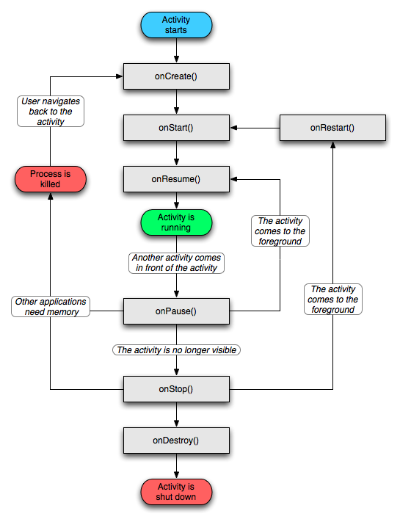
Activity Lifecycle

Slide 16
App Creation Checklist
If you own an Android device:
Ensure drivers are installed
Enable developer options on device under Settings, specifically USB Debugging
Android 4.2+: Go to Settings→About phone, press Build number 7 times to enable developer options
For Android Studio:
Under File→Settings→Appearance, enable "Show tool window bars"; the Android view shows LogCat, devices
Programs should log states via android.util.Log's Log.d(APP_TAG_STR, "debug"), where APP_TAG_STR is a final String tag denoting your app
Other commands: Log.e() (error); Log.i() (info); Log.w() (warning); Log.v() (verbose)

Slide 17
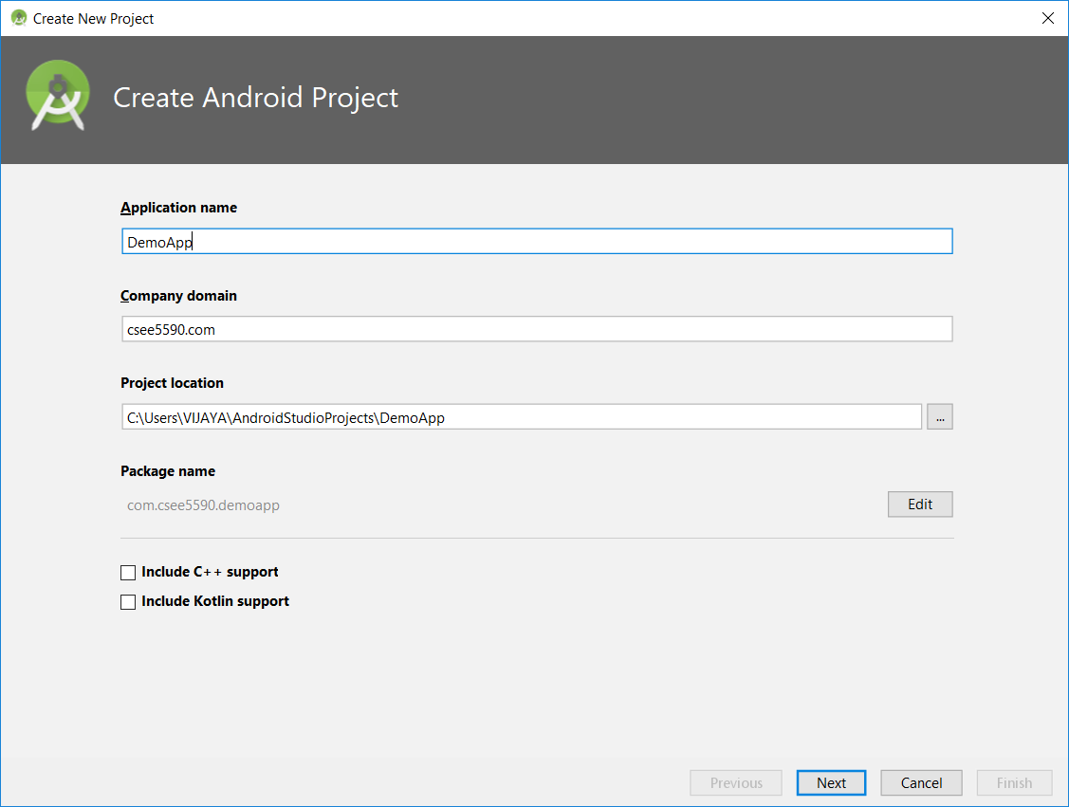
Creating Android App
Creating Android app project in Android Studio:
Go to File→New →New Project
Enter app, project name
Choose package name using "reverse URL" notation, e.g., edu.umkc.myapp

Slide 18
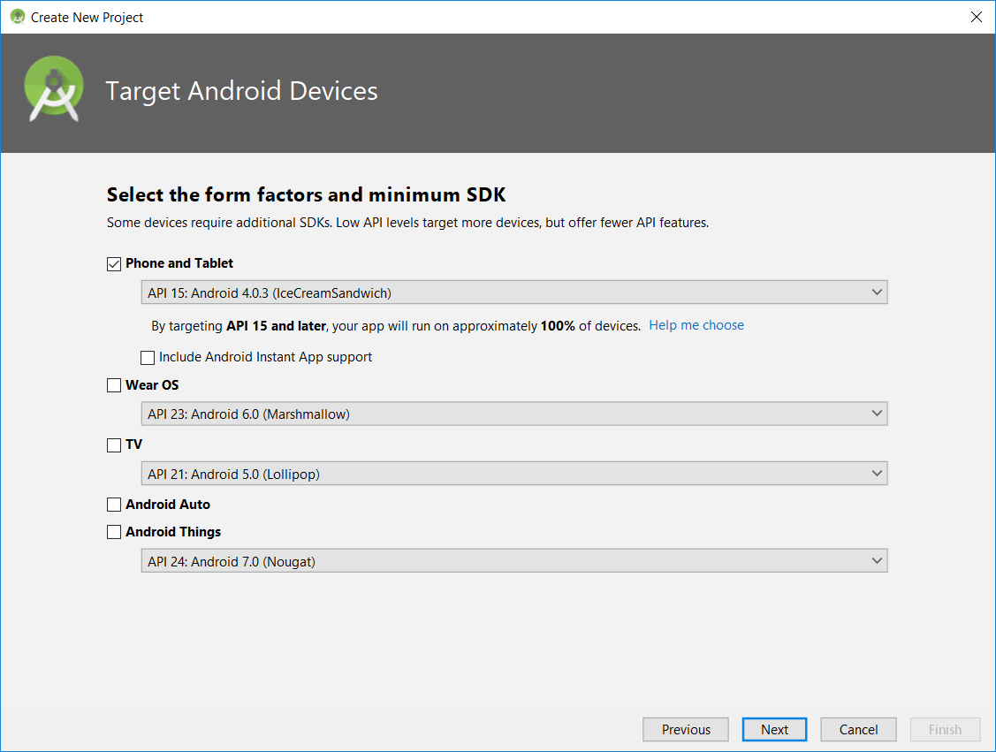
Selecting the SDK and type of device to deploy the application

Slide 19
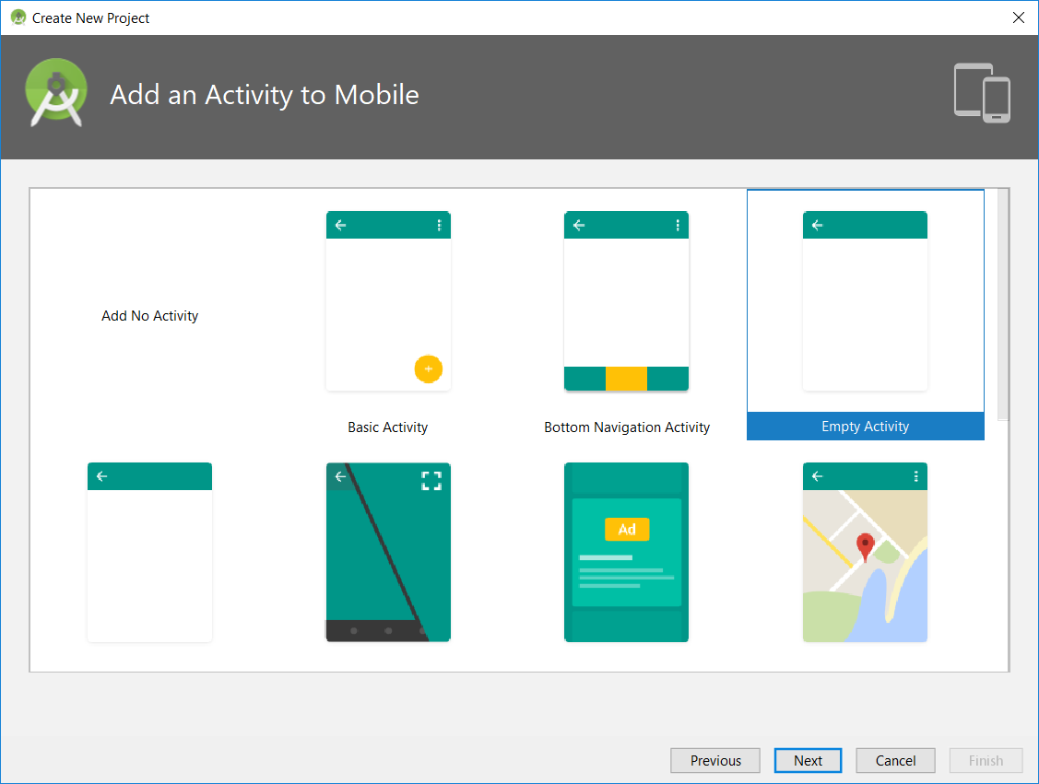
Selecting the type of activity for the application
You can choose from various templates available to start off the application. It is better to choose a Blank activity as you could add and manage the controls as you need.

Slide 20
Creating Android App
Determine what kind of Activity to create; then click Next
We'll choose a Blank Activity for simplicity
Enter information about your Activity, then click Finish
This creates a "Hello World" app

Slide 21

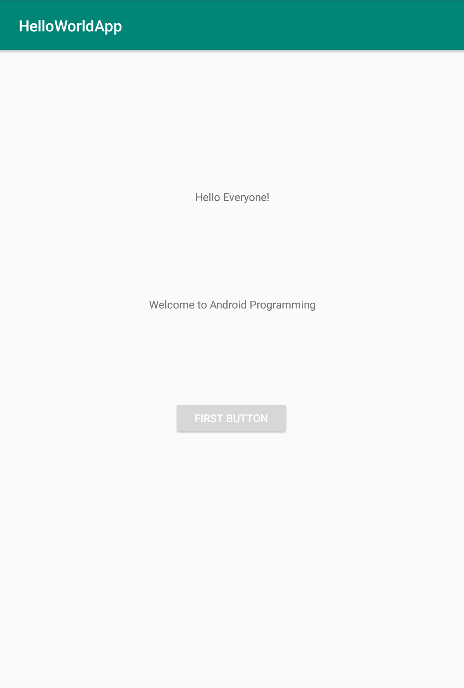
Deploying the App
Two ways:
Real Android device
Android virtual device
Plug in your real device; otherwise, create an Android virtual device
Emulator is slow. Try Intel accelerated version, or perhaps http://www.genymotion.com/
Run the app: press "Run" button in toolbar

Slide 22
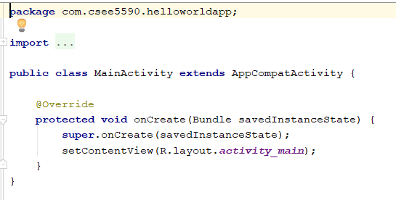
Use case: Source Code
java/…/MainActivity.java
Oncreate() method

Slide 23
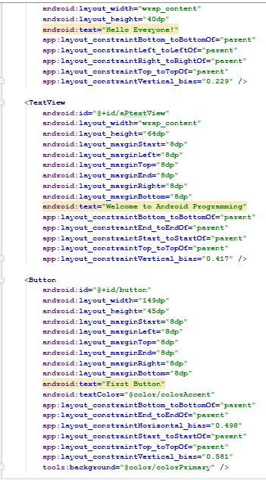
Underlying GUI Code
res/layout/activity_main.xml
Textview
Button

Slide 24
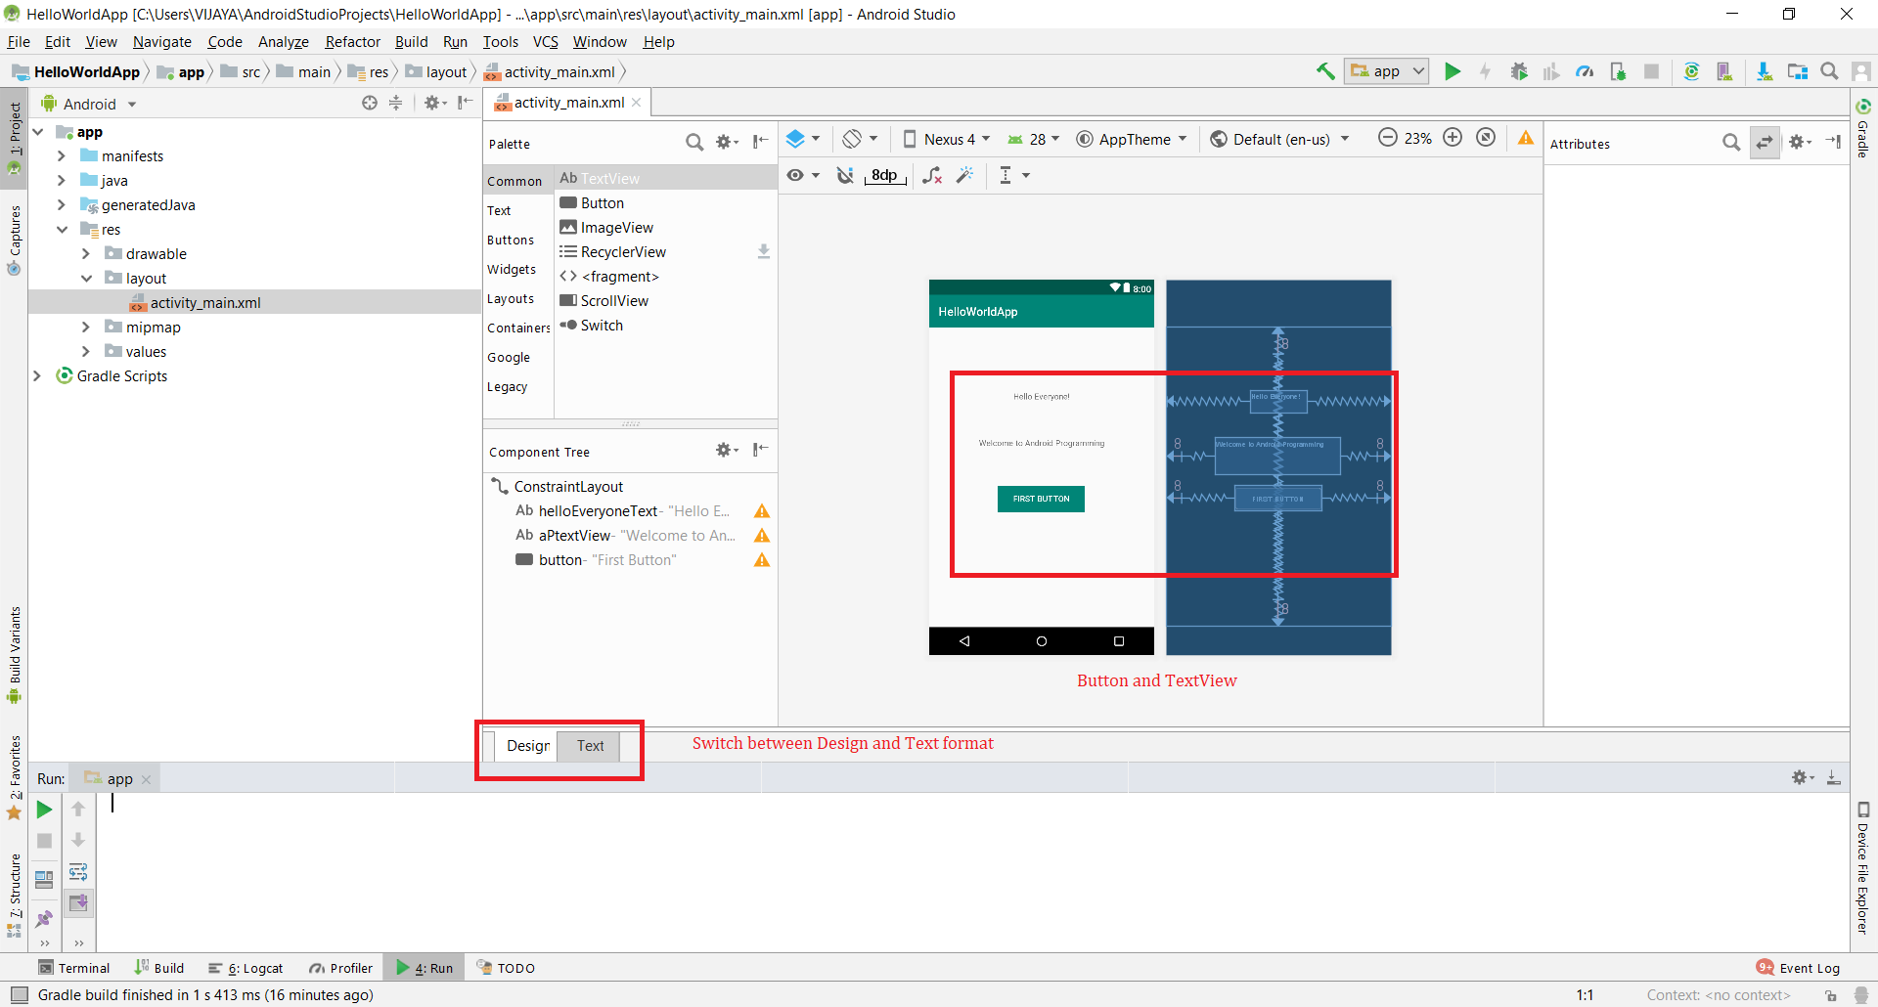
GUI Design

Slide 25
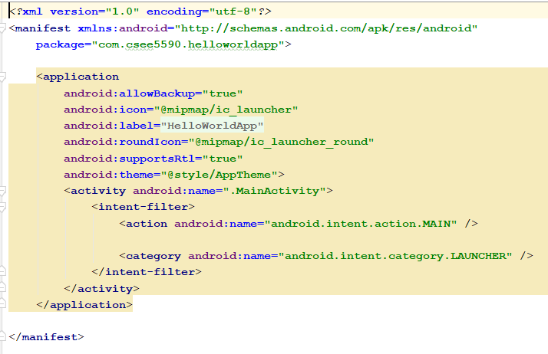
The App Manifest
AndroidManifest.xml
Tells the main Java class which starts the application

Slide 26
Output - Emulator

Slide 27
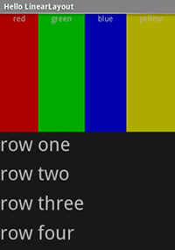
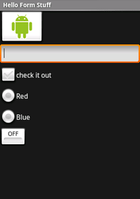
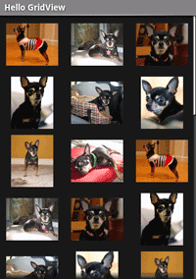
Views

Slide 28
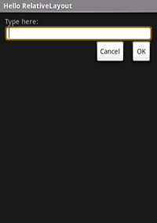
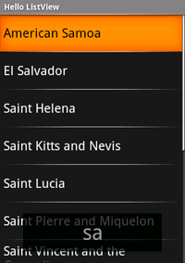
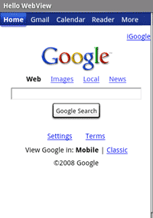
Views

Slide 29
Android Programming Notes
Android apps have multiple points of entry: no main() method
Cannot "sleep" in Android
During each entrance, certain Objects may be null
Defensive programming is very useful to avoid crashes, e.g., if (!(myObj == null)) { // do something }
Java concurrency techniques are required
Don't block the "main" thread in Activities
Implement long-running tasks such as network connections asynchronously, e.g., as AsyncTasks
Logging state via android.util.Log throughout app is essential when debugging (finding root causes)
Better to have "too many" permissions than too few
Otherwise, app crashes due to security exceptions!
Remove "unnecessary" permissions before releasing app to public
Event handling in Android GUIs entails many listener Objects

Slide 30
References
https://developer.android.com/studio/install
https://developer.android.com/training/basics/firstapp/
http://web.cse.ohio-state.edu/~xuan.3/courses/5432/AndroidProgramming.ppt
https://doc.lagout.org/operating%20system%20/android/Android%20Application%20Development.ppt
Book: http://www.kmvportal.co.in/Course/MAD/Android%20Book.pdf

Slide 31
ICP
Create manual Login App
Please refer steps in Lesson plan

