Slide 1

CSEE5590/490: Web/Mobile Programming
Mobile App Development

Slide 2

Overview
Accessing Android hardware
Location/Maps
Camera
Media Recorder/Audio Record
Device Storage
Understanding different sensors

Slide 3
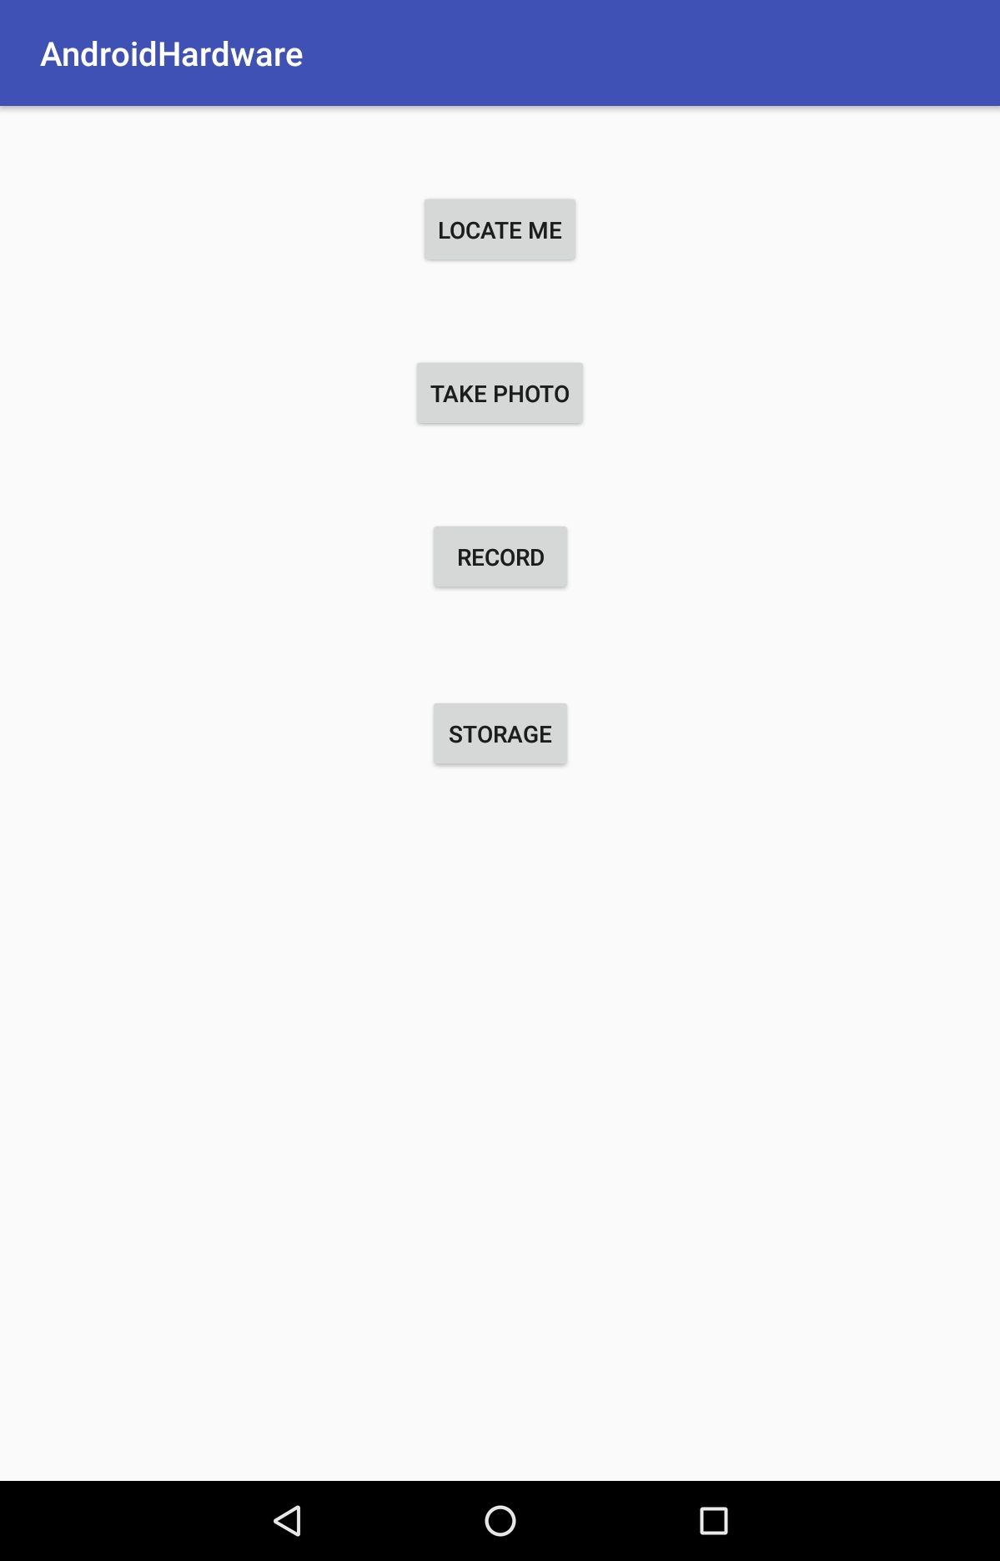
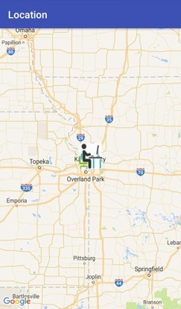
Android Location and Maps
Update with your own API Key
Source: https://developer.android.com/reference/android/location/Location

Slide 4
Android Location and Maps
Location and maps-based apps offer a compelling experience on mobile devices
LocationManager is the central component of location framework
LocationProvider is used to query for the user's last known location
android.location package contains the classes and methods for accessing location
Source: https://developer.android.com/guide/topics/location/

Slide 5
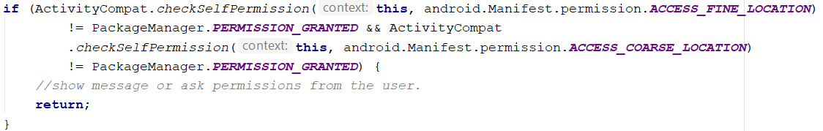
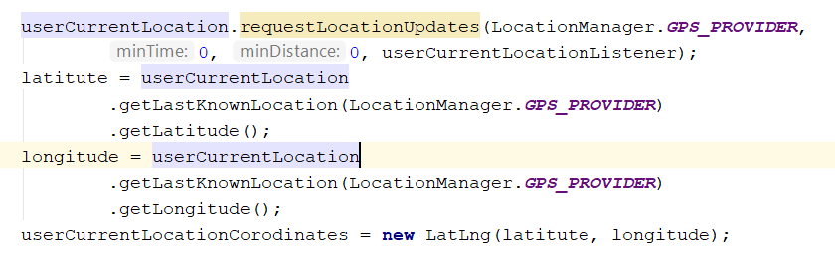
Android Location and Maps
Source: https://developers.google.com/maps/documentation/javascript/get-api-key

Slide 6
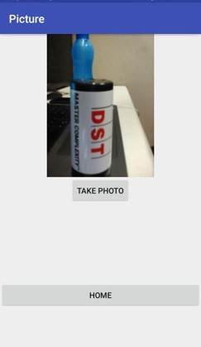
Android Camera
Source: https://developer.android.com/guide/topics/media/camera

Slide 7
Android Camera
The Android framework includes support for various cameras and camera features available on devices, allowing you to capture pictures and videos in your applications.
The Android framework supports capturing images and video through the android.hardware.camera2 API or camera Intent.
An intent action type of MediaStore.ACTION_IMAGE_CAPTURE or MediaStore.ACTION_VIDEO_CAPTURE can be used to capture images
Source: https://developer.android.com/training/camera/photobasics

Slide 8
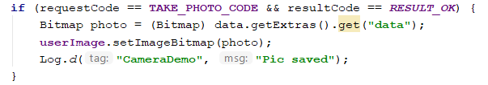
Android Camera

Slide 9
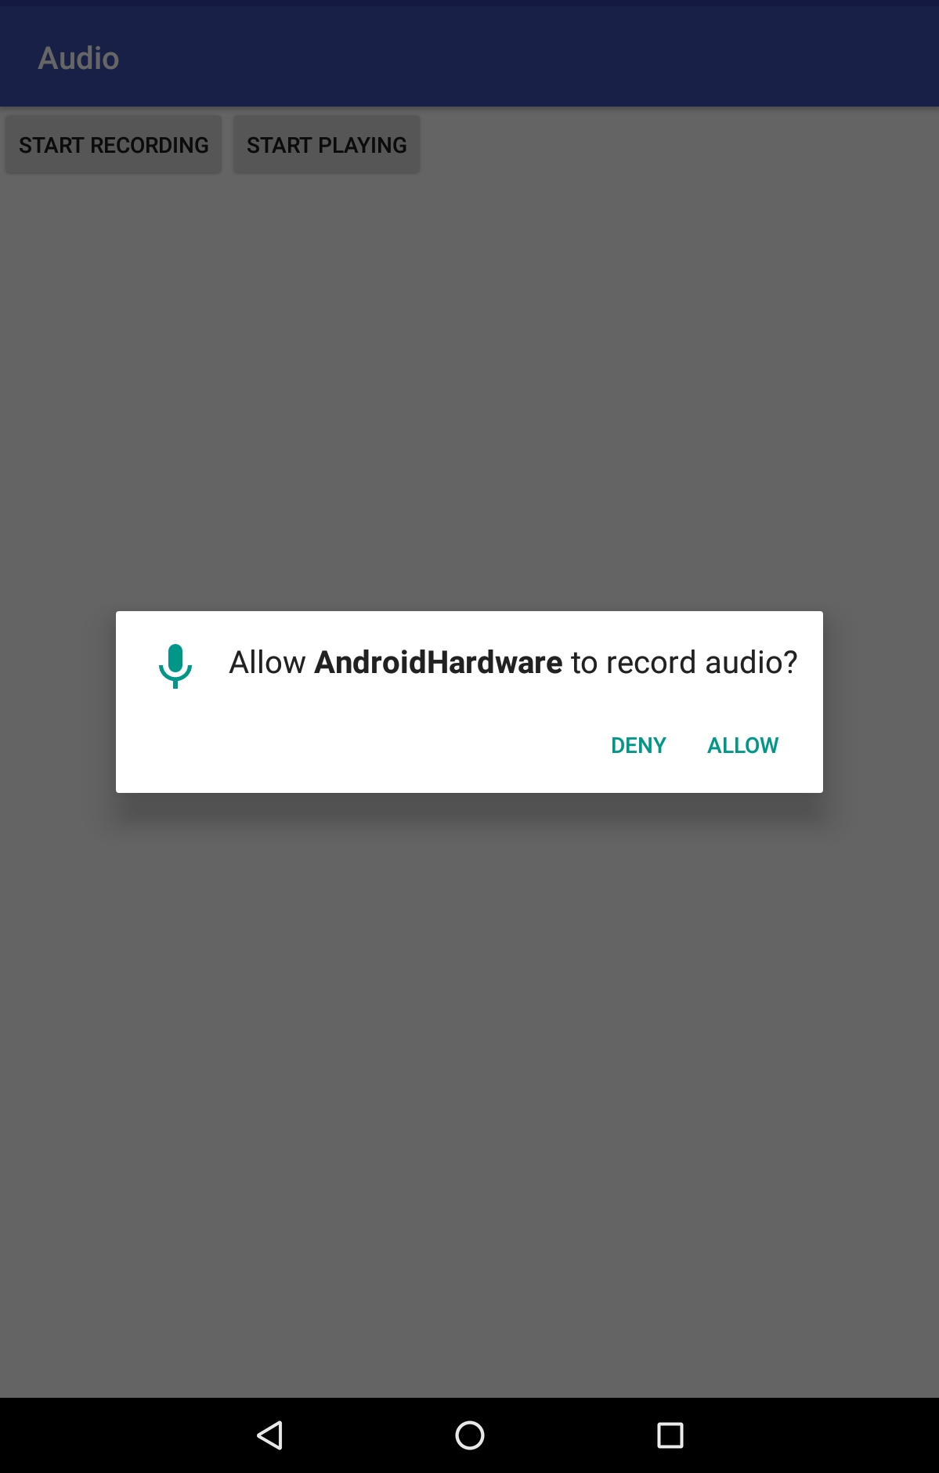
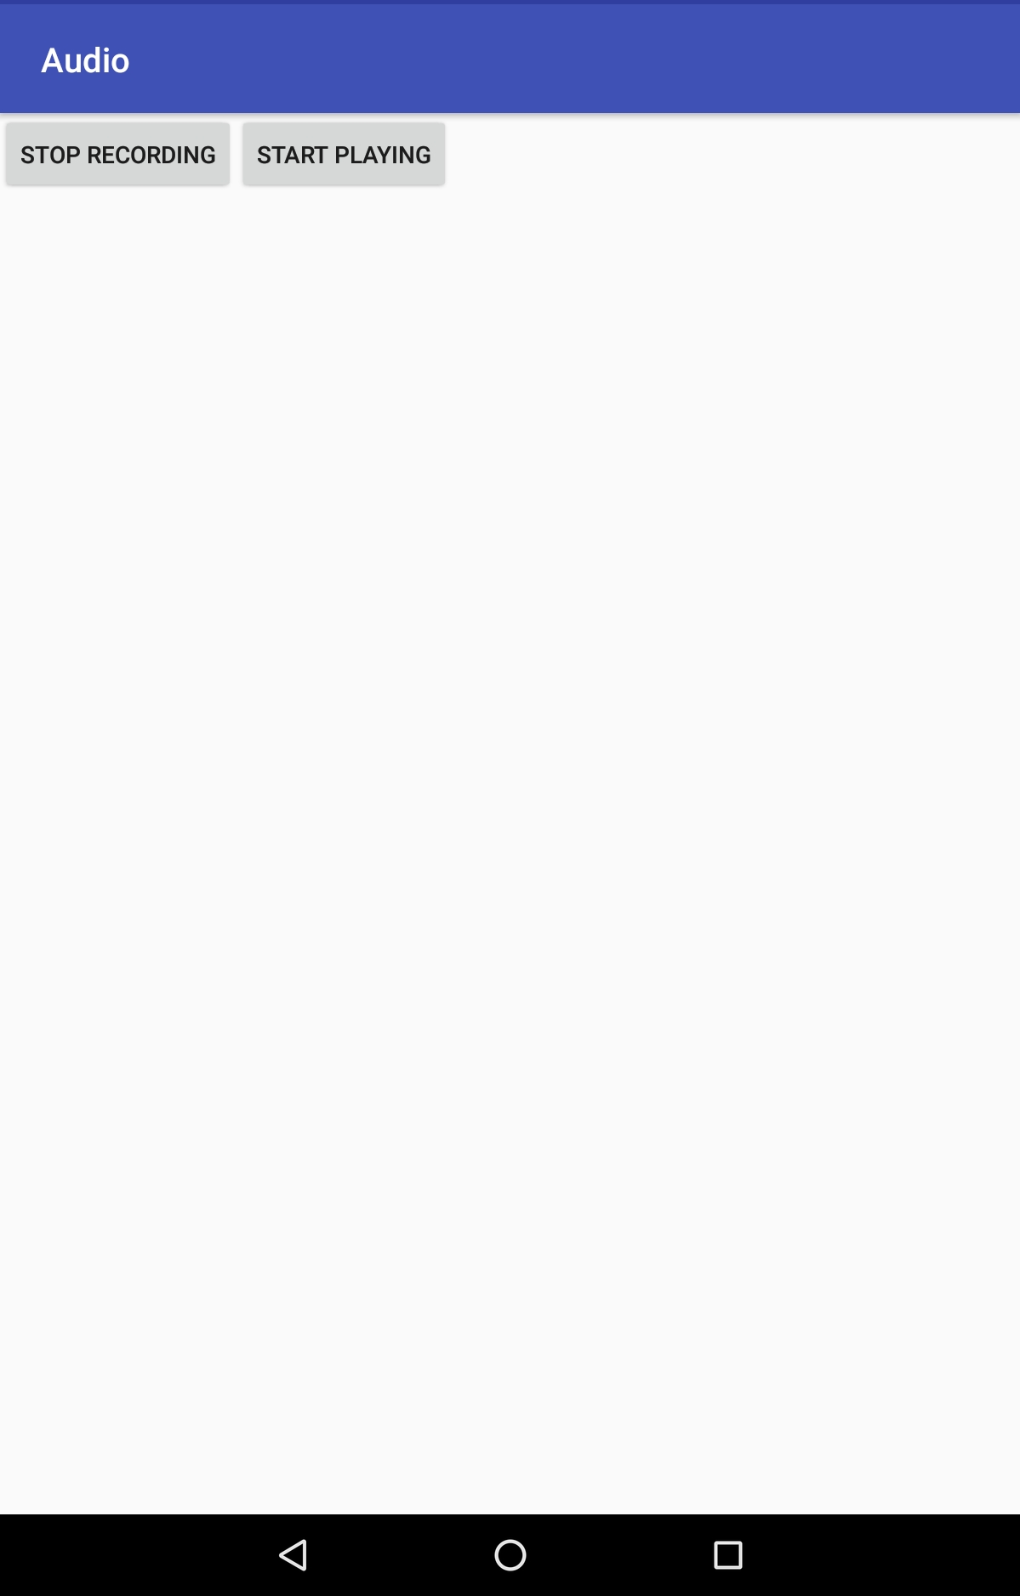
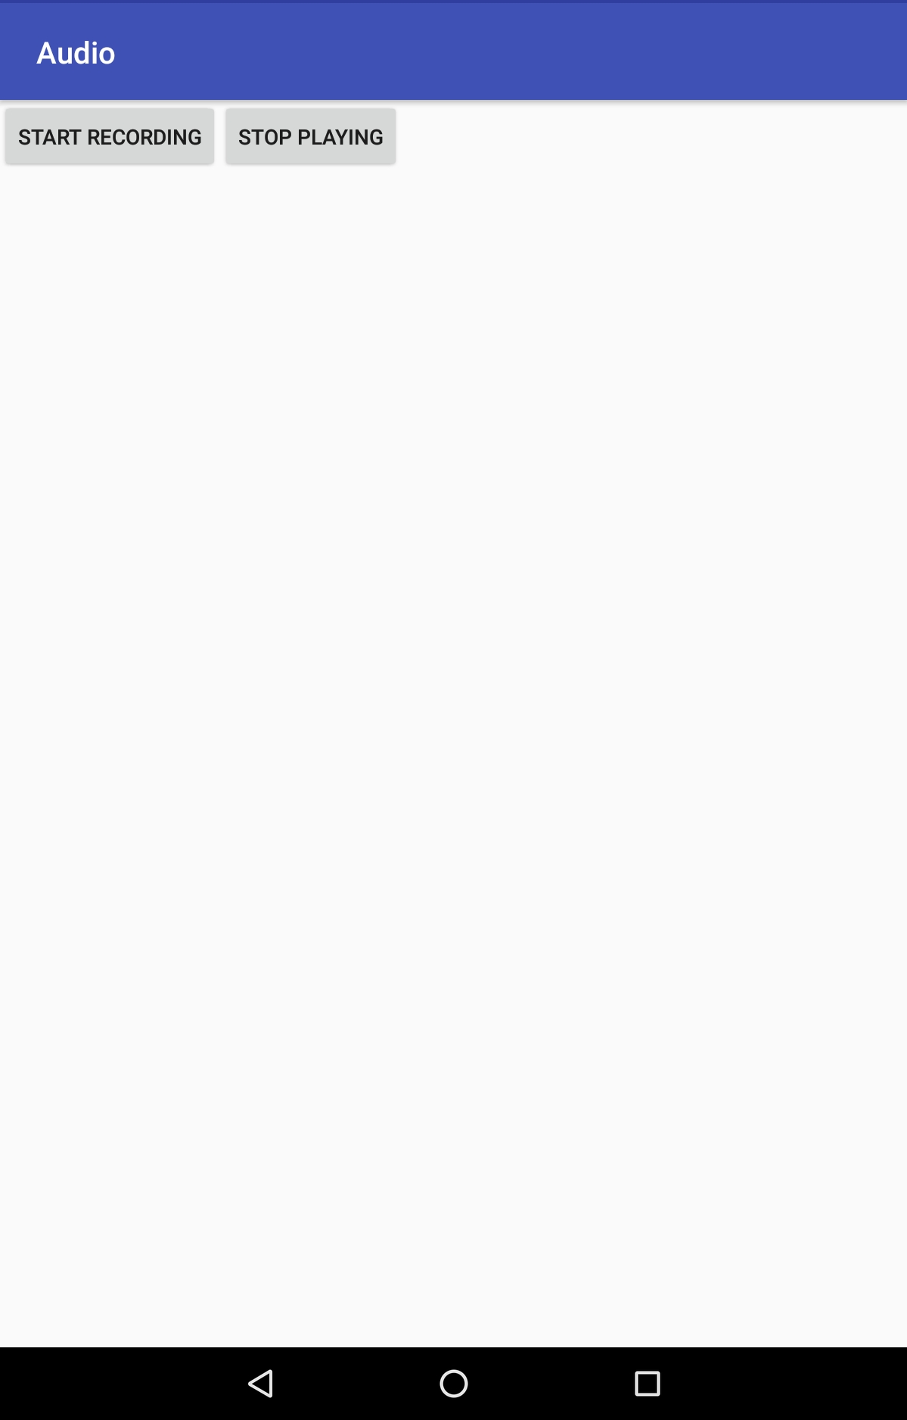
Android Media Recorder
Source: https://developer.android.com/guide/topics/media/mediarecorder

Slide 10
Android Media Recorder
The Android multimedia framework includes support for capturing and encoding a variety of common audio and video formats.
We can use the MediaRecorder APIs if supported by the device hardware.
Set the audio source using setAudioSource(). You'll probably use MIC.
Source: https://developer.android.com/reference/android/media/AudioRecord

Slide 11
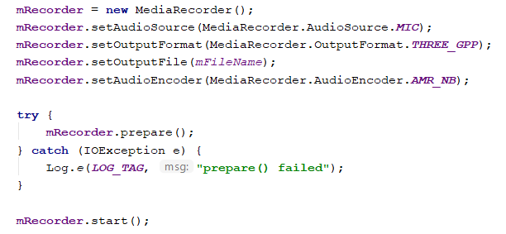
Android Media Recorder
Source: https://developer.android.com/reference/android/media/AudioRecord

Slide 12
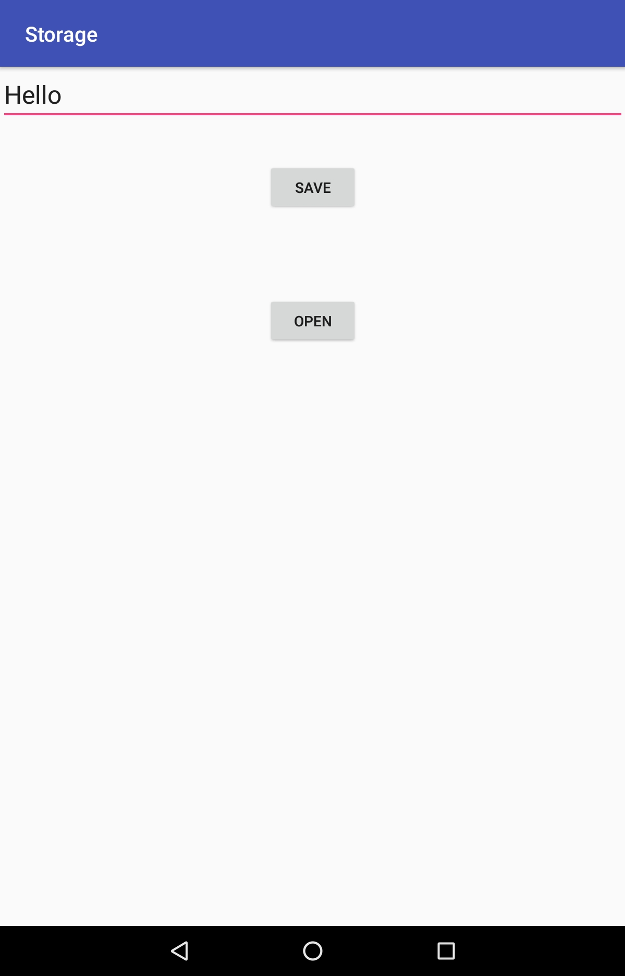
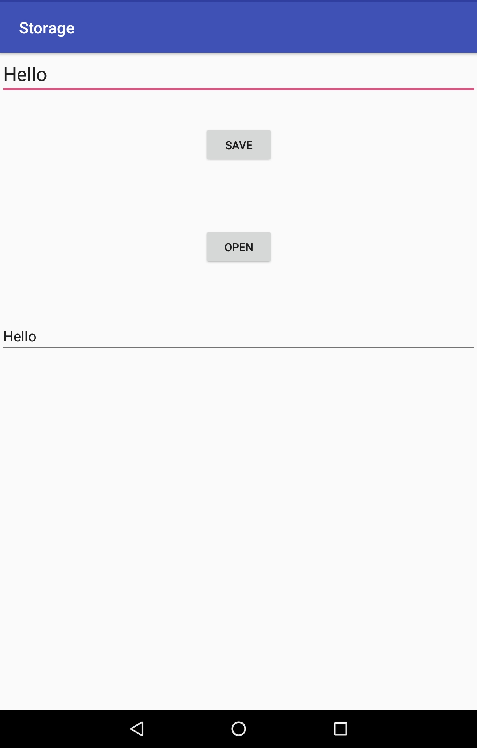
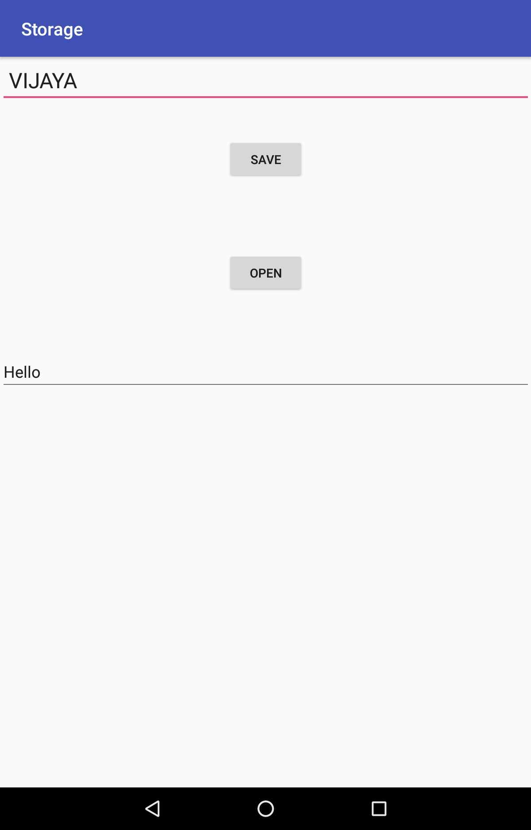
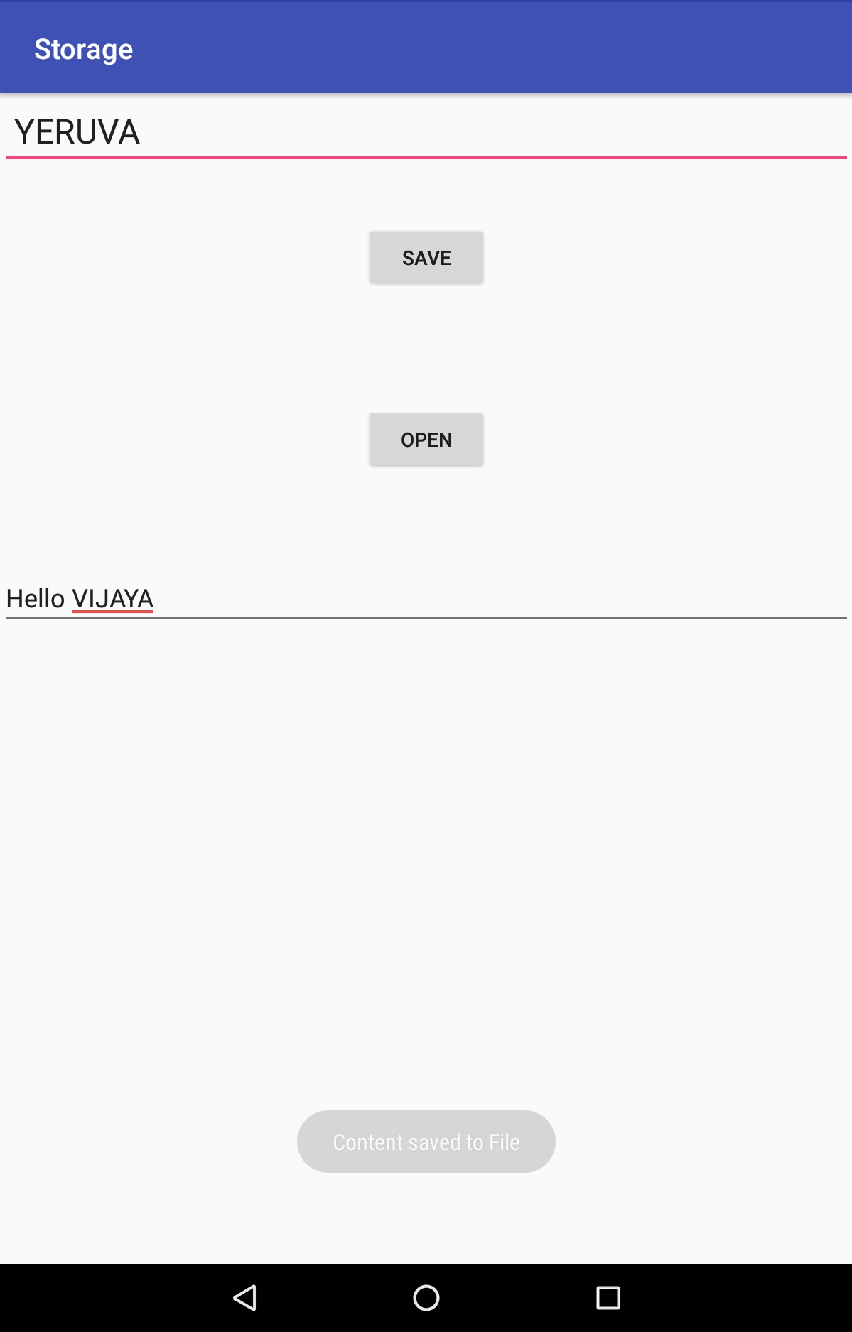
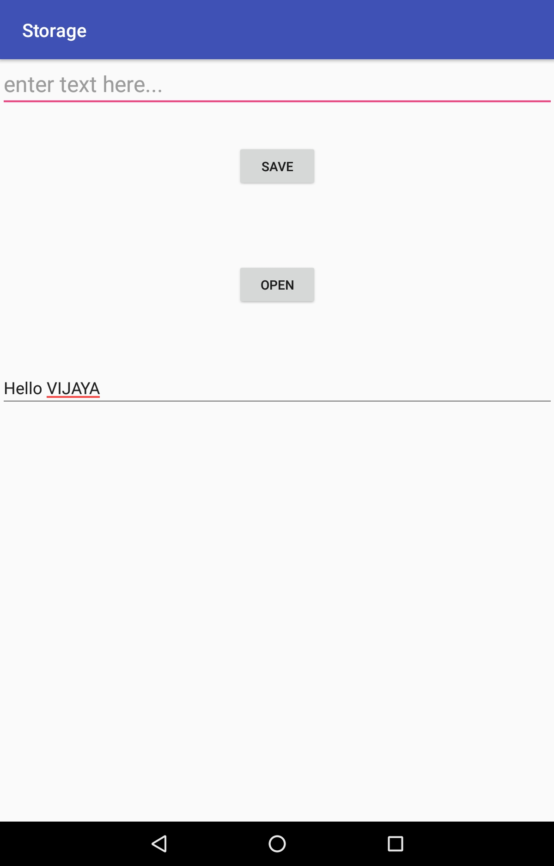
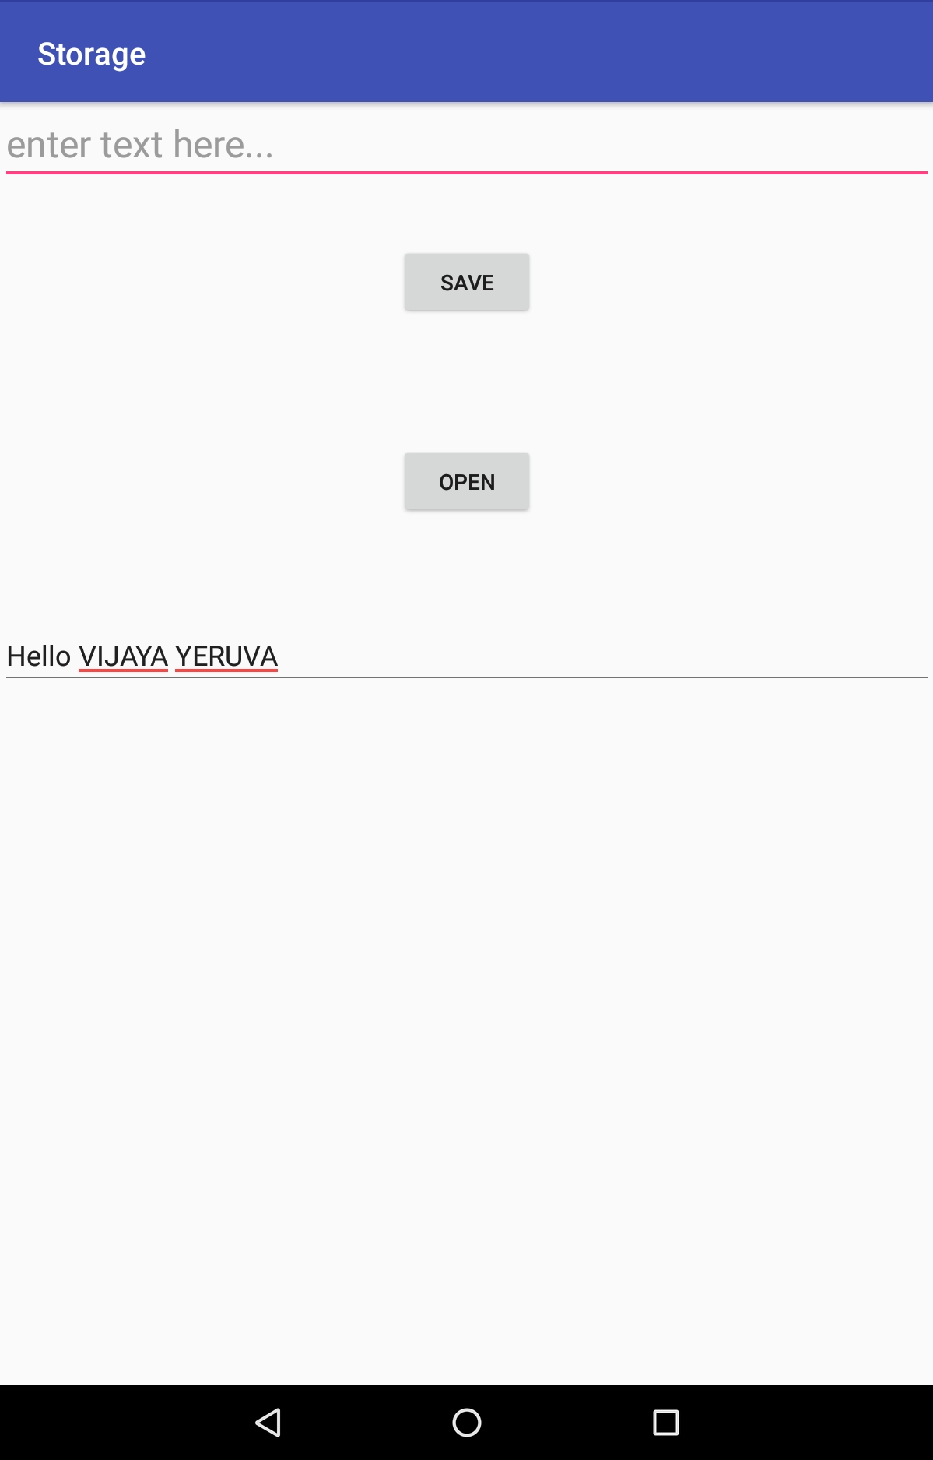
Save files on device storage
Source: https://developer.android.com/training/data-storage/files#java

Slide 13
Save files on device storage
Android provides several options for you to save your app data.
Android file system uses File APIs to read and write files
Internal file storage: Store app-private files on the device file system.
External file storage: Store files on the shared external file system. This is usually for shared user files, such as photos.
Shared preferences: Store private primitive data in key-value pairs.
Databases: Store structured data in a private database.
Source: https://developer.android.com/guide/topics/data/data-storage
Notes:
The solution you choose depends on your specific needs, such as how much space your data requires, what kind of data you need to store, and whether the data should be private to your app or accessible to other apps and the user.

Slide 14
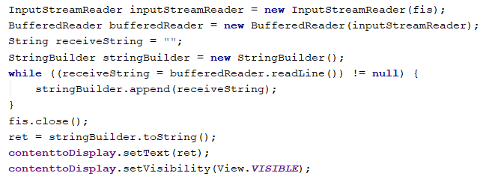
Save files on device storage
Source: https://developer.android.com/guide/topics/data/data-storage

Slide 15
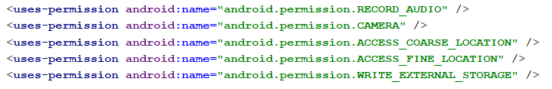
AndroidManifest.xml

Slide 16
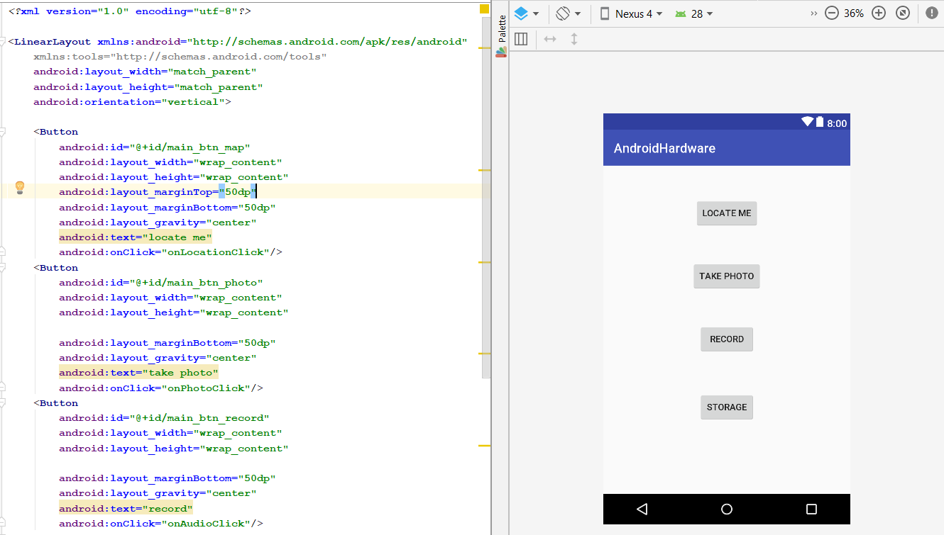
activity_main.xml

Slide 17
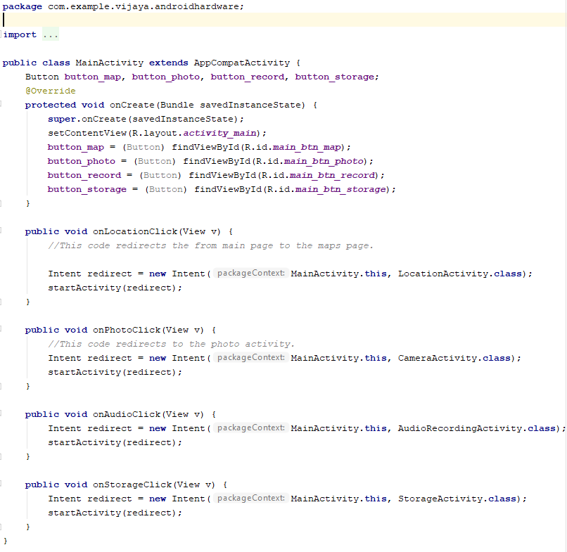
MainActivity.java

Slide 18
Sensors
Motion sensors
These sensors measure acceleration forces and rotational forces along three axes.
This category includes accelerometers, gravity sensors, gyroscopes, and rotational vector sensors.
Environmental sensors
These sensors measure various environmental parameters, such as ambient air temperature and pressure, illumination, and humidity.
This category includes barometers, photometers, and thermometers.
Position sensors
These sensors measure the physical position of a device.
This category includes orientation sensors and magnetometers.
Source: https://developer.android.com/guide/topics/sensors/sensors_overview

Slide 19

Identifying Sensors
We can get a listing of every sensor on a device by calling the getSensorList() method and using the TYPE_ALL constant
Source: https://developer.android.com/guide/topics/sensors/sensors_overview

Slide 20
ICP
Please refer steps in the lesson plan
Each button on the following screen function appropriately

Slide 21
References
https://developer.android.com/
https://developer.android.com/training/basics/firstapp/
https://developer.android.com/reference/android/location/Location
https://developer.android.com/guide/topics/media/camera
https://developer.android.com/guide/topics/media/mediarecorder
https://developer.android.com/training/data-storage/files#java

