Slide 1

CSEE5590/490: Web/Mobile Programming
Mobile App Development

Slide 2

Overview
Layouts
Views
Intents

Slide 3
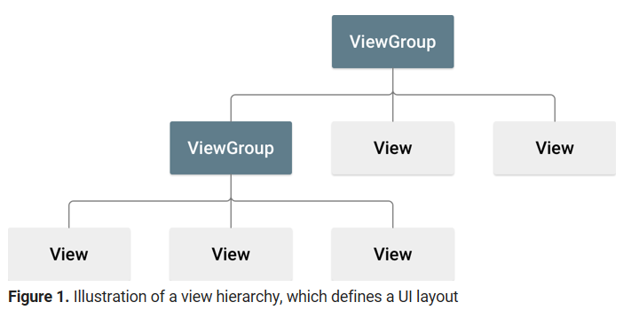
Layout
A layout defines the structure for a user interface in your app, such as in an activity.
All elements in the layout are built using a hierarchy of View and ViewGroup objects.
A View usually draws something the user can see and interact with.
Whereas a ViewGroup is an invisible container that defines the layout structure for View and other ViewGroup objects
Source: https://developer.android.com/guide/topics/ui/declaring-layout

Slide 4
Layouts
Constraint Layout
Relative Layout
Linear Layout
Grid Layout
Source: https://developer.android.com/guide/topics/ui/declaring-layout

Slide 5


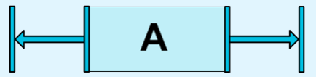
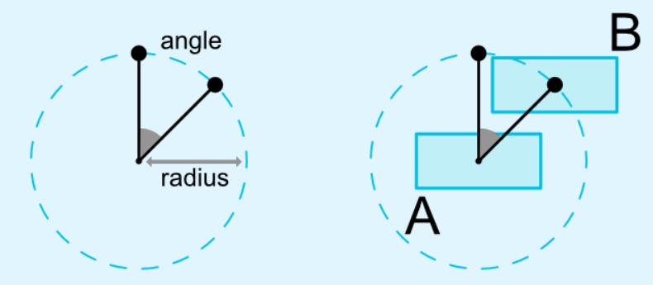
Constraint Layout
A ConstraintLayout is a ViewGroup which allows you to position and size widgets in a flexible way.
There are currently various types of constraints that you can use:
Relative positioning
Margins
Centering positioning
Circular positioning
Source: https://developer.android.com/reference/android/support/constraint/ConstraintLayout

Slide 6

Relative Layout
RelativeLayout is a view group that displays child views in relative positions.
The position of each view can be specified as relative to sibling elements (such as to the left-of or below another view) or in positions relative to the parent RelativeLayout area (such as aligned to the bottom, left or center).
Source: https://developer.android.com/guide/topics/ui/layout/relative

Slide 7

Linear Layout
LinearLayout is a view group that aligns all children in a single direction, vertically or horizontally.
You can specify the layout direction with the android:orientation attribute.
Source: https://developer.android.com/guide/topics/ui/layout/linear

Slide 8

Grid Layout
A GridLayout is a ViewGroup that places its children in a rectangular grid.
The grid is composed of a set of infinitely thin lines that separate the viewing area into cells.
The grid items are automatically inserted to the layout using a Adapter.
Source: https://developer.android.com/guide/topics/ui/layout/gridview

Slide 9
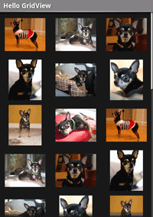
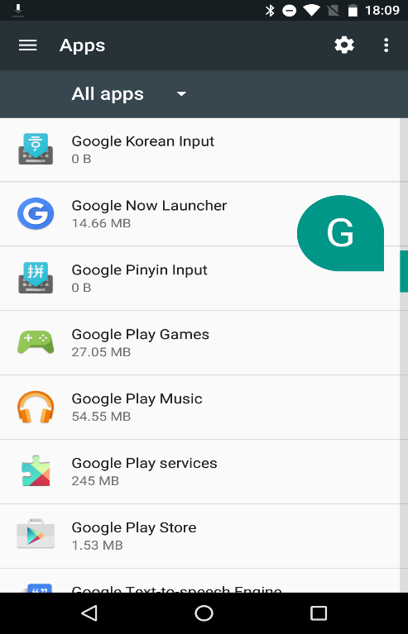
Layouts with Adapter
An Adapter object acts as a bridge between an AdapterView and the underlying data for that view.
The Adapter provides access to the data items.
Used when the content of the layout is dynamic or not pre-determined
Adapter binds data to the layout. It retrieves the data and converts each entry into a view that can be added
Source: https://developer.android.com/reference/android/widget/Adapter

Slide 10
Layout Attributes
android:id
android:layout_width
android:layout_height
Example:
android:layout_width=wrap_content tells your view to size itself to the dimensions required by its content.
android:layout_width=fill_parent tells your view to become as big as its parent view.
Source: https://developer.android.com/guide/topics/ui/declaring-layout

Slide 11
Views
A View represents the basic building block for user interface components.
A View occupies a rectangular area on the screen and is responsible for drawing and event handling.
A View is the base class for widgets, which are used to create interactive UI components (buttons, text fields, etc.).
Source: https://developer.android.com/reference/android/view/View

Slide 12
Views
Text View
Image View
Video View
List View
Button
And more

Slide 13
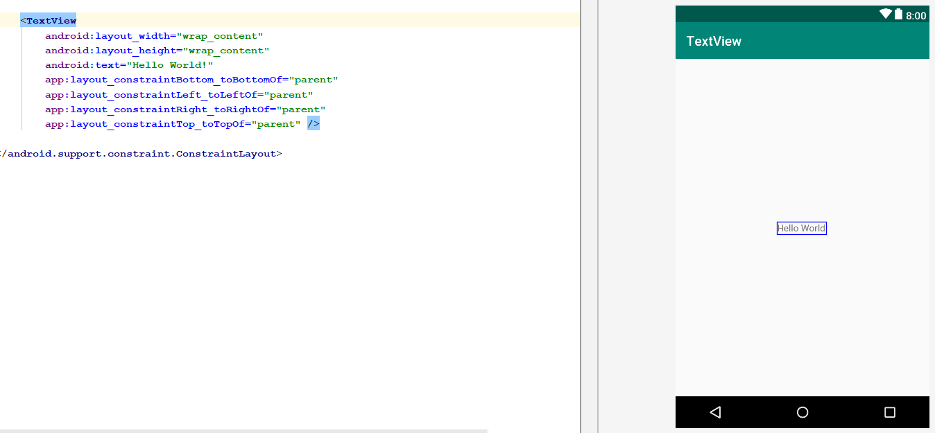
Text View
A user interface element that displays text to the user.
Source: https://developer.android.com/reference/android/widget/TextView

Slide 14
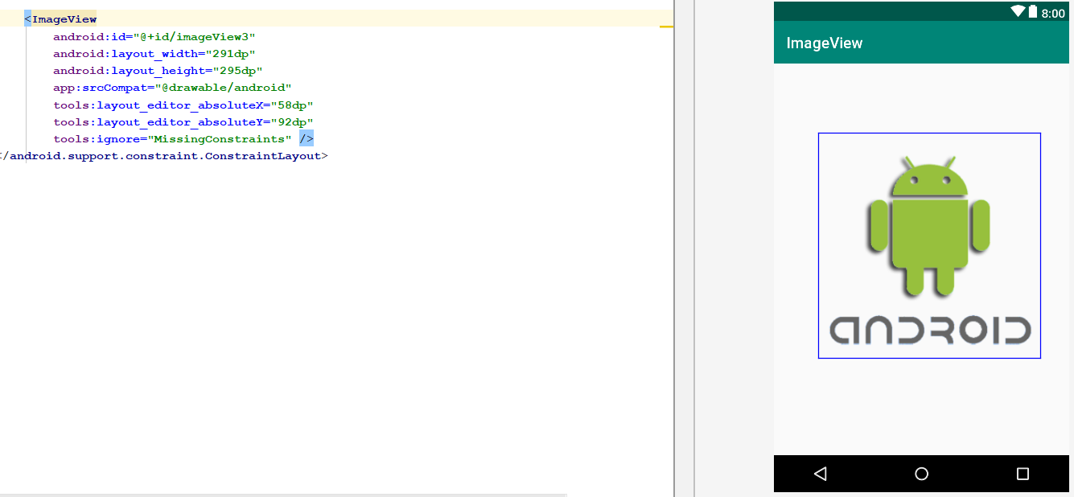
Image View
Displays image resources, for example Bitmap or Drawable resources.
ImageView is also commonly used to apply tints to an image and handle image scaling
Source: https://developer.android.com/reference/android/widget/TextView

Slide 15
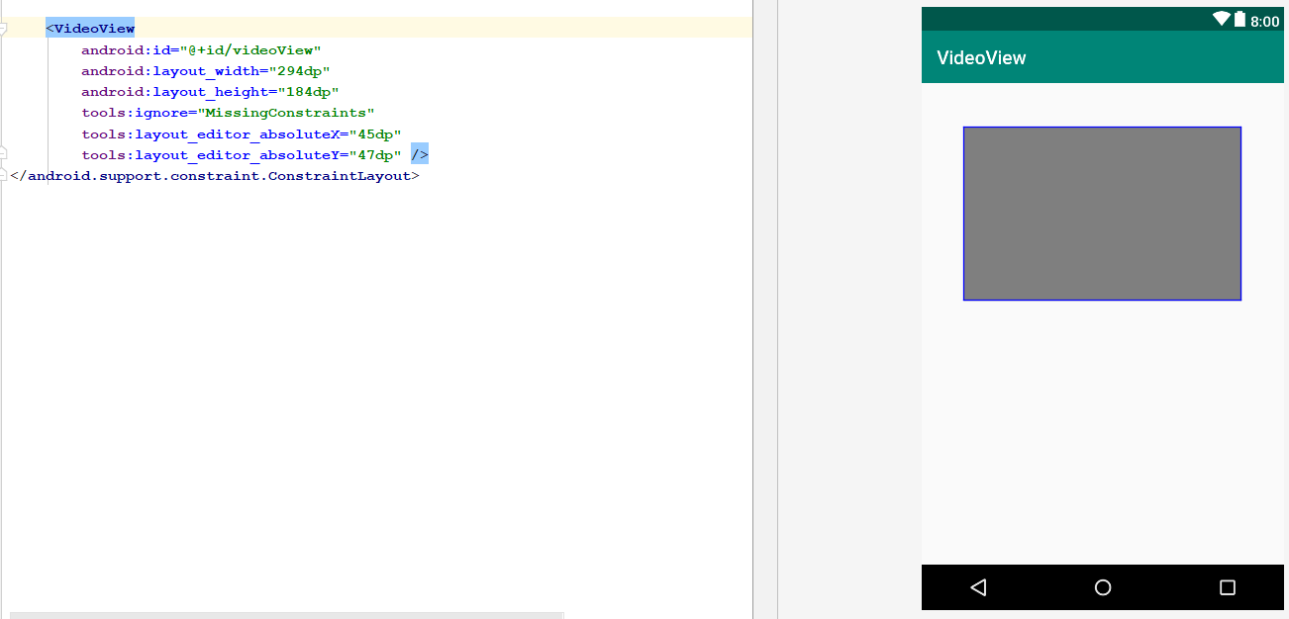
Video View
Displays a video file.
Source: https://developer.android.com/reference/android/widget/VideoView

Slide 16
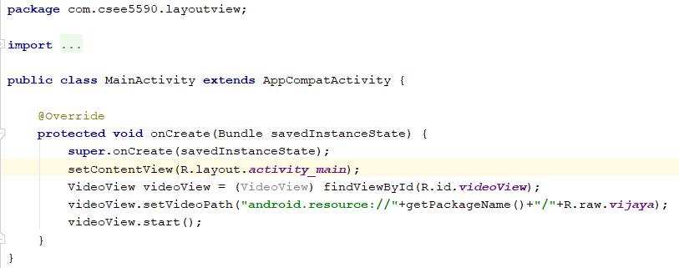
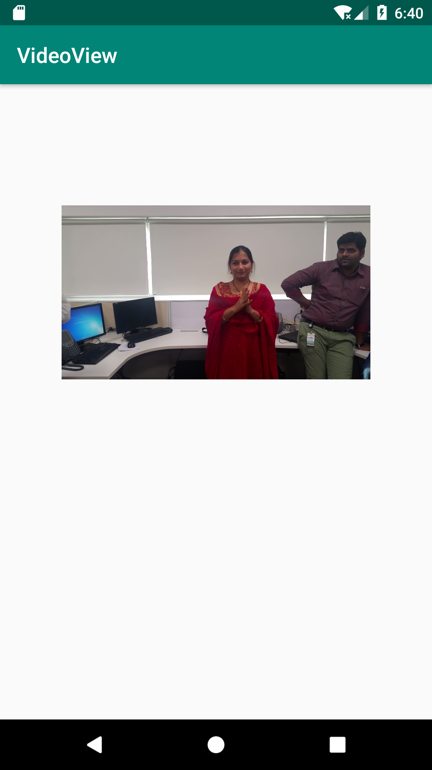
Video View
Java code to set video path/location
Video on emulator
Source: https://developer.android.com/reference/android/widget/VideoView

Slide 17
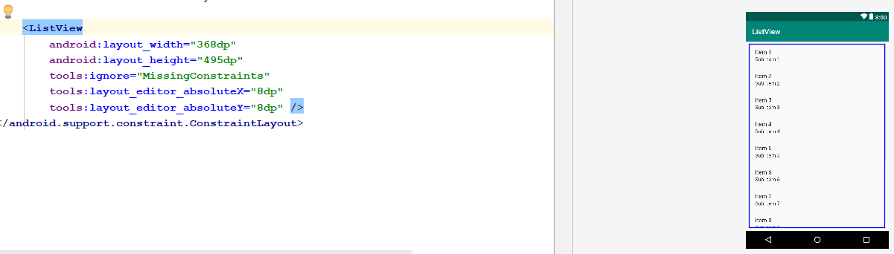
List View
ListView is a view group that displays a list of scrollable items.
The list items are automatically inserted to the list using an Adapter that pulls content from a source such as an array or database query and converts each item result into a view that's placed into the list.
Source: https://developer.android.com/guide/topics/ui/layout/listview

Slide 18
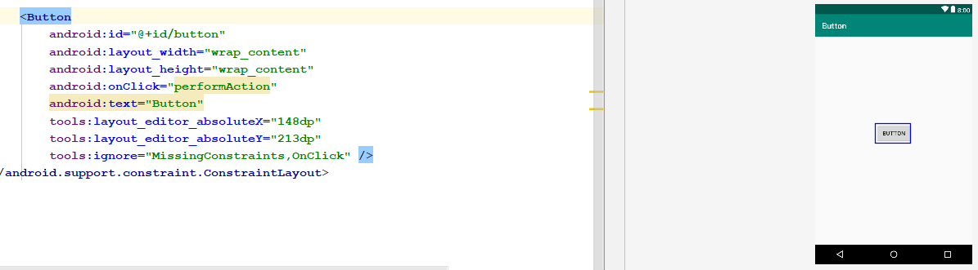
Button
A user interface element the user can tap or click to perform an action.
Source: https://developer.android.com/reference/android/widget/Button

Slide 19
Intent
An Intent is a messaging object you can use to request an action from another app component.
Although intents facilitate communication between components in several ways, there are three fundamental use cases:
Starting an activity
Starting a service
Delivering a broadcast
Source: https://developer.android.com/guide/components/intents-filters

Slide 20
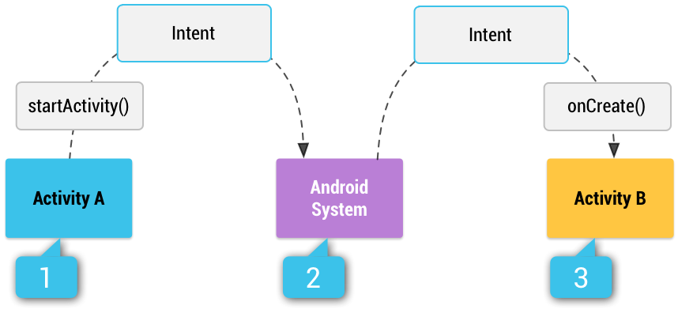
Intents
Explicit intents
Implicit intents
How an implicit intent is delivered through the system to start another activity

Slide 21
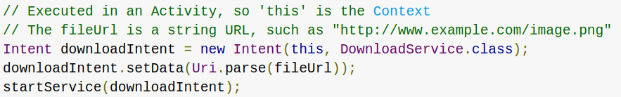
Explicit intent
Specify the component to start by name (the fully-qualified class name)

Slide 22
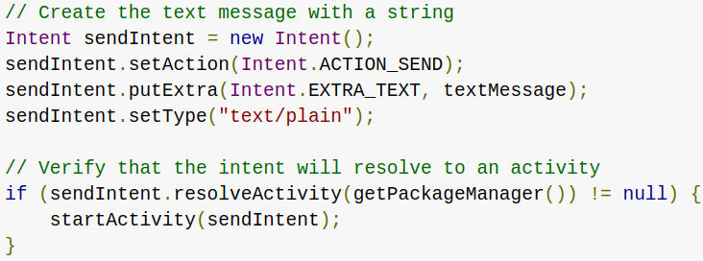
Implicit intent
Do not name a specific component, but instead declare a general action to perform

Slide 23
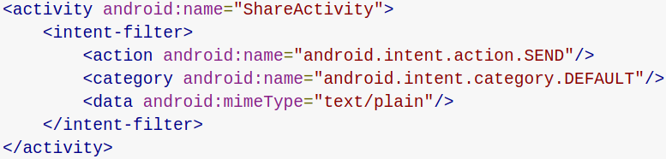
Intent Filter
An expression in an app's manifest file that specifies the type of intents that the component would like to receive

Slide 24
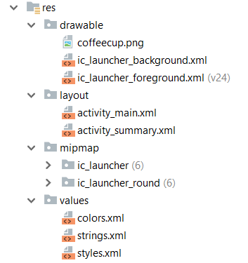
Resources
Class for accessing an application's resources.
R is a class containing the definitions for all resources of a particular application package.
It is in the namespace of the application package.

Slide 25
R Class
Generated when the application is compiled.
Contains resource IDs for all the resources in res/ directory.
For each type of resource, there is an R subclass (e.g. R.drawable for all drawable resources).
For each resource of that type, there is a static integer (e.g. R.drawable.coffeecup).
This integer is the resource ID that you can use to retrieve your resource.

Slide 26
Accessing Resources in Code
Syntax: [<package_name>.]R.<resource_type>.<resource_name>
<package_name> name of the package in which the resource is located (not required when referencing resources from your own package).
<resource_type> the R subclass for the resource type.
<resource_name> is either the resource filename without the extension or the android:nameattribute value in the XML element (for simple values).

Slide 27
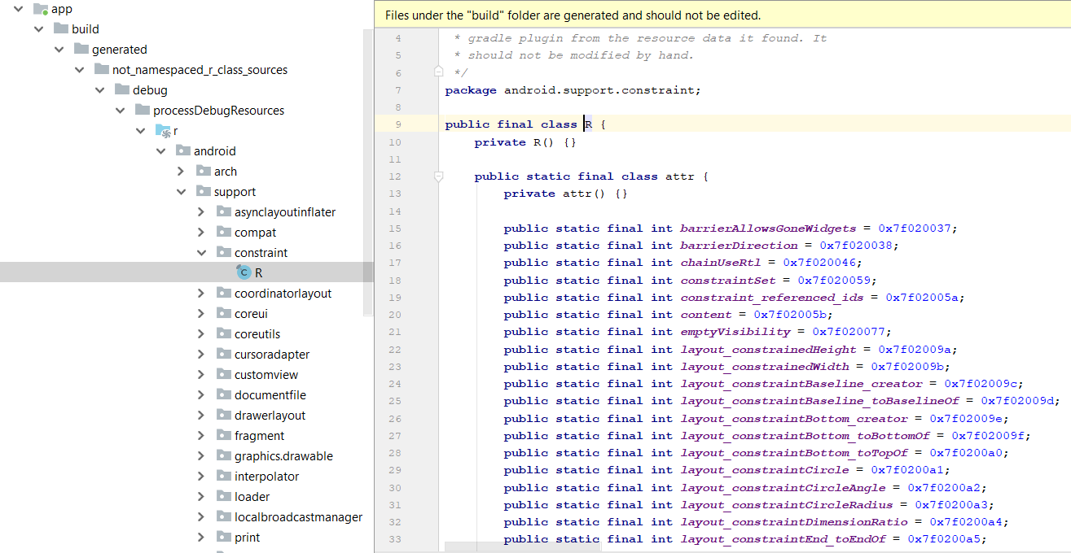
Location of R class
Location: Project\app\build\generated\not_namespaced_r_class_sources\debug\processDebugResources\r\android\support\constraint\R.java

Slide 28
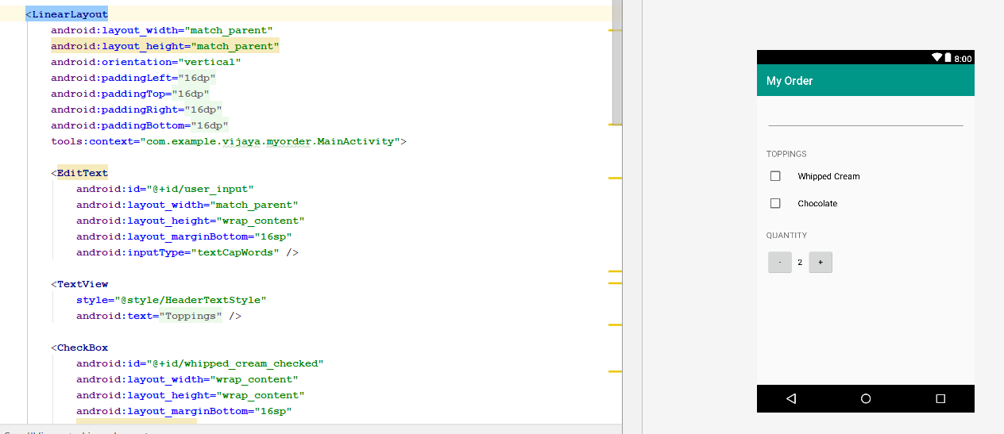
Use case: My Coffee

Slide 29
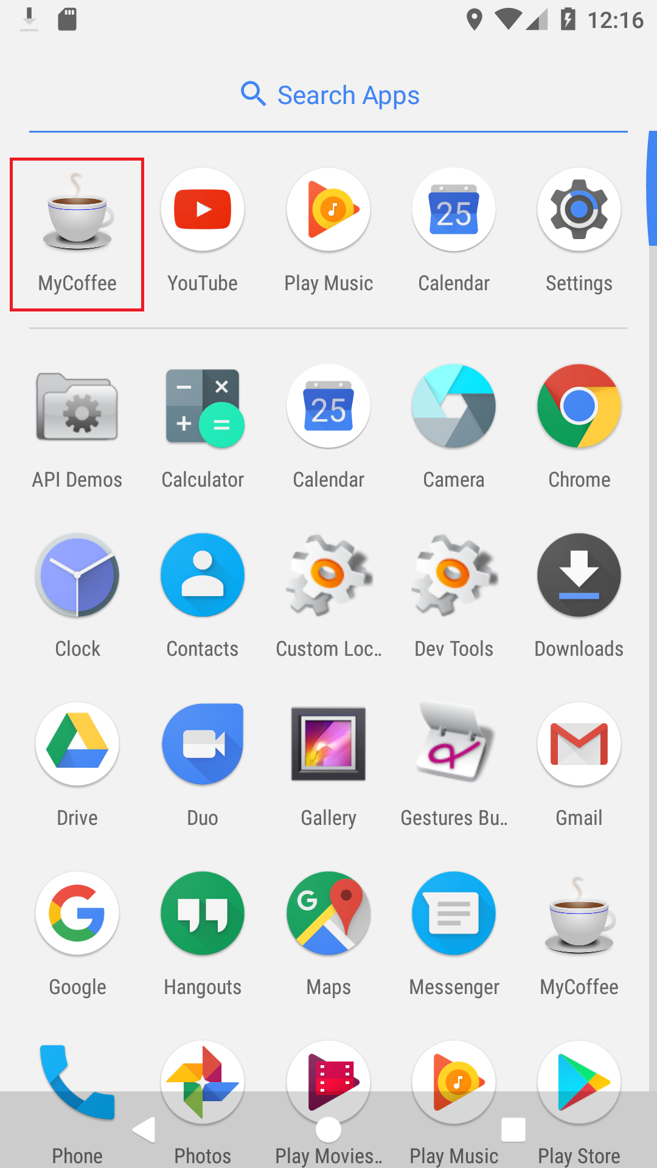
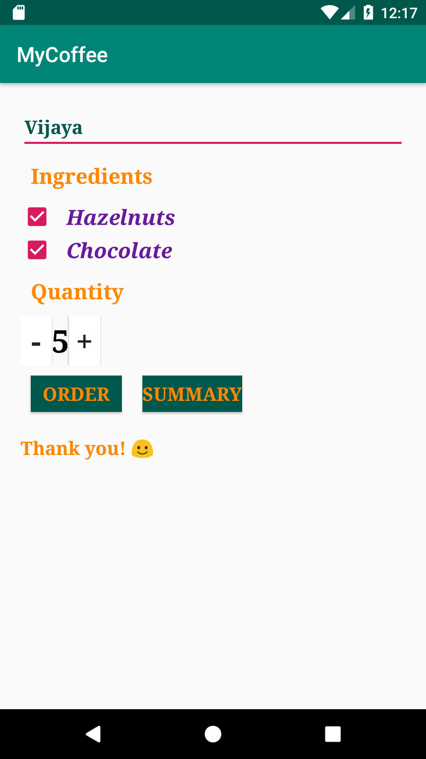
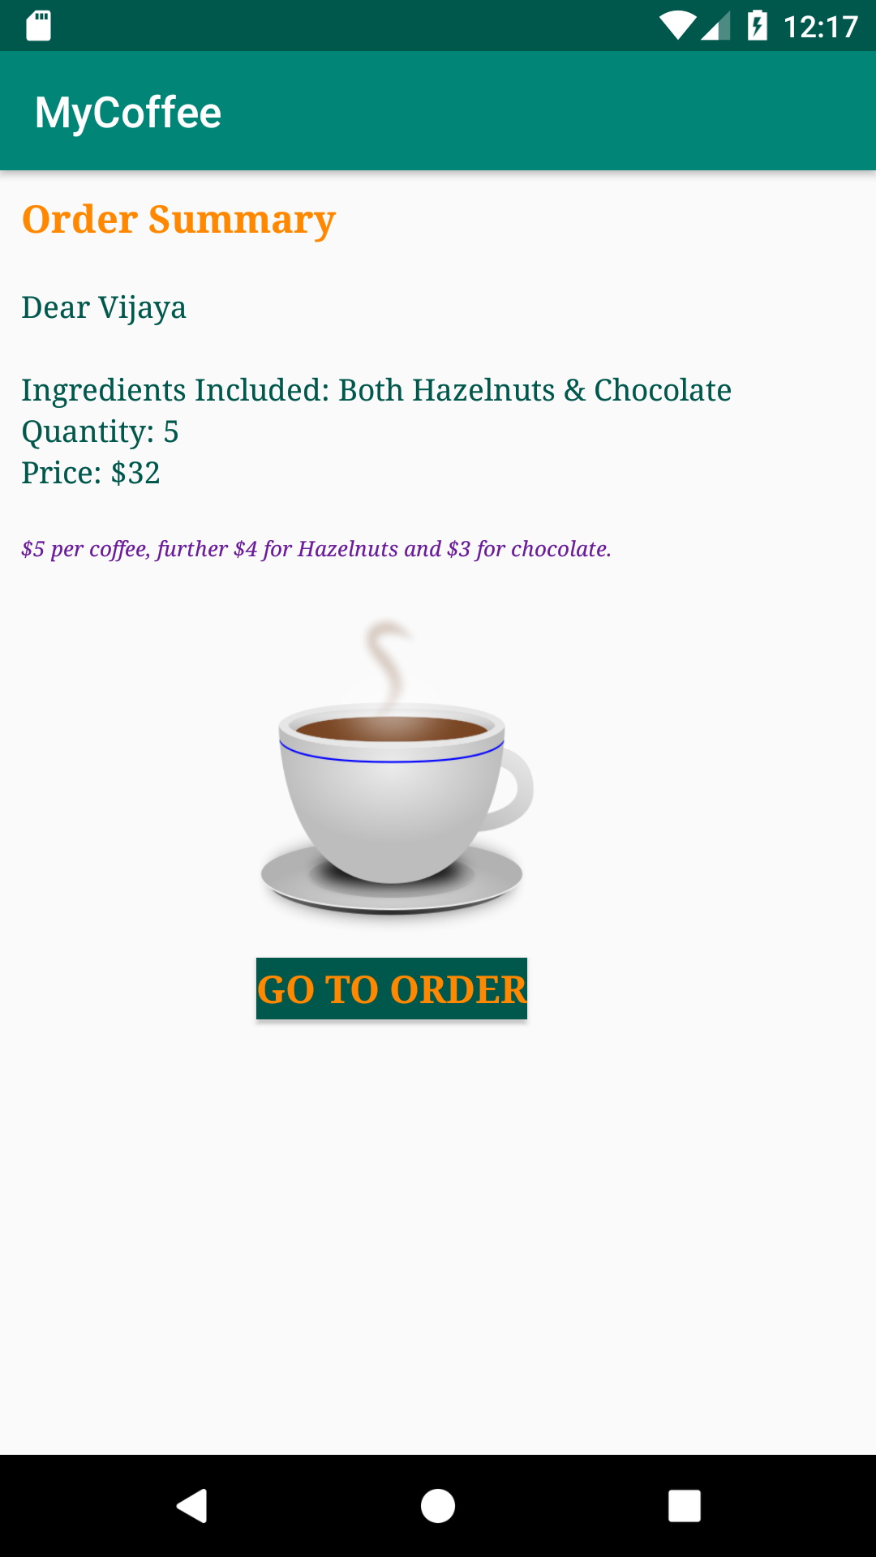
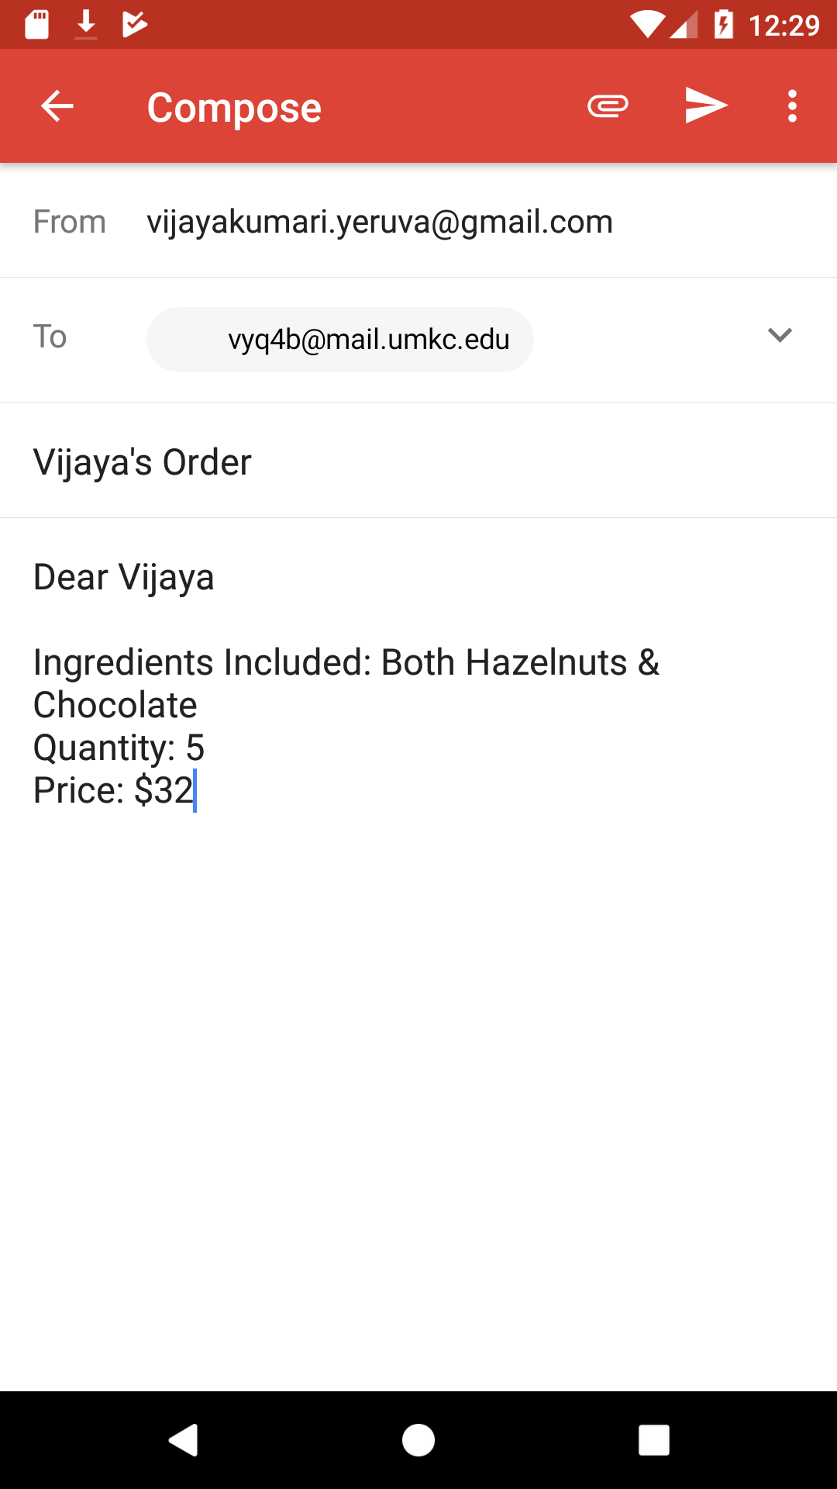
ICP
Create a pizza ordering application
Please refer steps in the lesson plan. See below example output

Slide 30
References
https://developer.android.com/
https://developers.google.com/android/for-all/vocab-words/
https://developer.android.com/guide/topics/ui/controls/checkbox
https://developer.android.com/guide/topics/ui/controls/radiobutton
https://developer.android.com/guide/topics/ui/controls/spinner
https://developer.android.com/training/basics/firstapp/
Book: http://www.kmvportal.co.in/Course/MAD/Android%20Book.pdf

