Slide 1

MIS Workshop
Day 4 - Statistics
Descriptive Statistics Refresher

Slide 2
Terminology
Population – The aggregate of all subjects being analyzed. Example: All cars in the world. Or.. All jeeps in Utah. We can limit the population as needed.
Sample – A collection of subjects that represent our population… Usually a 100% sample size is unrealistic. Example: 1,000 Jeeps in Utah (evenly dispersed)
Observation – A measured unit within the sample. Example: Year, Color, 4x4 or not.

Slide 3
Terminology (Continued)
Quantitative Variable – Numeric, something that can be quantified or counted.
Discrete – Can be counted in integers. Example: Number of engine cylinders.
Continuous – Counted in fractions. Example: Fuel Capacity.
Qualitative Variable – Non-Numeric, Usually has a “Set” of acceptable values (Categorical Variables)
Nominal – Order doesn’t matter – Example: Color.
Ordinal – Order does matter - Example: Outdoor Rating (excellent, good, bad).

Slide 4
3 Measures of Data
Measure of Central Tendency
Measure of Dispersion
Measure of Shape of Distribution Curve

Slide 5
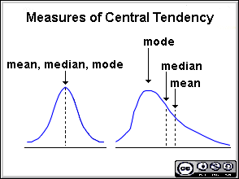
Measure of Central Tendency
Mean - The sample mean is the arithmetic average of the data. (Average)
Median - The Median is the middle point of ordered data. If two values intersect in the middle point, take the average of those two.
Mode – The value that occurs most frequently.

Slide 6
Measure of Dispersion
Range – Difference in the maximum and minimum value in the population
Quartiles – Values, which divide the population in 4 equal subsets (typically referred to as first quartile, second quartile and third quartile)
Variance: The average of the squared differences from the Mean.
Standard Deviation: is square root of Variance.
NOTE: Both the mean and standard deviation are sensitive to the extremes in the data.

Slide 7
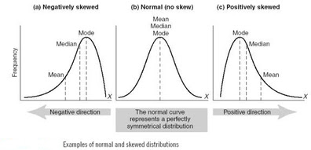
Measure of Distribution Shape
Skew – Measure of Symmetry.
Negative – Left Tail is Longer
Positive – Right Tail is Longer.

Slide 8
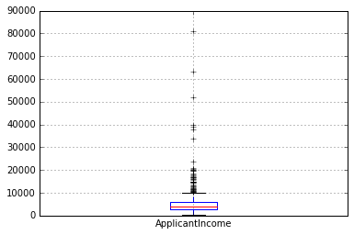
Boxplot
Boxplot – Identify Outliers, easily see distribution.

Slide 9
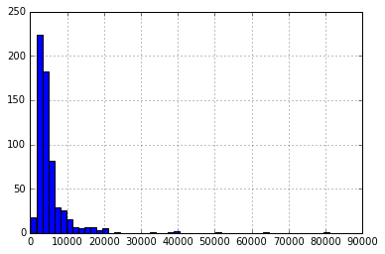
Histogram
Histogram – Easily see distribution.

