Slide 1

Methods and Tools for Encoding the
WordNet.Br Sentences,
Concept Glosses, and
Conceptual Relations
PROPOR´2006
Bento C. Dias-da-Silva¹
Ariani Di Felippo (CNPq)²
Ricardo Hasegawa³
Centro de Estudos Lingüísticos e Computacionais da Linguagem (CELiC)^{1,2}
Faculdade de Ciências e Letras - Universidade Estadual Paulista (UNESP)
Núcleo Interinstitucional de Lingüística Computacional (NILC)^{1,2,3}
Instituto de Ciências Matemáticas e de Computação - Universidade de São Paulo (USP)
{bento@fclar.unesp.br; arianidf@uol.com.br; rh@icmc.usp.br}

Slide 2
Outline
PROPOR´2006
Setting
  NLP and the lexicon
  Wordnet framework
The WordNet.Br lexical database
  Ongoing steps of development
  Methods and tools
Further work

Slide 3
Setting (1)
PROPOR´2006
Development of lexicons for NLP applications (Briscoe, 1991; Handke, 1995; Hanks, 2003)
  Lexical bottleneck
    Bulk of the problem has to do with the amount, the variety, and the complexity of specialized and interrelated lexical information
  Time-consuming activity
  Primarily manual process
  Alternative: semi-automatic methodologies (Rigau, 2002)
    Resort to pre-existing MRD lexical resources

Slide 4
Setting (2)
PROPOR´2006
Princeton WordNet (PWN) (Fellbaum, 1998)
  Successful psycholinguistic experiment
  Framework for compiling bulky relational lexicons
  Applications in different fields of research in NLP
    Meaning disambiguation
    Semantic tagging
    Text/information retrieval and extraction, etc

Slide 5
Setting (3)
PROPOR´2006
What´s a WordNet? (Fellbaum, 1998)
Designed to model part of human mental lexicon, a WORDNET is a particular electronic lexical database organized in terms of synsets (understood as sets of word forms that share the same concept) and logical-conceptual relations between synsets such as hyponymy, troponymy, meronymy, cause, and entailment.

Slide 6
Setting (4)
PROPOR´2006
Wordnets of different languages are under development
EuroWordNet (Vossen, 1998)
  Multilingual database containing monolingual wordnets and equivalence relations for each language synset to the closest concept from the so-called Inter-Lingual-Index (ILI)
WordNet.Br (WNBr) (Dias-da-Silva et al., 2002)
  Launched in 2003
  Extends the Brazilian Portuguese Thesaurus (TeP)

Slide 7
WordNet.Br: Three-domain methodology
PROPOR´2006
Linguistic-related domain:
  Where the lexical resources (dictionaries and text corpuses), the lexical-conceptual relations (Rodriguez, 1998) are mined;
Representational domain:
  Where the overall information selected and organized in the preceeding domain is molded into a computer-tractable representation (the "synsets", the "lexical matrix", and the wordnet "lexical database" itself) (Fellmaun, 1998);
Computational domain:
  Where the computer-tractable representations are assembled by means of utilities (the WordNet.Br editor).

Slide 8
Linguistic-related domain: encoding
PROPOR´2006
Encoding synsets, glosses, sample-sentences, and lexical-conceptual relations
  The reference corpus
    NILC corpus (http://www.linguateca.pt/)
    Texts in Brazilian Portuguese in the web
    Entries and sample-sentences of monolingual Brazilian Portuguese dictionaries:
      Michaelis (Weiszlog, 1998)
      Aurélio (Ferreira, 1999)
      Houaiss (Houaiss, 2001)
      Dicionário de verbos (Borba, 1990)
      DUP (Borba et al., 2002)

Slide 9
Representational domain: linking
PROPOR´2006
Linking each synset to its concept gloss via the “concept gloss link”
Linking each word form to its co-text sentence via the “co-text sentence link”

Slide 10
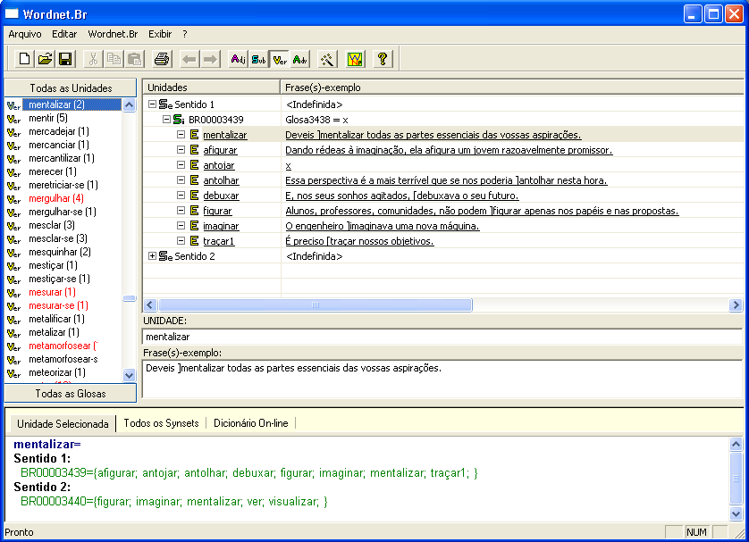
Computational domain:
the editing tool
PROPOR´2006
Figure 2: The WordNet.Br editing tool

Slide 11
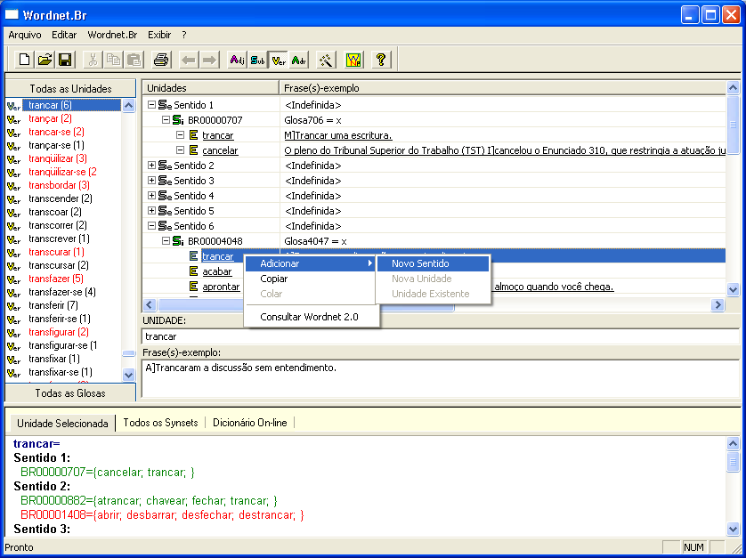
Computational domain:
some pop-up menus
PROPOR´2006
Figure 4: The pop-up menu to add new words to the synsets in the database.

Slide 12
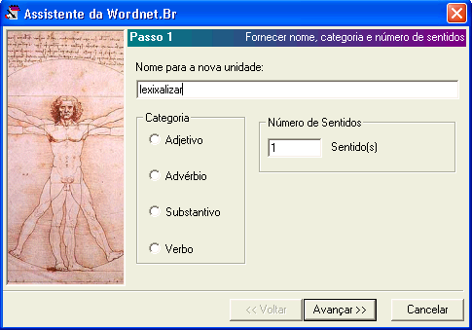
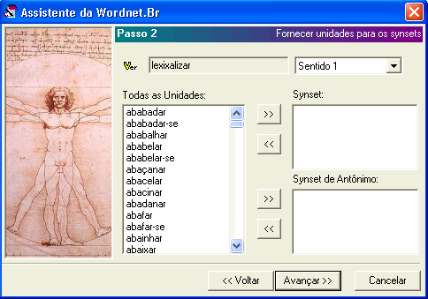
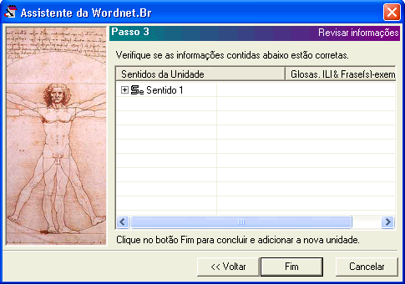
PROPOR´2006
Computational domain:
the wizards
Figure 3: The wizards that help the linguist insert words in the database.

Slide 13
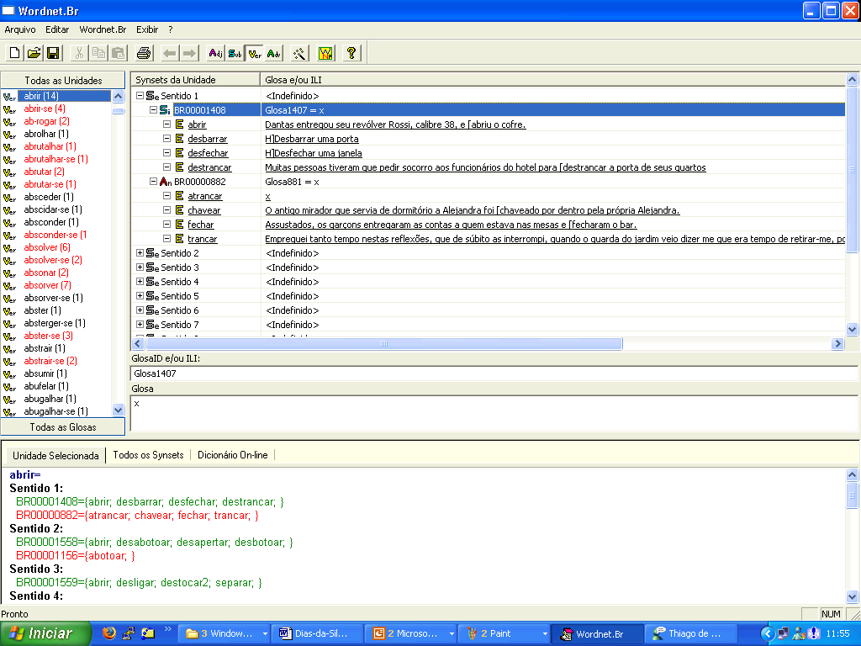
Computational domain: the gloss field
PROPOR´2006
Glosses
Figure 5: The procedure for encoding concept glosses in the database.

Slide 14
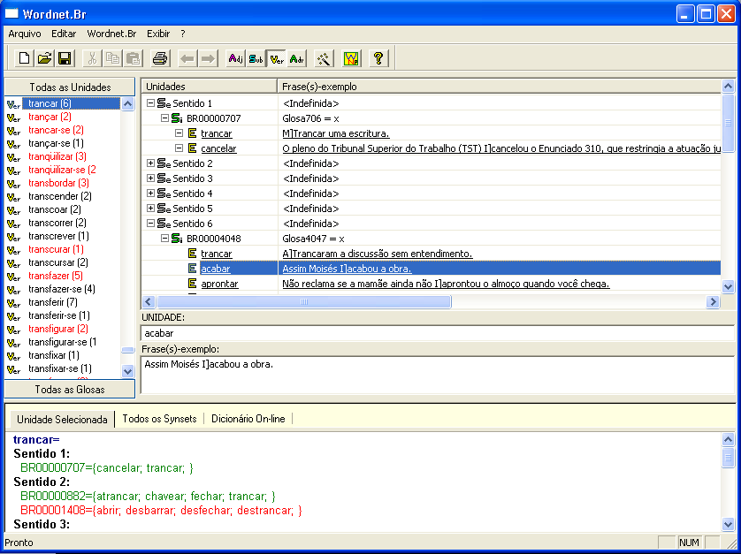
Computational domain: the co-text sentence field
PROPOR´2006
Co-text senteces
Figure 6: The procedure for encoding co-text sentences in the database.

Slide 15
WordNet.Br: statistics
PROPOR´2006
Table 1. The WNBr core statistics
Category | Word Forms | Synsets
Nouns | 17,388 | 8,527
Verbs | 11,078 | 4,130
Adjectives | 15,073 | 6,649
Adverbs | 1,139 | 567
TOTAL | 44,678 | 19,872

Slide 16
WordNet.Br: its underlying structure (1)
PROPOR´2006
The overall structure of the database is made up of three lists:
  The list of Headwords (LH)
  The list of Words (arranged in alphabetical order)
  The list of Synsets (LS)

Slide 17
WordNet.Br: its underlying structure (2)
PROPOR´2006
Each word in the synset is listed in the LH
Each word is specified for its particular Sense Description (SDv) vector
Each SDv is indexed by three pointers:
  The synonymy pointer: to identify a particular synset in the LS
  The antonymy pointer: to identify a particular antonym synset in the LS
  The sense pointer: to identify a particular word form sense number in the SDv

Slide 18
Headwords
Senses
...
^{abreviado}
E16
Ac1E16
C10
C58
Ac2E16
C33
C0
...
E188
ampliado
Ac1E188
C58
C10
...
E232
cifrado
Ac1E232
C33
C0
...
abridged
brief
compact
compendious
concise
condensed
short
shortened
succinct
terse
complete
entire
expanded
extended
long
unabridged
uncondensed
uncut
E278
encurtado
Ac1E278
C10
C58
...
E393
extenso
Ac1E393
C58
C10
...
E459
resumido
Ac1E459
C10
C58
...
E601
sucinto
Ac1E601
C10
C58
...
Synsets
C0
empty set
...
E16
E278
E459
E601
C10
Ac1E16
Ac1E188
Ac1E278
Ac1E393
Ac1E459
Ac1E601
...
E16
E232
C33
Ac2E16
Ac1E232
...
C58
E188
E393
...
Ac1E16
Ac1E188
Ac1E278
Ac1E393
Ac1E459
Ac1E601
Figure 1: The database underlying structure (a)

Slide 19
Headwords
Senses
...
^{abreviado}
E16
Ac1E16
C10
C58
Ac2E16
C33
C0
...
E188
ampliado
Ac1E188
C58
C10
...
Sense 2 (Princeton WordNet)
compendious, compact, succinct, summary -- (briefly giving the gist of something; "a short and compendious book"; "a compact style is brief and pithy"; "succinct comparisons"; "a summary formulation of a wide-ranging subject")
=> concise (vs. prolix) -- (expressing much in few words; "a concise explanation")
E232
cifrado
Ac1E232
C33
C0
...
E278
encurtado
Ac1E278
C10
C58
...
E393
extenso
Ac1E393
C58
C10
...
E459
resumido
Ac1E459
C10
C58
...
E601
sucinto
Ac1E601
C10
C58
...
Synsets
C0
empty set
...
E16
E278
E459
E601
C10
Ac1E16
Ac1E188
Ac1E278
Ac1E393
Ac1E459
Ac1E601
...
E16
E232
C33
Ac2E16
Ac1E232
...
C58
E188
E393
...
Ac1E16
Ac1E188
Ac1E278
Ac1E393
Ac1E459
Ac1E601
Figure 1: The database underlying structure (b)

Slide 20
Headwords
Senses
...
^{abreviado}
E16
Ac1E16
C10
C58
Ac2E16
C33
C0
...
E188
ampliado
Ac1E188
C58
C10
...
cifrado
Sense 1 (Princeton WordNet)
unabridged (vs. abridged) -- ((used of texts) not shortened; "an unabridged novel")
=> comprehensive -- (being the most comprehensive of its class; "an unabridged dictionary")
=> full-length, uncut -- (complete; "the full-length play")
E232
Ac1E232
C33
C0
...
E278
encurtado
Ac1E278
C10
C58
...
E393
extenso
Ac1E393
C58
C10
...
E459
resumido
Ac1E459
C10
C58
...
E601
sucinto
Ac1E601
C10
C58
...
Synsets
C0
empty set
...
E16
E278
E459
E601
C10
Ac1E16
Ac1E188
Ac1E278
Ac1E393
Ac1E459
Ac1E601
...
E16
E232
C33
Ac2E16
Ac1E232
...
C58
E188
E393
...
Ac1E16
Ac1E188
Ac1E278
Ac1E393
Ac1E459
Ac1E601
Figure 1: The database underlying structure (c)

Slide 21
WordNet.Br: ongoing steps
PROPOR´2006
Encoding of the following information:
  A concept gloss for each synset
    Gloss =def. an informal definition that identifies the concept encoded in the synset
  A co-text sentence for each word form
  The cross-linguistic alignment between WNBr and PWN databases through the Inter-Lingual-Index (ILI)
  The conceptual relations of hyponymy, hyperonymy, meronymy, entailment, and cause

Slide 22
Cross-linguistic alignment: linguistic domain (1)
PROPOR´2006
ILI =def. the list of PWN synsets, plus its concept gloss and its ID number. (Vossen, 1998)
Additional vector to identify:
  The wordnet standard language-independent conceptual relations
    hyponymy, co-hyponymy, etc
  The cross-lingual conceptual relations between synsets of the two wordnets
    EQ_(NEAR)_RELATIONS

Slide 23
Cross-linguistic alignment: linguistic domain (2)
PROPOR´2006
Extension of the WNBr database structure with:
  Semantic types
    <verb.social>
  American English synsets
    {risk, put on the line, lay on the line}
  American English glosses and co-text sentences
    Expose to a chance of loss or damage
    "Why risk your life?"
  EQ_(NEAR)_RELATIONS
    EQ_(NEAR)_SYNONYM relations

Slide 24
Cross-linguistic alignment: representational domain (1)
PROPOR´2006
WNBr
BR0000 |  | empty set
...
 |  | E1508 | E1778 |  | E7956
BR1846 |  | S2-E1508 | S1-E1778 |  | S1-E7956
 |  | <EQ-NEAR-SYNONYMY, 02469144> |  |  |  | ...
...
 |  | E1508 | E6649
BR2566 |  | S1- E1508 | S2-E6649
 |  | <EQ-SYNONYMY, 02470374> |  |  | ...
...
 |  | E1306 | E1508 |  | E7702 | E8861
BR3919 |  | S2-E1306 | S3-E1508 |  | S22-E7702 | S2-E8861
 |  | <EQ-NEAR-SYNONYMY, 02469144>
PWN
00000000 |  | empty set
...
02454930 |  | <verb.social> |  | try, seek, attempt, essay, assay | Gloss: make na effort or attempt | E.g.: He tried to shake ...
 |  | Hypernyms: 02296591 |  | Troponyms: {02470068 ...} | Derivationally-related: {007528006 ...}
...
02470374 |  | <verb.social> |  | risk, put on the line, lay on the line | Gloss: expose to a chance of less... | E.g.: We risk your life?
 |  | Hypernyms: 02454930 |  | Troponyms: {02470068 ...} | Derivationally-related: {007528006 ...}
...
Figure 7: The synset structure augmented with conceptual EQ_(NEAR)_RELATIONS.

Slide 25
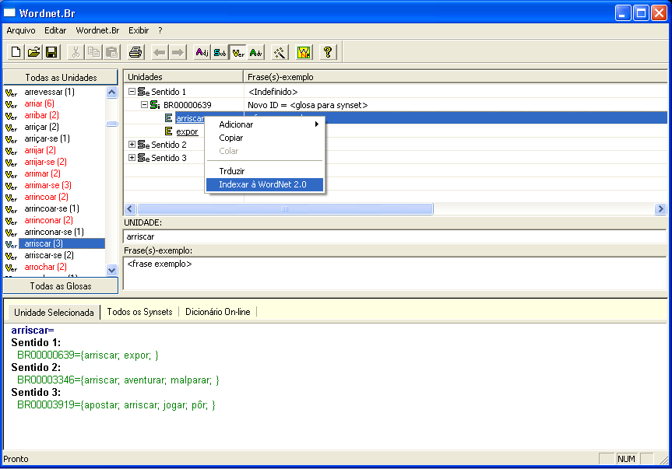
Cross-linguistic alignment: computational domain (2)
PROPOR´2006
Figure 8: The pop-up menu to index the WNBr to PWN.

Slide 26
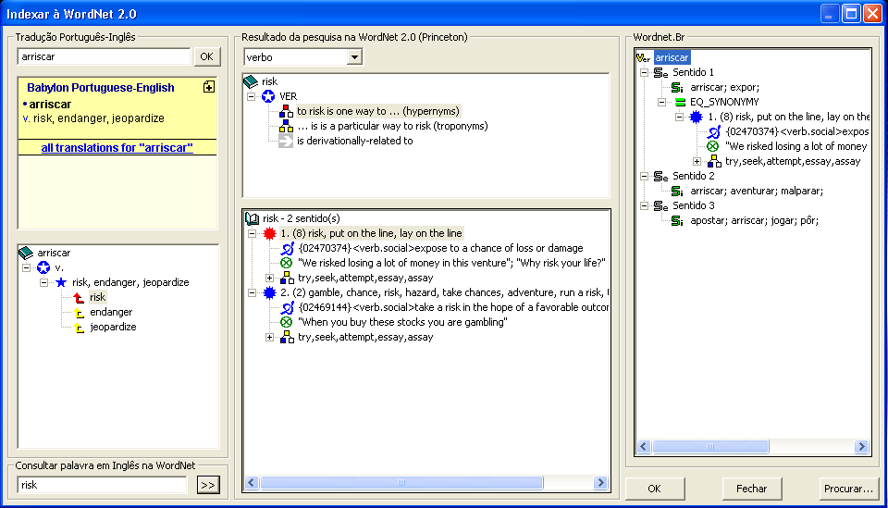
Cross-linguistic alignment: computational domain (3)
PROPOR´2006
Figure 9: The three-column WNBr GUI.

Slide 27
Encoding of conceptual relations
PROPOR´2006
WNBr
PWN (2.0)
EQ-SYNONYMY (specified)
2126
TENTAR
{02454930}
TRY
HYPERNYMY (given)
EQ-HYPERNYMY (inherited from PWN)
CO-HYPONYMY (inheritaed from PWN)
3919
APOSTAR
{02469144}
GAMBLE
2566
ARRISCAR
{02470374}
RISK
Figure 10: Automatic inheritance

Slide 28
Further work
PROPOR´2006
Frase-exemplo: Muitos juízes são incrivelmente preguiçosos, encarando sua posição como uma espécie de tranquila aposentadoria que os [livrou das dificuldades da advocacia.
Frase-exemplo: Joana D' Arc disse ter recebido um aviso dos céus para liderar os exércitos franceses e [libertar a França do domínio inglês.
Frase-exemplo: São mais do que ridículos os métodos que propõem nossos retóricos para [salvar a humanidade dessa queda fatal e iminente.
livrar
libertar
ILI: 02475841 <verb.social>
rescue#1, deliver1#4 -- (free from harm or evil)
--------------------------------
Chave: RESGATAR
Glosa: libertar do dano ou mal
salvar
ILI: 02475565 <verb.social>
salvage#1, salve#1, relieve#5, save1#1 -- (save from ruin, destruction, or harm)
--------------------------
Chave: LIVRAR
Glosa: livrar da desgraça, destruição ou dano
é hipônimo de
Frase-exemplo: Mecânicos e bombeiros começaram a extinguir o fogo e [retirar o piloto do carro.
resgatar
retirar
tirar
Frase-exemplo: Ele conseguiu [resgatar dos escombros duas crianças, João Pedro e Messias de Freitas.
Frase-exemplo: Para [tirar os meninos das minas, o ministro Reinhold Stephanes anuncia amanhã, na cidade, que o governo oferecerá três mil bolsas de R$ 50 para crianças que deixarem o trabalho.
Figure 11: WNBr GUI sketch (a)

Slide 29
Further work
PROPOR´2006
defender
desafrontar
cortejar
anteparar
guardar
cumprimentar
acautelar
livrar
mesurar
abrigar
preservar
proteger
saudar
resguardar
recatar
salvar
libertar
reservar
livrar
segurar
descuidar
é hipônimo de
desprevenir
precaver
retirar
salvaguardar
é antônimo de
resgatar
tirar
resguardar
prevenir
Figure 12: WNBr GUI sketch (b)

Slide 30
References
PROPOR´2006
Briscoe, T. Lexical issues in natural language processing. In: Klein, E.; Veltman, F. (Eds.) Natural language and speech. Springer-Verlag, p.39-68, 1991.
2. Handke, J.: The structure of the Lexicon: human versus machine. Berlin: Mouton de Gruyter (1995)
3. Hanks, P.: Lexicography. In: The Oxford Handbook of Computational Linguistics, R. Mitkov (ed.), Oxford, Oxford University Press (2003)
4. Rigau, G., Eneko, A.: Semi-automatic methods for WordNet construction. In: 1st Intenational WordNet Conference Tutorial, Mysore, India (2002)
5. Fellbaum, C. (ed.): WordNet: An Electronic Lexical Database. The MIT Press, Cambridge (1998)
6. Weiszflog, W. (ed.): Michaelis Português – Moderno Dicionário da Língua Portuguesa. DTS Software Brasil Ltda, São Paulo, CD-ROM (1998)
7. Ferreira, A. B. H.: Dicionário Aurélio Eletrônico Século XXI. Lexicon, São Paulo, CD-ROM (1999)
8. Houaiss, A.: Dicionário Eletrônico Houaiss da Língua Portuguesa. FL Gama Design Ltda., Rio de Janeiro CD-ROM (2001)
9. Borba, F.S. (coord.): Dicionário Gramatical de Verbos do Português Contemporâneo do Brasil. Editora da Unesp, São Paulo, 600 p. (1990)
10. Borba, F.S.: Dicionário de usos do português do Brasil. São Paulo: Ed. da UNESP (2002)
11. Vossen, P.: Introduction to EuroWordNet. Computers and the Humanities, Vol. 32(2,3)(1998) 73-89
12. Dias-da-Silva, B.C., Oliveira, M.F.; Moraes, H.R. Groundwork for the development of the Brazilian Portuguese Wordnet. Advances in natural language processing. Berlin: Springer-Verlag (2002)189-196
13. Rodríguez, H. et al. (1998) The Top-Down Strategy for Building EuroWordNet: Vocabulary Coverage, Base Concepts and Top Ontology. Computers and the Humanities, 32/2,3, pp.117-152.

Slide 31
PROPOR´2006
THANKS!

