Slide 1
Catcher Framing & Challenge System Project
Estimating value distribution changes under a ball-strike challenge system
By Ben Troutman
Main Takeaway: The implementation of a pitch challenge system compresses framing value towards zero, affecting elite catchers the most.

Slide 2
Modeling Framing Value
Using a Generalized Additive Model (GAM)

Slide 3
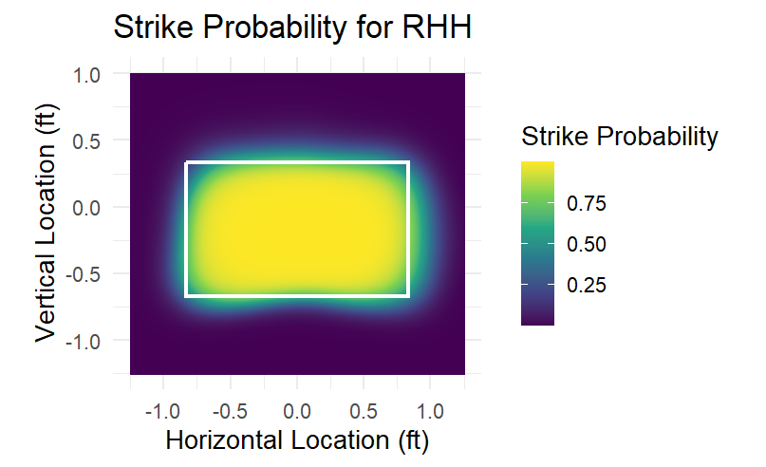
Determine Strike Probabilities
Model Choice:
  GAM to capture smooth, non-linear effects
  Ideal for strike zone modeling, where location effects are highly non-linear
  Chosen over black-box models (like XGBoost) to retain interpretability of strike probability surfaces and control complexity via penalized smoothing
Modeling Decisions:
  Split RHH and LHH — asymmetric zones
  Estimates league average strike probability (not catcher specific) to isolate framing via residuals
  Basis dimension k = 55 chosen for k-index ≈ 1
Predictors:
  Plate location (smoothed using GAM)
  Pitch characteristics (movement and velocity)
  Game state (outs, count, baserunners, score)

Slide 4
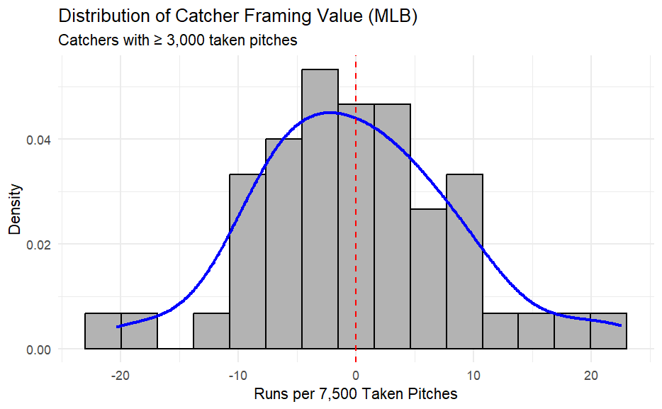

Quantifying Framing Value
Framing Value Definition:
Residual = Actual Call − P(Strike)
Summed residuals by catcher yields extra strikes gained, isolating catcher impact after controlling for context
Noise at pitch level, but stable over large samples
Converting Strikes to Runs:
  Context-neutral: Extra strikes * 0.125 runs (Baseball Savant)
Seasonal Scaling & Sample Control:
  Scaled to runs per 7,500 taken pitches (roughly a full season)
  Restricted to catchers with ≥ 3,000 pitches to limit small-sample noise
  Measures sustainable framing skill

Slide 5
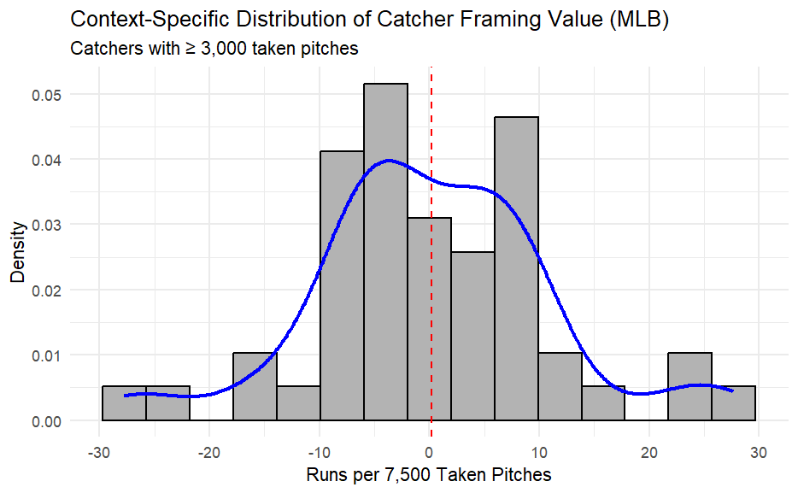

Context-Specific Framing Value (Run Expectancy)
Why Two Framing Metrics?:
  Contextual measures on-field impact
Converting Strikes to Runs:
  Run expectancy change (update count, base state, outs)
Interpretation:
  More variance due to uneven exposure to high-leverage situations
  Little evidence of persistent “clutch” framing ability
Why It Matters for Challenges:
  Most affect high-leverage pitches
  Best captures actual runs gained or lost
  Not used for skill evaluation, but essential for impact assessment

Slide 6
2) Impact of Challenge System
Determined using XGBoost Models

Slide 7
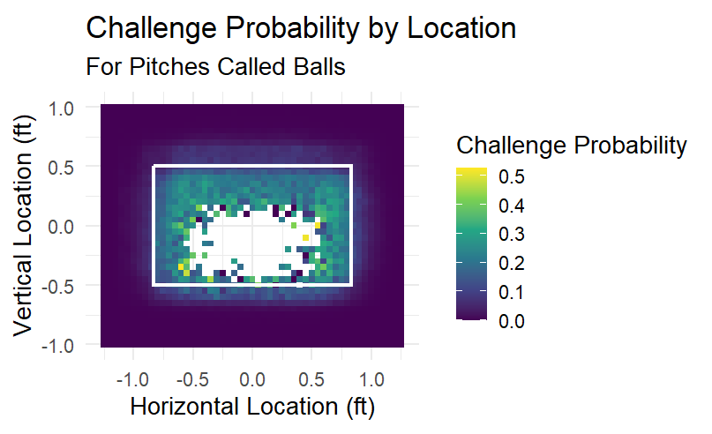
Estimating When Teams Challenge
Key Idea:
  Challenges are constrained (2 per game) and used strategically
  Most egregious calls are most likely to be challenged
Model:
  XGBoost binary classifier
  Trained on AAA data
  Target: Was the pitch challenged?
Inputs:
  Pitch location
  Leverage (count, inning, base state, score)
  Challenges remaining
Why XGBoost?
  Captures non-linear interactions (location, leverage)
  Handles rare events (challenges are only about 2% of pitches)
  Outperforms parametric models due to increased flexibility

Slide 8
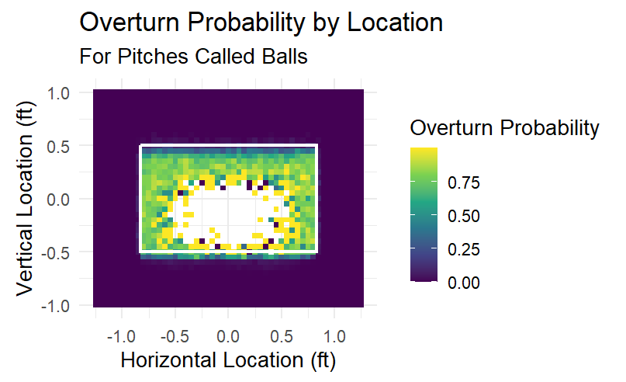
Estimating Overturn Probability
Key Idea:
  Accuracy depends on how objectively “wrong” the call was — borderline calls sometimes preserved
Model:
  XGBoost binary classifier
  Trained on challenged pitches only
  Target: Was the challenge successful?
    Target has to be multiplied by challenge probability to get total overturn probability
Key Inputs:
  Pitch location & initial ball/strike call
  True strike indicator (using zone coordinates)
Result:
  Overall overturn probability ≈ 1% of all pitches
  High confidence overturns only occur on clearly incorrect calls
  Assumes similar accuracy to MiLB

Slide 9
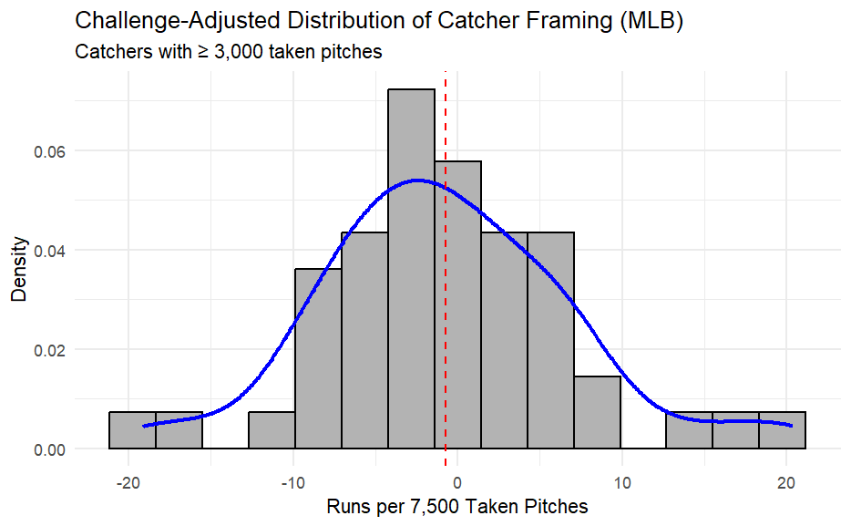

Effect of Challenges on Framing Skill
Key Findings:
  Distribution remains bell-shaped and centered near 0
  Mean remains near zero, but variance decreases
  Compression toward the mean
  Framing is reduced but not eliminated
  SD decreases by 10–15%
Interpretation:
  Elite framers lose 10–20% of impact
  Poor framers benefit from fewer extreme negative outcomes (5–15% more runs)
  Framing remains valuable due to challenge limits

Slide 10
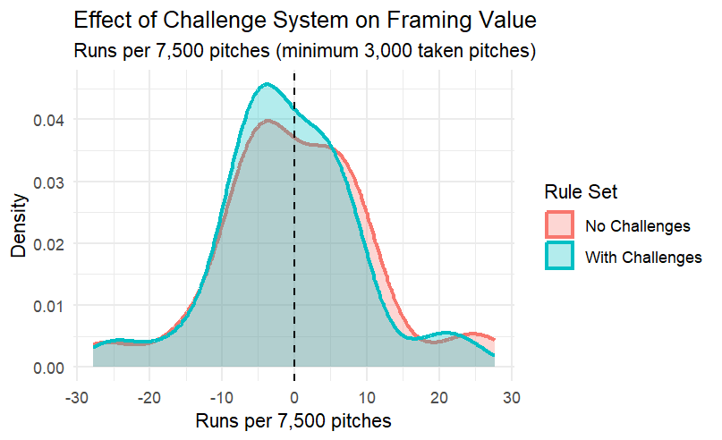
Effect of Challenges on Framing Skill Visualization

Slide 11
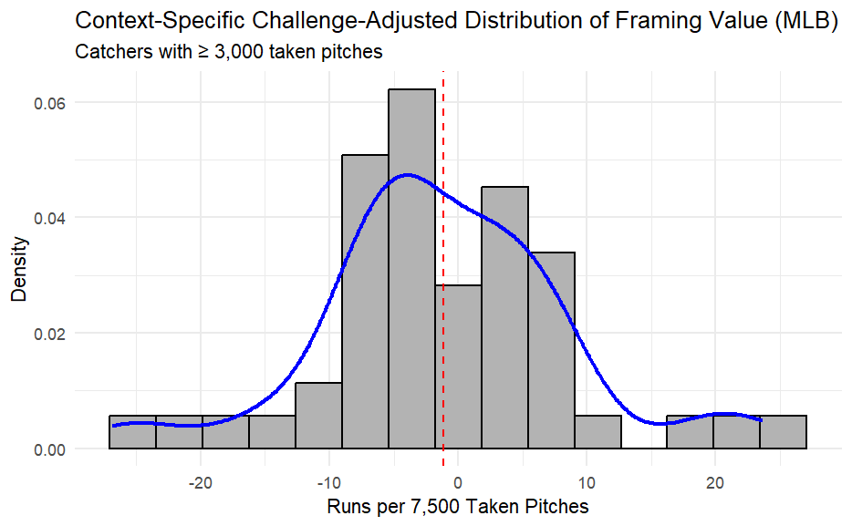

Effect of Challenges on In-Game Impact
Why Context Matters:
  Challenges target high-leverage pitches
  Context-specific framing captures real run impact
Takeaway:
  Elite catchers lose more value than weak catchers gain
  Challenges reduce magnitude of impact
  Framing retains most of its seasonal impact
    Impact reduction is greater than player-specific reduction — a few bad calls are less likely to have devastating impacts to teams
  With challenges, the most hurt teams lose 4-5 runs a season (context-adjusted)

Slide 12
3) Catchers Most Affected by Challenge System

Slide 13
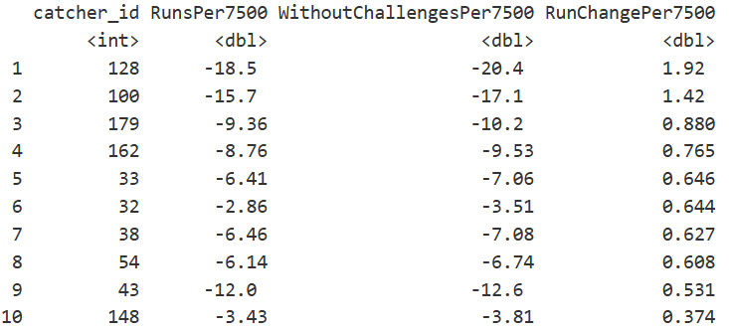
Impact of Challenge System — Most Benefited Catchers
Considerations:
  Based on residual-based framing model (captures skill, not leverage)
  Only catchers with ≥3,000 pitches included (rate stat)
Takeaways:
  Smaller impact: challenge system reduces extreme outcomes by 0.5–2 runs per season
  Benefited Catchers: Poor framers who can now get egregious ball calls overturned

Slide 14
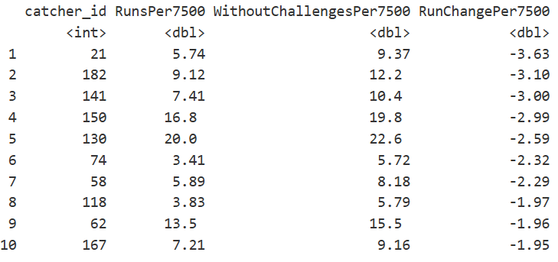
Impact of Challenge System — Most Hurt Catchers
Takeaways:
  Challenge system reduces extreme outcomes by 2–4 runs per season
  Hurt Catchers tend to have high framing impact — framed strikes are easier to overturn, especially for pitches far outside the zone
  Overall framing value compressed toward mean
Additional Impact:
  Strongest players are slightly penalized by increased competition — reduced impact of poor framing makes some marginal catchers become viable roster options if they have a strong bat or other defensive skills

