Slide 1

Notes:
Ben

Slide 2
PROJECT OVERVIEW
BlueBox is a DVD and video game rental business
  Kiosks nationwide
  100,000+ customers
Our goal: Develop a database for BlueBox that includes information on:
  Inventory
  Customers and payment methods
  Employees and vendors
Notes:
Ben

Slide 3
VISION
BlueBox Database
Inventory of DVDS and games
Tracking customer rentals
Membership tier system
Management reporting interface
  Marketing
  Rental Inventory
  Vendors
Notes:
Ben

Slide 4
DATABASE DEVELOPMENT
Conceptual Model
ERD
Revisions
Final ERD & Conceptual model
Input from Prof. Nolan: Eliminate LINE_ITEM table
Changes during data generation: Add gender, overdue, etc…
Notes:
Ben

Slide 5
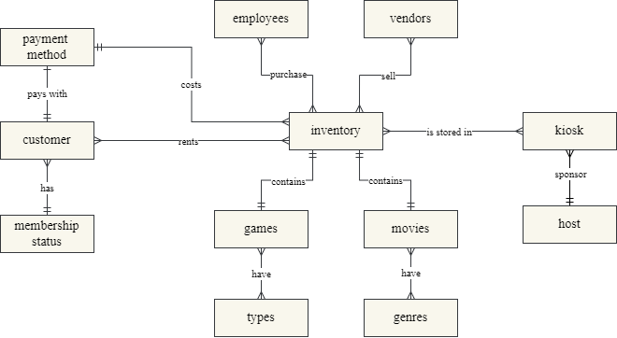
CONCEPTUAL MODEL
Notes:
Kaitlyn

Slide 6
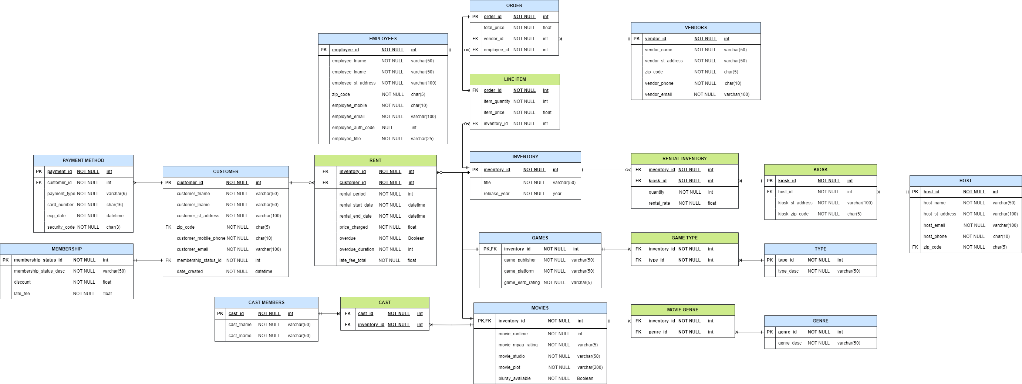
ERD – PHASE 1
Notes:
Kaitlyn

Slide 7
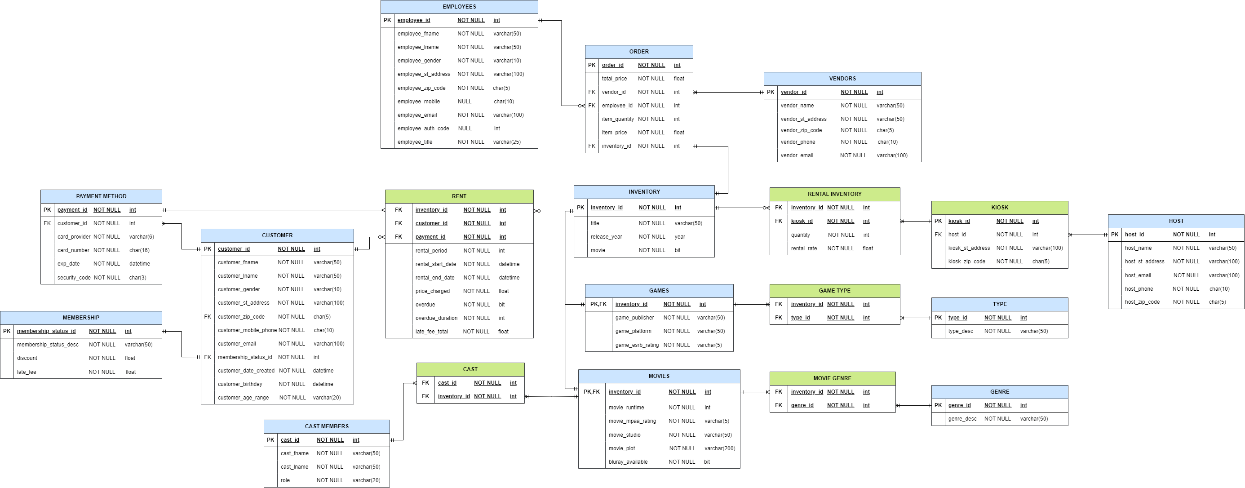
Merged ORDER and LINE ITEM
FINAL ERD
Notes:
Kaitlyn

Slide 8
DATA GENERATION
_|_|_|_| _|
_| _|_|_| _| _| _|_| _| _|_|
_|_|_| _| _| _|_| _|_|_|_| _|_|
_| _| _| _| _| _| _|
_| _|_|_| _| _| _|_|_| _|
Packages Used:
  Numpy random number generator
  Faker
Randomly generated customer, vendor, employee, payment, and inventory data
Data was generated as a list of lists, then written to a CSV file
Notes:
Ruth
Structure of the database → fake data
Numpy
Faker – python package
Fake people, payment methods, businesses
Wrote to list of lists

Slide 9
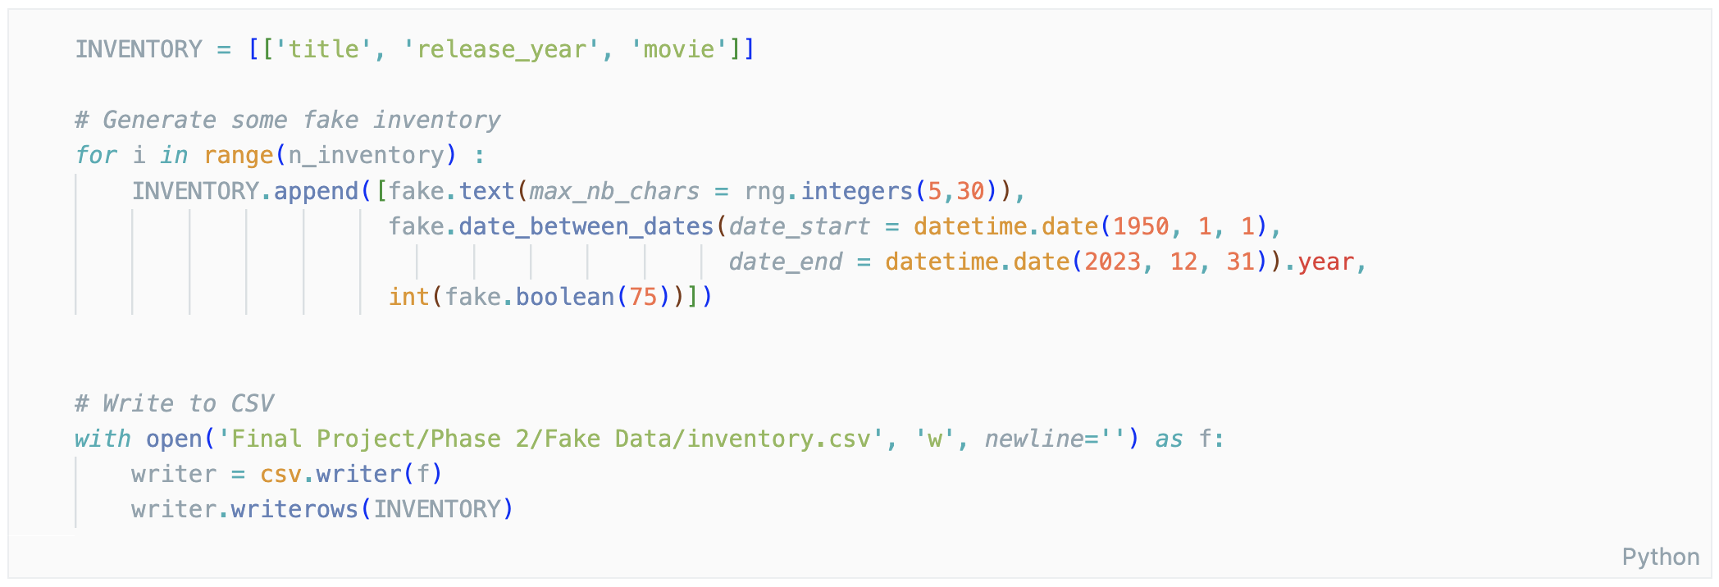
Title: Fake text with a random number for approximate length
SAMPLE FACT DATA GENERATION
Notes:
Ruth
Sample data generation for fact table
Notice there’s no need for inventory ID- SQL server automatically generates the column and increments the PK
Using faker methods to get:
Text for title
Dates for release date

Slide 10
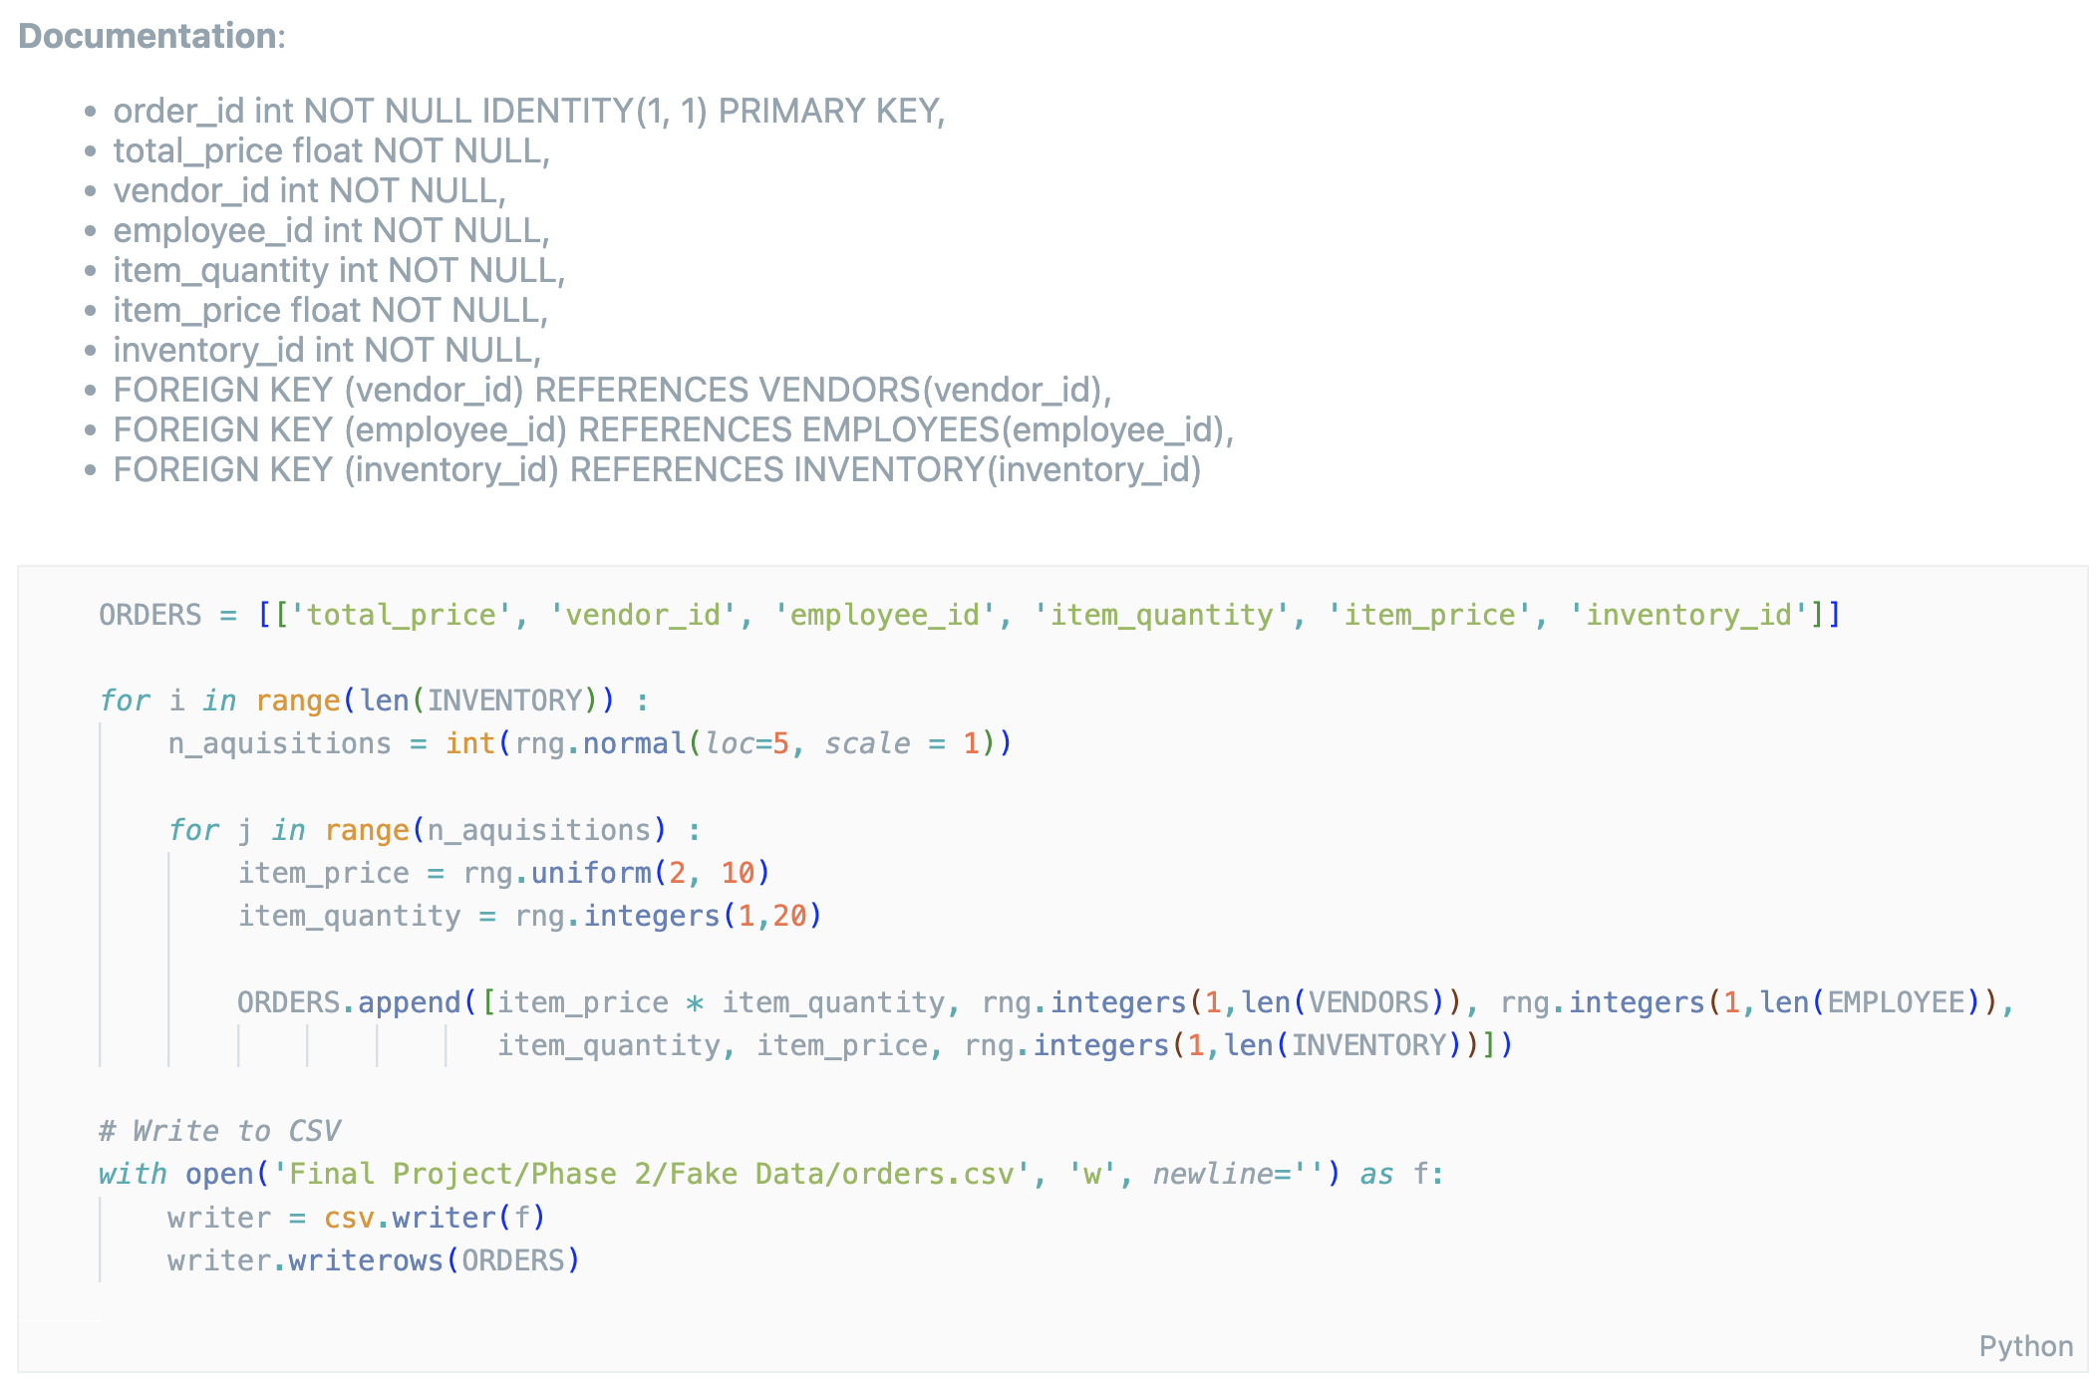
SAMPLE BRIDGE DATA GENERATION
Notes:
Ruth
More complex table
Bridge table data generation
Biggest takeaway here is foreign keys
RNG generates integers between 1 and max length
Ensures referential integrity

Slide 11
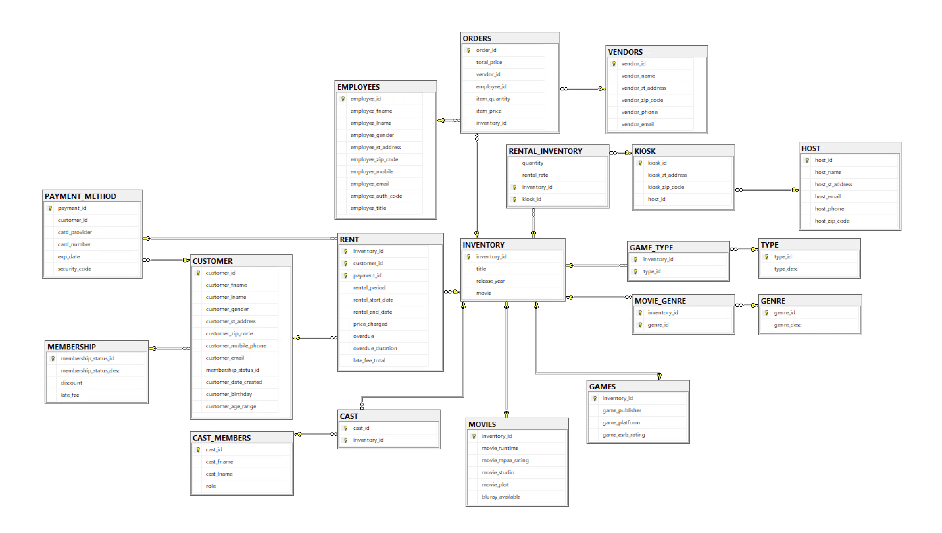
SQL SERVER DATABASE DIAGRAM
Notes:
Ben - talk about the SQL server create statements too

Slide 12
IMPORTING DATA
Microsoft Visual Studio Integration Services Project
Imported data from 19 flat CSV files
Exported to Microsoft SQL server
Notes:
Ben

Slide 13
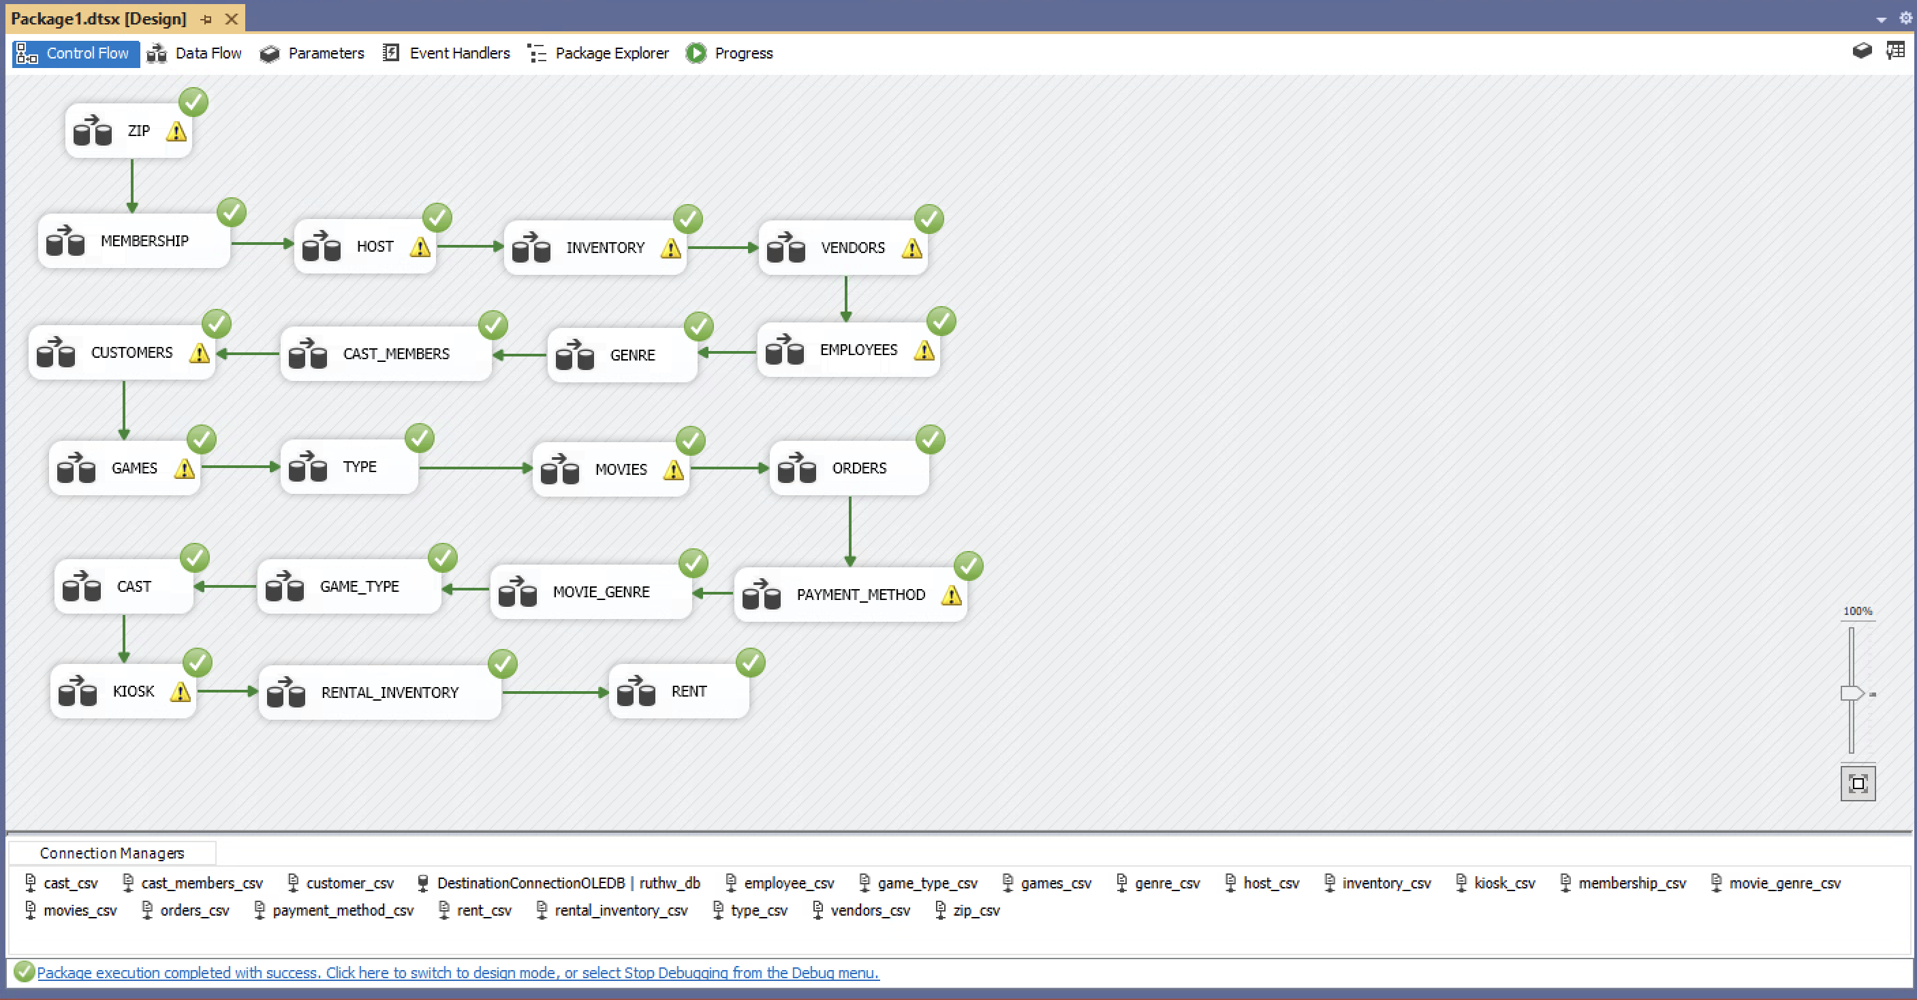
VISUAL STUDIO WORKFLOW
Notes:
Ben
Microsoft Visual Studio Integration Services Package
Each CSV imported as a flat file, then exported to SQL server

Slide 14
REPORT GENERATION
Accessed SQL via Python and `pyodbc`
General reports were built from generic queries
User reports were built from dynamic queries (i.e queries with variables)
Graphs were generated using `matplotlib` and `seaborn`
Reports were written to markdown documents
Notes:
Ruth
Once data in SQL server
Get the requested data into python using pyodbc
General reports, generic queries
User reports dynamic queries
Exported raw data tables and graphs
Used markdown
Versatile – pdf, word, html
Easy to format tables in

Slide 15
REPORT GENERATION
 | Inventory Report | Vendors Report | Marketing Report
General Report | + Most popular - Movies - Games - Studio - Cast - Directors - Writers - Actors | + Most utilized vendors + Most popular items (DVDs or games) sold by each vendor + Top genre from each vendor | + Overview of customer demographics (age, gender, location) + Overview of genre preferences in different demographics + Supporting graphs
User Report | n/a | n/a | User may select product type, genre, age, region, and gender
Notes:
Ruth
What is most useful to reporting departments
Inventory: what’s most popular, what to buy more/less of
Vendors: who we buy most from, what they sell us
Marketing: Customer demographics and preference
User may generate more granular data for differen demographics

Slide 16
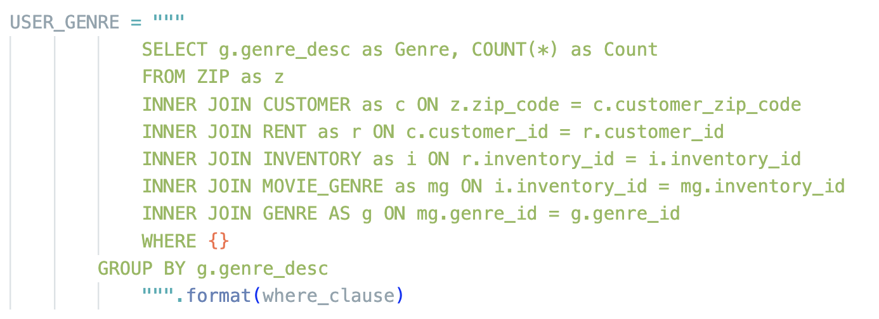
SAMPLE DYNAMIC QUERY
Notes:
Ruth
Dyanmic querying
Takes input on product, region, genre, gender , age returns a granular table

Slide 17
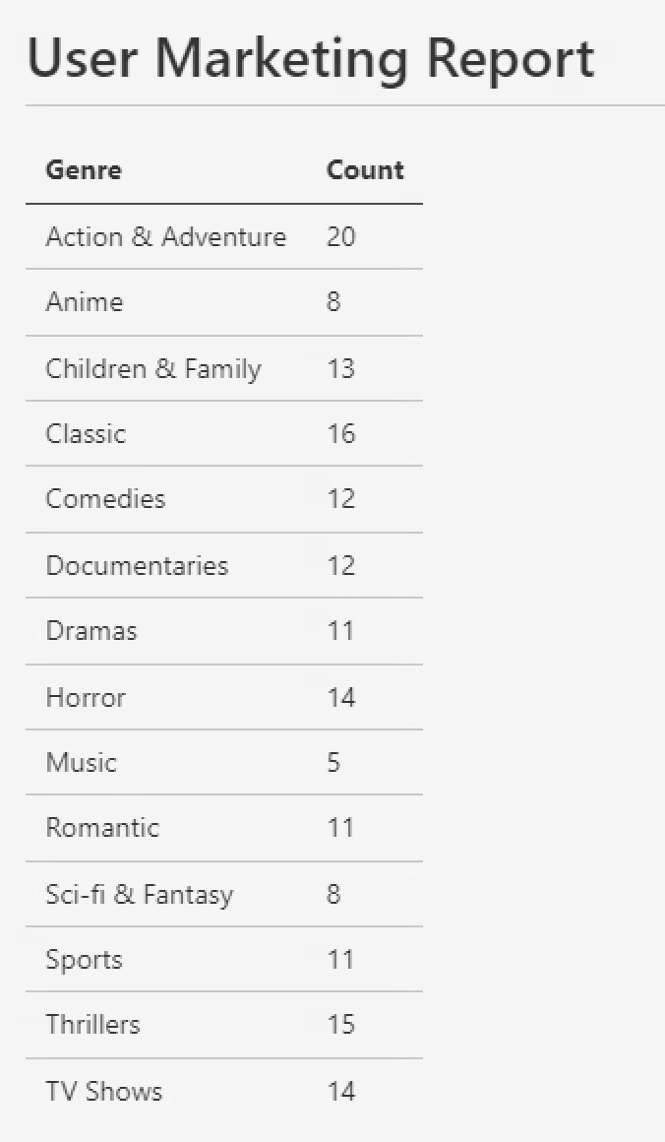
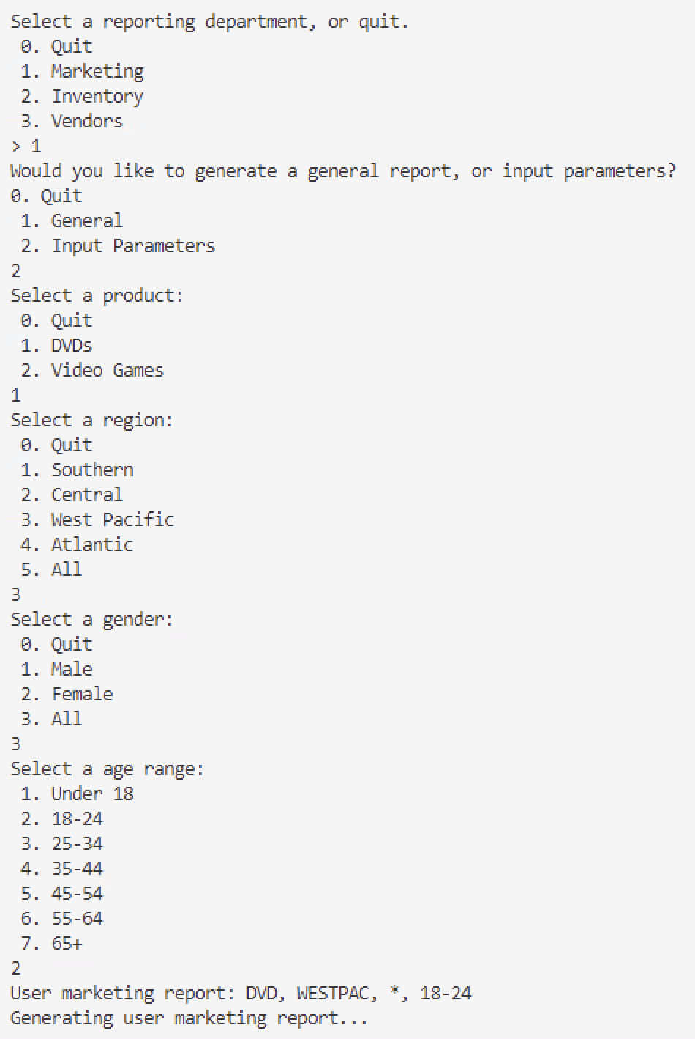
Product: DVDs
Region: West Pacific
Gender: All
Age group: 18-24
SAMPLE USER REPORTS
Notes:
Ruth
Example of process in real application

Slide 18
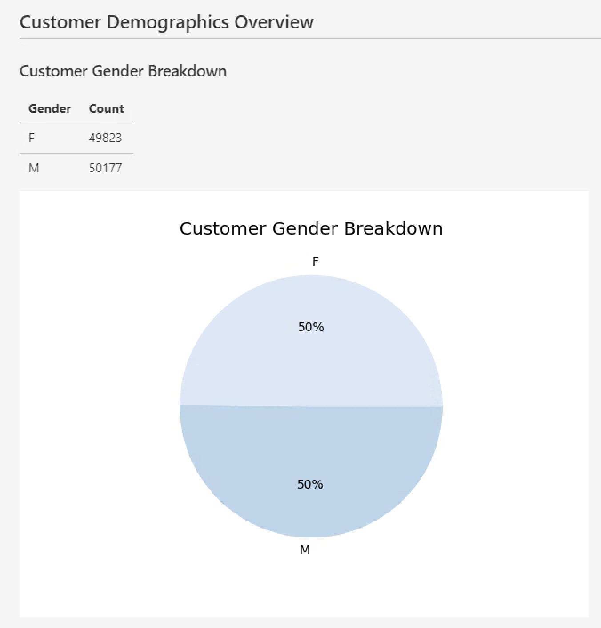
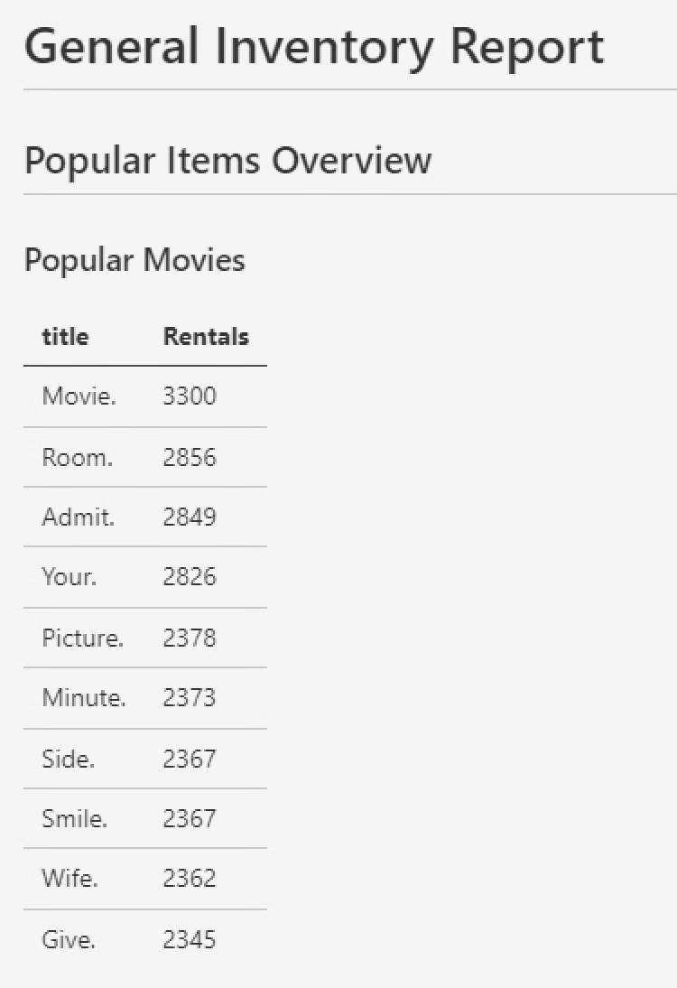
SAMPLE REPORTS
Notes:
Ruth
- General reports

Slide 19
USER INTERFACE
Initially designed a Windows Forms .NET interface in Visual Studio
Difficulties with python back-end
Transitioned to a text-based python interface
  User navigates by entering numbers corresponding to different choices
Notes:
Kaitlyn

Slide 20
CHALLENGES
Generating data with the correct logical relations
  Foreign key mismatches
Visual Studio
  Importing data in Visual Studio
  Connecting the user interface to Visual Studio
Late stage pivot to text-based interface
Notes:
Kaitlyn

Slide 21
LESSONS LEARNED
New appreciation for people who work with databases
  There are a lot of things to take into account
More experience in SQL and designing an interface
Notes:
Kaitlyn

Slide 22
FUTURE WORK
Create a more visually pleasing and interactive interface
Provide reports regarding sales and employees
Allow for more customizability and specificality for reports
Notes:
Kaitlyn

Slide 23
THANK YOU!
Notes:
Kaitlyn

