Slide 1
Playful Acquisition of Basic Behavioral Skills
FIAS Winter School
Amr Almaddah, Jimmy Baraglia, Fabien Benureau,
Chrisantha Fernando, Quan Wang
Students
Georg Martius, Ralf Der
supervisors

Slide 2
The Playful Machine
Ralf Der, Georg Martius
Theoretical Foundation and Practical Realization of Self-Organizing Robots
Springers
Cognitive Systems Monographs, Vol. 15
Many illustrations in this presentation
are shamelessly taken from this book.

Slide 3
Homeokinesis is trying to actively investigate
the perturbations rather than canceling them out
This is an exploration heuristic

Slide 4
What Ralf showed Monday was not homeokinesis
But it is close enough to be considered the same in the context of this presentation

Slide 5
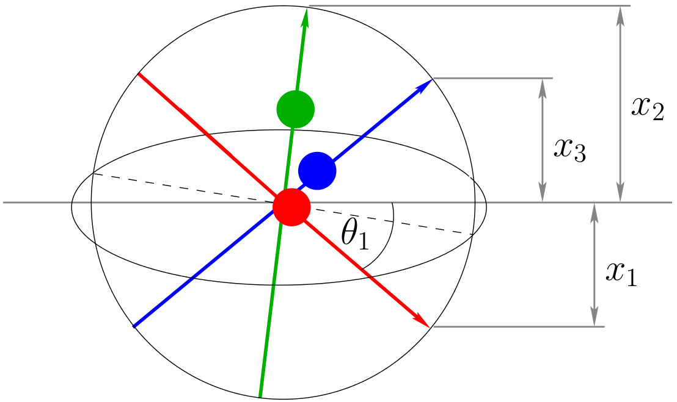
Spherical
A robot that goes around in circles

Slide 6
Homeokinesis in 4 slides*
and 4 equations
*this one not included

Slide 7
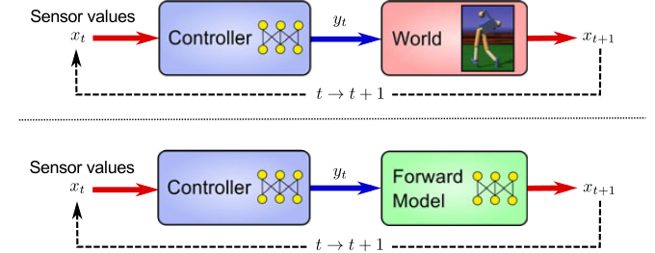
Sensorimotor Loops
the reality, the model

Slide 8
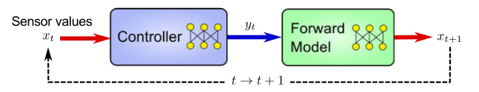


K controller
M model
(one)
(two)

Slide 9


Homeokinesis : find ν such that
t
(three)
Since Ψ is probably not inversible, define ν as
t
(four)

Slide 10
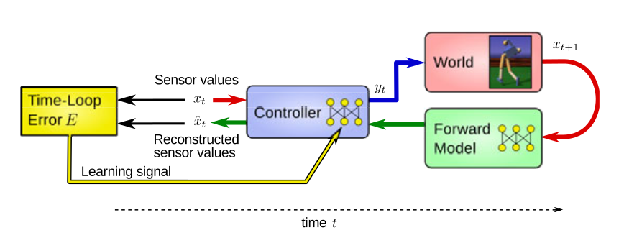
The norm of ν is the time-loop error
t

Slide 11
Take home message
Homeokinesis minimize an error measure that is proportional to the predictability and inversely proportional to the instability

Slide 12
Where to go from there ?
Homeokinesis is an exploration heuristic
A. It does not retain acquired skills
B. It does not try to learn anything specific

Slide 13
First idea
Clustering
also known as “the back-up plan”

Slide 14
Learning
1. Run a homekinesis simulation
2. Capture the state of the controller at regular intervals
3. Put them in a database
4. At the end of the simulation, clusterize.

Slide 15
Reusing skills ?
1. Deactivate learning
2. Pick a cluster center
3. Set it as the current controller.
4. Observe

Slide 16
Live Demo

Slide 17
Video

Slide 18
Takeaway
1. Correctly identified different behaviors
2. Reuse is possible, but subject to a favorable context
3. Effectively created a set of skills

Slide 19
Second idea
Echo State Network
a.k.a. “satellite memory”

Slide 20
Homeokinesis can explore several behavior
But it is not storing any of them

Slide 21

The ESN
Our idea were to add long term memory to do that, we used an ESN
Inputs
(I)
Outputs
(O)
Weights (Wi)
Weights (Wo)

Slide 22
Learning phase
Sensors values
Motor commands values
The ESN is learning by observing as a satellite

Slide 23
Controlling phase
yt
Sensors values
Motor commands
The ESN send the motor signal instead of the controller

Slide 24
Some video of the recoded behaviors

Slide 25
Third idea
Reward Driven E.S.N.
a.k.a. “Adaptive Learning”

Slide 26
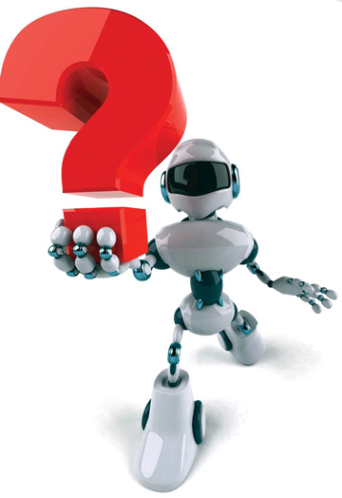
Motivation
1. Acquiring adaptive learning skills
2. Maximizing the learning rate for beneficial behaviors
3. Minimizing exploratory actions in low rewards regions
4. Rational behavior transition.

Slide 27
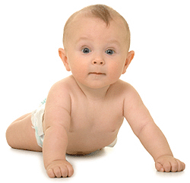
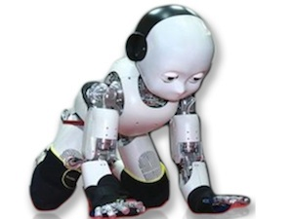
Approach
Reward driven reinforcement learning by employing adaptive learning rate for the echo state network

Slide 28
Learning phase
R.L. Control Unit
E.S.N
Sensors values
Learning
rate
Motor commands values

Slide 29
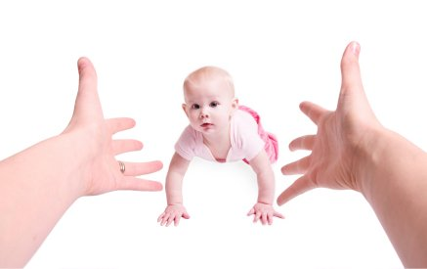

Slide 30
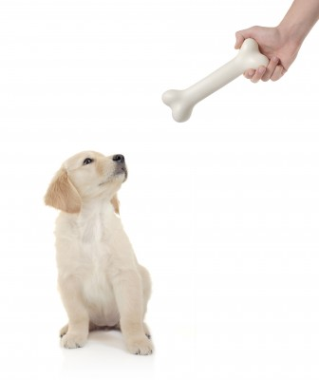
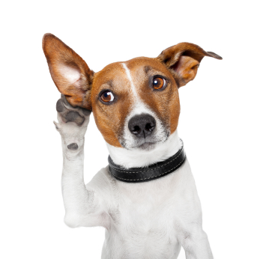
Video demonstrating
different skills learned by
our robot dog
(4min)

Slide 31
Fourth and last idea
Darwinian Neurodynamics
a.k.a. “Selecting”

Slide 32
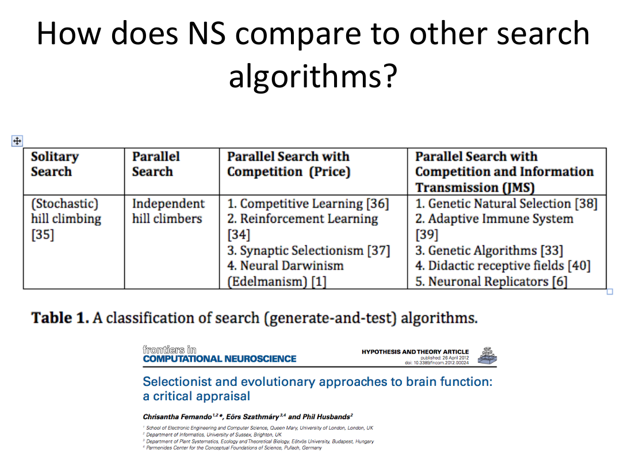

Slide 33
Thanks
To Georg and Ralf, our supervisors, for their patience and enthusiasm.
To Jochen, for everything.
To Gaby, for making any of this and every of this possible.

