Slide 1
Playful Acquisition of Basic Behavioral Skills
FIAS Winter School
Georg Martius, Ralf Der
supervisors
Amr Almaddah, Jimmy Baraglia, Fabien Benureau,
Chrisantha Fernando, Quan Wang
students

Slide 2
Homeokinesis is trying to actively investigate
the perturbations rather than canceling them out
This is an exploration heuristic

Slide 3
What Ralf showed Monday was not homeokinesis
But it is close enough to be considered the same in the context of this presentation

Slide 4
Homeokinesis in 4 slides*
and 4 equations
*this one not included

Slide 5
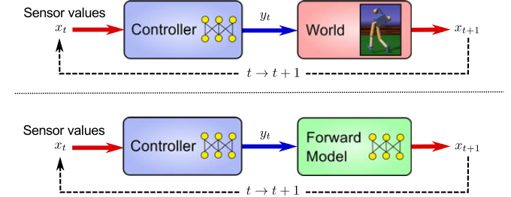
Sensorimotor Loops
the reality, the model

Slide 6
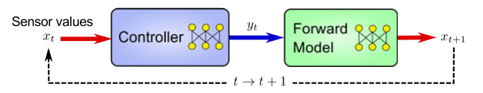


K matrix
M matrix
(one)
(two)

Slide 7


Homeokinesis : find ν such that
t
(three)
with the constraint that
(four)

Slide 8
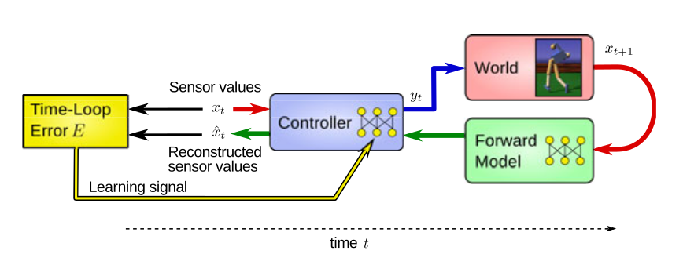
The norm of ν is the time-loop error
t

Slide 9
Where to go from there ?
Homeokinesis is an exploration heuristic
A. It does not retain aquired skills
B. It does not try to learn anything

Slide 10
First idea
Clustering
also known as “the back-up plan”

