Slide 1
Playful Acquisition of Basic Behavioral Skills
FIAS Winter School
Georg Martius, Ralf Der
supervisors
Amr Almaddah, Jimmy Baraglia, Fabien Benureau,
Chrisantha Fernando, Quan Wang
students

Slide 2
The Playful Machine
Ralf Der, Georg Martius
Theoretical Foundation and Practical Realization of Self-Organizing Robots
Springers
Cognitive Systems Monographs, Vol. 15

Slide 3
Homeokinesis is trying to actively investigate
the perturbations rather than canceling them out
This is an exploration heuristic

Slide 4
What Ralf showed Monday was not homeokinesis
But it is close enough to be considered the same in the context of this presentation

Slide 5
Homeokinesis in 4 slides*
and 4 equations
*this one not included

Slide 6
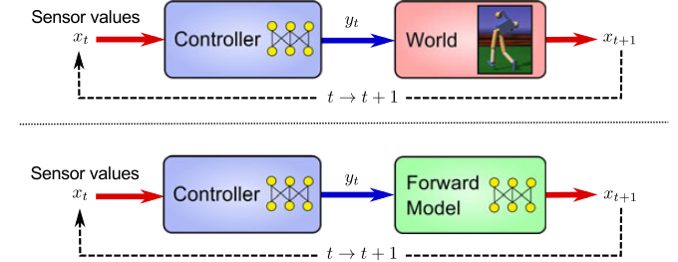
Sensorimotor Loops
the reality, the model

Slide 7
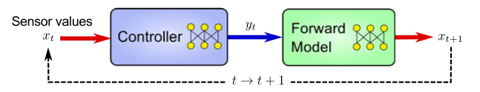


K matrix
M matrix
(one)
(two)

Slide 8


Homeokinesis : find ν such that
t
(three)
with the constraint that
(four)

Slide 9
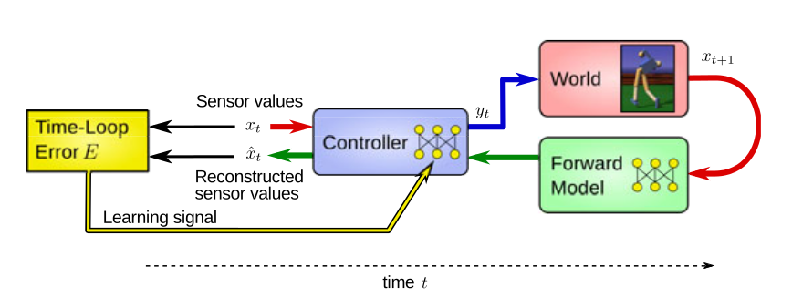
The norm of ν is the time-loop error
t

Slide 10
Where to go from there ?
Homeokinesis is an exploration heuristic
A. It does not retain aquired skills
B. It does not try to learn anything

Slide 11
First idea
Clustering
also known as “the back-up plan”

Slide 12
Learning
1. Run a homekinesis simulation
2. Capture the state of the controller at regular interval
3. Put that in a database
4. At the end of the simulation, clusterize.

Slide 13
Reuse
1. Deactivate learning
2. Pick a cluster center
3. Set it as the current controller.
4. Observe

Slide 14
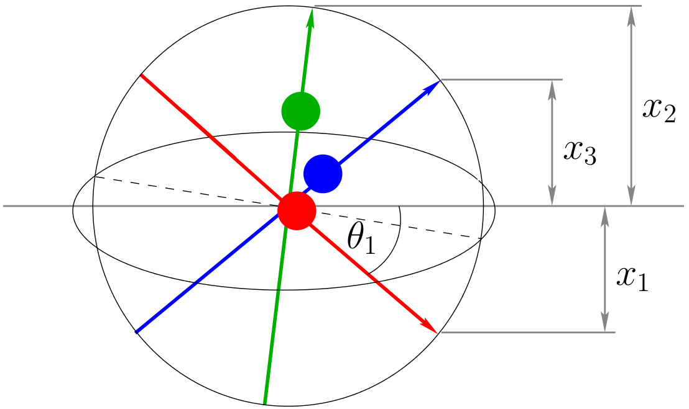
Spherical
A robot that goes around in circles

Slide 15
Live Demo

