Slide 1
Playful Acquisition of Basic Behavioral Skills
FIAS Winter School
Georg Martius, Ralf Der
supervisors
Amr Almaddah, Jimmy Baraglia, Fabien Benureau,
Chrisantha Fernando, Quan Wang
students

Slide 2
Homeokinesis is trying to actively investigate
the perturbations rather than canceling them out
This is an exploration heuristic

Slide 3
What Ralf showed Monday was not homeokinesis
But it is close enough to be considered the same in the context of this presentation

Slide 4
Homeokinesis in 4 slides*
and 4 equations
*this one not included

Slide 5
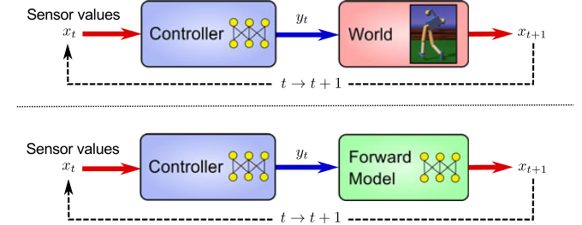
Sensorimotor Loops
the reality, the model

Slide 6
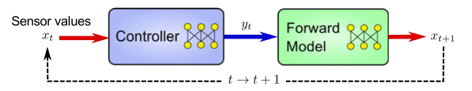


K matrix
M matrix
(one)
(two)

Slide 7


Homeokinesis : find ν such that
t
(three)
with the constraint that
(four)

Slide 8
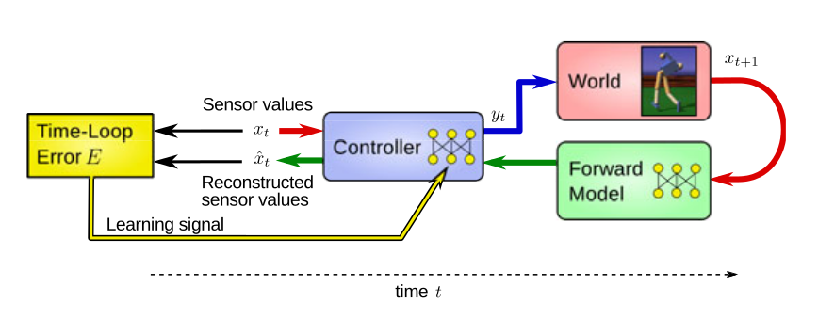
The norm of ν is the time-loop error
t

Slide 9
Where to go from there ?
Homeokinesis is an exploration heuristic
A. It does not retain aquired skills
B. It does not try to learn anything

Slide 10
First idea
Clustering
also known as “the back-up plan”

Slide 11
Second idea
ESN
also known as “satellite memory”

Slide 12
The former model shown several behavior
But the system is not storing any of them
*this one not included

Slide 13
The ESN
Our idea were to add more long time memory To perform this goal we used an ESN
Entry
Output
Only the Output are trained
*this one not included

Slide 14
Learning phase
Sensors values
Motor commands values
The ESN is learning by observing as a satellite

Slide 15
Controlling phase
yt
Sensors values
Motor commands
The ESN send the motor signal instead of the controller

Slide 16
Some video of the recoded behaviors

