Slide 1
CIT-260 Week 7

Slide 2
Objectives
At the completion of this topic, students should be able to:
Write programs that correctly
* Declare and use single and multidimensional arrays
* Use loops to manipulate array elements
* Pass arrays to methods
Explain what an out of bounds error is and why it occurs
Declare and use single and 2-dimensional arrays in a program
Explain the difference between a linear and a binary search
Write a linear search routine
Write a binary search routine
Write a bubble sort routine

Slide 3
MOTIVATION
Write a program that does the following:
Reads in 10 integer values from the user
Displays the sum of the values
Adds 5 to each value entered by the user
Displays the new values after adding 5,
and the sum of the new values

Slide 4
Scanner keyboard = new Scanner(System.in);
int number1 = 0;
int number2 = 0;
int number3 = 0;
int number4 = 0;
. . .
System.out.println(“Enter in an integer value: )”;
number1 = keyboard.nextInt();
System.out.println(“Enter in an integer value: )”;
number2 = keyboard.nextInt();
System.out.println(“Enter in an integer value: )”;
number3 = keyboard.nextInt();
. . .

Slide 5
int sum = number1 + number2 + … + number10;
System.out.format(“The sum is %d%n”, sum);
number1 = number1 + 5;
number2 = number2 + 5;
number 3 = number3 + 5;
. . .
System.out.format(“Number 1 = %d%n”, number1);
System.out.format(“Number 2 = %d%n”, number2);
System.out.format(“Number 3 = %d%n”, number3);
. . .
int sum2 = number1 + number2 + … + number10;
System.out.format(“The sum is %d%n”, sum2);

Slide 6
What if I asked you to write a program like
this, but let the user enter 1000 values?
It could get pretty ugly!
Whenever a program deals with long lists of values
that are processed in a common way, think about
using an array to store your values in.

Slide 7
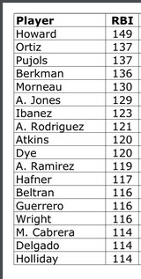
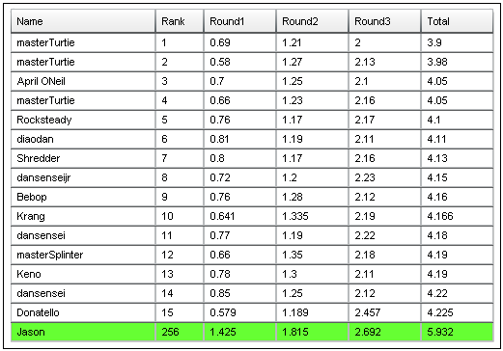
Examples of Tabular data
sports
Game programs

Slide 8
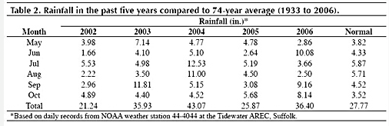
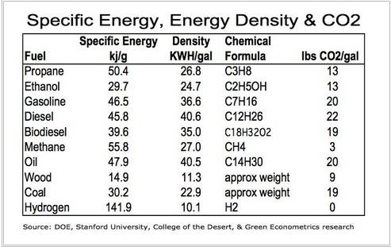
Weather data
Engineering data

Slide 9
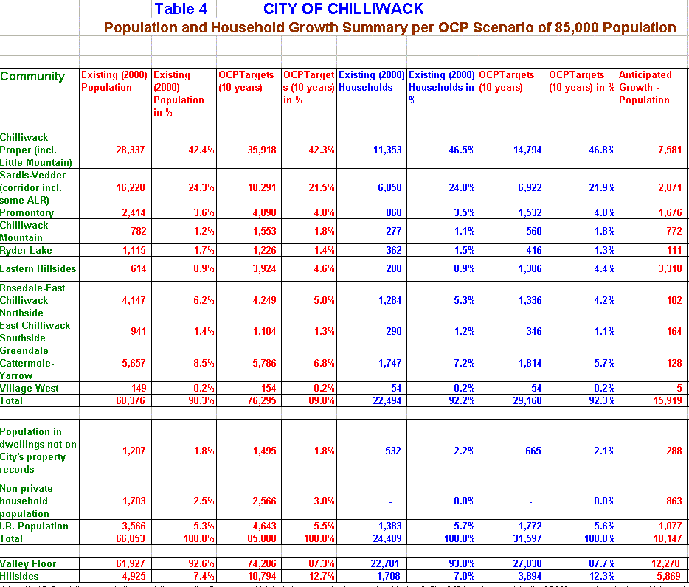
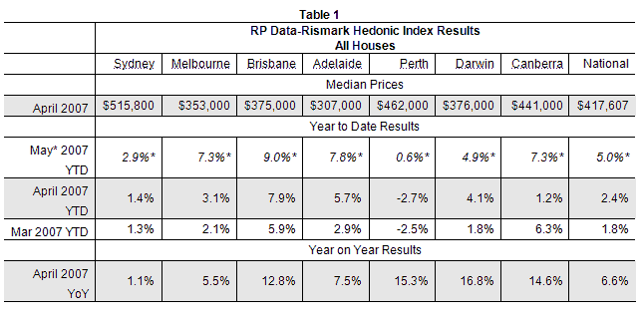
Population data
Sales and marketing data

Slide 10
An array is a list or table of values
An array has a single identifier for all its values
examScores
All values must be of the same type
0
89
Values are stored in consecutive
memory locations. Access is fast.
1
94
2
78
The position where a value is stored
in an array is given by its index.
We sometimes refer to this as the
subscript.
3
93
4
75
5
99
Indexing always begins with zero
6
82
To access an element of an array, we
use the array name, followed by the index
inside of square brackets
int aResult = examScores[8];
7
77
8
53
9
87

Slide 11
examScores
0
89
1
94
2
78
The array index can also use an expression, such as
examScores[n+1];
3
93
4
75
5
99
6
82
7
77
8
53
9
87

Slide 12
index
examScores
base address
1200
89
0
1204
94
1
1208
78
2
examScores[4]
1212
93
3
1216
75
4
Array elements are stored in consecutive memory
locations. The compiler calculates the address
of a specific array element using the equation
address = base address + index * element size
99
5
82
6
77
7
53
8
1200 + 4 * 4
9
87

Slide 13
Declaring an Array
examScores
0
0
data type of array elements
array size
0
1
0
2
int[ ] examScores = new int[10];
0
3
0
4
0
5
Good programming style dictates that we
use a constant for the array size. For example
final int SIZE = 10;
int[ ] examScores = new int[SIZE];
0
6
0
7
0
8
0
9

Slide 14
Arrays are Objects
Array object on the Heap
0
0
0
1
examScores
0
2
0
3
reference
variable
0
4
0
5
0
6
0
7
0
8
0
9

Slide 15
Accessing Array Elements
examScores
examScores
12
0
12
examScores [ 0 ] = 12;
0
1
0
2
0
3
array name
0
4
index
(must be an integer value or
an expression that results in
an integer value )
0
5
0
6
0
7
System.out.println(examScores[0] ) ;
0
8
0
9

Slide 16
Arrays and Loops
A for loop is the preferred tool for
working with an array.
examScores
0
0
. . .
final int SIZE = 10;
final int MULTIPLE = 3;
int[ ] examScores = new int [ SIZE ];
for ( int i = 0; i < SIZE; i++ )
{
examScores[ i ] = i * MULTIPLE;
}
. . .
3
1
6
2
9
3
12
4
15
5
18
6
21
7
24
8
27
9

Slide 17
Arrays and Loops
examScores
. . .
final int SIZE = 10;
final int MULTIPLE = 3;
int[ ] examScores = new int [ SIZE ];
for ( int i = 0; i < SIZE; i++ )
{
examScores[ i ] = i * MULTIPLE;
}
. . .
0
0
3
1
6
2
9
3
12
4
15
5
18
6
Watch for off-by-one errors
The maximum index in an array
is always one less than its size.
7
21
24
8
27
9

Slide 18
Out of Bounds Errors
When a Java program executes a statement that
accesses an array, it checks to make sure that the
element you are trying to access is actually
within the boundaries of the array (0 to SIZE-1).
If it is not, your program will throw an exception.

Slide 19
Initializer lists
int[ ] examScores = { 87, 83, 94, 99, 74, 66, 88 };
The array object is automatically created. The array size
is determined by the number of items in the initializer list.
The elements of the array are set to equal the values in the
initializer list.

Slide 20
Array Elements as Parameters
Array elements can be passed just as any other parameter…
for example
given the method
static void printInteger (int n);
we can pass a single element of an integer array as
printInteger (someData[3]);

Slide 21
Arrays as Parameters
the square brackets tell the compiler
that an array object will be passed.
void PrintEm( int[ ] r )
{
for( int i = 0; i < r.length; i++ )
{
System.out.println( r [ i ] );
}
}
static void main( )
{
int[ ] mine = { 1, 2, 3, 4, 5 };
PrintEm ( mine );
}
}
The Array object has a
length field that contains
the size of the array
Just pass the name of the
array when invoking the method

Slide 22
Partially Filled Arrays
Often in a program, you don’t know how much data
will be stored in an array. So, you make the array
some very large maximum size, and then keep track
of how much data is in the array.

Slide 23
Developing a Program that Uses An Array

Slide 24
Arrays are used most often when writing an application that
deals with tabular data, for example …
Year
Average rainfall (in)
1941
1942
1943
1944
1945
1946
1947
1948
1949
1950
4.5
5.4
3.9
7.1
6.9
7.3
5.8
4.9
4.4
5.1

Slide 25
Suppose that we are given the average amounts of rainfall
for each of ten consecutive years, and we want to find
the average over the ten year period.
Year
Average rainfall (in)
1941
1942
1943
1944
1945
1946
1947
1948
1949
1950
4.5
5.4
3.9
7.1
6.9
7.3
5.8
4.9
4.4
5.1

Slide 26
Since we are going to process each of these data elements
in turn as we do the calculations, an array is a handy way
of storing the data.
Year
Average rainfall (in)
1941
1942
1943
1944
1945
1946
1947
1948
1949
1950
4.5
5.4
3.9
7.1
6.9
7.3
5.8
4.9
4.4
5.1

Slide 27
Declare the array
double[ ] rainFall = new double[10];
rainFall
0
0
0
0
0
0
0
0
0
0

Slide 28
Read the data into the array
(assume that the user enters data from the keyboard)
rainFall
4.5
5.4
3.9
7.1
6.9
7.3
5.8
4.9
4.4
5.1
Scanner keyboard = new Scanner(System.in);
final int SIZE= 10;
for (int i = 0; i < SIZE; i++)
{
System.out.println(“Enter the amount of rainfall”);
System.out.format(“for year %d“, i+1);
rainfall[i] = keyboard.nextDouble();
}

Slide 29
Calculate the average
rainFall
4.5
5.4
3.9
7.1
6.9
7.3
5.8
4.9
4.4
5.1
double sum = 0;
for (int i = 0; i < SIZE; i++)
{
sum += rainfall[ i ];
}
double average = sum / SIZE;

Slide 30
The foreach Loop
Processing each element of an array is such a common
operation, that Java provides a special loop construct to
do this. The foreach loop allows you to access each element
of an array in turn. The foreach loop has two important
restrictions:
* You must process the entire array
* You cannot modify data in the array

Slide 31
The foreach Loop
int[ ] myScores = {56, 78, 81, 93, 21};
. . .
for (int score : myScores)
{
System.out.println( score );
}

Slide 32
Practice
Write a program that does the following:
Creates an array of 10 integer values
Fills the array with random numbers between 0 and 50
Displays the contents of the array
Displays the values that are at an odd index
Displays the values in the array that are odd
Displays the values in the array in reverse order
Uses a method to add the numbers in the array
Uses a method to compute the average of the values in the array

Slide 33
Copying Arrays
Suppose that two arrays were declared as shown:
int[ ] odds = {1,3,5,9};
int[ ] evens = {2,4,6,8};
And you wrote …
odds = evens;
What do you expect would happen?

Slide 34
odds
1
3
5
9
odds = evens;
evens
2
4
6
8

Slide 35
odds
1
3
5
9
odds = evens;
This does what is called
a “Shallow Copy”. That is,
only the reference is copied.
the array data is not copied.
evens
2
4
6
8

Slide 36
odds
1
3
5
9
If you want to copy the array
data, you must use a loop:
for (int i = 0; i < 4; i++)
{
odds[i] = evens[i];
}
evens
2
4
6
8

Slide 37
Two Dimensional Arrays
columns
rows
How we think of a two dimensional array

Slide 38
examScores
student 1
78
89
65
97
student 2
76
79
82
85
student 3
83
89
91
90
exam 1
exam 2
exam 3
exam 4

Slide 39
DECLARING A TWO-DIMENSIONAL ARRAY
int[ ] [ ] examScores = new int[5][5];
this is the number of
columns in the array
two sets of square brackets
are required to declare this
as a two dimensional array.
this is the number of
rows in the array

Slide 40
ACCESSING AN ELEMENT OF A TWO-DIMENSIONAL ARRAY
int topGrade = examScores[3][2];
gets the element of the
array at row3, column 2

Slide 41
USING AN ARRAY INITIALIZER WITH A TWO-DIMENSIONAL ARRAY
int[ ][ ] examScores = {
{78, 89, 65, 97},
{76, 79, 82, 85},
{83, 89, 91, 90}
};
the data in row 1
the data in row 2
the data in row 3
or … on one line
int[ ][ ]examScores = { {78, 89, 65, 97},{76, 79, 82, 85},{83, 89, 91, 90} };

Slide 42
LOOPS AND TWO-DIMENSIONAL ARRAYS
Use nested for loops to process the data in a two
dimensional array. Normally the outer loop goes
through the rows in the loop and the inner loops
goes through a column.
for ( int i = 0; i < STUDENT; i++ )
{
int sum = 0;
for ( int j = 0; j < EXAMS; j++ )
sum = sum + examScores [i][j];
}

Slide 43
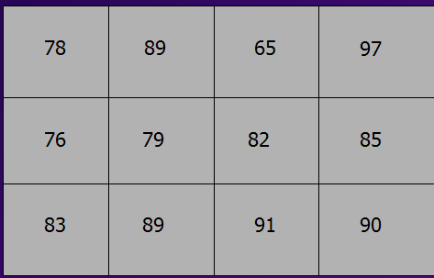
public class TwoDimensions {
public static void main(String[] args) {
final int STUDENT = 3;
final int EXAMS = 4;
// declare an array 3 x 4
int[][] examScores = { {78, 89, 65, 97},{76, 79, 82, 85},{83, 89, 91, 90} };
for ( int i = 0; i < STUDENT; i++ )
{
int sum = 0;
for ( int j = 0; j < EXAMS; j++ )
sum = sum + examScores [i][j];
double avg = ((double)sum)/EXAMS;
System.out.format("Average score for Student #%1d: %.2f%n", i, avg);
}
}//End Main()
}//End class

Slide 44
Practice
Write a program that does the following:
Creates an array that holds the judges scores for 5 gymnasts
There are 3 judges
Gather the judges input
Compute the average score for each gymnast
Display the winning score

Slide 45
Practice
Write a program that does the following:
Declares an array of 6 integers and an array of 6 Strings
Get’s a student name and exam score from the user
Stores the name and score in their respective arrays
Use a method to compute the average score
Prints each student name, their score, and if their score is
- above average
- below average
- equal to the average

Slide 46
Searching and Sorting

Slide 47

Find the person who is 23 years old.

Slide 48
Rules
You may only talk to one person at a time
You may only ask “How old are you?”
The person must respond in years and months

Slide 49
Write down your algorithm

Slide 50
Searching an Array
Linear Search
Binary Search

Slide 51
Linear Search
examScores
A linear search starts at the beginning of the array,
and looks at each element of the array in turn.
Problem: Determine which element in the array
contains the score 87.
72
0
98
1
56
2
87
3
int thisOne = -1;
for (int index = 0; index < SIZE; index++)
{
if (examScores[index] == 87)
thisOne = index;
}
…
64
4
83
5
77
6
91
7
66
8
70
9

Slide 52
Binary Search
examScores
98
91
In general, a binary search is much, much faster than a linear search, but requires that the array be sorted.
87
83
Start in the middle
77
72
Is this the one you are looking for (87)?
70
If not, is this number smaller than 87?
66
In this case it is. Therefore, we can elminate
the entire bottom half of the array. Why?
64
Now try again, picking the middle of the
remaining array elements.

Slide 53
Arrange the people in order of age – youngest to oldest

Slide 54
Rules
You may only talk to one person at a time
You may only ask “How old are you?”
Responses will be in years and months.
You are only allowed to keep track of two people’s
ages at any one time.
5. You may only ask two people to switch places at this time.
6. A person cannot move unless asked to.

Slide 55
Write down your algorithm

Slide 56
Sorting
Sorting means to put data into some specified order.
There are many, many algorithms that have been developed
to sort data. In this section we will mention two of them:
Selection Sort
Bubble Sort

Slide 57
Developing the Selection Sort Algorithm

Slide 58
Selection Sort
Step one:
find the lowest card
in the hand

Slide 59
Selection sort
Step two:
Swap the lowest card with
the left-most card
left-most card

Slide 60
Selection Sort

Slide 61
Selection Sort

Slide 62
Selection Sort

Slide 63
Selection Sort
Now …
Make the second card
The left-most card
left-most card

Slide 64
Selection Sort
Find the lowest card
in the remaining cards

Slide 65
Selection Sort
It is already the
left-most card, so
no swap is required
left-most card

Slide 66
Selection Sort
Now make the third
card the left-most card
Left-most card

Slide 67
Selection Sort
And find the lowest card
In the remaining cards

Slide 68
Selection Sort
Swap it with the
left-most card

Slide 69
Selection Sort

Slide 70
Selection Sort
Make the 4th card
the left-most card

Slide 71
Selection Sort
Find the lowest card
in the remaining cards

Slide 72
Selection Sort
The lowest card is the
left-most card, so no
swap is necessary

Slide 73
Selection Sort
Make the next card
the Leftmost-card

Slide 74
Selection Sort
Lowest remaining card
is the left-most card so
no swap is necessary

Slide 75
Selection Sort
Make the next card the left-most
card. It is the last card, so we are
done

Slide 76
Activity Diagram High Level View
start
Make the left-most card the card to the right of the current left-most card
Find lowest card in hand
Swap it with the left-most card
yes
Is this the last card?
end
Find the lowest card
In the set of cards to the right of the current left-most card
no

Slide 77
BUBBLE SORT
A bubble sort is one of the least efficient sorting algorithms,
but it is one of the easiest to visualize. In a bubble sort you
repeatedly move through all of the elements of an array,
swapping an element with the one next to it, if they are in
the wrong order. A bubble sort uses nested for loops to
accomplish this.

Slide 78
static void bubbleSort(int[] arr) {
// get the length of the array
int n = arr.length;
for(int i=0; i < n; i++) {
for(int j=1; j < (n-i); j++) {
if(arr[j-1] > arr[j]) {
//if out of order, swap them
temp = arr[j-1];
arr[j-1] = arr[j];
arr[j] = temp;
}
}
}
}

