Slide 1
CIT-260 Week 9

Slide 2
Objectives
At the end of this topic, students should be able to:
Describe the object model of programming.
Correctly use the terms encapsulation, abstraction and interface.
Explain the terms simplicity, cohesion, coupling, consistency and clarity.
Demonstrate good class design.
Define the class relationships: association, aggregation, and composition
Correctly use aggregation and composition in class design.

Slide 3
THINKING IN OBJECTS

Slide 4
Dr. Alan Kay, sometimes known as the father of object-oriented programming,
described these characteristics of object-oriented programing when discussing
Smalltalk, the first successful object-oriented programming language.
Everything is an object. Think of an object as a fancy variable; it stores data, but
you can “make requests” of that object, asking it to perform operations on itself.
2. A program is a bunch of objects telling each other what to do by sending messages.
More concretely, you can think of a message as a request to call a method that
belongs to a particular object.
3. Each object has its own memory made up of other objects. Put another way, you
create a new kind of object by making a package containing existing objects.
Thus, you can build complexity into a program while hiding it behind the simplicity
of objects.

Slide 5
Objects model things in the real world. All objects, while being unique,
are a part of a class of objects that have characteristics and behaviors
in common. For example, sparrows, robins, and pigeons are all of the type
bird. In Java, we use the notion of a class to represent a type. Then we
use classes to create objects. We often think about a class as a blueprint
to create an object.

Slide 6
Once a class is defined, you can make as many objects of that class
as you need, and then your program manipulates these objects as if
they are the elements in the problem you are trying to solve.
The requests you can make of an object are defined by its interface.

Slide 7
CLASS ABSTRACTION AND ENCAPSULATION
Remember that a class usually models some thing from the real world.
We say that the class is an abstraction of the thing that it models
because it only presents to us the essential things required to allow
the class to do its work, without having to understand the details of
how the class is implemented. The details of the implementation are
hidden from the user of the class. This is known as encapsulation.

Slide 8
Class Design Guidelines

Slide 9
Simplicity
A class should be a model of just one thing. For example,
do not define a class that represents a student and a teacher.
When designing a class, add only the number of member
methods and data members that are required for the objects
of the class to do their work. Beginning students often put
everything they can think of into a class, but this just makes
the class complicated and the code difficult to work with.

Slide 10
STRONG Cohesion
Have you ever played the game “Which of these does not
belong”? In good class design, it should be clear that all of
the methods and the data in the class belong, and work
together to support the purpose of the class.

Slide 11
Which does not belong
class StudentRoster
{
public addStudent(Student s) { … }
public deleteStudent(infex n) { … }
public getStudent(index n) { … }
public addFacultyMember(String s) { … }
. . .
}

Slide 12
WEAK COUPLING
Coupling is defined as a measure of how strongly one class
is connected to, has knowledge of, or relies on other classes.
In good class design we look for weak coupling – one class
should have few or no dependencies on other classes in
the program. When there is strong coupling
* A change in one class forces changes in others
* It is more difficult to understand a type in isolation
* It is harder to reuse because it depends on others

Slide 13
Consistency
Follow standard Java programming style and naming conventions.
Choose informative names for methods and data fields. Similar
methods should be set up with similar patterns (names, return
types, and parameters).

Slide 14
CLARITY
A class should have a clear reason for existing.
You should design a class so that it imposes no restrictions
on how the class is used. It should be possible for a user of
your class to set the properties of an instance of your class
in any order and with an combination of values, or call methods
in any order.
You should not define a data member of a class that can be
derived from other data members. For example, in a
Rectangle class with data members for height and width,
do not add a data member for area. It can be derived from
height and width.

Slide 15
CLEAR SEPARATION OF INTERFACE AND IMPLEMENTATION
Make all data members private
Create an interface of public methods for accessing/manipulating data
Ensure that all actions leave the object in a valid state
Getters should always return something
Setters should never return anything

Slide 16
CLASS RELATIONSHIPS

Slide 17
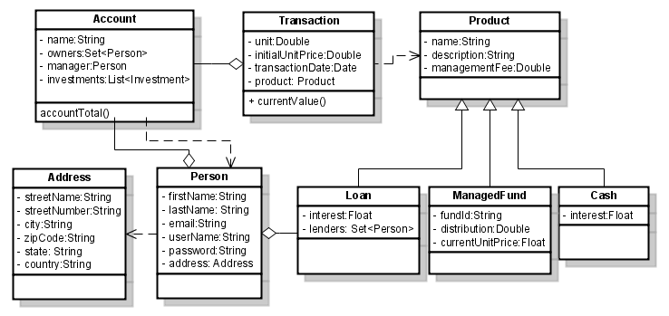
Class Relationships
In real world applications, it is possible to have many different classes
in a program, with complicated class relationships. As an example,
consider this class diagram for a banking application:

Slide 18
In this section we will look at three class relationships:
Association
* Aggregation
* Composition

Slide 19
ASSOCIATION
If two classes are somehow linked together, we say that the
classes have an association relationship. This is the most
general kind of relationship. As an example, consider the
relationship between students and teachers. A student can
have many teachers, and a teacher can have many students.
There is no ownership between the objects and each has its
own lifecycle. All can be created and destroyed independently.

Slide 20
ASSOCIATION
In a class diagram, association is shown as a straight line between
two classes. There may be an optional label that describes the
relationship. Each class in the relationship may specify a multiplicity;
that is, how many objects of the class are involved in the relationship.
0..3
1
Course
teaches
Faculty
Course
teaches
Faculty
This diagram says that a faculty
member teaches a course
This diagram says a course is only
taught by one faculty member, but
a faculty member may teach 0, 1, 2, or
3 courses.

Slide 21
ASSOCIATION
The * symbol in an association means an unlimited number of objects.
15..35
takes
*
Student
Course
This diagram says that a student
may take any number of courses,
but a course must have between
15 and 35 students.

Slide 22
ASSOCIATION
Association may be implemented in many different ways, but if
an object of one class somehow references an object of another
class, there is an association relationship.

Slide 23
AGGREGATION
Aggregation is a special form of association, where all objects
have their own lifecycle, but there is ownership. When an
object belongs to an object of another class, it cannot belong
to any other objects. Aggregation is a has-a relationship.
Department
Teacher
This diagram says that a teacher
belongs to a department. If the
department is deleted, the teacher
still exists.

Slide 24
AGGREGATION
Aggregation is a usually implemented by adding a field in the
owner class that contains a reference to the owned class. In
this example the Department class has an array of references
to Teacher objects.
public class Teacher
{
. . .
}
public class Department
{
private Teacher[ ] teachers;
. . .
}

Slide 25
COMPOSITION
Composition is a stronger form of aggregation, where all objects
have the same lifecycle. When the containing objects is deleted
the contained object also gets deleted.
Person
Heart
This diagram says that a person
has a heart. If the person is deleted
the heart object is also deleted.

Slide 26
INHERITANCE
Inheritance relationships exist when one class is derived from another.
We will talk more about inheritance next week. Inheritance is an is-a
relationship.
Vehicle
Car
This diagram says that the Car
class is derived from the Vehicle
class. A car is-a vehicle.

