Slide 1

Mastering AI Systems
A Professional Guide to LLMs, Prompting Frameworks, & Skills

Slide 2








AI SYSTEMS: A HUMAN ANALOGY
LLM = Brain
RAG = Brain + Books
MCP = Connector
Agent = Brain + Hands
Understands context, reasons through complex instructions, and acts as the computational intelligence core.
Accesses external secure databases and files dynamically to ground model answers in real-world facts.
Model Context Protocol standardizes local connections, linking LLMs directly to file systems and services.
Combines advanced planning loops, native tools, and actions to complete business goals autonomously.
Analogy layout conceptualized in strict reference to visual components from Capture.JPG and Capture_2.JPG.

Slide 3



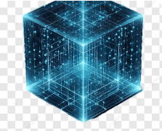
WHY PROMPT FRAMEWORKS? CONTROL VS. CHAOS
The Top 5 Operational Risks of Raw LLMs
1. Confident Hallucinations: Generating technically plausible but completely fictitious facts or source links.
2. Algorithmic Contextual Bias: Over-reliance on latent training data prejudices without objective constraints.
3. Output Structural Drift: Disorganized, raw language outputs that crash downstream system integrations.
Mitigating Hallucinations
Neutralizing Bias
4. Prompt Injection Vulnerabilities: Malicious user queries hijacking agent processing paths.
System guidelines actively balance implicit data weights.
Frameworks isolate instruction paths, restricting generative entropy.
5. Data Leakage Risks: Unconstrained agents repeating confidential files or operational parameters.
Operational frameworks convert unstable open-ended LLMs into deterministic enterprise utilities.

Slide 4






FRAMEWORKS FOR ADMINISTRATIVE TASKS
CRAFT
RTF
PGTC
Context, Role, Action, Format, Tone The premiere all-rounder for creating standard operating procedures (SOPs), templates, and operational drafts.
Role, Task, Format The standard for speed-oriented admin automation, like transforming raw logs into markdown tables.
Persona, Goal, Task, Context Tailored specifically for management coordination, executive schedules, and executive communications.

Slide 5
STRUCTURING ADMINISTRATIVE SUCCESS
Operational Focus
Repeatable Patterns: Guarantees uniform style throughout document generations.
Administrative tasks demand strict, unyielding format conventions and minimal temperature configurations. Randomness causes system formatting failures.
No Over-complications: Eliminates conversational fluff and returns direct, clean files.
Structured prompts establish guardrails that enforce layout consistency, translating unstructured human communications into pristine business reports.
Persona Protection: Aligns communication tones exactly with corporate brand standards.

Slide 6





FRAMEWORKS FOR ENGINEERING TASKS
RISEN
Chain-of-Thought
Few-Shot Prompting
Role, Instructions, Steps, End-goal, Narrowing Imposes sequential pipelines for architectural builds, software designs, and multi-tier databases.
Step-by-Step Logic Progression The global standard for software testing and math. Forces internal execution reasoning before code generation.
Target Schema Replication Injects native code style blocks. Forces the AI to mimic existing file architectures without code pattern drift.

Slide 7

TECHNICAL LOGICAL PROGRESSION
Logical Determinism: Eliminates runtime errors in synthesized scripts.
Engineering Mechanics
By forcing the model to trace logical paths step-by-step, engineers bypass common semantic and structural synthesis errors.
Internal Code Verification: Encourages testing loops during development.
Applying Few-Shot templates next to Chain-of-Thought (CoT) ensures syntax accuracy while bounding computational logic within standard systems.
Strict Boundaries: Narrowing tags prevent use of deprecated or outdated libraries.

Slide 8

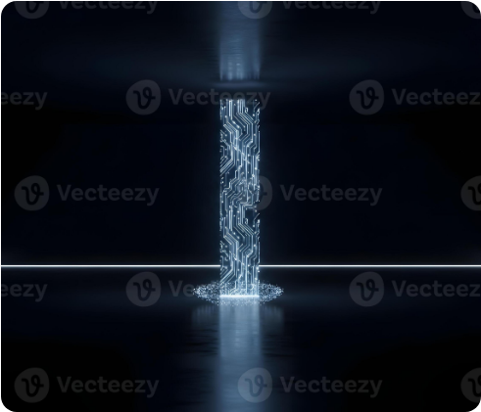
THE THREE PILLARS OF AI SKILLS
Baseline Skill Architecture
Structuring core instructions isolates performance rules, preventing the model from defaulting to basic assistant behaviors.
Pillar 1: Identity & Persona: Establishes implicit backgrounds, expertise boundaries, and core communication style.
Pillar 2: Mechanics & Guardrails: Configures strict negative constraints, formatting, and disallowed wording.
Pillar 3: Knowledge Base: Feeds design schemas and proprietary context files for system replica modeling.

Slide 9
Advanced Skill Architecture
Constructing Production-Grade Prompt Systems

Slide 10



CO-STAR SKILL CONFIGURATION
Context & Objective
Style & Tone
Audience & Response
Defines the workspace setting and permanent operational mission this specific skill system is programmed to achieve.
Sets precise presentation rules (e.g., highly technical, plain) alongside communication boundaries (e.g., analytical, non-apologetic).
Calibrates complex technical language to specific target groups, delivering structured outputs in formats like markdown or JSON.

Slide 11
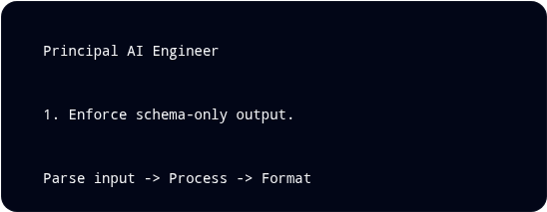
XML-TAGGED MODULAR ARCHITECTURE
The Industrial Standard
Markup symbols (e.g., XML tags) cleanly isolate instruction blocks. Advanced models detect these visual dividers programmatically with extreme accuracy.
This isolation guarantees system logic and system rules remain protected from user inputs, preventing runtime prompt injections.

Slide 12

HOW FRAMEWORKS COMPARE IN PRODUCTION
Framework | Best Used For | Primary Advantage
3 Pillars | Voice design, style cloning & role setup | High readability; easily written and modified.
CO-STAR | Complex strategic planning & business models | Maintains strict alignment with enterprise goals.
XML-Tagged | Complex automation systems & software design | Absolute programmatic control; avoids code injections.

Slide 13
Questions?
Intro to LLMs, Prompting, and Skills Complete
system_mode // prompt_engineering_academy

Slide 14






IMAGE SOURCES
https://static.vecteezy.com/system/resources/previews/019/032/106/non_2x/brain-abstract-digital-human-brain-in-a-distorted-glitch-style-neural-network-iq-testing-artificial-intelligence-virtual-emulation-technology-concept-brainstorm-think-idea-illustration-vector.jpg
Source: www.vecteezy.com
https://png.pngtree.com/thumb_back/fh260/background/20260505/pngtree-abstract-flow-of-glowing-dots-and-lines-in-blue-pink-purple-image_21777984.webp
Source: pngtree.com
https://png.pngtree.com/thumb_back/fw800/background/20260117/pngtree-abstract-high-tech-motherboard-background-featuring-glowing-colorful-neural-network-connections-image_21148954.webp
Source: pngtree.com
https://i.pcmag.com/imagery/articles/06tRsMNeqsP8HkZjg9F5kYo-2.fit_lim.v1774547518.jpg
Source: www.pcmag.com
https://images.stockcake.com/public/3/e/9/3e9120f2-ad42-4846-b2ac-2a65fbc973af_large/neon-glitch-pattern-stockcake.jpg
Source: stockcake.com
https://png.pngtree.com/png-vector/20250808/ourlarge/pngtree-glowing-blue-digital-cube-with-grid-lines-and-nodes-on-isolated-png-image_16792901.webp
Source: pngtree.com

Slide 15

IMAGE SOURCES
https://static.vecteezy.com/system/resources/previews/072/923/056/large_2x/abstract-glowing-digital-column-in-a-dark-futuristic-room-illustrating-the-concept-of-advanced-technology-ai-and-seamless-data-transfer-photo.jpg
Source: www.vecteezy.com

