Slide 1
Secure Systems Control-Flow Integrity
Georgios Portokalidis
Stevens Institute of Technology

Slide 2

ROP Recap
Re
t
u
r
n
o
r
ien
ted
Pro
g
ra
mm
ing

Slide 3
mov (%rcx),%rbx
test %rbx,%rbx
je 41c523 <main+0x803>
mov %rbx,%rdi
callq 42ab00
mov %rax,0x2cda9d(%rip)
cmpb $0x2d,(%rbx)
je 41c4ac <main+0x78c>
mov 0x2cda8d(%rip),%rax
ret
test %rbx,%rbx
mov $0x4ab054,%eax
cmove %rax,%rbx
mov %rbx,0x2cda6a(%rip)
test %rdi,%rdi
je 41c0c2 <main+0x3a2>
mov $0x63b,%edx
mov $0x4ab01d,%esi
callq 46cab0 <sh_xfree>
ret
mov %rax,0x2d2945(%rip)
mov 0x2cda16(%rip),%rax
test %rax,%rax
je 41c112 <main+0x3f2>
movzbl (%rax),%edx
callq 41b640 <time@plt>
mov 0xb8(%rsp),%r15d
cmp 0xc(%rsp),%r15d
mov %rax,0x2d2670(%rip)
je 41c214 <main+0x4f4>
xchg %ax,%ax
mov (%rsp),%rdx
movslq %r15d,%rax
mov (%rdx,%rax,8),%r14
ret
je 41c214 <main+0x4f4>
cmpb $0x2d,(%r14)
jne 41c214 <main+0x4f4>
movzbl 0x1(%r14),%r12d
movl $0x0,0x18(%rsp)
cmp $0x2d,%r12b
je 41c440 <main+0x720>
xor %ebp,%ebp
mov $0x4c223a,%ebx
add $0x1,%r14
jmp 41c1a3 <main+0x483>
cmp (%rbx),%r12b
mov %ebp,%r13d
jne 41c188 <main+0x468>
mov %rbx,%rsi
test %eax,%eax
xchg %ax,%ax
jne 41c188 <main+0x468>
movslq %ebp,%rax
ret
cmpl $0x1,0x4ab3c8(%rax)
je 41c461 <main+0x741>
mov (%rsp),%rcx
add $0x1,%r15d
movslq %r15d,%rdx
mov (%rcx,%rdx,8),%rdx
test %rdx,%rdx
je 41cefd <main+0x11dd>
Gadgets

Slide 4
ROP Recap
Use existing code to disable NX-bit
Then jump to buffer
Stack
Points to
Return address
buf
…
…
ret
…
…
ret
mprotect()
buf
buf
…
…
ret
buf

Slide 5
The Root Causes
No memory safety
No control-flow integrity

Slide 6
Memory Safety
char buf[26];
int i;
for (i = 0; i <= 26; i++) {
buf[i] = ‘A’ + i;
}
No bounds checking
Weakly typed
unsigned short buf[13];
unsigned char *bufp;
int i;
for (i = 0, bufp = buf; i <= 26; i++) {
bufp[i] = ‘A’ + i;
}

Slide 7
Control-flow Integrity (CFI)
call
call
parent_function()
function()
call
ret
next_function()

Slide 8
CFI Violated
call
call
parent_function()
function()
call
ret
next_function()
attacker_function()

Slide 9
CFI Enforcement
call
call
parent_function()
function()
call
check retaddr
ret
next_function()
attacker_function()

Slide 10
Protect Unsafe Transitions
call eax
Function_A:
retn
call Function_A
Safe
Unsafe
jmp eax
jmp Function_A

Slide 11
Control-Flow Graph (CFG)
Shows how control flows in a program
branch
Basic blocks
Any instruction except a branch
branch
branch
branch
branch
branch

Slide 12
CFG with Indirect Branches Only
indirectbranch
Goal: Enforce control-flow graph
indirectbranch
branch
indirectbranch
branch

Slide 13
Enforcing CFI Through IDs
Target address IDs may be…
Embedded in code
Stored separately
See any issue with this?
call eax
Function_A:
[ID_1]
check [ID_1]
retn
[ID_2]
check [ID_2]

Slide 14
Reachable Targets Under CFI
Current CFI solutions disable > 98% of them
Why so many?
Targetable locations
in code pages:
Without
CFI
With
CFI

Slide 15
Reachable Targets Without CFI
Function_A:
Every instruction can be targeted
mov (%rcx),%rbx
test %rbx,%rbx
je 41c523 <main+0x803>
mov %rbx,%rdi
callq 42ab00
mov %rax,0x2cda9d(%rip)
cmpb $0x2d,(%rbx)
je 41c4ac <main+0x78c>
mov 0x2cda8d(%rip),%rax
ret
test %rbx,%rbx
mov $0x4ab054,%eax
cmove %rax,%rbx
mov %rbx,0x2cda6a(%rip)
test %rdi,%rdi
je 41c0c2 <main+0x3a2>
mov $0x63b,%edx
mov $0x4ab01d,%esi
callq 46cab0 <sh_xfree>
ret
call eax
?

Slide 16
Variable Length Instruction Sets
Every byte is targetable
Should translate to a valid gadget to be of use
PC
.text:00404074 push 0x5C
.text:00404076 push 0x409598
.text:0040407B call 0x0040448C

Slide 17
Variable Length Instruction Sets
Every byte is targetable
Should translate to a valid gadget to be of use
.text:00404074 0x6A
.text:00404075 pop esp
.text:00404076 push 0x409598
.text:0040407B call 0x0040448C
.text:00404074 push 0x5C
.text:00404076 push 0x409598
.text:0040407B call 0x0040448C
PC

Slide 18
Reachable Targets Under CFI
Current CFI solutions disable > 98% of them
The remaining <2-1% may be enough
Targetable locations
in code pages:
Without
CFI
With
CFI

Slide 19
Multiple Targets
IDs are “flattened”
All targets of a single indirect branch receive the same ID
Function_A:
[ID_1]
retn
call eax
check [ID_1]
check [ID_2]
[ID_2]
Function_B:
[ID_1]
retn
check [ID_2]

Slide 20
Multiple Shared Targets
How to assign IDs?
Function_A:
[ID_?]
retn
call eax
check [ID_?]
check [ID_?]
[ID_?]
Function_B:
[ID_?]
retn
call eax
check [ID_?]
check [ID_?]
[ID_?]

Slide 21
Multiple IDs
Checking multiple IDs does not scale
Think of function return targets!
Function_A:
[ID_1]
retn
call eax
check [ID_*]
check [ID_2]
[ID_2]
Function_B:
[ID_3]
retn
call eax
check [ID_3]
check [ID_*]
[ID_4]

Slide 22
Flattening IDs Can be Unavoidable
Function_A:
[ID_1]
retn
call eax
check [ID_1]
check [ID_2]
[ID_2]
Function_B:
[ID_1]
retn
call eax
check [ID_1]
check [ID_2]
[ID_2]
Function_C:
[ID_3]
retn
call eax
check [ID_3]
check [ID_4]
[ID_4]

Slide 23
Allowed but Not in the CFG
Function_A:
[ID_1]
retn
call eax
check [ID_1]
check [ID_2]
[ID_2]
Function_B:
[ID_1]
retn
call eax
check [ID_1]
check [ID_2]
[ID_2]
Function_C:
[ID_3]
retn
call eax
check [ID_3]
check [ID_4]
[ID_4]

Slide 24
Allowed but Not in the CFG
Function_A:
[ID_1]
retn
call eax
check [ID_1]
check [ID_2]
[ID_2]
Function_B:
[ID_1]
retn
call eax
check [ID_1]
check [ID_2]
[ID_2]
Function_C:
[ID_3]
retn
call eax
check [ID_3]
check [ID_4]
[ID_4]

Slide 25
Extracting the CFG
With source code
More reliable
Still not perfect
How to handle libraries?
static void (*fptr)(char *string, int len);
void set_callback(void *ptr)
{
fptr = ptr;
}

Slide 26
Extracting the CFG
With source code
More reliable
Still not perfect
How to handle libraries?
Without source code
Requires accurate disassembly
Cannot accurately define all paths
Shared libraries are easier to handle
static void (*fptr)(char *string, int len);
void set_callback(void *ptr)
{
fptr = ptr;
}

Slide 27
Loose CFI for binaries
Two or three IDS used for everything
For indirect call targets, return targets (optionally jump targets)
Function_A:
[ID_1]
retn
call eax
check [ID_1]
check [ID_2]
[ID_2]
Function_B:
[ID_1]
retn
call eax
check [ID_1]
check [ID_2]
[ID_2]

Slide 28
State-of-the-Art CFI for Binaries
Practical Control Flow Integrity & Randomization for Binary Executables, Oakland 2013
http://www.cs.berkeley.edu/~dawnsong/papers/Oakland2013-CCFIR-CR.pdf
Control Flow Integrity for COTS Binaries, USENIX Security 2014
http://www.cs.stonybrook.edu/~mizhang/papers/binCFI.pdf

Slide 29
Modus Operandi
Disassemble binary
CCFIR: Use relocation information (Windows)
binCFI: Use multiple heuristics (Linux)
Extract CFG
Incomplete
Sufficient to locate functions
Rewrite binary with security checks

Slide 30
CCFIR: Disassembly
Exploit relocation information on Windows binaries
Relocation is used as an alternative faster way to position-independent code
Guides to rewrite the code to correctly point to
Functions
Global variables
Identify function entry points and use to correctly disassemble

Slide 31
Binary view
Instance in Memory
Instance in Memory
0x0010: 0xdeadbeef
0x1000:
…
0x10f0: call 0x2000
…
0x2000: inc [0x0010]
…
0x2020 ret
0x80010: 0xdeadbeef
0x81000:
…
0x810f0: call 0x82000
…
0x82000: inc [0x80010]
…
0x82020 ret
0x80010: 0xdeadbeef
0x81000:
…
0x810f0: call 0x2000
…
0x82000: inc [0x0010]
…
0x82020 ret
Load library
Logical view
0x0010: var_1
0x1000: func_1
…
0x10f0: call func_2
…
0x2000: func_2
0x2000: var_1++
…
0x2020 ret
Relocation Entries
Address | Flags | Fixup
0x2001 | 0x1 | 0x0
0x10f1 | 0x2 | 0x0

Slide 32
binCFI: Disassembly
Linear disassembly
Initial error detection
invalid opcode
direct jump/call outside module address
direct control into instruction
Error correction
Identify “gap:” data/padding disassembled as code
Scan backward to preceding unconditional jump
Scan forward to next direct or indirect target
Indirect targets obtained from static analysis
Mark “gap,” repeat until no more errors

Slide 33
binCFI: Identifying CFG Edges
Categories
Code Pointer Constants (CK)
Any constant that could be an address within the current module
Computed Code Pointers (CC)
Jump tables
Exception handlers (EH)
Exported symbols (ES)
Return addresses (RA)
Extracted through static analysis of disassembled code

Slide 34
State-of-the-Art CFI for Binaries
Practical Control Flow Integrity & Randomization for Binary Executables, Oakland 2013
http://www.cs.berkeley.edu/~dawnsong/papers/Oakland2013-CCFIR-CR.pdf
Control Flow Integrity for COTS Binaries, USENIX Security 2014
http://www.cs.stonybrook.edu/~mizhang/papers/binCFI.pdf
Are they strong enough?

Slide 35
What is available
Call Site (CS) gadgets
Targetable by return instructions
Return Oriented Programming (ROP)
Entry Point (EP) gadgets
Targetable by indirect call and indirect jump instructions
Call Oriented Programming (COP)
call …
retn
CS
Function_X:
call eax
EP

Slide 36
CS gadgets: Linking
call …
retn
CS
call …
retn
CS
call …
retn
CS

Slide 37
CS gadgets: Calling Functions
Function_X:
call …
retn
retn
CS
call …
call esi
retn
CS
call …
retn
CS

Slide 38
CS gadgets: Calling Functions
CCFIR: No indirect calls to sensitive APIs
VirtualProtect:
call …
retn
retn
CS
call …
call esi
retn
CS
call …
retn
CS

Slide 39
CS gadgets: Calling Functions
call …
call esi
retn
CS
VirtualProtect:
call …
retn
retn
CS
call …
call 788..
retn
CS
call …
retn
CS

Slide 40
EP gadgets: Linking
Function_X:
call eax
EP
Function_Y:
call ebx
EP
Function_Z:
call esi
EP

Slide 41
EP gadgets: Calling Functions
memset:
Function_X:
retn
call eax
EP
Function_Q:
call ebx
call edx
EP
Function_Z:
call esi
EP

Slide 42
EP gadgets: Calling Functions
memset:
Function_X:
retn
call eax
EP
Function_L:
call 78..
call edx
EP
Function_Z:
call esi
EP
Function_Q:
call ebx
call edx
EP

Slide 43
Switch Control: CS → EP
call …
retn
CS
call …
call eax
CS
Function_X:
call eax
EP

Slide 44
Switch Control: EP → CS
Function_Y:
Need to corrupt return address
retn
Function_X:
call eax
EP
call …
retn
CS

Slide 45
Switch Control: EP → CS
Function_Y:
retn
Function_X:
call eax
EP
call …
retn
CS
Corrupt stack by breaking calling conventions

Slide 46
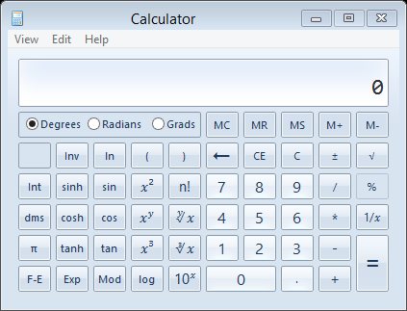
Bringing It All Together
Exploiting Internet Explorer 8
Vulnerability: Heap Overflow (CVE-2012-1876)
More info about vulnerability @ http://www.vupen.com/blog
Assume ASLR / DEP / CCFIR in place
First controlled indirect branch instruction: jmp edx
(EP → CS) + VirtualProtect + memcpy = Code Injection

Slide 47

kBouncer
Vassilis Pappas et al. [Usenix Security ‘13]
Winner of Microsoft’s Blue hat prize
Use LBR to detect abnormal control-flow transfers
Low overhead!

Slide 48
Last Branch Record (LBR)
CPU registers store last branches taken by the program
Ring-buffer structure
Holds last 16 entries
Store source:destination
Configurable
Example: Store only indirect calls
Branch
Branch
Branch
Branch
Branch
Branch
Branch
Branch
Branch
Branch
Branch
Branch
Branch
Branch
Branch
Branch
Branch
Branch
Branch
Branch
Branch
Branch
Branch
Branch
Branch
Branch
Branch
Branch
Branch
Branch
Branch
Branch
Branch

Slide 49
Detection Approach
Returns must target call sites
A limited number of small code fragments can be chained together
call …
retn
call …
retn
CS
CS
Max gadget size
pop ecx
pop eax
retn
add eax, ecx
retn
pop esi
pop edi
retn
add eax, esi
add eax, edi
pop ecx
retn
Max chain length

Slide 50
Detection Approach
Returns must target call sites
A limited number of small code fragments can be chained together
call …
retn
call …
retn
CS
CS
How can we establish the max gadget size and max chain length?
Max gadget size
pop ecx
pop eax
retn
add eax, ecx
retn
pop esi
pop edi
retn
add eax, esi
add eax, edi
pop ecx
retn
Max chain length

Slide 51
Making It Fast
The payload will eventually interact with the OS through system calls
Check for abnormal control transfers on system call entry

Slide 52
Establishing The Parameters
Set max gadget size to 19 (<20)
Evaluate max chain length experimentally
detection threshold
Dataset: Internet Explorer, Adobe Reader, Flash Player, Microsoft Office (Word, Excel, Powerpoint)

Slide 53
Chosen Parameters
Approach similar to kBouncer
 | kBouncer | ROPecker
Time-of-Check | Entry of Sensitive API | Entry of Sensitive API + during execution
Gadget Length | 20 instructions | 6 instructions
Inspect BH instances | Detected max "benign" gadget chain length: 5 | Detected max "benign" gadget chain length: 10
Gadget Chain Length | 8 gadgets | 11 gadgets

Slide 54
Why Picking Parameters Is Hard
Executing a legitimate program
Max gadget size
Security
Check
Max chain length
No alert, all is good!

Slide 55
Why Picking Parameters Is Hard
Executing a legitimate program
Max gadget size
Security
Check
Max chain length
False positive!

Slide 56
Why Picking Parameters Is Hard
Executing a legitimate program
Max gadget size
Security
Check
Max chain length
No alert, all is good!

Slide 57
Why Picking Parameters Is Hard
Executing a legitimate program
Max gadget size
Security
Check
Max chain length
False positive!

Slide 58
Would Our Previous Attack Work?
Gadget
Gadget
Gadget
Gadget
Gadget
Gadget
However
Gadgets containing more than T_{G} instructions are ignored
Gadget chains longer than T_{C} gadget are prevented

Slide 59
How to Avoid Detection?
Interpose longer gadgets in the exploit
Max gadget size
Security
Check
Max chain length
No alert, all is good!

Slide 60
Using Long Gadgets
Long gadgets frequently:
Use a high number of registers
Leave used registers dirty at exit
Require memory preparations to avoid crashing
Have whacky code sequences
mov eax, ebx
mov ecx, edx
add esi, edi
mov esi, [0x1234]
cmp esi, 10
jg X
mov ecx, 0x2321
div ecx
mov [eax], edi
mov ecx, 0x5678
and edi, ecx
xor eax, edi
retn

Slide 61
Two Proof of Concept Attacks
Exploiting Internet Explorer 8 similar to CFI attack
Assume kBouncer is in place
Also applies to similar defenses like ROPecker [NDSS ‘13]
Multiple payloads
kBouncer thresholds: T_{C}=6, T_{G}=20
Stricter thresholds: T_{C}=2, T_{G}=27

Slide 62
*-RET
7
33
2
2
2
3
Security check
VirtualProtect
SHELLCODE

Slide 63
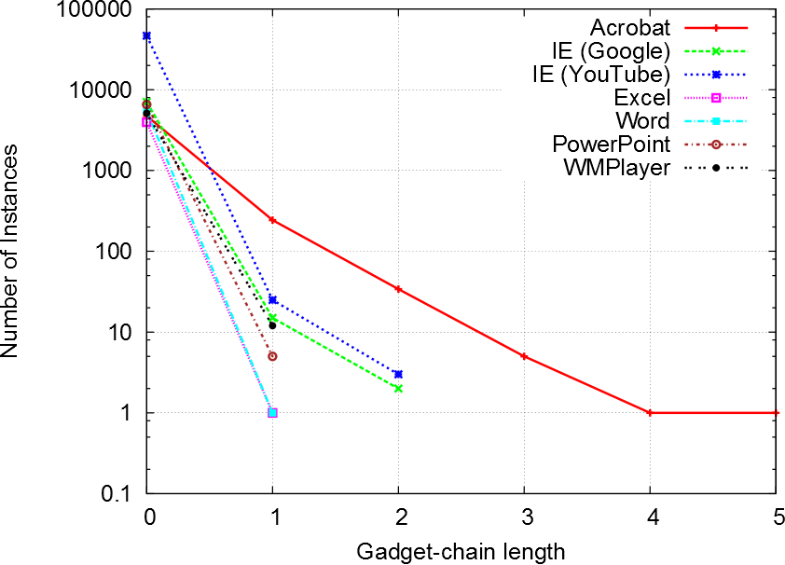
Per Application Thresholds

