Slide 1
CS 577 Cybersecurity Lab
Lab 2
Dimitrios Damopoulos – Stevens Institute of Technology

Slide 2
Exercise 1
PassCracker

Slide 3
Password cracking
Dictionary attack
Username anagrams
  A name with n characters -> has n! anagrams
Brute-force
  ONLY within a range of strings the user provides (in our case [1ZA, BC9AA])
Combination of the above

Slide 4
The passwords
The passwords have been created by using the following function
hash = MD5(password,salt)
Find the passwords ???
 | Username | Hash | Salt | Password | Method | Time
1 | kalliopi | 014c70133ffef170d030549ecd8d42bc | 5017
2 | kalliopi | 2312452cfda49f882e56687a799a0518 | 5017
3 | kalliopi | f0364168ebe2442dc5f56c1747778bd0 | 5017
4 | kalliopi | f81b8830c8c5fd21a300c20f04dcae80

Slide 5
To Do list…
Create a program that takes the following inputs
  the username
  the md5 hash value
  the salt value
The cracking method should also be provided by the user
In case that the salt value is not provided, create a new cracking method based on your previous one
  Dictionary and Brute-force attacks
Keep it simple

Slide 6
To Do list… (2/2)
Measure the time to find the password
Last but not least, submit:
  The source code (as a project)
  Executable
  Documentation
  Report

Slide 7
When
Cyber Security meets
Machine Learning

Slide 8
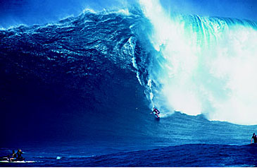
Trends Leading to Data Flood
More data is generated:
  Bank, telecom, other business transactions ...
  Scientific data: astronomy, biology, etc
  Web, text, and e-commerce

Slide 9
The Concept of Learning
Learning = Improving with experience at some task
  Improve over task T,
  With respect to performance measure, P
  Based on experience, E.

Slide 10
Application Areas
Science
  astronomy, bioinformatics, drug discovery, …
Business
  CRM (Customer Relationship management), fraud detection, e-commerce, manufacturing, sports/entertainment, telecom, targeted marketing, health care, …
Web:
  search engines, advertising, web and text mining, …
Government
  surveillance (?|), crime detection, cyber security, profiling tax cheaters, …

Slide 11
Machine Learning for e-commerce
A person buys a book (product) at Amazon.com
What is the task?

Slide 12
Successful e-Commerce – Case Study
Task: Recommend other books (products) this person is likely to buy
Amazon does clustering based on books bought:
  customers who bought “Advances in Knowledge Discovery and Data Mining”, also bought “Data Mining: Practical Machine Learning Tools and Techniques with Java Implementations”
Recommendation program is quite successful

Slide 13

Information Security and Machine Learning
Problem Domain : Information Security – the problems we need to solve:
    Malware detection
    Intrusion detection
    SPAM mitigation
    Etc.
Solution Domain: Machine-Learning – from which solutions are drawn.
    Artificial neural networks
    Decision Trees etc.

Slide 14
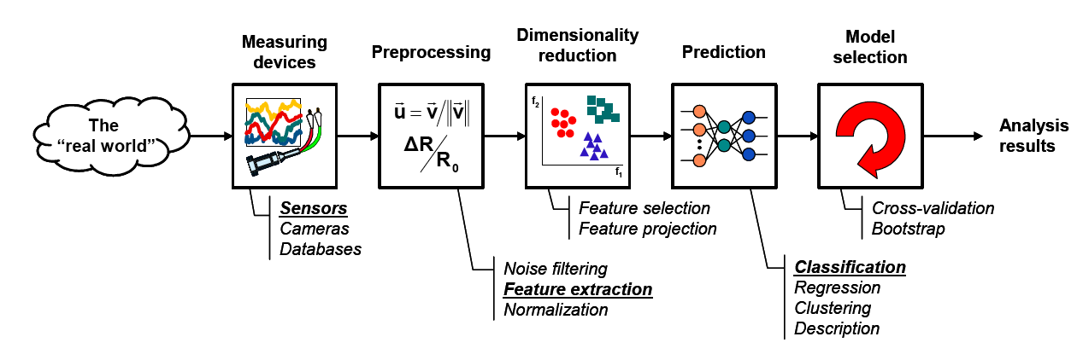
The Learning Process

Slide 15

Data Set
Target Features
2 Class
Input Features
Number of new Recipients | Email Length (K) | Country (IP) | Customer Type | Email Type
0 | 2 | Germany | Gold | Ham
1 | 4 | Germany | Silver | Ham
5 | 2 | Nigeria | Bronze | Spam
2 | 4 | Russia | Bronze | Spam
3 | 4 | Germany | Bronze | Ham
0 | 1 | USA | Silver | Ham
4 | 2 | USA | Silver | Spam
Instances

Slide 16
Data Mining Tasks: Classification
Learn a method for predicting the instance class from pre-labeled (classified) instances
Many approaches: Statistics,
Decision Trees, Neural Networks,
...

Slide 17
Data Mining Tasks: Clustering
Find “natural” grouping of instances given un-labeled data

Slide 18
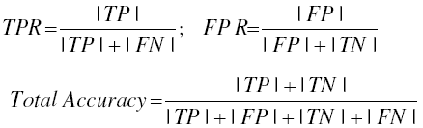
Performance Measures
True Positive Rate (TPR) - The number of positive instances classified correctly.
False Positive Rate (FPR) - The number of negative instances misclassified.
Total Accuracy - The number of absolutely correctly classified instances.

Slide 19
Classifiers
Same selected features can give different results, when different classifiers are utilized
  Boosted Decision Tree
  Artificial Neural Network
Classifier | Accuracy | FP | FN
ANN | 0.941 | 0.033 | 0.134
DT | 0.943 | 0.039 | 0.099
NB | 0.697 | 0.382 | 0.069
BDT | 0.949 | 0.040 | 0.110
BNB | 0.697 | 0.382 | 0.069
SVM-lin | 0.921 | 0.033 | 0.214
SVM-poly | 0.852 | 0.014 | 0.544
SVM-rbf | 0.939 | 0.029 | 0.154

Slide 20
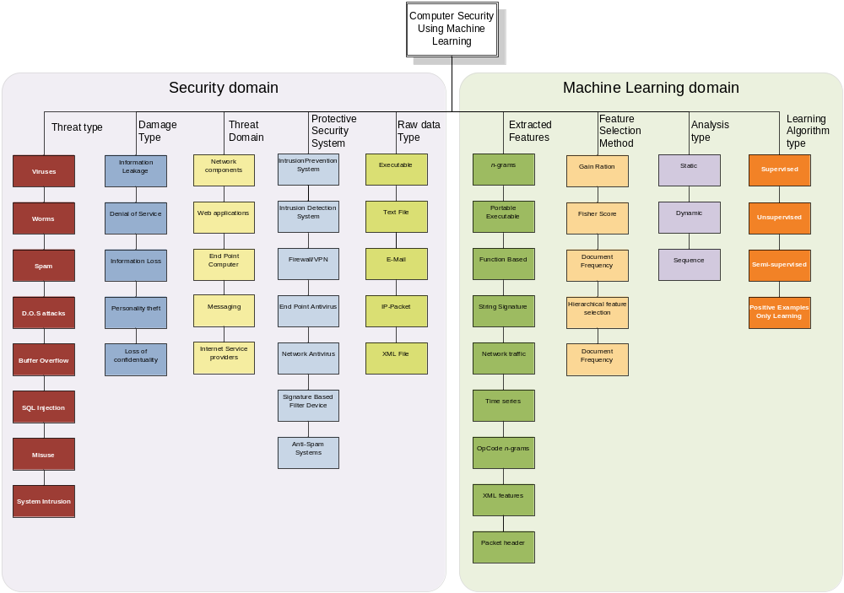
A Taxonomy
Prof. Lior Rokach
Information Systems Eng., Ben-Gurion University of the Negev

Slide 21
Exercise 2
Password hardening based on keystroke dynamics

Slide 22
Keystroke Dynamics
Keystroke dynamics: not what you type, but how you type
  Does every one write a password the same way???
Password hardening based on keystroke dynamics
  Create unique user profiles based on the way they write

Slide 23
The Engine
Weka is a collection of machine learning algorithms for data mining task (Java)
OpenCV has a set of algorithms for statistical classification, regression, and clustering of data (C++, C, Python)

Slide 24
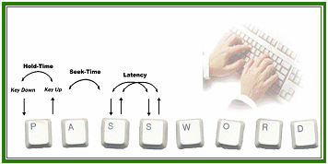
Keystroke Features
Keep it simple !
  Hold-time: is a commonly used feature in keystroke analysis and refers to the amount of time each key is pressed. It is calculated as the time starting from pressing a given key down until its release.
  Seek-time: this is another standard feature widely employed in keystroke dynamics. It refers to the time between the release of a key until pressing the next.
Other features ???
  Timestamp, Latency, Password length etc.

Slide 25
The problems
Which classifier provides the best results ???
Which features create the best profile ???
Keep it simple, play with the features, test various classifiers

Slide 26
To Do list… (1/2)
Create a program that collects keystrokes
Collect from 3-4 people 20 times the keystrokes for the same password (e.g., ap2lv9!)
Create the behavior profiles (.arff files)
Test various classifiers and features performing experiments (10-fold cross validation)
Report your findings (Accuracy/experiment)
Use the features and the classifier that provides the best results

Slide 27
To Do list… (2/2)
Create a second program that:
  Asks for a username and password
  Checks if they are both correct
  Also, checks if the the password was entered by the legit user by utilizing machine learning
Last but not least, submit:
  The source code
  Executable
  Documentation
  Report

Slide 28
Links
Weka
  http://www.cs.waikato.ac.nz/ml/weka/
OpenCV
  http://opencv.org/
Keystrokes
  Find easy ways to get the keystrokes and key listeners with Java (Google it)

