Slide 1
Linking & Loading

Slide 2
What happens to your program …
…after it is compiled, but before it can be run?

Slide 3
Linking
Linker – key part of OS – not in kernel
  Combines object files and libraries into a “standard” format that the OS loader can interpret
  Resolves references and does static relocation of addresses
  Creates information for loader to complete binding process
  Supports dynamic shared libraries

Slide 4
From source code to a process
Source
(.c, .cc)
Binding is the process of mapping names to addresses
Most compilers produce relocatable object code
    Addresses relative to zero
The linker combines multiple object files and library modules into a single executable file
    Addresses also relative to zero
The Loader reads the executable file
  Allocates memory
  Maps addresses within file to physical memory addresses
  Resolves names of dynamic library items
Compiler
Object
(.o)
Other Objects
(.o)
Linker
Static libraries
(.a)
Executable
Dynamic libraries
(.dll)
Loader
In-memory Image
Notes:
Correct - $190, Possible - $90, $200

Slide 5
Static Linking and Loading
Printf.c
HelloWorld.c
gcc
Static
Library
gcc
Printf.o
ar
HelloWorld.o
Linker
a.Out
(or name of
your command)
Loader
Memory

Slide 6
Shared Libraries
Observation – “everyone” links to standard libraries (libc.a, etc.)
Consume space in
    every executable image
    every process memory at runtime
Would it be possible to share the common libraries?
  Automatically load at runtime?

Slide 7
Shared libraries (continued)
Libraries designated as “shared”
    .so, .dll, etc.
    Supported by corresponding “.a” libraries containing symbol information
Linker sets up symbols to be resolved at runtime
Loader: Is library already in memory?
  If so, map into new process space
    “map,” an operation to be defined
  If not, load and then map

Slide 8
Run-time Linking/Loading
Printf.c
HelloWorld.c
gcc
gcc
Printf.o
HelloWorld.o
Linker
ar
Save disk space.
Startup faster.
Might not need all.
a.Out
(or name of
your command)
Shared
Library
Run-time
Loader
Loader
Memory

Slide 9
Dynamic Shared Libraries
Static shared libraries requires address space pre-allocation
Dynamic shared libraries – address binding at runtime
  Code must be position independent
  At runtime, references are resolved as
    Library_relative_address + library_base_address

Slide 10
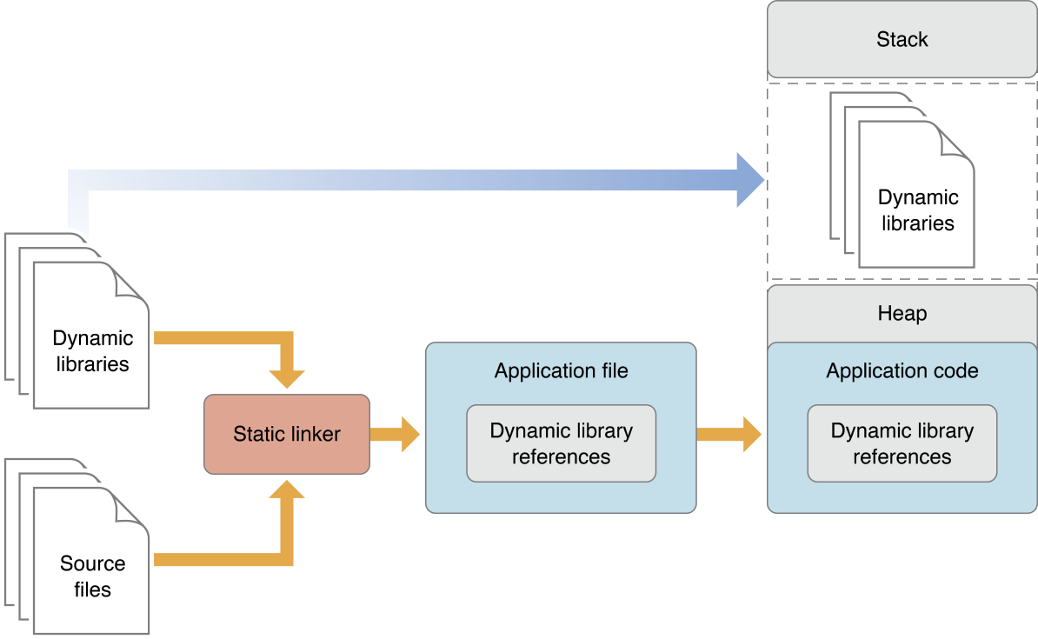
Dynamic Shared Libraries

Slide 11
LD_PRELOAD
Preloading is a feature of the dynamic linker (ld).
It is a available on most Unix system and allows to load a user specified, shared library before all other shared libraries which are linked to an executable.
Library pre-loading is most commonly used when you need a custom version of a library function to be called.

Slide 12
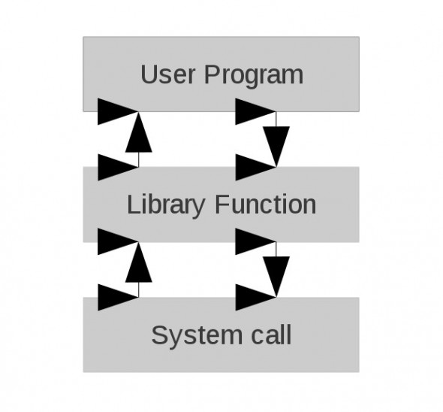
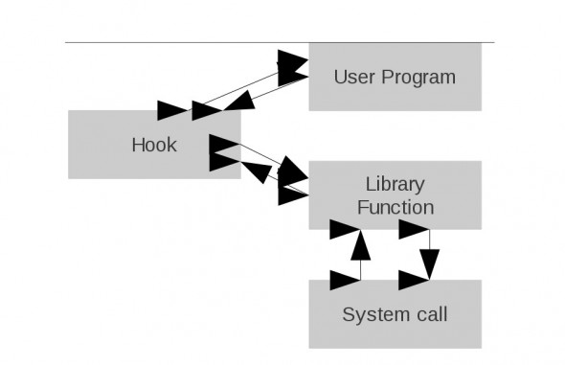
Function Interposition

Slide 13
Data Alignment

Slide 14
Data Alignment
In programming language, a data object (variable) has 2 properties; its value and the storage location (address).
Data alignment means that the address of a data can be evenly divisible by 1, 2, 4, or 8.
  In other words, data object can have 1-byte, 2-byte, 4-byte, 8-byte alignment or any power of 2.

Slide 15
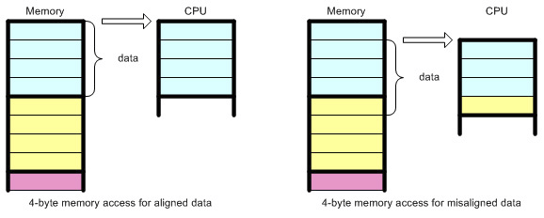
Data Alignment
CPU does not read from or write to memory one byte at a time.
Instead, CPU accesses memory in 2, 4, 8, 16, or 32 byte chunks at a time.
  The reason for doing this is the performance

Slide 16
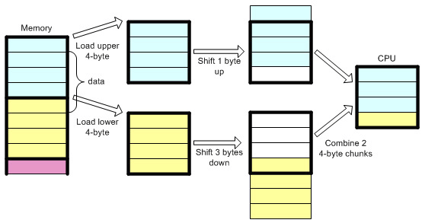
Misalignment
If the data is misaligned of 4-byte boundary, CPU has to perform extra work to access the data:
  load 2 chucks of data, shift out unwanted bytes then combine them together.

Slide 17
Bit Hacks
Playing with bits:
  https://graphics.stanford.edu/~seander/bithacks.html

Slide 18
Protect Memory Allocation

Slide 19
Protect Memory Allocation with Guard Pages (1/2)
Mixed
Overwrite
and
overreads
Underwrite
and
underread
Guard page
Protect buffers using guard pages
padding
Guard page
0xmagic0xmagic
buf
padding
buf
0xmagic0xmagic
buf
buf
buf
buf
buf
buf
buf
buf
Guard page
buf
buf
0xmagic0xmagic
padding
Guard page

Slide 20
Protect Memory Allocation with Guard Pages (2/2)
ptr
Len ???
4k
buf
Guard page
4-8 Alignment
malloc()

Slide 21
Protect Memory Allocation
malloc() - returns a pointer to a block of at least size bytes suitably aligned for any use.
  If the space assigned by malloc() is overrun, the results are undefined
realloc() - changes the size of the block pointed to by ptr to size bytes and returns a pointer to the (possibly moved) block
calloc() - allocates a block of memory for an array of num elements, each of them size bytes long, and initializes all its bits to zero.

Slide 22
Protect Memory Allocation
memaling() - allocates size bytes on a specified alignment boundary and returns a pointer to the allocated block.
  The value of the returned address is guaranteed to be an even multiple of alignment.
  The value of alignment must be a power of two and must be greater than or equal to the size of a word.

Slide 23
Protect Memory Allocation
free() – is a pointer to a block previously allocated by malloc(), calloc(), or realloc().
  after free() is executed, this space is made available for further allocation by the application, though not returned to the system.
  memory is returned to the system only upon termination of the application
    if ptr is a null pointer, no action occurs.
    if a random number is passed to free(), the results are undefined.

Slide 24
Lab exercise

Slide 25
Lab exercise
For the following program, create your own version of fopen() that prints
printf(”My fopen\n");
Step 1: Overwrite the C standard library function with yours
Step 2: Overwrite the C standard library function with yours but also call the original function

Slide 26
Function Interposition (1/4)
$ ls
prog.c test.txt
$ gcc prog.c -o prog
$ ls
prog prog.c test.txt
$ ./prog
Calling the fopen() function...
fopen() succeeded
#include <stdio.h>
int main(void) {
printf("Calling the fopen() function...\n");
FILE *fd = fopen("test.txt","r");
if (!fd) {
printf("fopen() returned NULL\n");
return 1;
}
printf("fopen() succeeded\n");
return 0;
}

Slide 27
Function Interposition (2/4) – Solution 1
Our own version of fopen
#include <stdio.h>
FILE *fopen(const char *path, const char *mode) {
printf("Always failing fopen\n");
return NULL;
}
Compile it as a shared library:
gcc -Wall -fPIC -shared -o myfopen.so myfopen.c
Now we can simply modify LD_PRELOAD:
LD_PRELOAD=./myfopen.so ./prog
Calling the fopen() function...
Always failing fopen
fopen() returned NULL

Slide 28
Function Interposition (3/4) – Solution 2
Overrides fopen and calls the original fopen from the c standard library:
#define _GNU_SOURCE
#include <stdio.h>
#include <dlfcn.h>
FILE *fopen(const char *path, const char *mode) {
printf("In our own fopen, opening %s\n", path);
FILE *(*original_fopen)(const char*, const char*);
original_fopen = dlsym(RTLD_NEXT, "fopen");
return (*original_fopen)(path, mode);
}
gcc -Wall -fPIC -shared -o myfopen.so myfopen.c -ldl
$ LD_PRELOAD=./myfopen.so ./prog
Calling the fopen() function...
In our own fopen, opening test.txt
fopen() succeeded

