Slide 1


Multi-Class Emotion Classification
Matthew Lee

Slide 2
Is It Worth It?

Slide 3
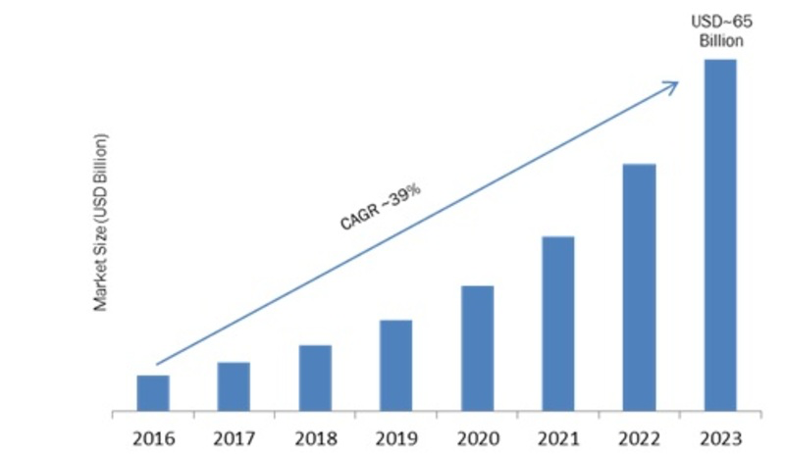
The emotion recognition market is worth$7 billion in 2016 and estimated to reach $65 billion by 2023.
Exponential

Slide 4
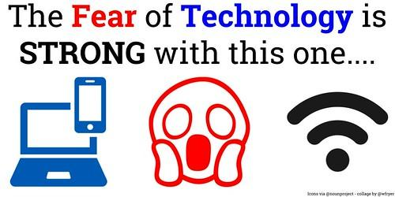
Applications
Automated customer service
Dynamic marketing & advertising
Law enforcement
Animating characters in virtual world
NLP - Better Siri & robocalls

Slide 5
Datasets

Slide 6
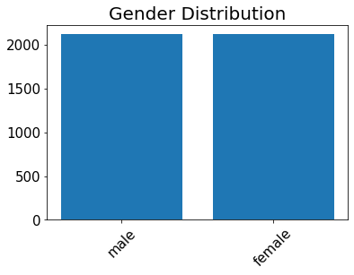
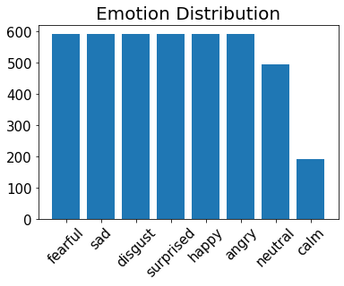
RAVDESS
1440 files
12 male and 12 female speakers
8 emotions
Neutral, calm, happy, sad, angry, fearful, disgust, and surprised
TESS
2800 files
1 male and 1 female speakers
7 emotions
Neutral, happy, sad, angry, and surprised

Slide 7
Feature Engineering

Slide 8
Difficulties of Feature Engineering for Signals
Time domain
Noise (background, microphone, etc …)
Harmonics
Gender

Slide 9
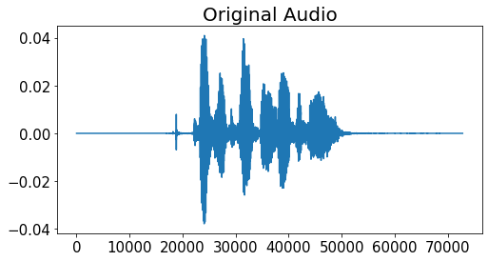
Let’s Condense
No one likes silences

Slide 10
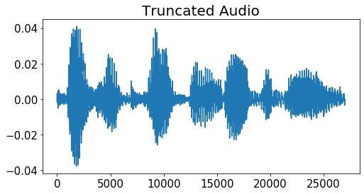
Truncate by detecting sudden change in energy.

Slide 11
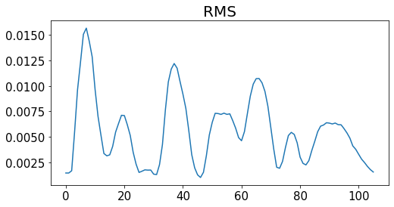
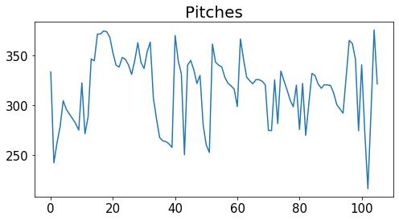
Mean of RMS & frequency values along moving frames to reduce sample size while retaining useful information.
RMS
Energy over time.
Frequency
Autocorrelation & frequency capping while tracking

Slide 12
Further Processing
Mean, std, 0th, 1st, 25th, 50th, 75th, 99th, 100th percentiles of processed signals
Mel-frequency cepstral coefficients (MFCCs)
Most used feature in speech recognition

Slide 13
Modeling

Slide 14
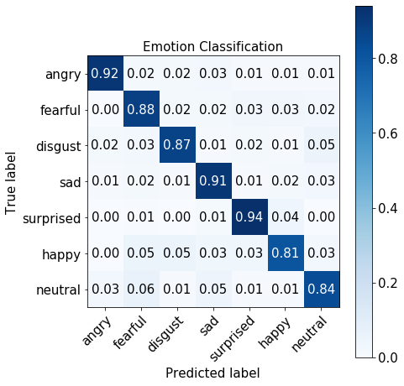
Models & Results
Confution Matrix
*CV = 5 | Logistic Regression | LightGBM
Accuracy % | Train / Test 69.8 / 71.3 | Train / Test 86.4 / 76.8
Precision | Train / Test 0.70 / 0.72 | Train / Test 0.86 / 0.78
Recall | Train / Test 0.70 / 0.71 | Train / Test 0.86 / 0.77
F1 | Train / Test 0.69 / 0.71 | Train / Test 0.86 / 0.77
*LightGBM was more robust with truly outside samples.

Slide 15

Future Work
Model
CNN & LSTM
Gender
Dedicated Models
Make $$
Real Time Classification

Slide 16
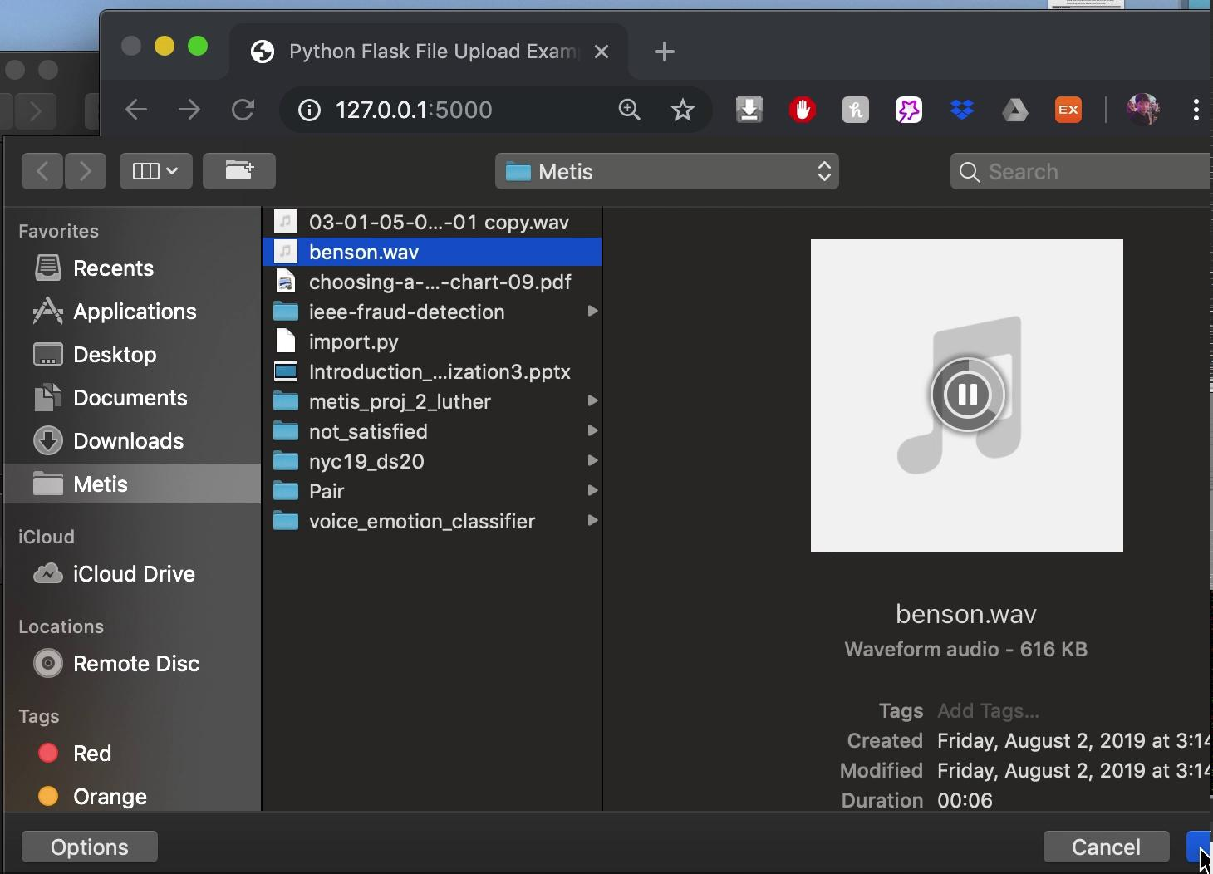
Flask Demo
Place your screenshot here

Slide 17
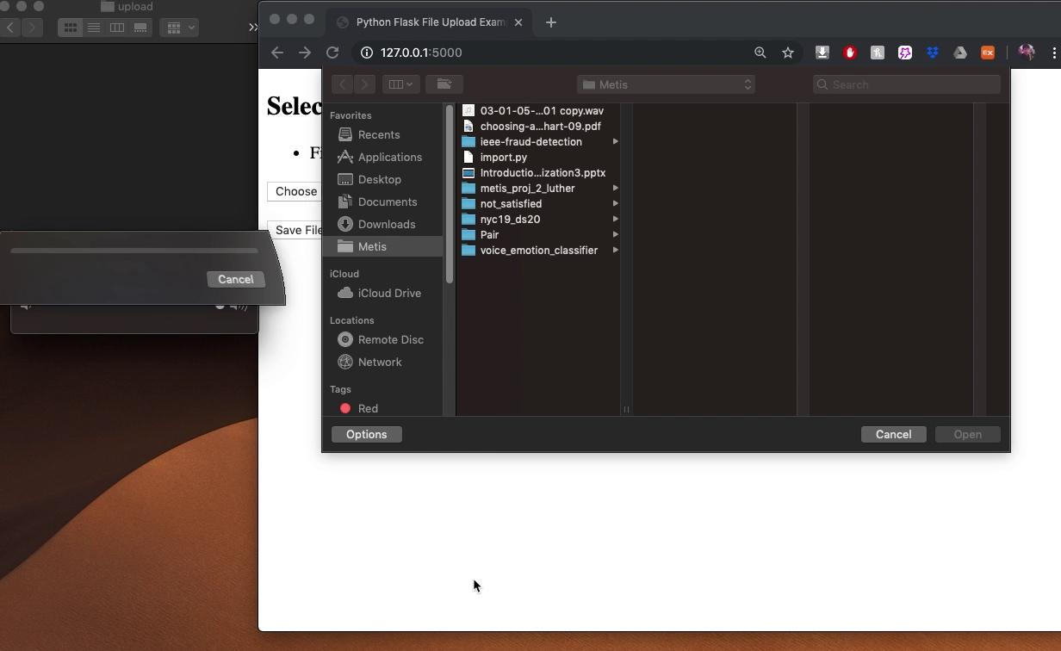
Flask Demo
Place your screenshot here

Slide 18

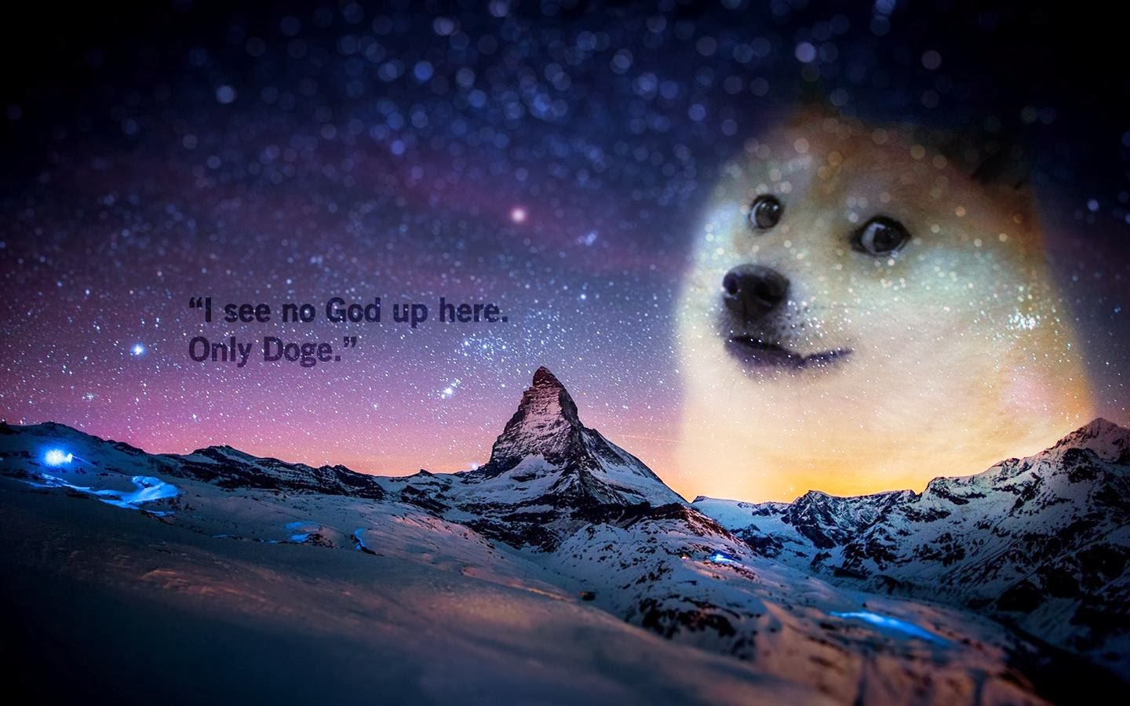
Questions?
Github : silvernine209

Slide 19
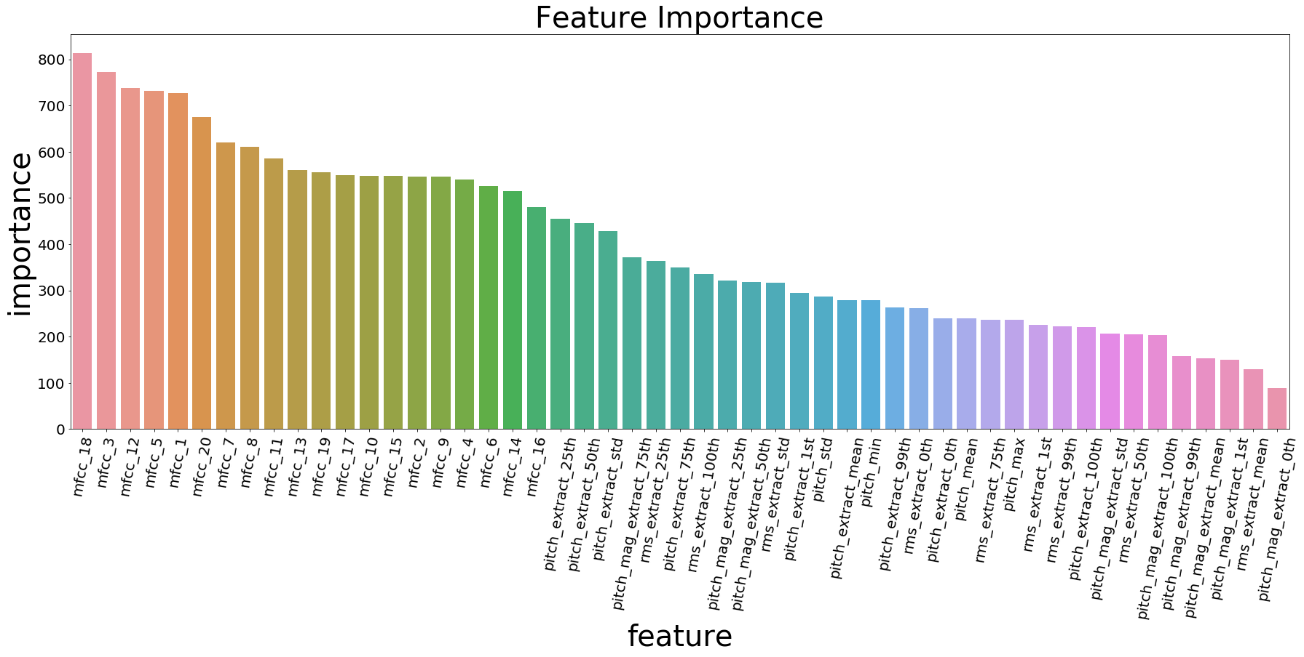

Slide 20
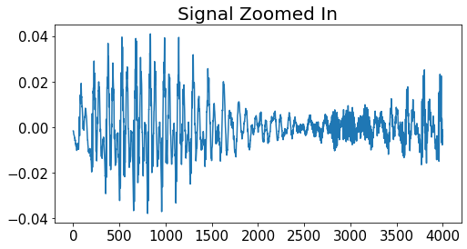
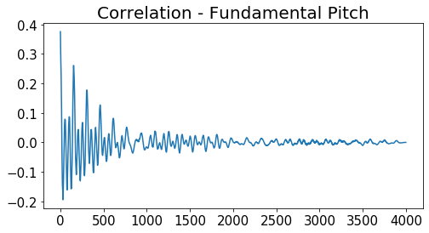
Autocorrelation of a signal with its delayed copy to find strongest repeating pattern.

