Slide 1
lifesavR ‘Check your knowledge’ questions and answers
Ben Whalley

Slide 2
Check your knowledge Q and A

Slide 3
Teachers’ notes
Each week we pose ‘check your knowledge’ questions.
This presentation includes the answers to each question, designed to be used as a group Q/A exercise in-class.

Slide 4
Session 1

Slide 5
How do you run part of a line of R code using the keyboard short cut?

Slide 6
Select just that part, and press ctrl+Enter

Slide 7
Which library will you always need to load in your first RMarkdown chunk?

Slide 8
tidyverse, loaded with library(tidyverse) (and often also library(psydata))

Slide 9
What is psydata?

Slide 10
A package we provide which includes example datasets.

Slide 11
How would you look at/inspect a whole dataset?

Slide 12
Just type the name of the dataset and ‘run’ it. In RStudio this provides a data-viewer window.

Slide 13
What does glimpse() do and when is it useful?

Slide 14
It provides a preview of all the columns in a dataset, showing the type and first few values of each.
It’s useful when you have a lot of columns in a dataset which would otherwise be too wide to view on screen.

Slide 15
What is the 5th column in the development dataset?

Slide 16
psydata::development %>% names %>% .[5] %>% pander::pandoc.verbatim()
`population`

Slide 17
Which function makes a plot? (there are many, but we mean the one shown in the worksheet)

Slide 18
ggplot

Slide 19
Which function chooses the columns of data used in the plot?

Slide 20
The aes() function allows us to choose which variables are used for each axis on the plot.

Slide 21
Session 2

Slide 22
What is the <- symbol called and what does it do?

Slide 23
This is the assignment operator. It stores the result from its right-hand side in the variable named on the left.

Slide 24
What is the %>% symbol called and what does it do?

Slide 25
%>% is the pipe.
It passes the data on its left-hand side to the function on the right.

Slide 26
Which function would you pipe a dataset into if you wanted to see the first few rows?

Slide 27
head

Slide 28
Which function is used to select rows from a dataset?

Slide 29
filter

Slide 30
How would you select rows where values in a numeric column are between 10 and 20?

Slide 31
dataset %>%
filter(column > 9 & column < 21)
If you wrote dataset %>% filter(column > 10 & column < 20) this is almost right, but you would be excluding values of 10 and 20.
Normally when we say ‘between’ 10 and 20 we would include 10 and 20.
filter(column >= 10 & column <= 20) also works, and works for non-integer values too.

Slide 32
Which function is used to summarise data?

Slide 33
summarise

Slide 34
Which summary function would you use to calculate the mean of a numeric column?

Slide 35
summarise(mean(columnname))

Slide 36
How would you calculate the median of a subset of rows in a data frame?

Slide 37
dataset %>%
filter(SOMETHING HERE) %>%
summarise(median(columnname))

Slide 38
Session 3

Slide 39
Which functions are needed to make a boxplot?

Slide 40
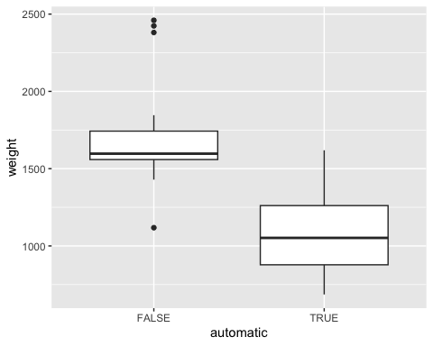
As a minimum, in this example we need the ggplot, aes and geom_boxplot functions
fuel %>%
ggplot(aes(automatic, weight)) + geom_boxplot()

Slide 41
What is the difference between a dbl and a fct or ord?

Slide 42
A dbl is a ‘double precision floating point number’
(that’s just ‘a number’ to you and me).
A fct is a ‘factor’, so a categorical variable.
An ord is an ‘ordinal’ variable, which is a factor in which the categories have an ordering.

Slide 43
Which data types are used for continuous variables?

Slide 44
dbl or int (short for integer).

Slide 45
Give an example of why the difference between dbl and fct matters when making a plot (include code examples for this if you can)

Slide 46
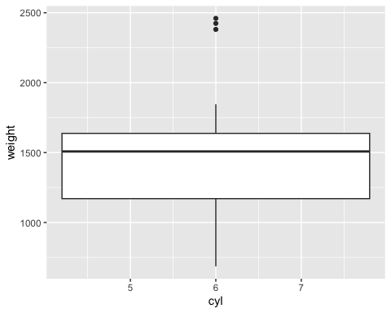
One example would be this plot: In a boxplot we need the x axis to be a categorical variable, but in the fuel data the cyl variable is an integer, so we only get one box rather than 3.
fuel %>%
ggplot(aes(x=cyl, weight)) + geom_boxplot()
Warning: Orientation is not uniquely specified when both the x and y aesthetics are
continuous. Picking default orientation 'x'.
Warning: Continuous x aesthetic
ℹ did you forget `aes(group = ...)`?

Slide 47
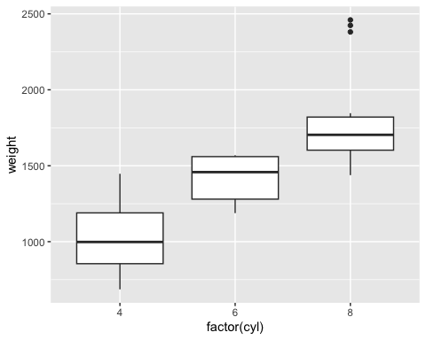
fuel %>%
ggplot(aes(x=factor(cyl), weight)) + geom_boxplot()

Slide 48
How can you convert a variable from a dbl to a fct?

Slide 49
dataset %>%
mutate(myvar_as_factor = factor(myvar))

Slide 50
How could you calculate the mean for one level of a factor?

Slide 51
development %>%
filter(continent=="Africa") %>%
summarise(mean(population))
# A tibble: 1 × 1
`mean(population)`
<dbl>
1 9916003.

Slide 52
How would you calculate the mean for all levels of a factor (e.g. for continent in the development dataset)?

Slide 53
development %>%
group_by(continent) %>%
summarise(mean(population))
# A tibble: 5 × 2
continent `mean(population)`
<fct> <dbl>
1 Africa 9916003.
2 Americas 24504795.
3 Asia 77038722.
4 Europe 17169765.
5 Oceania 8874672.

Slide 54
How would you calculate means and standard deviations for all combinations of levels in two factors?

Slide 55
development %>%
filter(year < 1960) %>%
group_by(continent, year) %>%
summarise(M=mean(population),
SD=sd(population))
# A tibble: 10 × 4
# Groups: continent [5]
continent year M SD
<fct> <int> <dbl> <dbl>
1 Africa 1952 4570010. 6317450.
2 Africa 1957 5093033. 7076042.
3 Americas 1952 13806098. 32341632.
4 Americas 1957 15478157. 35537059.
5 Asia 1952 42283556. 113226736.
6 Asia 1957 47356988. 128096097.
7 Europe 1952 13937362. 17247450.
8 Europe 1957 14596345. 17832354.
9 Oceania 1952 5343003 4735083.
10 Oceania 1957 5970988 5291395.

Slide 56
Session 4

Slide 57
What functions in R describe the central tendency of a variable?

Slide 58
mean() or median().

Slide 59
What type of column can we use with mean()?

Slide 60
Numeric (dbl or int).

Slide 61
How might you describe patterns in a categorical variable?

Slide 62
Making a frequency table (or using a plot).

Slide 63
What function did we use to create a new column in the funimagery dataset?

Slide 64
mutate()

Slide 65
In the funimagery data, what was the mean change in weight (kg3 - kg2) for FIT participants AFTER the end of treatment? (Remember that a negative number means weight was lost.)

Slide 66
funimagery %>%
filter(intervention=="FIT") %>%
summarise(mean(kg3 - kg2))
mean(kg3 - kg2)
1 -2.335593
The mean change was -2.34 kg: because the number is negative, FIT participants lost (on average) a further 2.34 kg after the end of treatment.

Slide 67
What type of plot describes the relationship between two variables?

Slide 68
Scatterplot.

Slide 69
What function do we use to make a plot that shows a relationship between two variables in ggplot()?

Slide 70
geom_point() (or geom_jitter()).

Slide 71
Session 5

Slide 72
What hypotheses are being compared when we calculate a Bayes Factor for a correlation?

Slide 73
H1
There is a correlation between x and y
H0
There is NO correlation between x and y
The Bayes Factor tells us how many times more likely the data are under H1 than under H0.

Slide 74
Which function do we recommend to calculate correlation coefficients?

Slide 75
correlate() in the corrr package.

Slide 76
Which function calculates the Bayes Factor for a correlation?

Slide 77
correlationBF()

Slide 78
Which function calculates the Bayes Factor for a difference in the average of two groups?

Slide 79
ttestBF()

Slide 80
What direction slope does a correlation of -0.5 imply? What would the scatterplot look like?

Slide 81
A negative relationship: the slope goes down. As x increases, y tends to decrease, so the points slope downwards from left to right.

Slide 82
What conclusion should we draw if the Bayes Factor for a correlation is 2.1? How about if it was 0.21, or 210?

Slide 83
2.1 is inconclusive (it is between 1/3 and 3)
0.21 is moderate evidence against the correlation (i.e. for the null hypothesis), because $1/0.21=4.76$: the data are about 4.8 times more likely under H0 than H1
210 is strong evidence in favour of the correlation

Slide 84
What conclusion should we draw if the Bayes Factor for a t test is 0.8? How about if it were > 10?

Slide 85
0.8 is inconclusive
>10 is strong evidence for a difference

Slide 86
What is the difference between ttestBF() and correlationBF()?

Slide 87
ttestBF() calculates the BF for a difference between two groups; correlationBF() calculates the BF for a correlation between two continuous variables.

Slide 88
Session 6

Slide 89
What is an intercept?

Slide 90
The expected value of the outcome when the predictor is equal to zero.

Slide 91
What is the slope?

Slide 92
The increase in the outcome for a unit change in the predictor.

Slide 93
What is a residual?

Slide 94
The distance between an observed outcome value and the value predicted by the best fit line.

Slide 95
Which function fits a regression model?

Slide 96
lm()

Slide 97
Which function calculates residuals and predictions from a saved lm model?

Slide 98
augment() (from the broom package). It adds the .fitted and .resid columns.

Slide 99
What are the three assumptions of regression introduced in this session?

Slide 100
The ‘true’ best-fit line is straight (i.e. not curved)
Model residuals are approximately normal
The residuals are of equal size along the regression line

Slide 101
Session 7

Slide 102
We prefer models with smaller or larger residuals?

Slide 103
Smaller.

Slide 104
The $R^{2}$ statistic ranges from …?

Slide 105
0 to 1.

Slide 106
It’s better for a model to have a smaller or larger $R^{2}$ value?

Slide 107
Larger.

Slide 108
If we calculate the Bayes Factor for modelA / modelB and the result is > 1, this provides evidence that …?

Slide 109
We have more evidence for model A than model B: the data are more likely under model A than under model B.

Slide 110
A Bayes Factor of 25 means we have … evidence?

Slide 111
Strong evidence.

Slide 112
A Bayes Factor of 0.05 means we have …?

Slide 113
Strong evidence for the other hypothesis (e.g. the null).
Taking the reciprocal, $1/0.05=20$: the data are 20 times more likely under the other hypothesis.

