Slide 1
Repeated measurements
Explaining variation using mixed models
Notes:
Perhaps open with discussion of why students taking this option? What they want to achieve?

Slide 2
Why do we make repeated measures?
Pre-post intervention (Difference scores, Ancova)
Experiments: e.g. RT under multiple conditions (RM Anova)
Longitudinal: Watch trajectories over time
Experiments: multiple conditions, multiple stimuli
Surveys and studies with 'nesting'
Can also make repeated but different measures (we're not going to cover this)

Slide 3
Key theme: Variability
Effect on power/estimation/inference
As a phenomenon of interest

Slide 4
Schools sampling activity
Imagine you work for the UK Department for Education (DfE).
Your task is to find out whether a new educational intervention is effective. The new intervention has been rolled out in 1000 randomly-selected schools in the UK.
• You have a budget of around £10,000. • The cost to visit a single school is £100 • The cost to measure each pupil is £10 • The average size of a school in the UK is roughly 250.
Would you prefer to collect data from:
970 children across 3 schools
870 children across 13 schools
770 children across 23 schools
670 children across 33 schools
570 children across 43 schools
470 children across 53 schools
370 children across 63 schools
270 children across 73 schools
170 children across 83 schools
These options all cost around £10,000.
Discuss the problem as a small group.
Identify the different trade-offs involved.
Notes:
This exercise is really all about sources of variability and the effect it can have on the statistical power of our studies.
To put some numbers to the claim above:
Imagine we were studying a medium effect size (D=.5), in a situation where 15% of the variance in outcomes was explained by the school a child attended.
We want to achieve power of 80% for alpha = .05 (and this is fixed)
In this case, increasing the number of schools sampled from 20 to 21 would reduce the total N (total number of students) from 111 students to 105.
That is, we sample fewer students, but gain statistical power.

Slide 5
Social science datasets almost always show classification and nesting

Slide 11
Sometimes more than one type of nesting at once…

Slide 13
Different forms of repeat measures…
Or, put another way of saying, sources of variation.

Slide 14
We need to think about where variation comes from when choosing an analysis…

Slide 15
Within/between variation
Variation in the outcome

Slide 16
Repeated measures

Slide 17
Within/between variation
Between people
Within person

Slide 18
If people are 'consistent'
Between people
Within person

Slide 19
If people are 'inconsistent'
Between people
The proportion of variation within vs. between people is called the "intraclass correlation" or variance partition coefficient
Within person

Slide 20
Within subject designs
In a within person design we can mostly just ignore this now.
Sometimes people describe this as "participants acting as their own control"
Between people
Within person
This chunk explained by something…e.g., an experimental randomisation

Slide 21
This is why within-designs are more powerful
All the variation
Between people
(can be ignored in within designs because we can see how much people vary between each other and subtract that out)
Within person
Statistical tests often compare how much variation is explained (the circles) vs the total of the coloured areas. These circles are the same size, but it's a bigger proportion of the within variation.

Slide 22
Within-between designs
This part of the design is less powerful
Between people
Within person
Parts which crossover can
are halfway… but better
than a purely between design
This part is more powerful

Slide 23
Analysing within-person data
Repeat measures Anova
Account for non-independence
Unbalanced/missing data are problematic
Only one source of variation/random-error (people)
Various other assumptions (equal variances in groups)
Mixed-models/random effects models
Effectively replicate RM Anova by default
Missing data not a problem
Explore variation
Multiple sources of variation
Predictors can vary in their effects (random effects models)
Fewer, less restrictive assumptions

Slide 24
'Random effects' models
Between people
Within person
We can ask questions about how variable effects are between people… but that’s another topic
Effects vary between individuals

Slide 25
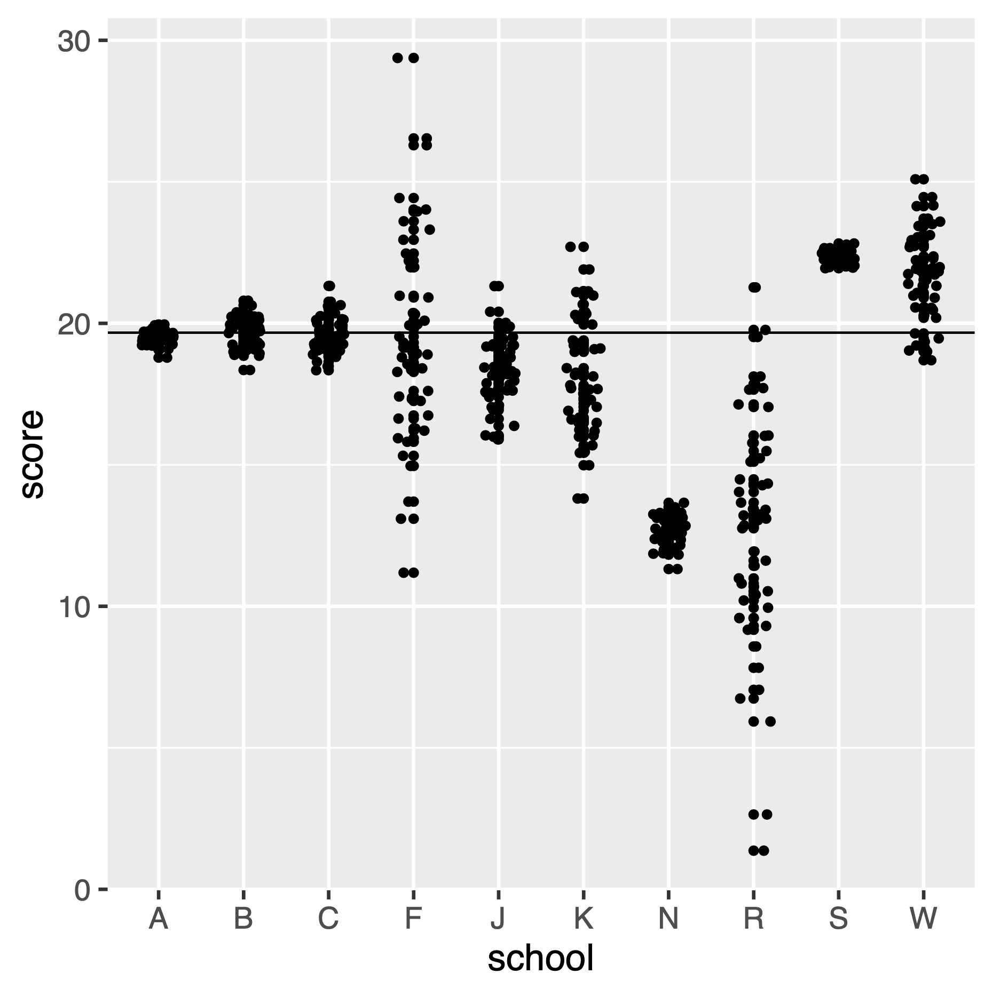
"Which school" activity
We are trying to estimate the average score
Which schools would you most and least want to sample another child from? Why?
Why would it be better to sample from another school, than another pupil from school in the set plotted?
Notes:
Hint: We need to think here about variability as well as the location of each school

Slide 26
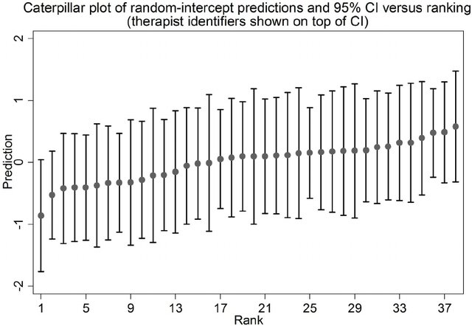
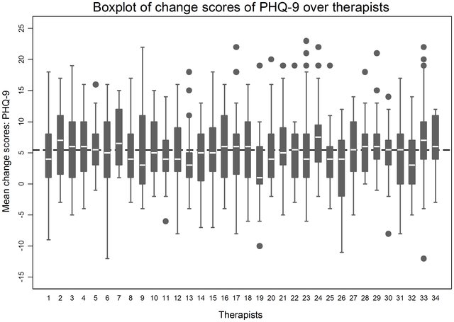
Therapist effects
Notes:
Not just about schools… but these effects matter
Eg. Therapists effects.
Some therapist much higher performing (worst can be > 1 SD worsethan best)
Some much more more variable too (either less data so less information, or genuinely more variable)
Patients AREN'T the only source of variability
We must take account of this when estimating treatment effects
Ali, S., Littlewood, E., McMillan, D., Delgadillo, J., Miranda, A., Croudace, T., & Gilbody, S. (2014). Heterogeneity in patient-reported outcomes following low-intensity mental health interventions: a multilevel analysis. PLoS One, 9(9), e99658.
https://www.researchgate.net/publication/265517021_Heterogeneity_in_Patient-Reported_Outcomes_following_Low-Intensity_Mental_Health_Interventions_A_Multilevel_Analysis/figures?lo=1

Slide 27
Quantifying sources of variation…

Slide 28
Quick recap
Mean
Variance/Std. Deviation
Residuals

Slide 29
How does this all link to linear models?
Imagine we have
Outcome = Y
Predictor = X
Repeated measurements of individuals

Slide 30
Scales are arbitrary here, but we could pretend y is change scores from pre-to post trx, one per-patient
X axis doesn't matter here… I just wanted to spread out the observations to make the plots easier to read later

Slide 31
y ~ 1
Notes:
This is the intercept-only model (so just estimate the mean)

Slide 32
Notes:
This is the variance/sums of squares

Slide 33
Notes:
If we colour the SS by person we can see that the variance is much bigger for some than for others. This would be a problem for conventional regression.

Slide 34
Notes:
Instead, we could spit the variance up into 2 parts:
Between (shown here) and
Within (next slide)

Slide 35
Notes:
Within variance

Slide 36
Notes:
Within and between variances

Slide 37
Splitting the variance
Between people
Within person
Within-cluster
Between-cluster
Can term it a random intercepts model
Instead of a being nuisance, clustering in the variance can now be the thing of interest

Slide 38
"Variance partition coefficient"
total
between
within

Slide 39

Scottish school-leavers data
> 30,000 students
508 schools
Year of leaving (cohort90)
Student gender
Prev. exam score
School type (private/state)
Location (urban/rural)

Slide 40
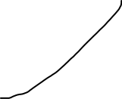



Schools
State/Private
Urban rural
Gender
Student
Student
Student
Student

Slide 41
lm(score ~ previous_score)
Notes:
You migth say we could just run a regression like this…
B0 is the intercept
B1 is the predictor coefficient and X is the predictor (prev exam score)
ei is the residual for each datapoint

Slide 42




Mixed models split the error term
Standard multiple regression - i represents an individual
Mixed regression - i represents an individual, j represents a measurement
Notes:
Everything is the same except we have the residual split in two

Slide 43
Mixed models
Flexible technique for splitting variance
Has superseded RM Anova except in simplest cases (balanced data, no missing, not interested in variability, no stimulus effects)
Already widely adopted in health and psycho-linguistics
Fitting with the `lmer` function, using `lmerTest` library.
Formulas now have an explicit 'random part'

Slide 44
This is the 'fixed' part which is just like lm
This is the 'random' part of the model
library(lmerTest)
lmer(outcome ~ predictors + (1|grouping)
The 1 just means add an intercept
This is the grouping variable

Slide 45
lmer(score ~ 1 + (1|school) )

Slide 46
Demonstration/walkthrough in RStudio…

Slide 47
Practice exercises
Re-run some of what I just showed
Apply the same technique to the `words` dataset we used in the RM Anova workshop

