Slide 1
Goodreads
An analysis of book popularity trends, 1980-2017

Slide 2
scenario
You’re a new publisher on the scene, looking to make your mark
Goodreads tracks 200 most popular books every year
Objective: find insights into trends so you can publish books that have a chance to make it onto the list of most popular books for a given year

Slide 3
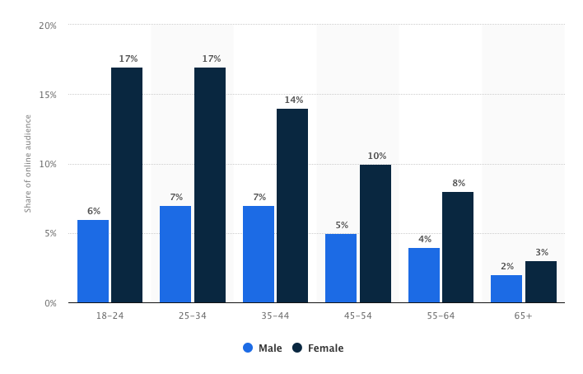
Assumptions/Potential data errors
Goodreads users reflect the overall reading population (but it probably doesn’t)
“Distribution of the online audience of goodreads.com in Great Britain (GB) in 2018, by age group and gender”, via Statista

Slide 4
Assumptions/potential data errors
List is organized by # of users who have ”added” the book, not # of users who have marked the book as ”read”
Readers classify genre, not Goodreads.

Slide 5
What affects rating?
Nothing

Slide 6
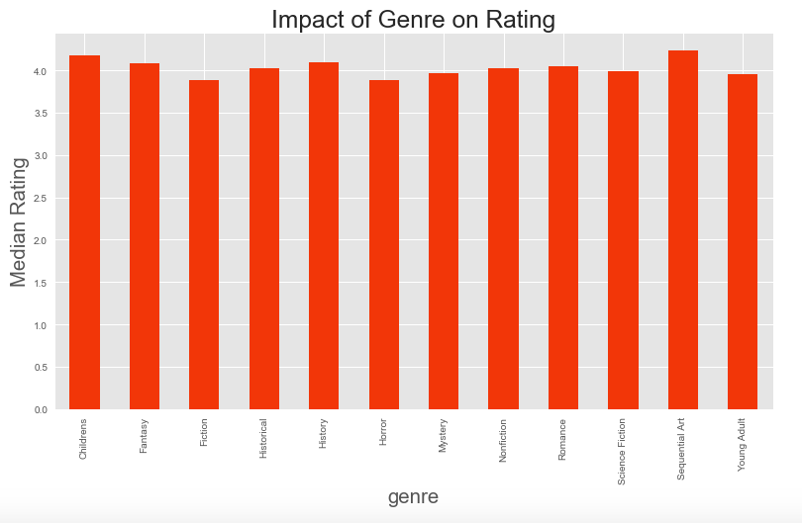
Ratings by genre

Slide 7
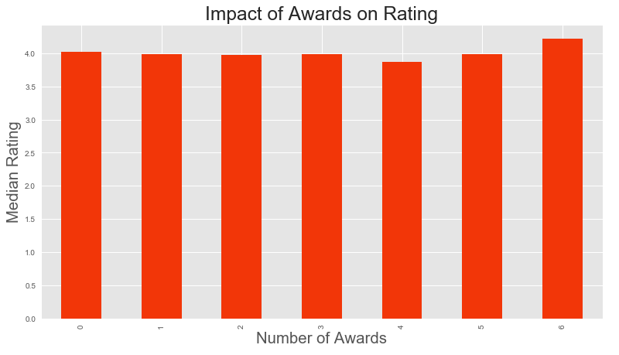
Ratings by number of awards

Slide 8
What affects How many people read a book?
Everything
…but only kind of…

Slide 9
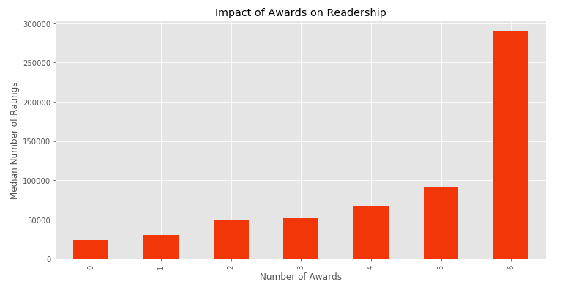
Total readers by number of awards

Slide 10
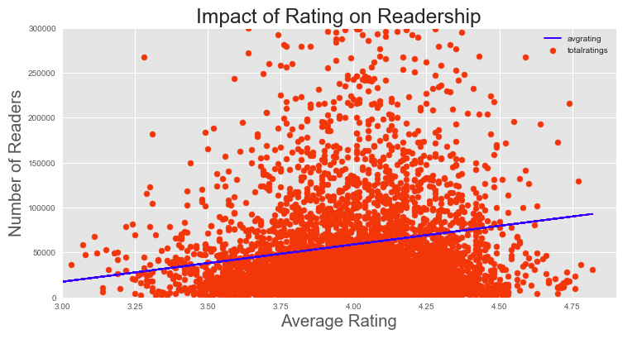
Does rating impact how many people read a book?

Slide 11
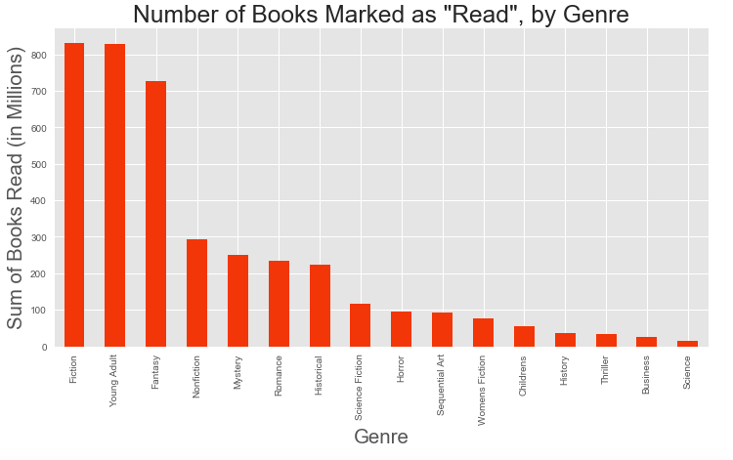
What genres should you focus on?

Slide 12
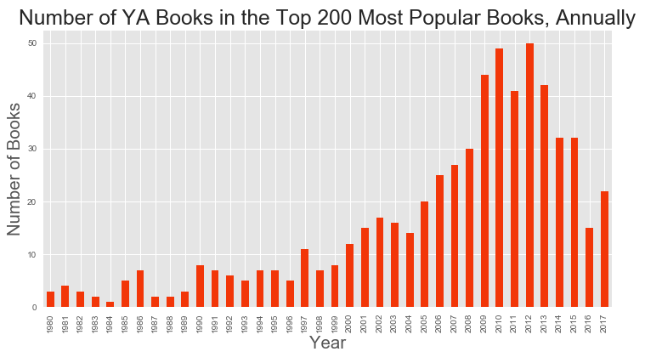
Young adult literature

Slide 13
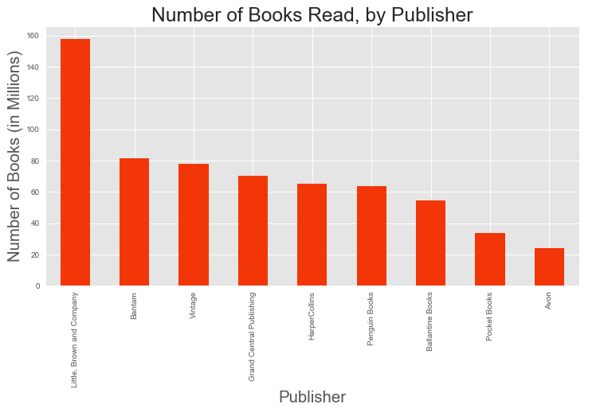
Popular publishers

Slide 14
takeaways
Try to find books by strong writers (more awards = more sales)
Focus on fiction, fantasy and young adult genres
Conduct further study on the practices of Little, Brown and Company to understand why they have had so much success

Slide 15
Moving forward
Time series analysis on YA and Fantasy
Analysis of individual books to determine what impacts ratings on a “local” level

