Slide 1
Microfluidic Valves
Benjamin Lam
Notes:
Hi everyone, today I will be talking about Microfluidic valves. This was one of the research projects I did for the Hui Lab during the 2020-2021 school year at UCI.

Slide 2
Agenda
Background
Project Motivations
Problem Solution
Testing/ Experimentation
Results
Notes:
I’ll be going through some background on Microfluidic valves first, then explaining the motivations for my project and the solution I produced. The testing and experimentation was a critical part of this project. I concluded this project last spring, so I’ll also share some of the results.

Slide 3
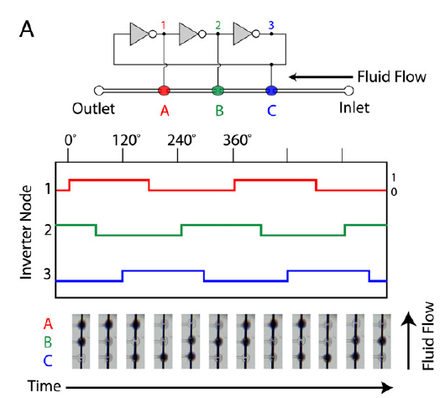
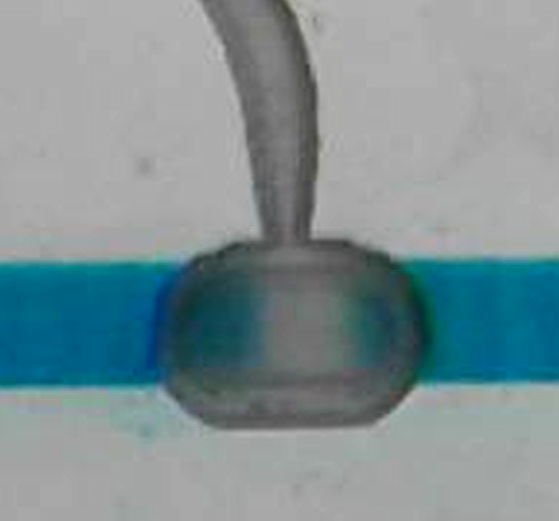
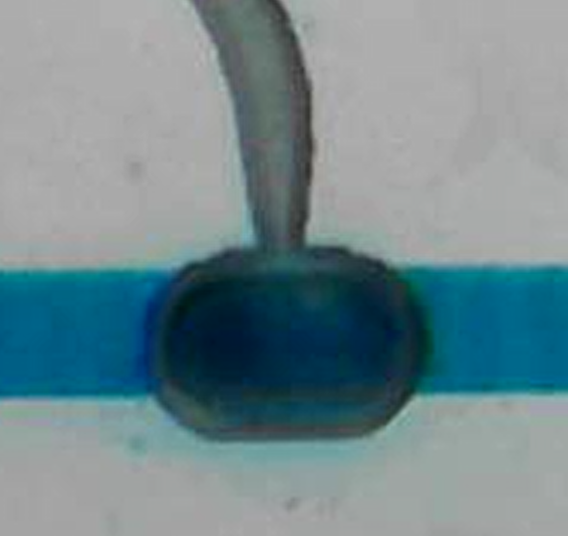
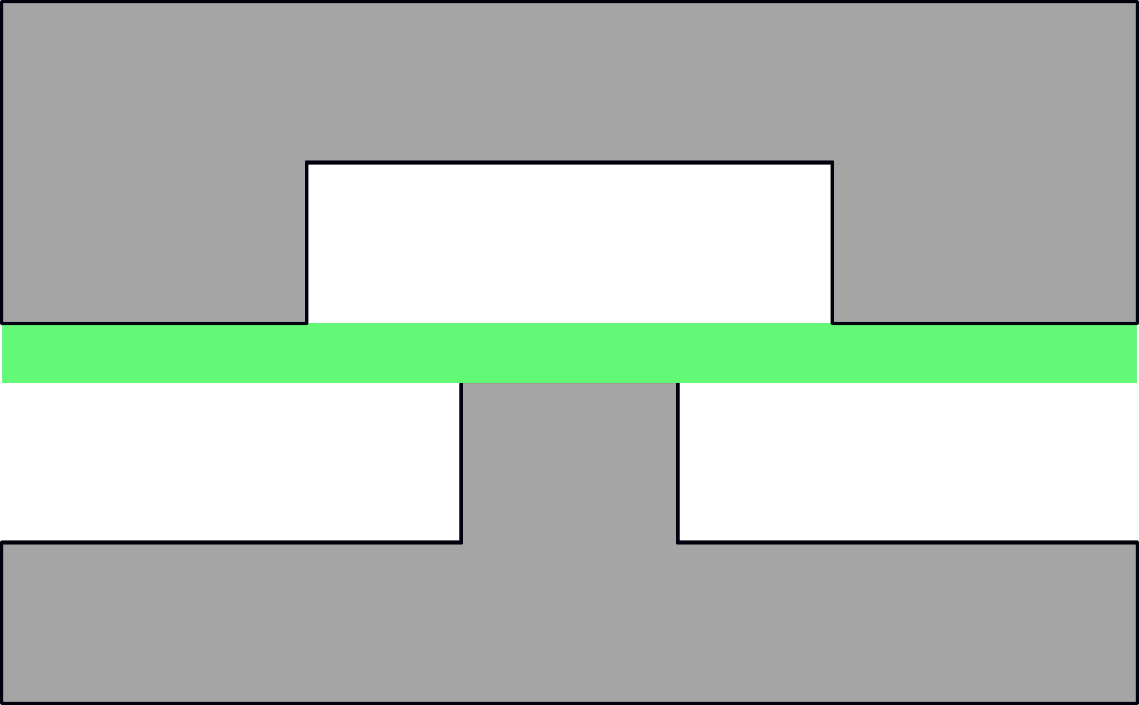
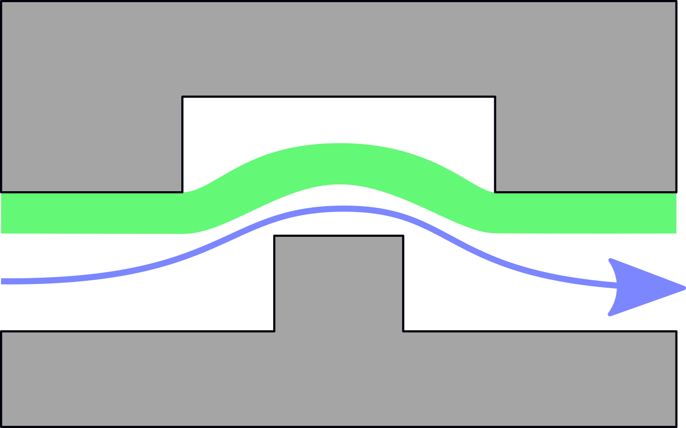
Microfluidics Background
Vacuum Pressure
Fig 3.1 Peristaltic pumping using a ring oscillator and three pumps.
[Duncan, et al. (2013) Pneumatic oscillator circuits for timing and control of integrated microfluidics]
Valve Closed
Valve Open
Notes:
Microfluidic devices deal with very small fluid volumes. Using a clever arrangement of valves, the devices, or chips, can achieve interesting behavior like pumping action and logic operations.
So here there’s an actual picture of a microfluidic valve. It’s about 1 mm in diameter. The bottom cartoons show that it is a 3 layered device with an elastic membrane sandwiched between two etched plastic pieces to form channels. A vacuum pressure is applied to the channel at the top which deflects the elastic sheet and allows fluid to pass.
On the left it’s closed and you can see the bottom piece of plastic. On the right, it’s open and water fills the valve, turning it dark blue.
Using these valves, we can get pumping action, shown on the right figure. If we open and close a valve, water will be sucked in and pushed out. But if on the left there is a closed valve, then when we close the valve, the water has to go rightwards. If we apply out of phase waveforms to 3 valves, the liquid is “squeezed along” and makes a peristaltic pump.

Slide 4
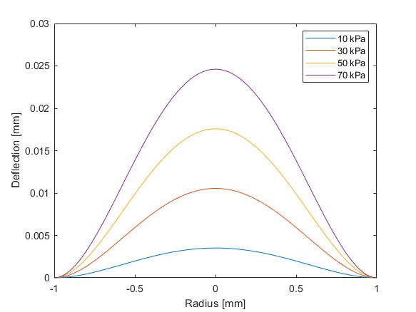
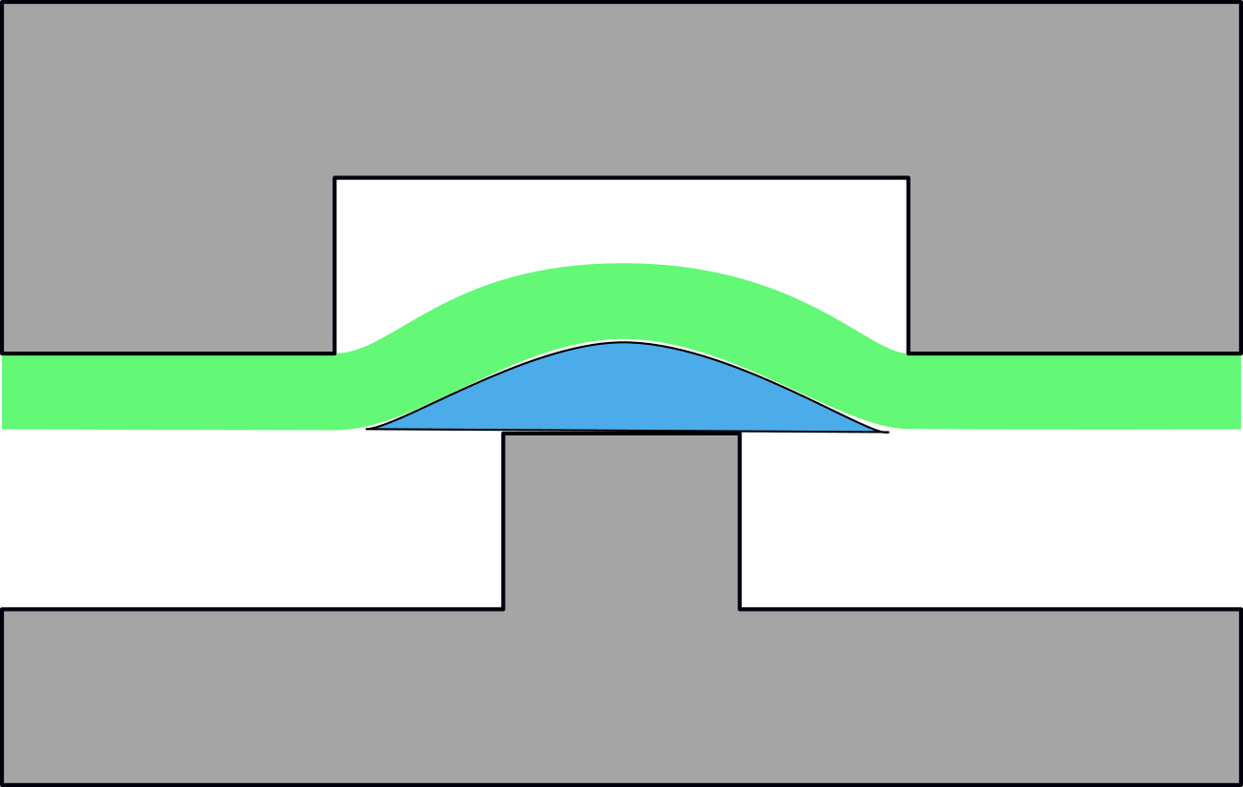
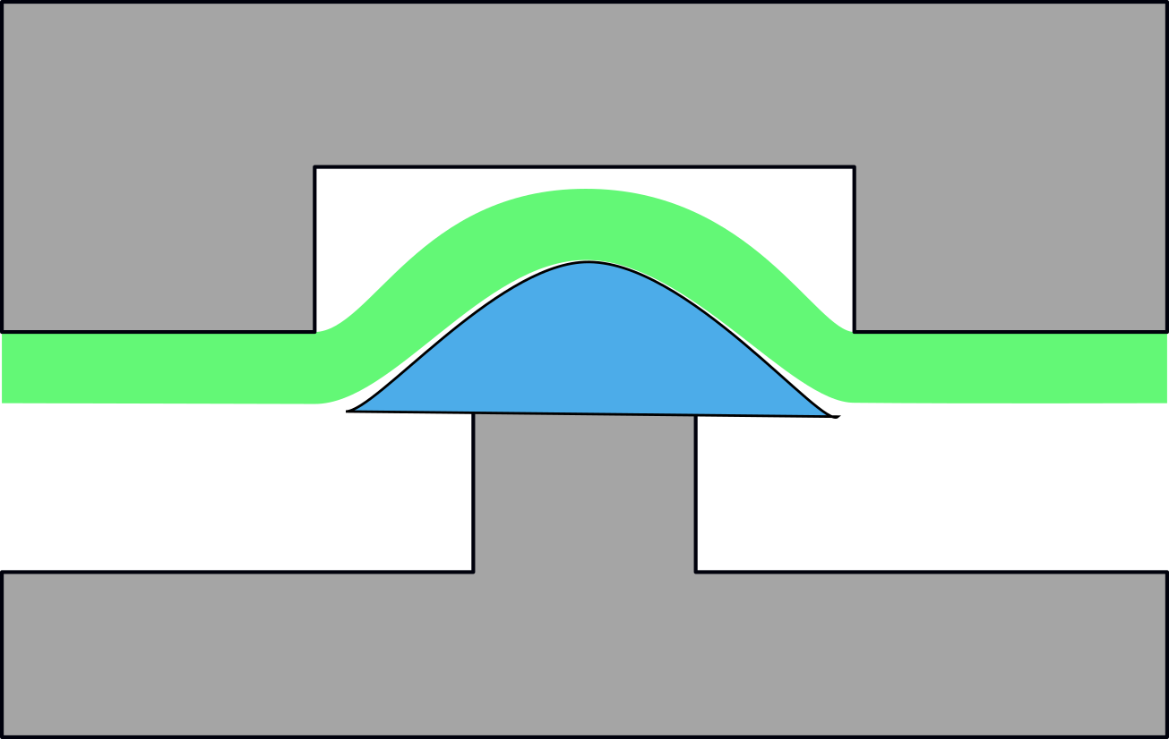
Volume Variance
Vacuum Pressure P1
P1 < P2
Vacuum Pressure P2
Fig 4.1 Deflections with varying vacuum pressure.
Notes:
When there is a different pressure applied to the membrane, a different amount of liquid volume is sucked into the valve. This is great because we now can have some flexibility with the volume amount. But what if we want a very specific amount of liquid pumped each time?

Slide 5
Project Motivation
Modify Pressure Input
Difficult in non-ideal vacuum sources, like syringes
Address volume variance in the amount of liquid pumped by valves to create more reliable microfluidic devices
Modify Valve Geometry
Easily modifiable, but limited by laser cutting
Notes:
This leads directly into the motivation for my project. I want to find a way to address the volume variance in the amount of liquid pumped by valves to create more reliable microfluidic devices.
There’s two main ways to do this: either modify the pressure input and make that more stable, or modify the valve geometry. I decided that stabilizing the pressure input was not the right path since we wanted to implement the microfluidic devices in applications with non-ideal vacuum sources, like with using syringes. The idea there is that a syringe can be pulled to provide a vacuum and a microfluidic chip can run off of that for point of care testing.
Modifying the valve geometry is the remaining option and should be easily modifiable, but the geometries are limited by shapes achievable by laser cutting.

Slide 6
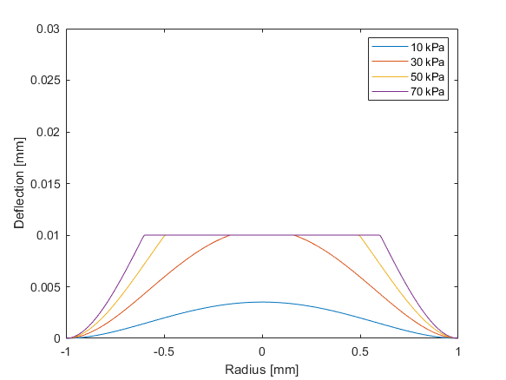
Limited Valve Design
Valve will have a shortened depth to constrain membrane deflection
At high pressures, the amount of additional volume deflected is negligible
Main idea: liquid “sucked in” reaches a saturation point as the membrane is constrained
Fig 6.1 Deflections with varying vacuum pressure for a valve height-limited to 10 µm.
Notes:
One sided tolerance, better than the two sided tolerance of pressure management

Slide 7
Testing Challenges and Requirements
Requirements:
Measure volume changes of <0.01 µL
Sampling rate of ~1 s
Measurements should be automatically processable
Challenges:
Tests done in apartment with limited space, uncontrolled lighting
Sample should not move during experiment
Notes:
Some of the requirements to test this design were that I had to measure volume changes of <0.01 µL and have a sampling rate on the order of 1s. This is because these devices may leak and I wouldn’t be able to detect leaks if I were taking measurements infrequently. This struck out some of the manual methods like measuring the amount of liquid pumped over a given amount of time….
I also wanted my testing setup to be automatically processable so I could run more of them.
I came up with using a computer vision system to find the volume change when the valve is opened and closed.
Some of the challenges I faced was that I performed these experiments in my bedroom which had limited space and uncontrolled lighting. Additionally, the sample should not move during the experiment, otherwise the test would not be accurate. In general, it was more difficult to work with a delicate system in my apartment.

Slide 8
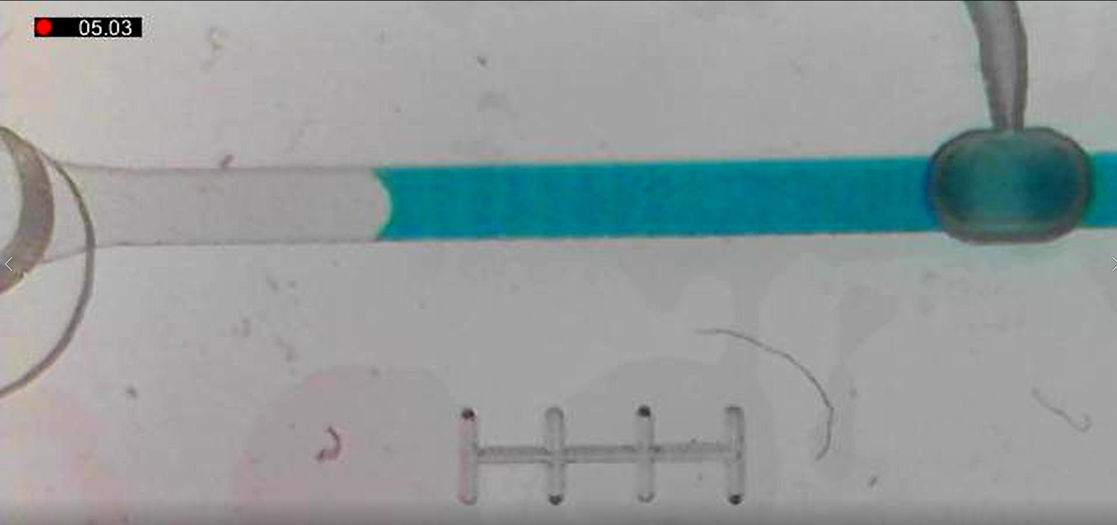
Experimental Setup
Solenoid
Notes:
Here’s a screenshot of what the computer vision system sees during a test. I turn on and off a solenoid which applies a vacuum pressure to the valve, opening and closing it. This makes the fluid in the channel move back and forth. This change can be measured using the integrated scalebar on the chip. Each division is 1 mm.

Slide 9
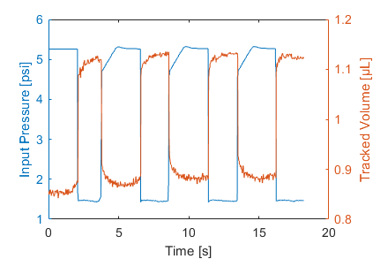
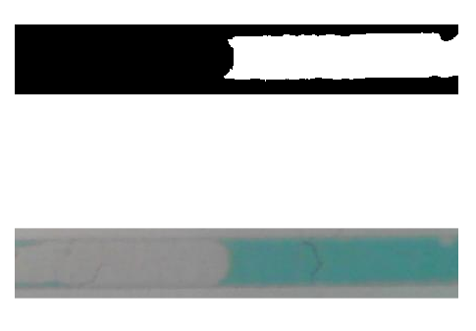
Data Flow
Storage
Camera Script
(Processing, Arduino)
.avi Video
.mat Datafile
Ingest Script
(MATLAB)
.bmp images
Pressure Data
Microscope
Data Processing (MATLAB)
Post Processing
Volume Conversion
Color Thresholding
Pixel Counting
(Convert to volume units)
Notes:
The full data flow is shown here. The microscope and sample setup is controlled using an Arduino and the images are captured using a processing script. These images and pressure data are sent to a matlab ingest script which summarizes the data into a .mat file and combines all the images into a .avi video for storage.
Next, to process the data, the image is cropped to just the channel and the color is thresholded. Now I can count the number of pixels that are water. This is a sample of the output. We can see when there is vacuum pressure, the pixel count goes down, showing that there is less “water” in the frame and that the water is sucked backwards into the valve. These pixel counts are converted into a volume measurement using the integrated scale bar and the data is sent to post processing.

Slide 10
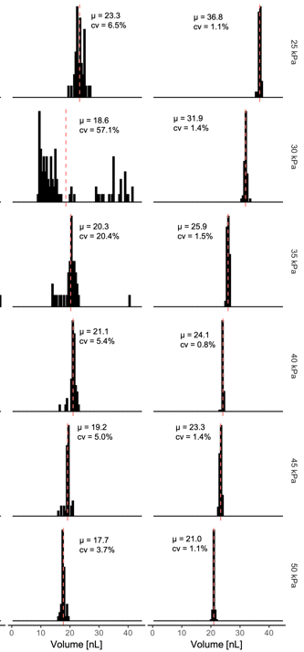
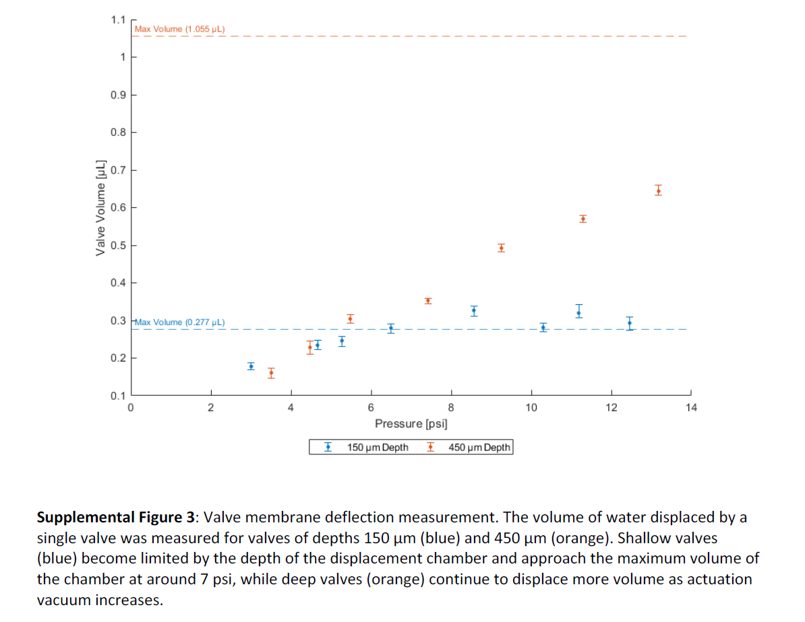
Outcomes
No Limited Depth
Limited Depth
Pressure
Fig 10.1 Supplemental figure for submitted droplet pump paper.
Fig 10.2 Comparison of droplet pumps with different valve geometry.
Notes:
My results were shown as a supplemental figure for a droplet pump paper. We can see here that for the shorter 150µm valve, the liquid volume is constrained after around 6 psi. The 450µm valve stays linear throughout the entire test. The limited depth valve design was integrated into a droplet pump and helped improve the droplet size variance.
With no limited depth valve, the droplet size has a wider distribution. At higher pressures, it does get more monodisperse. However, with the improvement, even at relatively low pressures, the distribution is far better.
This wraps up my project on Microfluidic valves and thank you for listening to my presentation

Slide 11
Supplemental Slides

Slide 12
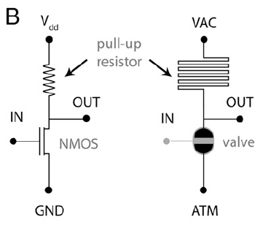
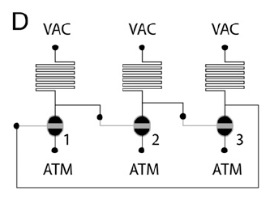
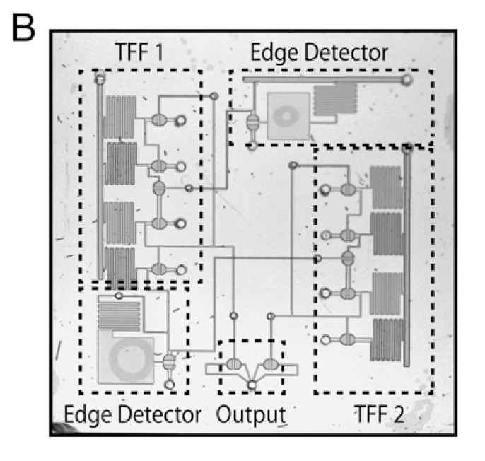
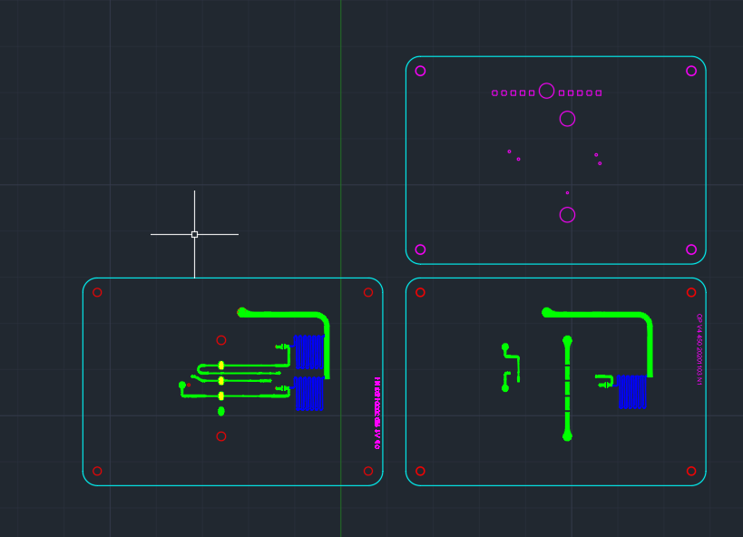
Fig S1. Microfluidic similarity to electric transistors.
Fig S2. Ring oscillator setup for microfluidic chip.
Fig S3. Frequency divider circuit
Fig S4. CAD of a microfluidic pump

