Slide 1
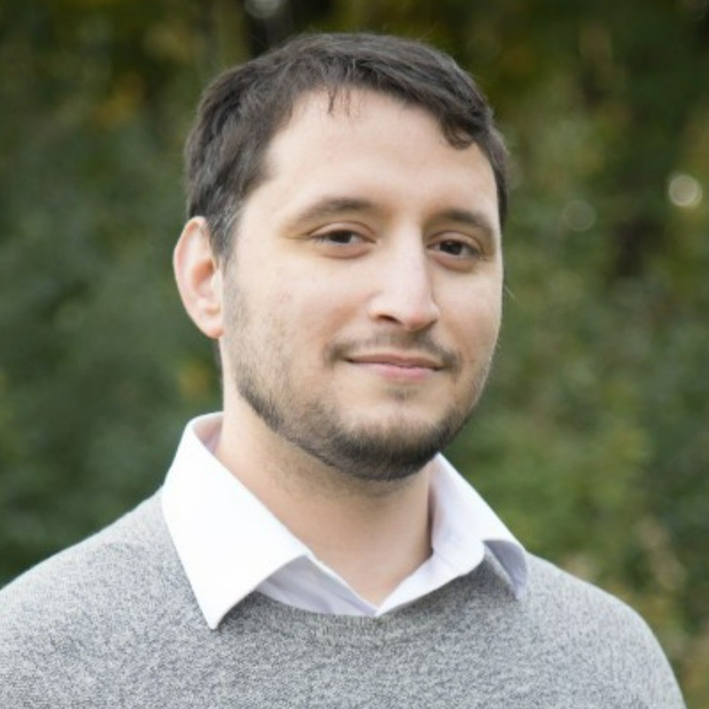



Centrality in Collaboration: Community Detection for Oncology Researchers
Benjamin Smith¹, Tyler Pittman², Wei Xu^{1,2}
¹Dalla Lana School of Public Health, Biostatistics Division, University of Toronto, Toronto, Canada.
² Department of Biostatistics, University Health Network, Toronto, Canada.
*E-mail: benyamin.smith@mail.utoronto.ca
Background:
Cancer patients who do not respond to standard treatments often become candidates for clinical trials. It is known that the collaboration networks between oncologists is a primary factor for further engagement in subsequent trial enrollment.
Social network analysis (SNA) and community detection algorithms can be used to explore collaboration patterns using data from the Princess Margaret Clinical Research Record and Cancer Registry.
Objectives:
The data consists of 2970 patients in 515 clinical trials between January 2016 to December 2018.
We are interested in the referral patterns among patients enrolled in multiple trials.
Among 389 patients enrolled in more than one of 288 trials, we aim to identify collaboration networks based on intervention type.
Methods:
We applied community detection algorithms, including Girvan-Newman and Louvain, and compared them to an author-developed algorithm that utilizes degree centrality and directionality in participant enrollments to identify influential interventions.
Community detection was assessed by superimposing sociograms and visualizing the contrast between the in-degree/out-degree distribution of participant enrollments.
Results:
Application of Girvan Newman, which incorporates edge betweenness but not degree centrality, and Louvain, which does not consider directionality, did not yield informative structure for oncology collaboration networks.
The algorithm developed by the authors found intuitively descriptive communities that were supported by the sociograms and visualized in-degree/out-degree distribution.
Conclusions:
SNA approaches utilizing a combination of degree centrality and edge betweenness can interpret oncology collaboration networks.
With this perspective, it is possible to delve deeper into patient engagement and improve the organizational design of clinical trial referrals.
References: 1.
2.
3.
4.
Acknowledgement: This work was made possible thanks to Professor Tony Panzarella and the Faculty in the Biostatistics Department at University of Toronto’s Dalla Lana School of Public Health
Benjamin Smith benyamin.smith@mail.utoronto.ca

