Slide 1
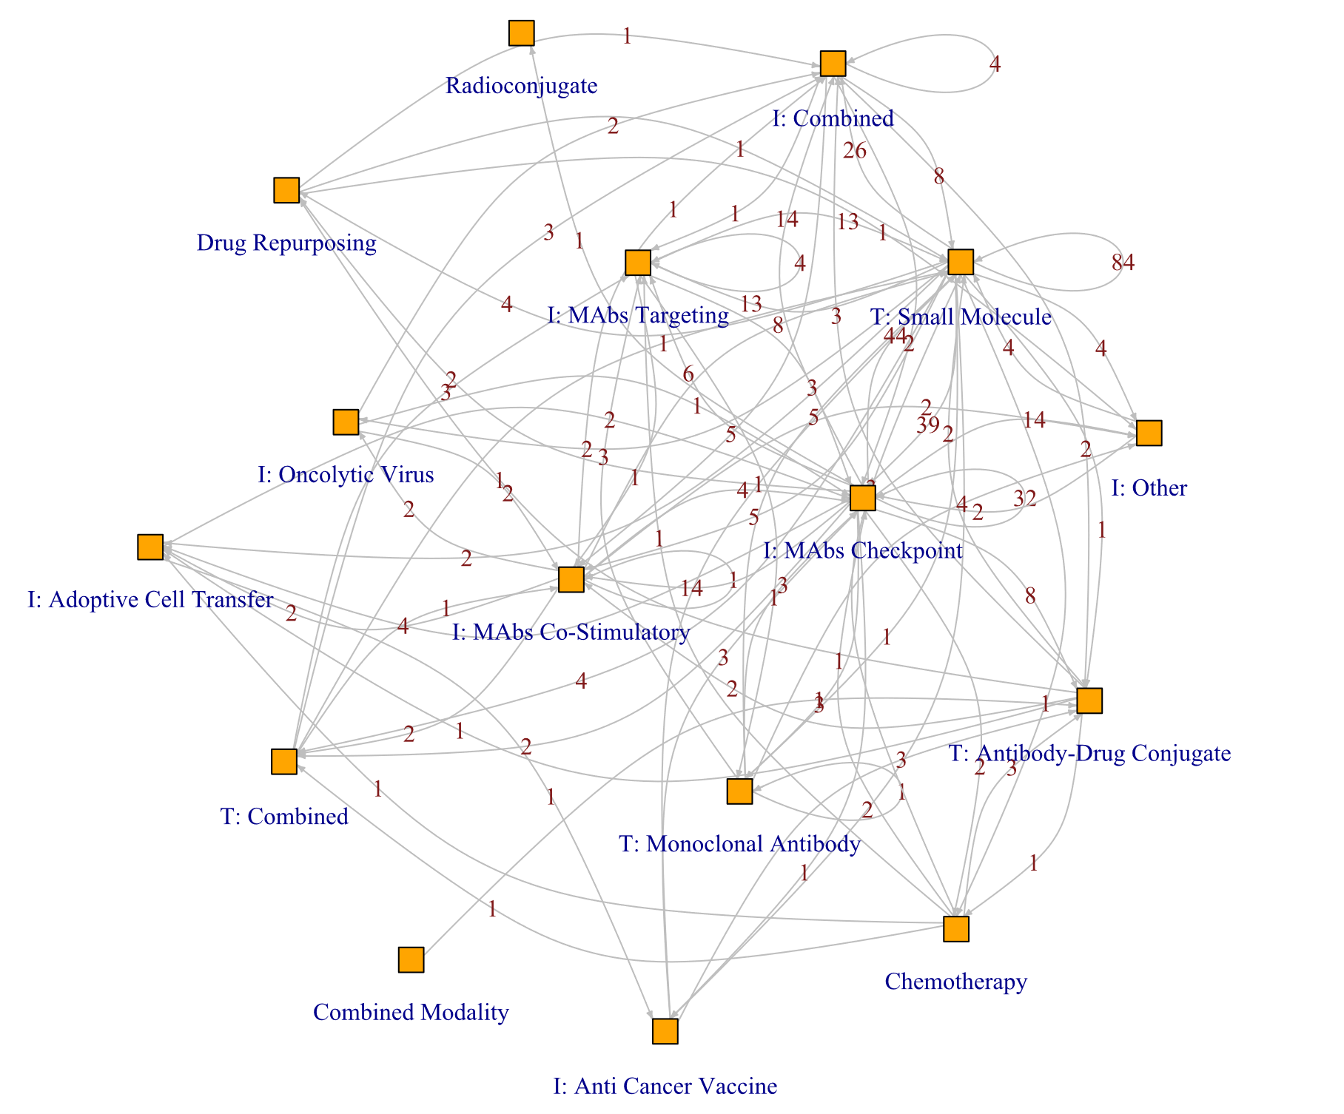
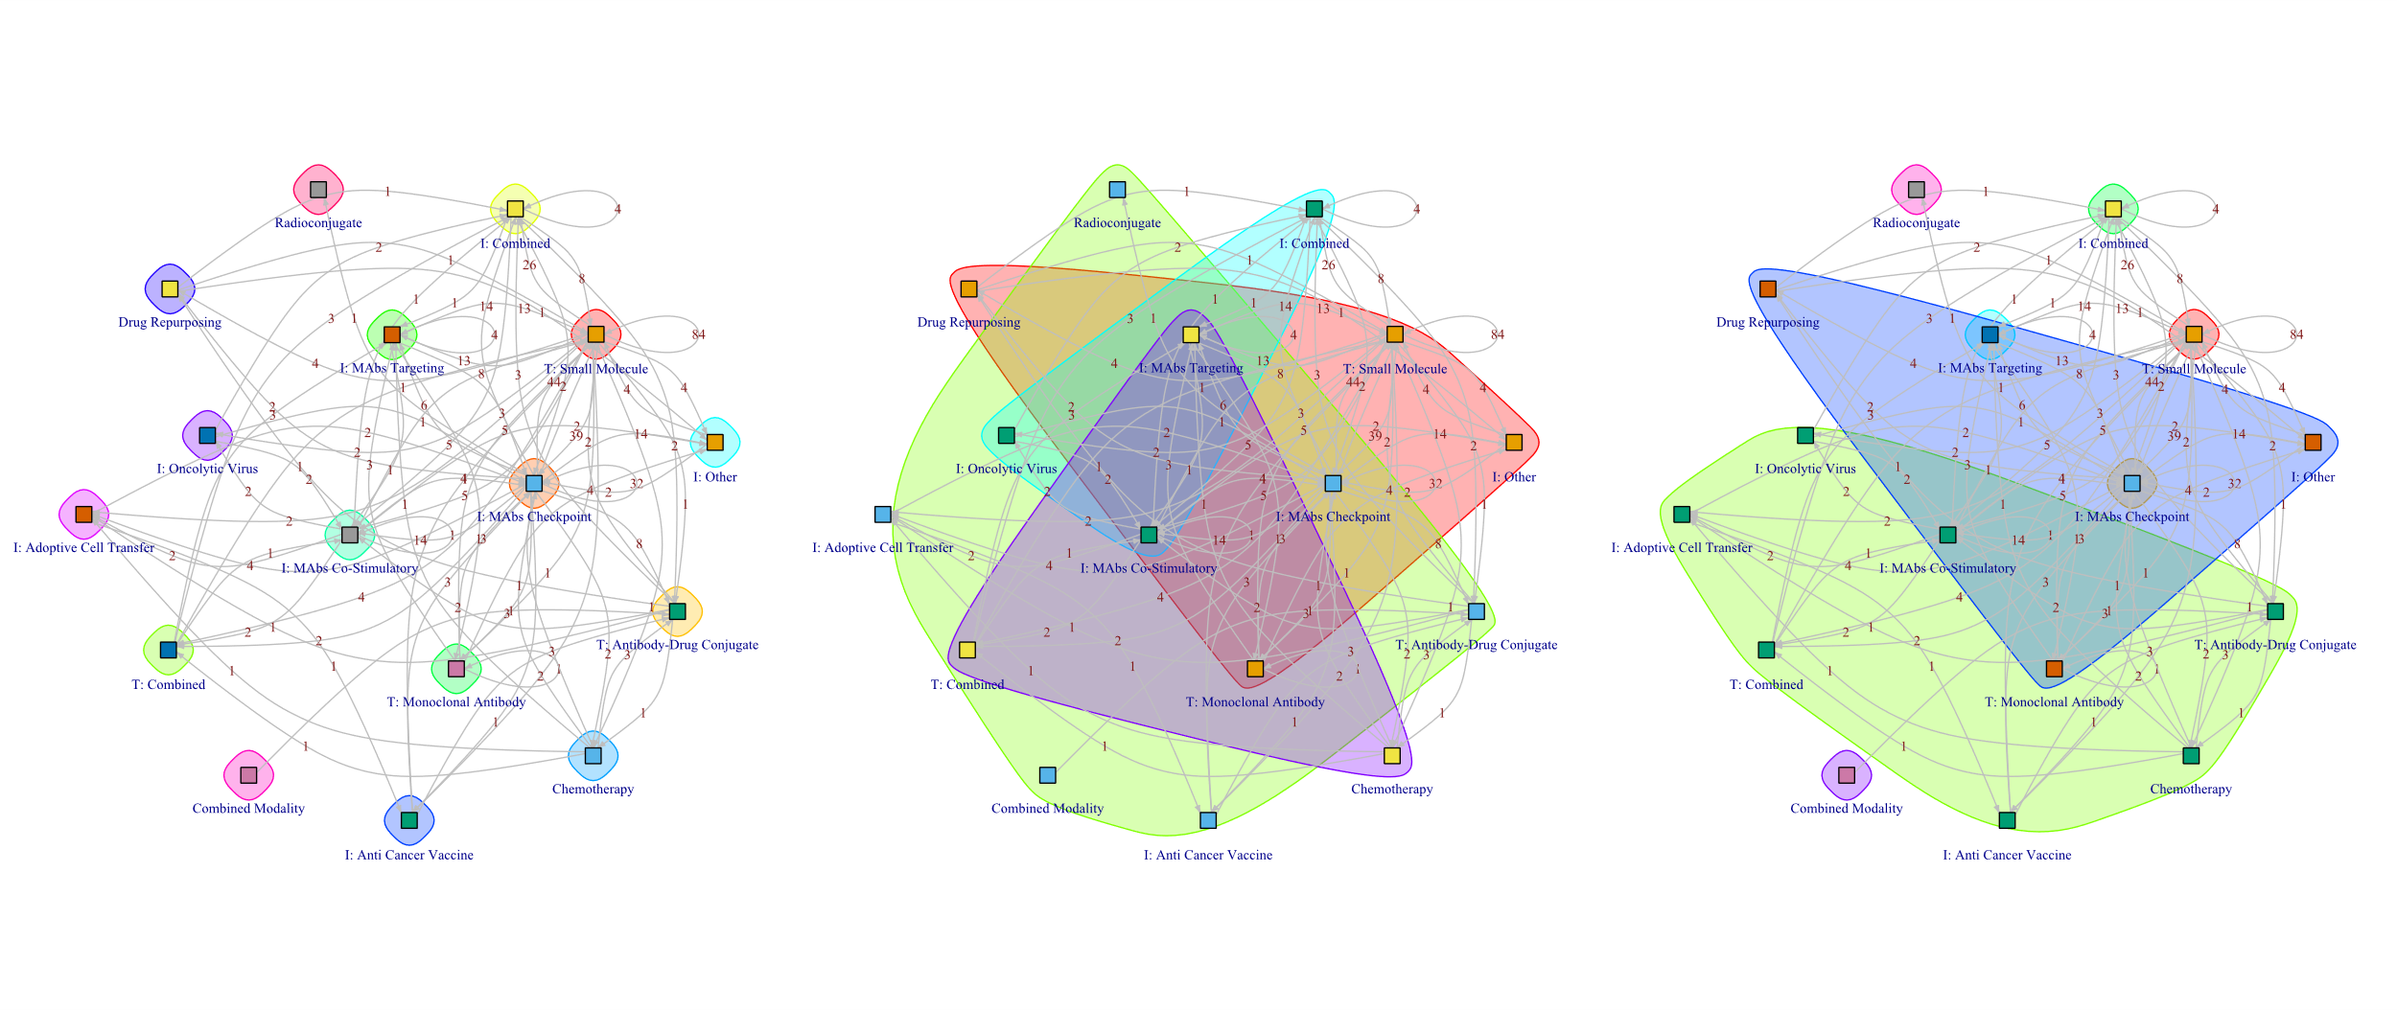
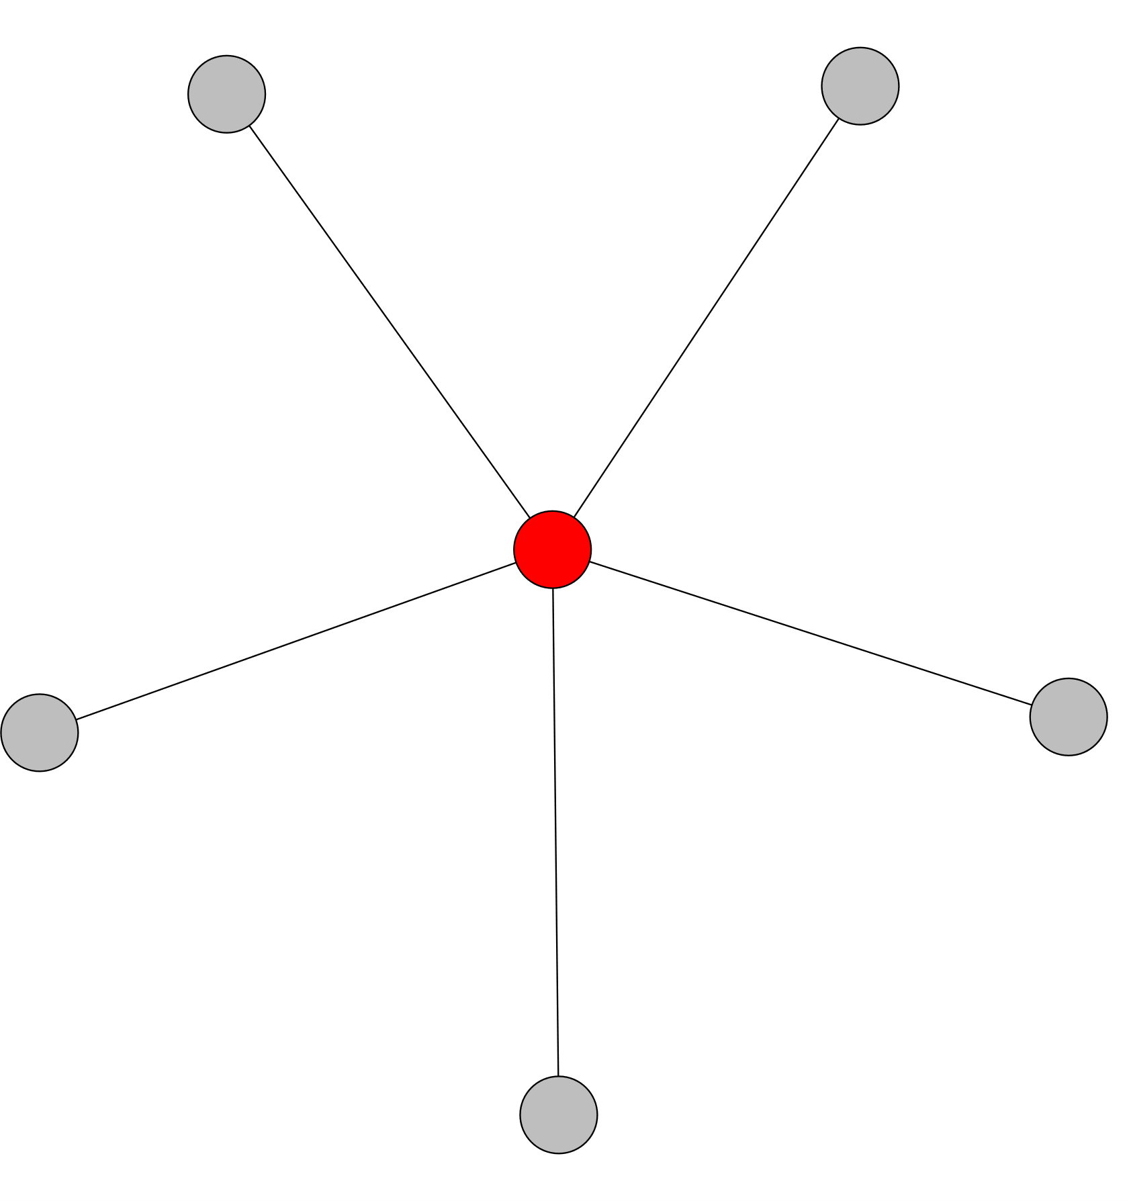
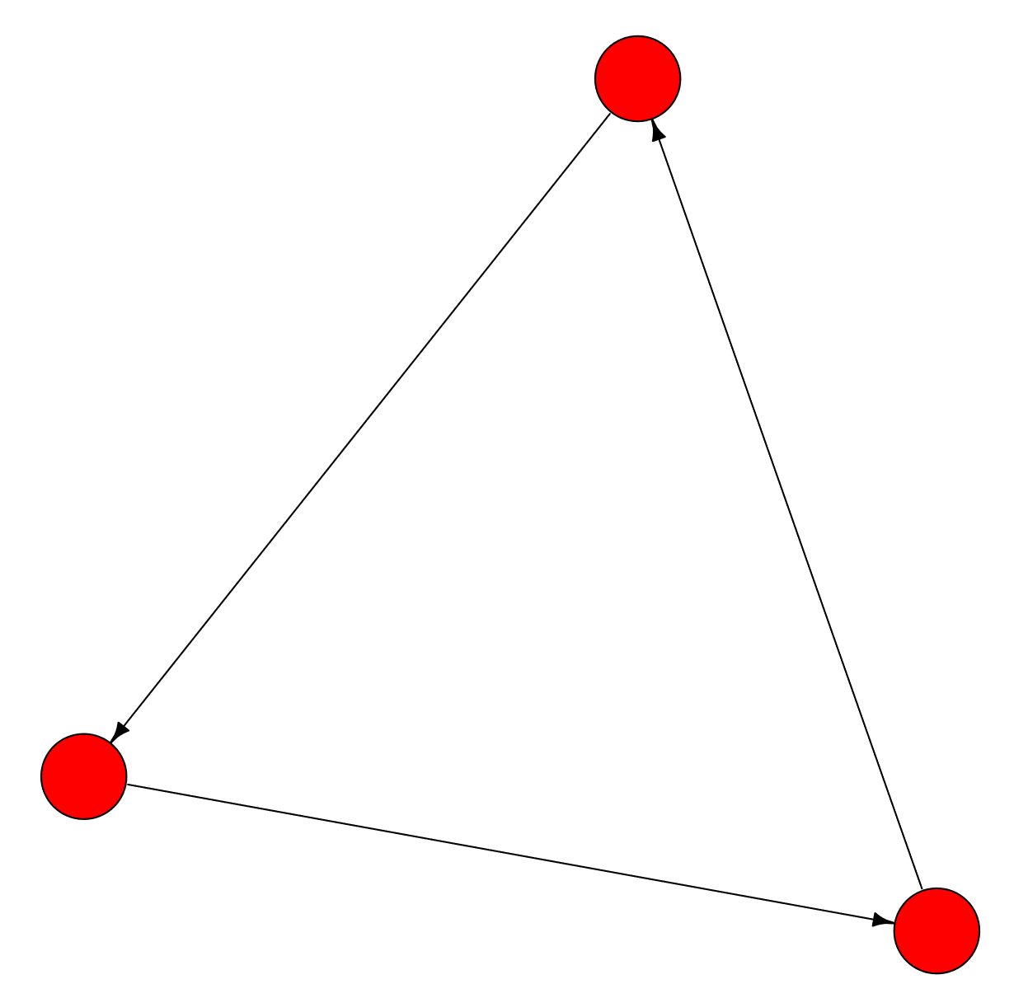
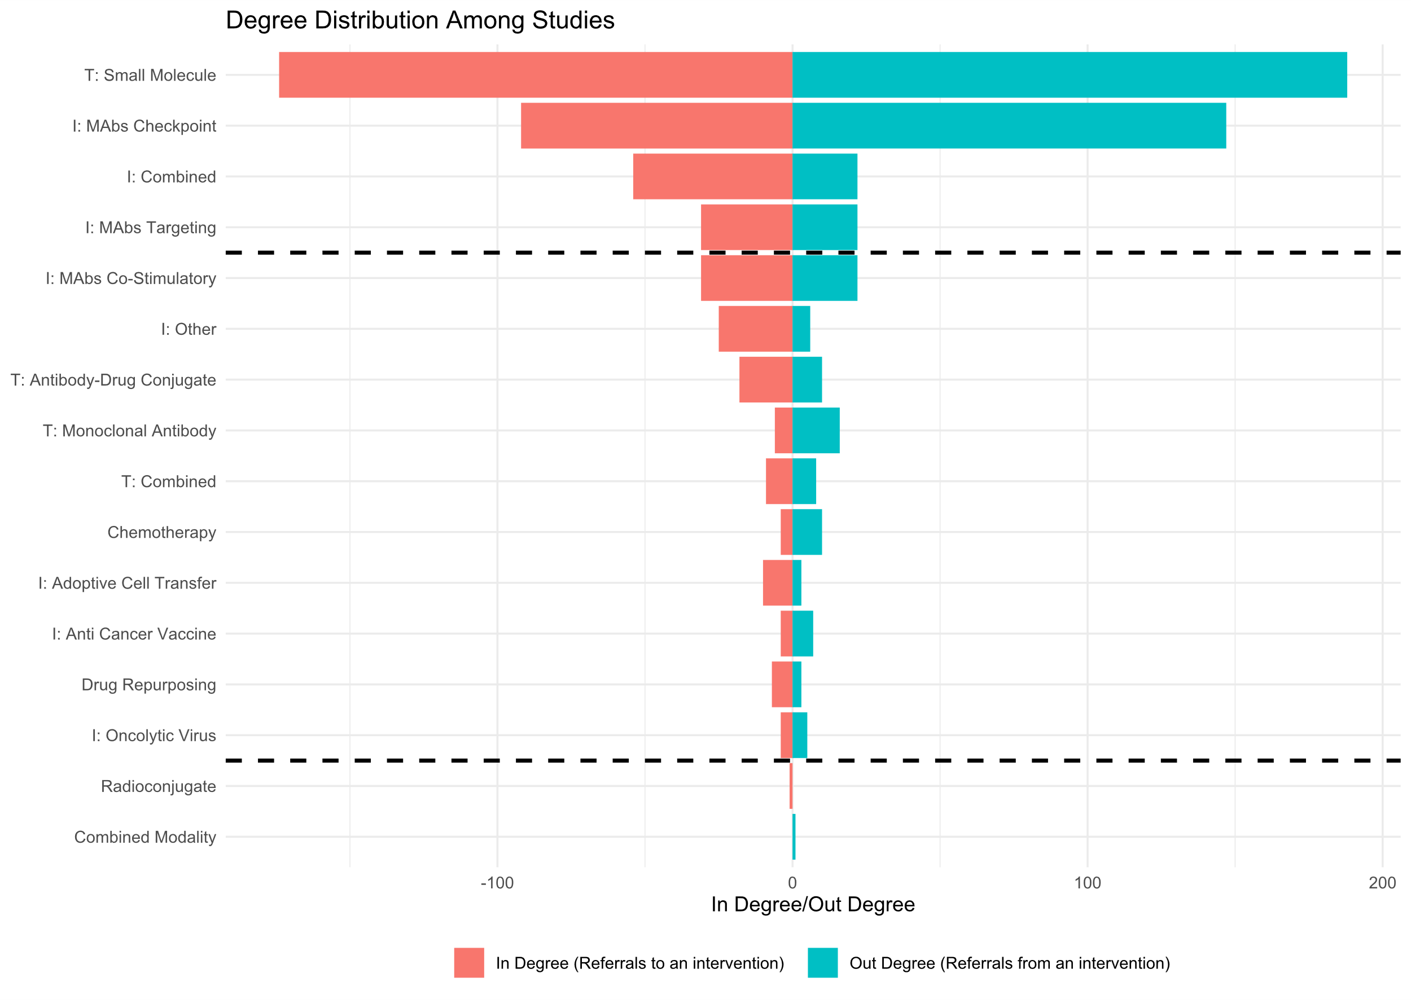





Centrality in Collaboration: Community Detection for Oncology Researchers
Benjamin Smith¹, Tyler Pittman², Wei Xu^{1,2}
¹Dalla Lana School of Public Health, Biostatistics Division, University of Toronto, Toronto, Canada.
² Department of Biostatistics, University Health Network, Toronto, Canada.
Background
Referral Network
Pre-existing Methods
Cancer patients who do not respond to standard treatments often become candidates for clinical trials.
It is known that the collaboration networks between oncologists is a primary factor for further engagement in subsequent trial enrollment by participants.
Social network analysis (SNA) and community detection algorithms can be used to explore collaboration patterns.
Figure 2: Girvan-Newman communities
Objectives
The data consists of 2970 patients in 515 clinical trials at UHN’s Princess Margaret Cancer Center spanning the time of January 2016 to December 2018.
Among 389 patients enrolled in more than one of 288 trials, we aim to identify collaboration networks based on the intervention type studied in the clinical trials (Fig. 1)
Figure 3: Louvain communities
Methods
We applied the Girvan-Newman and Louvain algorithms and compared them to an author-developed algorithm that utilizes degree centrality and directionality in participant enrollments.
Community detection was assessed by superimposing sociograms and visualizing the contrast between the in-degree/out-degree distribution.
Figure 1: Patient Referral Network Based on Intervention Type Studied in Clinical Trials at UHN’s Princess Margaret Cancer Center. Trials are classified to one of 16 intervention types.
Results
Application of Girvan-Newman (Fig. 2), which incorporates edge betweenness but not degree centrality (Fig. 4(a)), and Louvain (Fig. 3), which does not consider directionality (Fig. 4(b)), did not yield informative structure for oncology collaboration networks.
The algorithm developed by the authors (Fig. 5) found intuitively descriptive communities that were supported by the sociograms and visualized in-degree/out-degree distribution (Fig. 6)
Figure 4(a): Degree Centrality, A.K.A. the number of patient referrals intervention has given/received.
Figure 4(b): Directionality in relationships, A.K.A. the number of patients referred to/referred from an intervention type.
Author Developed Method
Conclusions
SNA approaches utilizing a combination of degree centrality and edge betweenness can interpret oncology collaboration networks.
With this perspective, it is possible to delve deeper into patient engagement and improve the organizational design of clinical trial referrals.
References
1. Rostami et al., 2023, IEEE, 10.1109/ACCESS.2023.3260652
2. Girvan et al., 2002, PNAS, 10.1073/pnas.122653799
3. Blondel et al., 2008, JSTAT, 10.1088/1742-5468/2008/10/p10008
Acknowledgements
Figure 5: Author-developed algorithm communities
Figure 6: In-degree/out-degree distribution. The author developed algorithm’s communities can be reflected in this distribution offering intuitively descriptive communities.
This work was made possible thanks to Dr. Wendy Lou, Professor Tony Panzarella and the Faculty in the Biostatistics Department at University of Toronto’s Dalla Lana School of Public Health
Benjamin Smith benyamin.smith@mail.utoronto.ca
Notes:
Hello Everyone,
My name is Benjamin and my Scientific Poster is titled "Centrality in Collaboration: Community Detection for Oncology Researchers".
The poster is based on the work from my practicum, which uses data from the Princess Margaret Clinical Record and Cancer Registry between the time of January 2016 to December 2018.
Our research problem is that when Cancer patients do not respond to standard treatments, they become candidates for Clinical trials. It is known that collaboration between oncologists is a primary factor for subsequent enrollment by patients in other clinical trials.
With the referral data that we have, we are looking to identify collaboration networks between oncologists via patient referrals between intervention types studied in the Clinical Trials.
A way to find these collaboration networks can be through Social Network Analysis and in particular - Community Detection Algorithms.
Figure 1 shows the social network constructed from the patient referral data which is from the referral data. From the 2970 patients enrolled in 515 clinical trials we limited the study to patients who were enrolled in more than one clinical trial because we are interested in in understanding patient movement between intervention types studied in the clinical trials- which results in 389 patients in 288 clinical trials which were classified by their intervention types- resulting in 16 unique interventions
For applying the community detection algorithms we first tried two popular algorithms, Girvan Newman and Louvain (listed in figures 2 and 3) and found that the communities identified were not very descriptive.
In particular Girvan newman assigned each intervention to their own communtity which isn't very informative. And Louvain did group nodes together, but is hard to interpret descriptively.
Figures 4(a) and 4(b) show that the author developed algorithm utilizes degree centrality- a measure that can be understood here as the number of referrals a certain intervention recieves or gives to others. And directionality- corresponding to the direction of the referral towards it or from it.
The results shown in Figures 5 and 6 show that with the author developed algorithm, the communities identified show the existence of popular and unpopular individual interventions which are identified as their own communities with the other nodes being identified as their own ambivalent communities. A story which is more aligned with the ground truth and offers a description that is visible both in view of the network and in the in-degree/out-degree distribution where these popular/unpopular interventions are present by the extrema.

