Slide 1









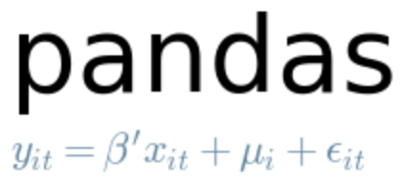



Box Office Smash Architecture Diagram
GitHub
SQL
Data Ingestion
AWS RDS
AWS EC2
Data Storage
v
Data Wrangling
PostGreSQL DB
Exploratory Analysis
Machine Learning
Input Data
boxofficemojo
Input Data
psycopg2
the-numbers.com
imdb.com

Slide 2
Box Office Smash Architecture Diagram
GitHub
SQL
Data Storage
Data Wrangling
Data Ingestion
AWS RDS
Exploratory Analysis
AWS S3
Machine Learning
Object
Storage
PostGreSQL DB
psycopg2
Input Data
boxofficemojo
Input Data
Data Visulization
the-numbers.com
imdb.com
matplatlib
ploty
seaborn
ggplt2

Slide 3

Box Office Smash Architecture Diagram
GitHub
SQL
Data Wrangling
Data Ingestion
AWS RDS
Exploratory Analysis
Data Storage
Machine Learning
PostGreSQL DB
psycopg2
Input Data
boxofficemojo
Input Data
Data Visulization
the-numbers.com
imdb.com

Slide 4
Box Office Smash Architecture Diagram
Input Data
Data Munging
boxofficemojo
Data Wrangling
the-numbers.com
Data Ingestion
Jupyter
Notebook
Data Modeling
GitHub
imdb.com
DB Connection
psycopg2
datasets.imdbws
Data Storage
Source Code
AWS S3
AWS RDS
Object
Storage
PostGreSQL DB
Data Visulization
pgAdmin

Slide 5
Box Office Smash Architecture Diagram
Input Data
Data Munging
boxofficemojo
Data Wrangling
the-numbers.com
Data Ingestion
Jupyter
Notebook
Data Modeling
GitHub
imdb.com
DB Connection
psycopg2
datasets.imdbws
AWS RDS
Source Code
Data Storage
PostGreSQL DB
Data Visulization
pgAdmin

