Slide 1
Digital Video
Solutions to Final Exam 2011
Edited by Shih-Ming Huang
Confirmed by Prof. Jar-Ferr Yang
LAB: 92923 R, TEL: ext. 621
E-mail: smhuang@video5.ee.ncku.edu.tw
Page of MediaCore: http://mediawww.ee.ncku.edu.tw

Slide 2
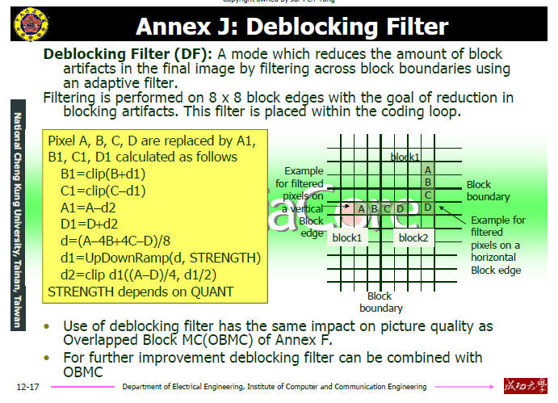
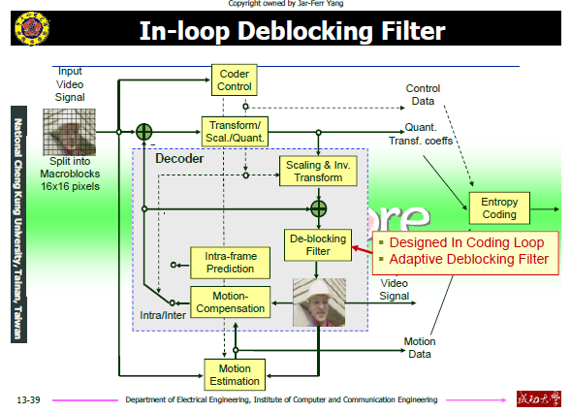
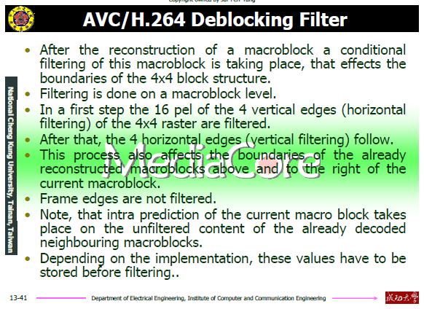
1 (1)
H.263
H.264

Slide 3
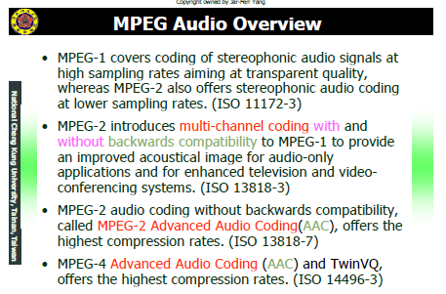


1 (2)

Slide 4

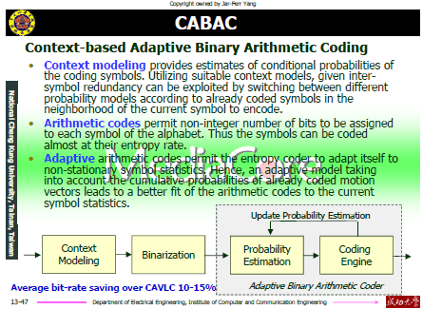
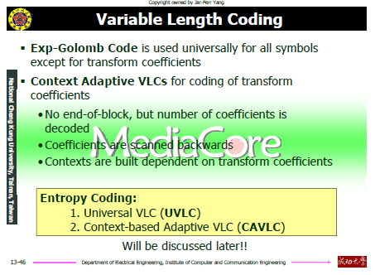
1 (3)

Slide 5
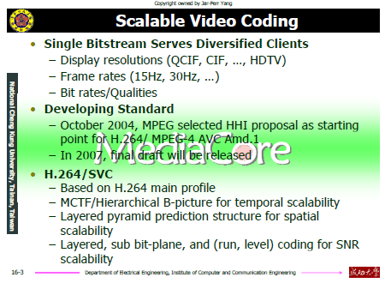
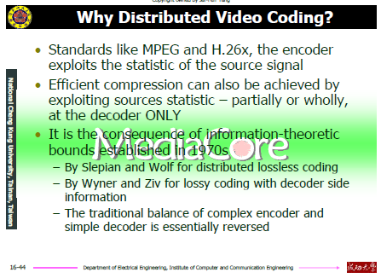
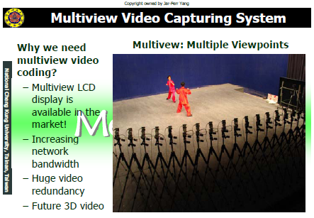
1 (4)

Slide 6
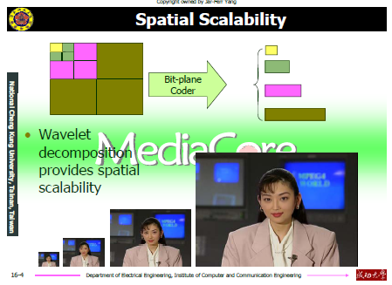
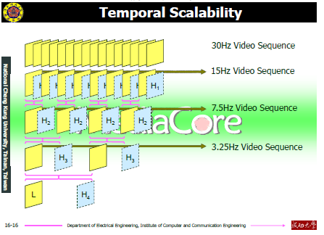
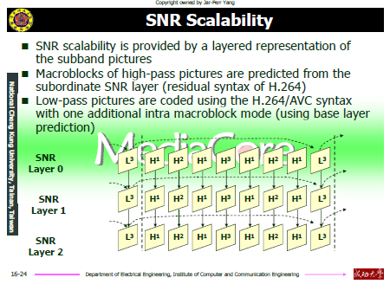
1 (5)

Slide 7
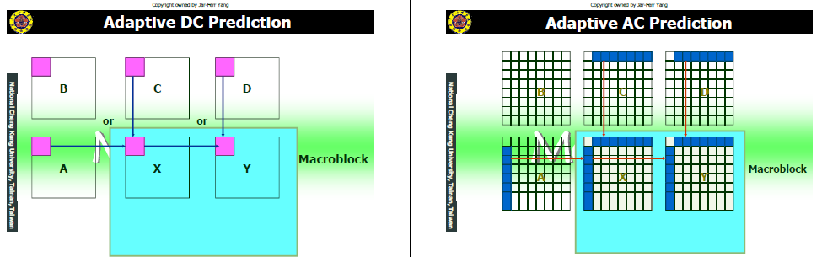
1 (6)

Slide 8
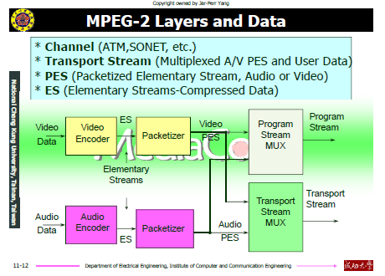
1 (7)

Slide 9
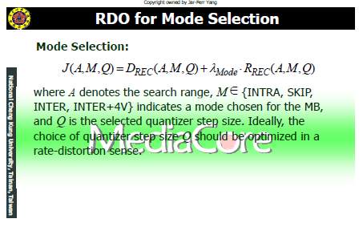
1 (8)

Slide 10

1 (9)

Slide 11
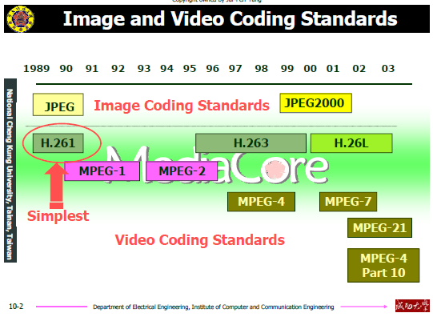


1 (10)

Slide 12
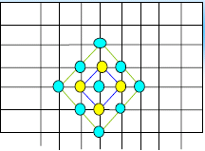
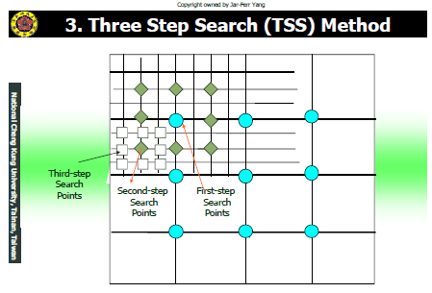
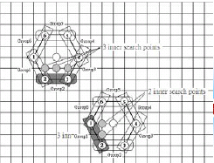
2.1
(a)
(b)
(c)
Diamond Search:
Best 9+4 = 13 points
Three Step Search:
Best 9+8+8+8
Enhanced Hexagon Search:
Best 7+2 = 9 points

Slide 13
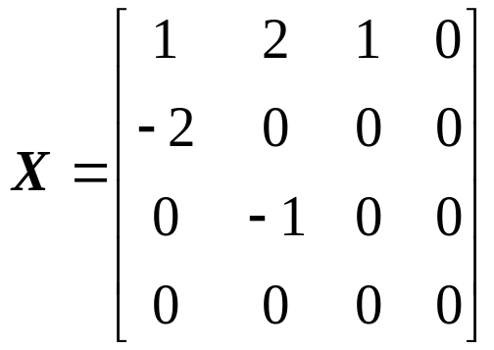
2.2
Reordered Block Data:
1, 2, -2, 0, 0, 1, 0, 0, -1, 0…
(a)
1, 2, -2, 0, 0, 1, 0, 0, -1, 0…
TotalCoeffs = 5
TotalZeros = 4
TrailingOne = 2
1, 2, -2, 0, 0, 1, 0, 0, -1, 0…
1, 2, -2, 0, 0, 1, 0, 0, -1, 0…

Slide 14
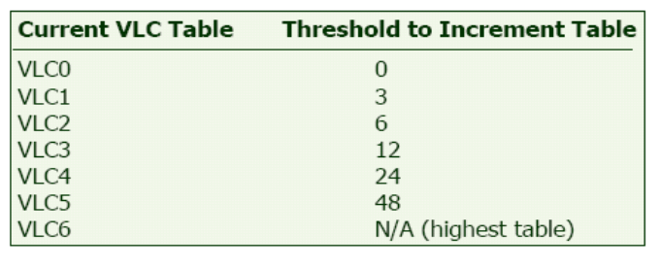
Reordered Block Data: 1, 2, -2, 0, 0, 1, 0, 0, -1, 0…
2.2
(b)
(1) nA=2, nB=4, nC = (nA + nB + 1)>>1=3
Coeff_token : 0000101 (查表)( TrailingOne = 2, TotalCoeffs = 5, nC = 3 )
(2) T1 sign codes : 10 (− +)
(3) Level codes : 0101010 (查表)
Level [2]: -1 (use Level_VLC0) 01
Level [1]: 2 (use Level_VLC1) 010
Level [0]: 1 (use Level_VLC1) 10
(4) TotalZeros code : 110 (查表) ( TotalZeros = 4, TotalCoeffs = 5 )
(5) Run_before codes : 0100
Run_before[4]: ZerosLeft=4; run_before=2 01 (查表)
Run_before[3]: ZerosLeft=2; run_before=2 00 (查表)
Run_before[2]: ZerosLeft=0; run_before=0 No code required
Run_before[1]:
Run_before[0]:
Note: Level (1), with a value of +2, is encoded as +1. If there are less than 3 T1s, then the first non-T1 level will not have a value of +/-1 (otherwise it would have been encoded as a T1). To save bits, this level is decremented if positive and incremented if negative.

Slide 15
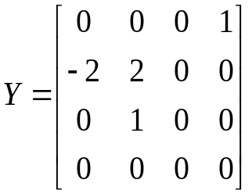
2.2
(c)
nA=2, nB=4, nC = (nA + nB + 1)>>1= 3
In Standard !!!
Bitstream: 000101 00 1 011 101 10 10 10
Code Element Value Output array
000101
coeff_token
TotalCoeffs=4, T1s=2
Empty
0
T1 sign
+
+1
0
T1 sign
+
+1, +1
1
Level (VLC_0)
+1 decoded as +2
+2, +1, +1
011
Level (VLC_1)
-2
-2, +2, +1, +1
101
TotalZeros
5
-2, +2, +1, +1
10
run_before
1
-2, +2, +1, 0, +1
10
run_before
1
-2, +2, 0, +1, 0, +1
10
run_before
1
-2, 0, +2, 0, +1, 0, +1
Last run_before
0, 0, -2, 0, +2, 0, +1, 0, +1

Slide 16
Table – coeff_token mapping to TotalCoeff( coeff_token ) and TrailingOnes( coeff_token )
TrailingOnes ( coeff_token ) | TotalCoeff ( coeff_token ) | 0 <= nC < 2 | 2 <= nC < 4 | 4 <= nC < 8 | 8 <= nC | nC = = -1
0 | 0 | 1 | 11 | 1111 | 0000 11 | 01
0 | 1 | 0001 01 | 0010 11 | 0011 11 | 0000 00 | 0001 11
1 | 1 | 01 | 10 | 1110 | 0000 01 | 1
0 | 2 | 0000 0111 | 0001 11 | 0010 11 | 0001 00 | 0001 00
1 | 2 | 0001 00 | 0011 1 | 0111 1 | 0001 01 | 0001 10
2 | 2 | 001 | 011 | 1101 | 0001 10 | 001
0 | 3 | 0000 0011 1 | 0000 111 | 0010 00 | 0010 00 | 0000 11
1 | 3 | 0000 0110 | 0010 10 | 0110 0 | 0010 01 | 0000 011
2 | 3 | 0000 101 | 0010 01 | 0111 0 | 0010 10 | 0000 010
3 | 3 | 0001 1 | 0101 | 1100 | 0010 11 | 0001 01
0 | 4 | 0000 0001 11 | 0000 0111 | 0001 111 | 0011 00 | 0000 10
1 | 4 | 0000 0011 0 | 0001 10 | 0101 0 | 0011 01 | 0000 0011
2 | 4 | 0000 0101 | 0001 01 | 0101 1 | 0011 10 | 0000 0010
3 | 4 | 0000 11 | 0100 | 1011 | 0011 11 | 0000 000
0 | 5 | 0000 0000 111 | 0000 0100 | 0001 011 | 0100 00 | -
1 | 5 | 0000 0001 10 | 0000 110 | 0100 0 | 0100 01 | -
2 | 5 | 0000 0010 1 | 0000 101 | 0100 1 | 0100 10 | -
3 | 5 | 0000 100 | 0011 0 | 1010 | 0100 11 | -
0 | 6 | 0000 0000 0111 1 | 0000 0011 1 | 0001 001 | 0101 00 | -
1 | 6 | 0000 0000 110 | 0000 0110 | 0011 10 | 0101 01 | -
2 | 6 | 0000 0001 01 | 0000 0101 | 0011 01 | 0101 10 | -
3 | 6 | 0000 0100 | 0010 00 | 1001 | 0101 11 | -

Slide 17
Table – total_zeros tables for 4x4 blocks with TotalCoeff( coeff_token ) 1 to 7
Table – Tables for run_before
total_zeros | TotalCoeff( coeff_token )
 | 1 | 2 | 3 | 4 | 5 | 6 | 7
0 | 1 | 111 | 0101 | 0001 1 | 0101 | 0000 01 | 0000 01
1 | 011 | 110 | 111 | 111 | 0100 | 0000 1 | 0000 1
2 | 010 | 101 | 110 | 0101 | 0011 | 111 | 101
3 | 0011 | 100 | 101 | 0100 | 111 | 110 | 100
4 | 0010 | 011 | 0100 | 110 | 110 | 101 | 011
5 | 0001 1 | 0101 | 0011 | 101 | 101 | 100 | 11
6 | 0001 0 | 0100 | 100 | 100 | 100 | 011 | 010
7 | 0000 11 | 0011 | 011 | 0011 | 011 | 010 | 0001
8 | 0000 10 | 0010 | 0010 | 011 | 0010 | 0001 | 001
9 | 0000 011 | 0001 1 | 0001 1 | 0010 | 0000 1 | 001 | 0000 00
10 | 0000 010 | 0001 0 | 0001 0 | 0001 0 | 0001 | 0000 00
11 | 0000 0011 | 0000 11 | 0000 01 | 0000 1 | 0000 0
12 | 0000 0010 | 0000 10 | 0000 1 | 0000 0
13 | 0000 0001 1 | 0000 01 | 0000 00
14 | 0000 0001 0 | 0000 00
15 | 0000 0000 1
run_before | zerosLeft
 | 1 | 2 | 3 | 4 | 5 | 6 | >6
0 | 1 | 1 | 11 | 11 | 11 | 11 | 111
1 | 0 | 01 | 10 | 10 | 10 | 000 | 110
2 | - | 00 | 01 | 01 | 011 | 001 | 101
3 | - | - | 00 | 001 | 010 | 011 | 100
4 | - | - | - | 000 | 001 | 010 | 011
5 | - | - | - | - | 000 | 101 | 010
6 | - | - | - | - | - | 100 | 001
7 | - | - | - | - | - | - | 0001
8 |  | - | - | - | - | - | 00001
9 | - | - | - | - | - | - | 000001
10 | - | - | - | - | - | - | 0000001
11 | - | - | - | - | - | - | 00000001
12 | - | - | - | - | - | - | 000000001
13 | - | - | - | - | - | - | 0000000001
14 | - | - | - | - | - | - | 00000000001

Slide 18
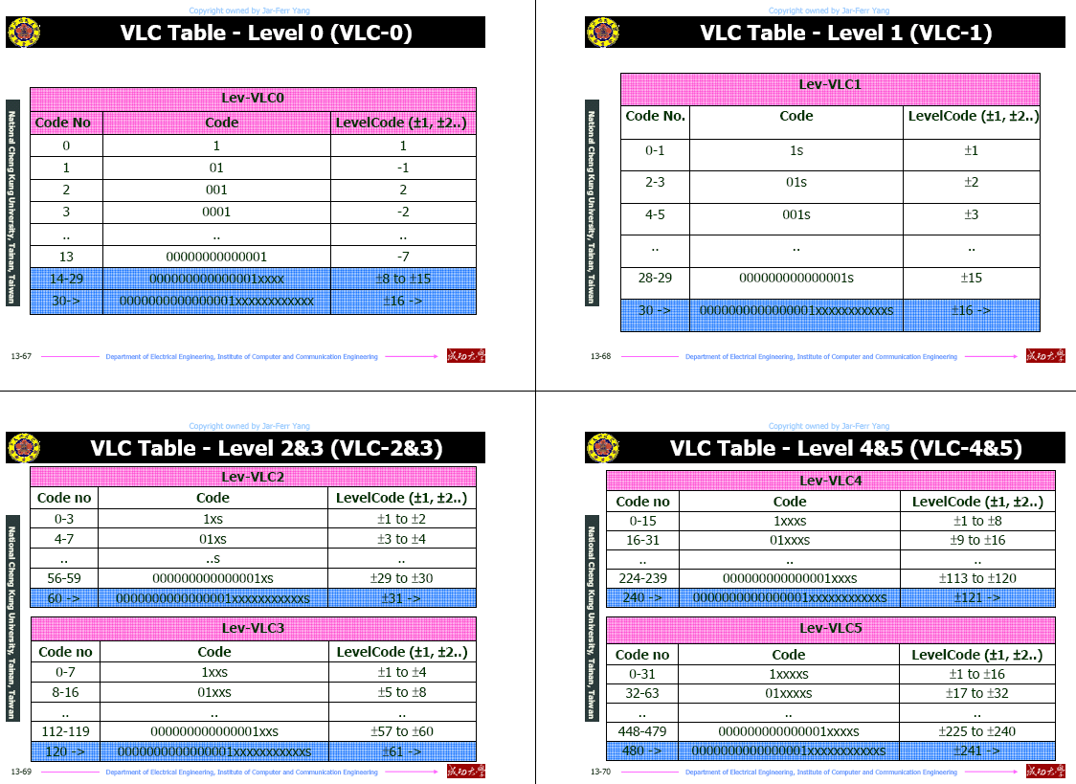

Slide 19
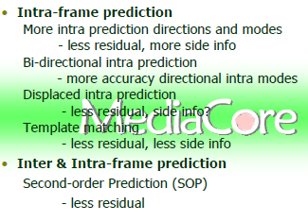
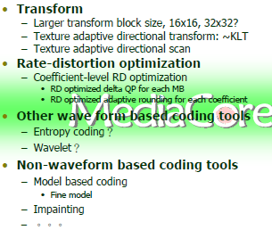
2.3
Major differences:
Motion compensation
Sub-pixel precision
不同的量化方式
區塊濾波器的有無
2.4

Slide 20
2.5
Fast motion estimation for multiple reference frames
Develop heuristic algorithms to reduce computational cost for multiple reference frames
Fast variable block size motion estimation
Search point reduction for variable block size motion estimation
Reduction of SAD operation for variable block size motion estimation
Fast quarter pixel motion estimation algorithm
An efficient quarter pixel interpolation

Slide 21
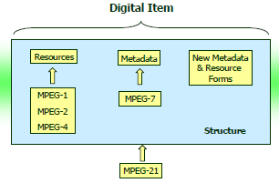

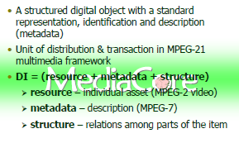
2.6

Slide 22
2.7
任四個
GOP
GOB
Slice structured mode
Referenced picture selection mode
Independently segmented decoding mode

Slide 23
III.
3.1 (F): the encoder is with ME and MC; the decoder is with MC
to reduce the temporal redundancy.
3.2 (F): If the number of bands is equivalent to the number of transform length, the DCT and Subband coding are equivalent.
Or 3.2 (T)
3.3 (F): RLC, which uses data consecution property, is a kind of data compaction.
3.4 (F): Even if you use the same standard, difference encoders could encoded difference coded data.
3.5 (F): For the decoder, the same coded data will obtain the same decoded video data. However, if considering post-processing of the decoded video, we may choose the better or more expensive one.

