Slide 1

DEJA VIEW
Notes:
So, we get super interested in “visiting” someone…
We need to work out where they live, what their surroundings look like e.g. power poles, trees, lights, alarm boxes, cameras (CCTV), neighboring properties
We’d also like to know about local points of interest. Car parks, shopping centres, 24-hour shops. Where can we hang out? Where might others be hanging out? Where can we run to?
To get info, manually search Open Sources e.g. real estate sites like AllHomes, Street View, etc. to get as much information about the area as possible. Manually…
What internal information do we already have? Have we visited other people in the area and already have data?

Slide 2
SCOPE
PHASE ONE: Automating phase zero reconnaissance
Automating open source research
Automated gathering of localised points-of-interest for development of the Technical Plan
PHASE TWO: Internal data silos
Data Discovery
Imagery Management

Slide 3
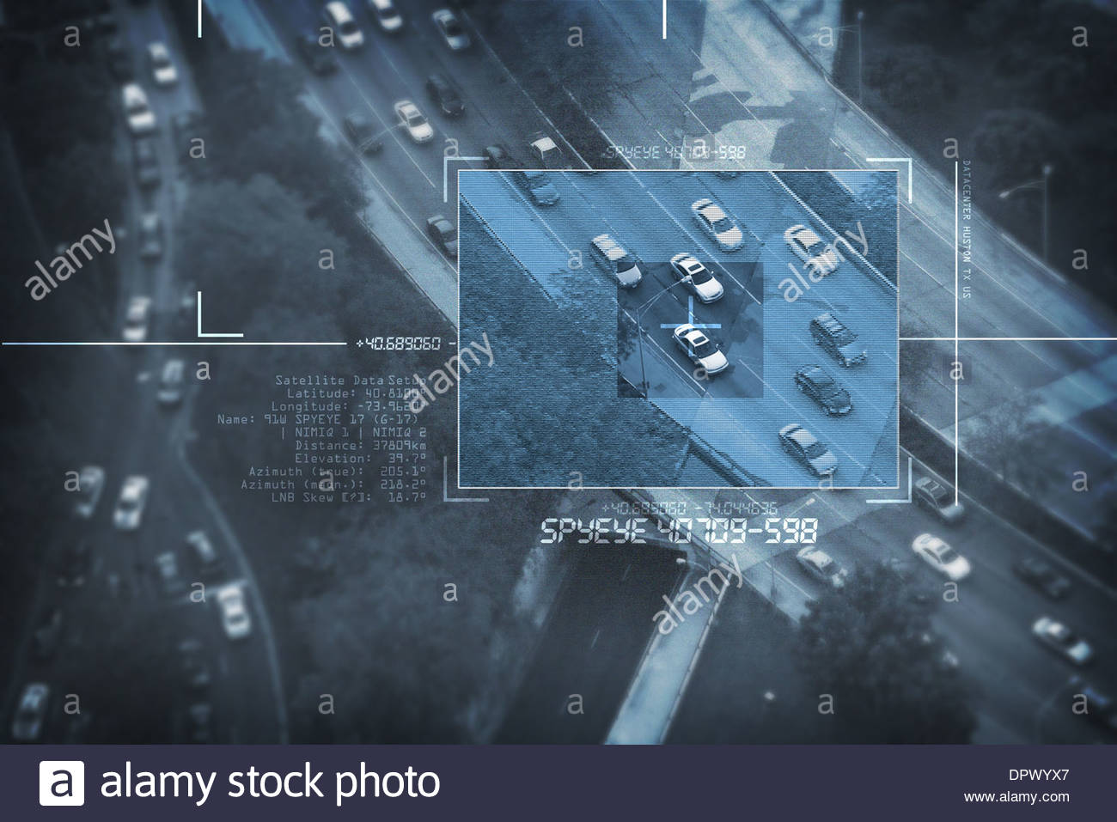
PHASE ONE:
Automating phase zero reconnaissance
Notes:
So, we get super interested in “visiting” someone…
We need to work out where they live, what their surroundings look like e.g. power poles, trees, lights, alarm boxes, cameras (CCTV), neighboring properties
We’d also like to know about local points of interest. Car parks, shopping centres, 24-hour shops. Where can we hang out? Where might others be hanging out? Where can we run to?
To get info, manually search Open Sources e.g. real estate sites like AllHomes, Street View, etc. to get as much information about the area as possible. Manually…
What internal information do we already have? Have we visited other people in the area and already have data?

Slide 4
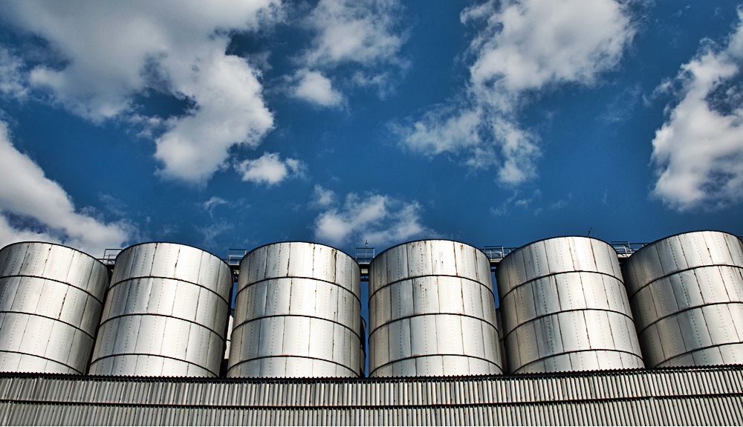
PHASE TWO:
Internal imagery and data management
Notes:
Automating image management system into corporate repositories to record and flag current or and new intelligence in relation to the target area
Look to establish some kind of machine learning to run across real time data to recognize data the could be of relevance could be extracted

Slide 5
technologies
Cross-Division Collaboration
Python
Pycharm
React
AWS
.Net core
BeautifulSoup
Bottle
Offline Backups
CCTV
Google Maps APIs
Bing API
Google API
Bulmer CSS Framwork
Git
Stride
MAC OS, Linux and Windows
Passing credentials
Internet
Catered Event

Slide 6
DEJA VIEW

