Slide 1
Predicting H1-B Application Status
Yueran Yang, Zongyuan Yuan

Slide 2
Content
Project Introduction
Exploratory Data Analysis
Models & Methods
Conclusions

Slide 3
What is H1-B?
A visa that allows US employers to temporarily employ foreign workers
Two parts:
Labor Condition Application (LCA)
H1-B Lottery
Effective 2022, a new policy will be applied to the lottery process, but the
LCA stage remains unchanged.
In this project, we focus only on the LCA stage.

Slide 4
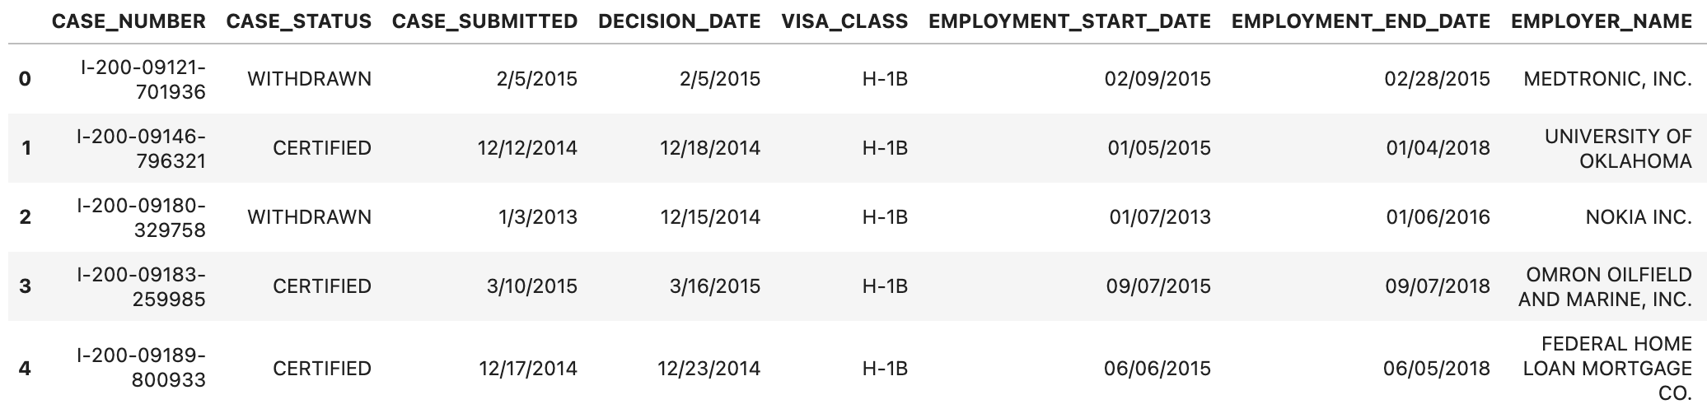
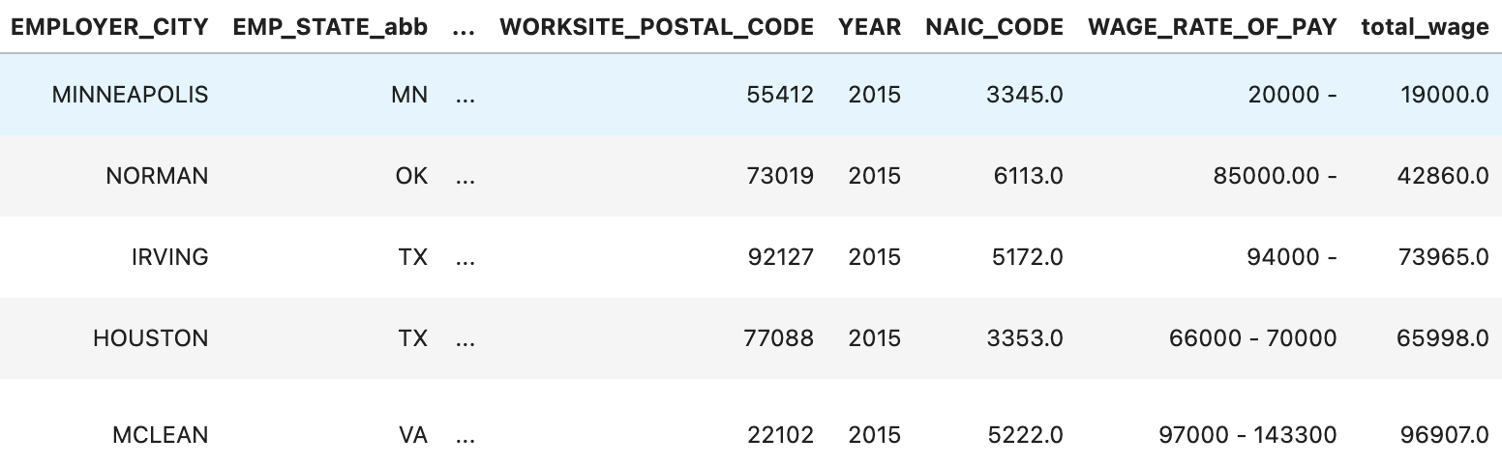
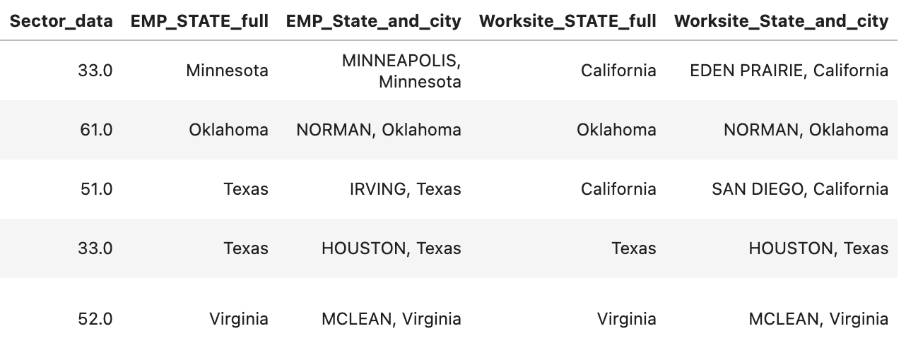
Data Overview
2,448,729 rows and 36 columns
Mixed data types
Numerical, date, categorical, texts
Label: CASE_STATUS

Slide 5
Preliminary Data Processing
Features | NA Count
Secto_rdata | 2
EMP_STATE_full | 2358
EMP_State_and_city | 0
Worksite_STATE_full | 2453
Worksite_State_and_city | 0
EMPLOYER_PHONE | 1
AGENT_ATTORNEY_NAME | 227034
AGENT_ATTORNEY_CITY | 840452
AGENT_ATTORNEY_STATE | 840452
JOB_TITLE | 11
EMPLOYER_POSTAL_CODE | 57
WORKSITE_POSTAL_CODE | 70
YEAR | 0
WORKSITE_COUNTY | 4616
WORKSITE_CITY | 41
WAGE_RATE_OF_PAY | 0
SOC_NAME | 20
EMPLOYER_CITY | 29
CASE_NUMBER | 0
Deleted redundant features
Features that contain essentially
the same information as other features
e.g., SOC_NAME, JOB_TITLE
Irrelevant information:
e.g., AGENT_ATTORNEY_NAME
Removed NA
Except a few irrelevant features,
other features contain small number
of missing values compared to the size
of the data
deleted features

Slide 6
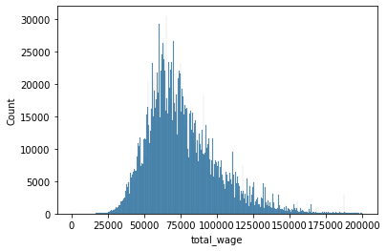
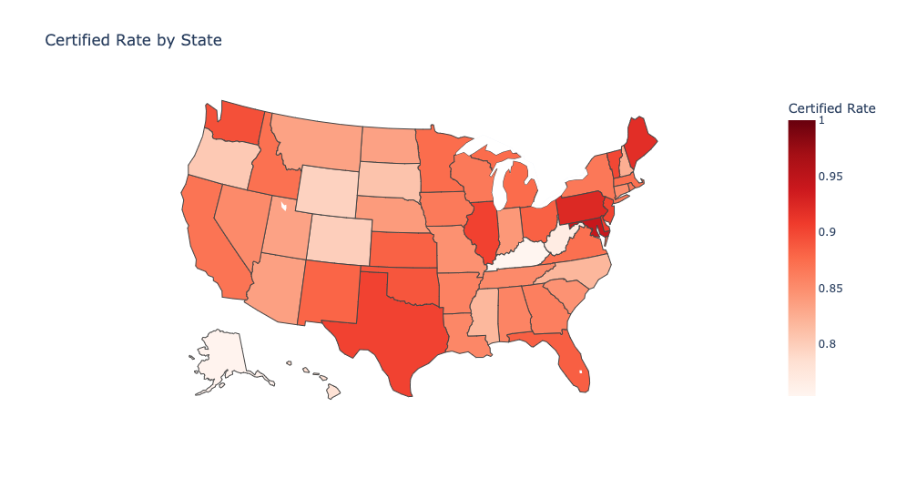
EDA
The wage in most of the applications
is between $50,000 and $100,000
Applications from employers in some states
are more likely to be certified than others.

Slide 7
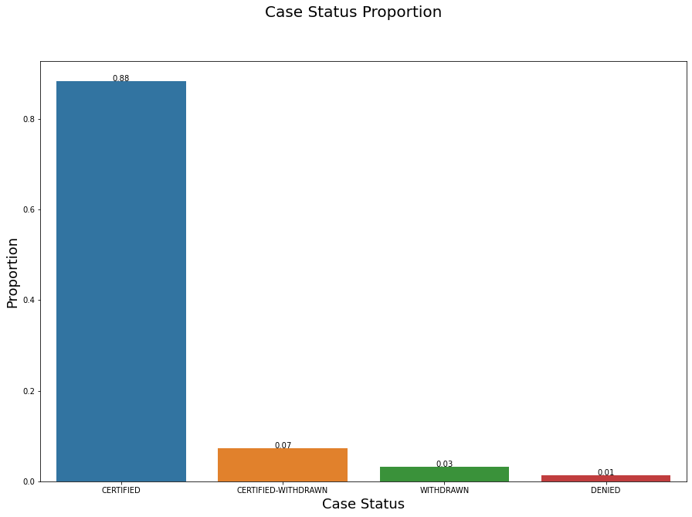
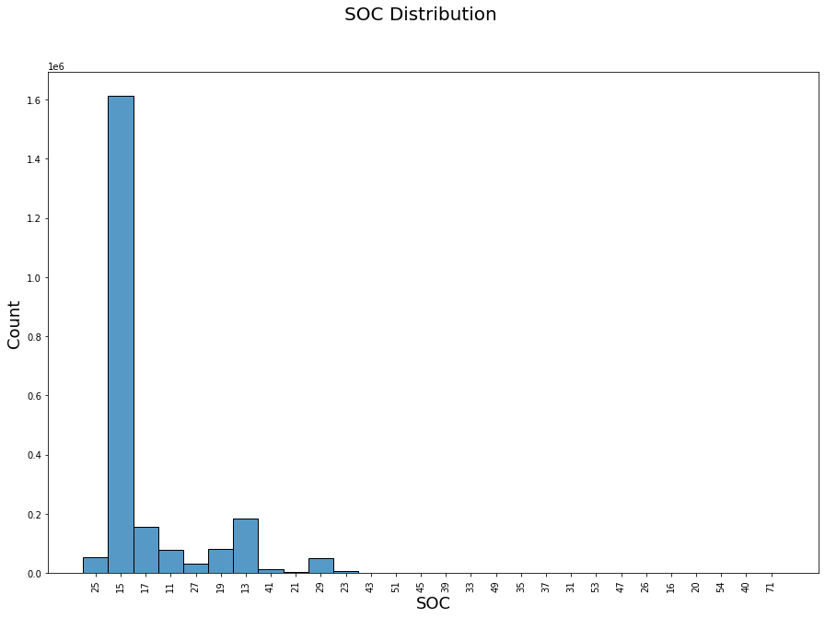
EDA
Most of the applications are certified
→ Imbalanced dataset
The majority of the applications have SOC code
that starts with 15 meaning that most of the applications
are computer or software related.

Slide 8
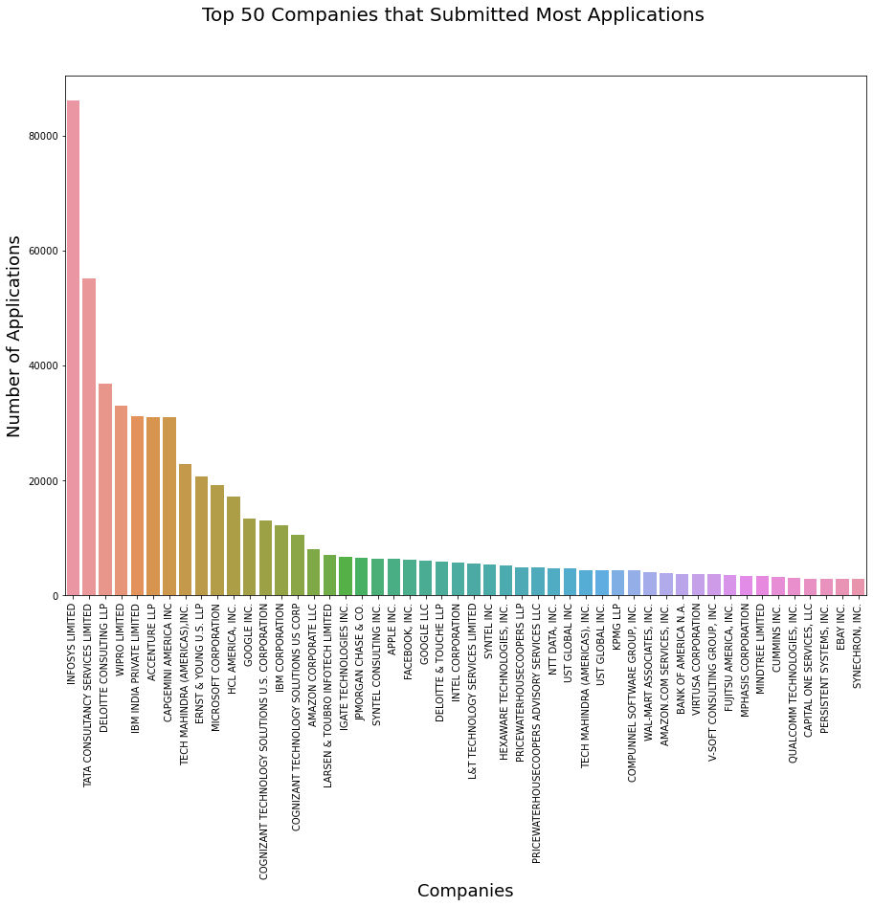
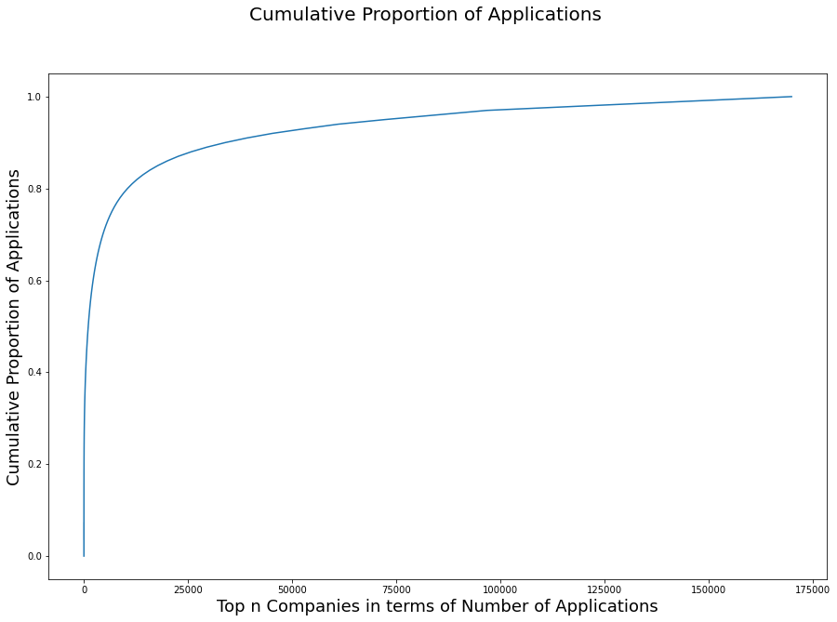
EDA
Top 67 companies submitted around
80% of total applications

Slide 9
Further Data Processing
Features | Transformation
CASE_SUBMITTED | calculate duration
DECISION_DATE | calculate duration
EMPLOYMENT_START_DATE | calculate duration
EMPLOYMENT_END_DATE | calculate duration
EMPLOYER_COUNTRY | OnlyconsiderAmerica.
PREVAILING_WAGE | Normalize it to yearly wage.
PW_UNIT_OF_PAY | Normalize it to yearly wage.
WAGE_UNIT_OF_PAY | Normalize it to yearly wage.
total_wage | Normalize it to yearly wage.
NAIC_CODE | Keep three digits.
EMP_STATE_abb | For geographical figures.
SOC_CODE | Keep three digits.
EMPLOYER_NAME | Count frequency
VISA_CLASS
FULL_TIME_POSITION
Worksite_STATE_abb
Hot-encode categorical variables
- e.g., SOC_CODE, NAIC_CODE
But too many categories
high dimensions
high training cost & risk of overfitting
Transformation
- NAIC_CODE, SOC_CODE
keep three digits - Count frequency of each company
- Normalize wage
- Date information → duration

Slide 10
Choosing Metrics
Dataset is very imbalanced
using accuracy as a metric is not a good choice
We use average accuracy across different status instead
Average accuracy across different status:
¼(accuracy for certified cases + accuracy for certified-withdrawn cases +
accuracy for withdrawn cases + accuracy for denied cases)

Slide 11
Fairness
Our features do not contain demographic information such as age, race and gender.
Since our dataset is very imbalanced, if we don’t add extra touch to our models, our
predictions might favor certified cases more. We’ve taken the following two
measures to ensure the fairness of our models.
Down sampling: data with each label constitutes an equal proportion in our training set
Average accuracy: we care about the accuracy of the model for applications with
different case status equally

Slide 12
Methods
Imbalanced
Down-Sampling: Use the same number of samples from the classes.
Original: 4-class classification (certified, withdrawn, certified-withdrawn, denied)
Certified possibility: binary classification
Notes:
Imbalanced, we use down-sampling to balance the number of samples from different classes in our training data.
The original dataset is a 4-class classification. The labels are shown here. And if only certified rate matters, we can turn the model into binary classification, by transforming certified rate into 0 and the other labels into 1.

Slide 13
Models & Methods
AutoGluon ---- AutoML library => lightGBM
Logistic Regression
LDA (Linear Discriminant Analysis) and QDA
MLP (Multi-Layer Perceptron)
lightGBM (Gradient boosting decision trees) An ensembled model
SVM
Neural Network
Notes:
We first have a AutoML algorithm named autogluon to pick a best model for me. The autoML choose lightGBM, which is a gradient boosting decision trees as the best models, as we can see in the following content. The other models are some baseline models to be compared to the ensembled model.

Slide 14
Evaluation of Models – binary classification
If only certified status matter
Using only accuracy
More flexible model can lead to higher accuracy
Training accuracy < Test Accuracy ---- Using down-sampled data as training data
Models | Training Accuracy | Test Accuracy
Decision Tree | 0.9820 | 0.9820
SVM | 0.7885 | 0.8417
Neural Network | 0.8933 | 0.9818
Logistic Regression | 0.7859 | 0.8462
QDA | 0.8275 | 0.8268
LDA | 0.9303 | 0.9305
Notes:
When it turns into a binary classification, we are using accuracy on this settings. As we can see in the following table, the Decision Tree shows high accuracy on this data. You may find some traning accuracy is less than the test accuracy, it is because we use down-sampled data in SVM, NN and logistic regression to balance the data.

Slide 15
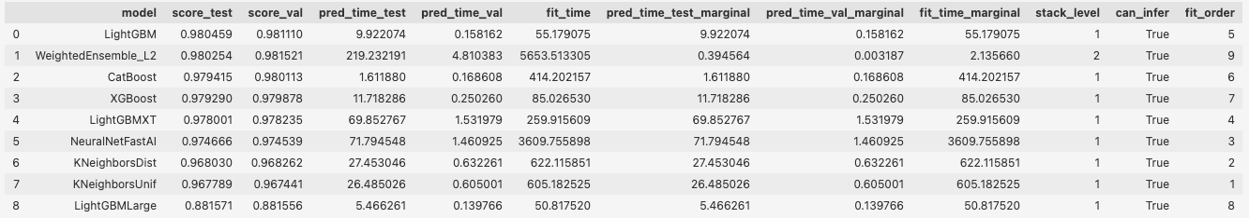
AutoGluon
Apply AutoGluon for 4-class classification
Compare lightGBM with models that is not on the leaderboard in the following content.
Notes:
Let us go back to the multiclass classification. AutoGluon is a autoML algorithms, which can help us compare performance of differ rent models automatically. We apply AutoGluon on the original 4-class classification. The following table shows the top 9 best models for this dataset. As we can see lightGBM has the highest score on test dataset. We then compare lightGBM with models that is not on the leaderboard.

Slide 16
Evaluation of Models – original problem
lightGBM (Gradient boosting decision trees) show highest average accuracy.
Models
Only the best result for logistic regression
For LDA and decision tree, we do not use down sampling method.
Models | Training Average Accuracy | Test Average Accuracy | Test Accuracy
 |  |  | Certified | Certified-Withdrawn | Denied | Withdrawn
lightGBM (OVA) | 0.8919 | 0.8804 | 0.9603 | 0.9650 | 0.7749 | 0.8215
lightGBM (multiclass) | 0.8976 | 0.8860 | 0.9170 | 0.9532 | 0.8522 | 0.8214
Logistic Regression (best) | 0.6070 | 0.6064 | 0.9708 | 0.8611 | 0.4034 | 0.1903
LDA (without downsampling) | 0.5967 | 0.5980 | 0.9559 | 0.6993 | 0.4611 | 0.2757
MLP | 0.8709 | 0.6343 | 0.9156 | 0.9078 | 0.1990 | 0.5147
Decision Tree (without downsampling) | 0.6659 | 0.6674 | 0.9900 | 0.9343 | 0.7452 | 0.0000
Notes:
The evaluation of all the models we have tried are shown in the table. lightGBM with one-vs-all and multiuclass have similar performance. The other models are weaker than the lightGBM, as you can tell from the test average accuracy. It is because lightGBM can handle all the class equally.

Slide 17
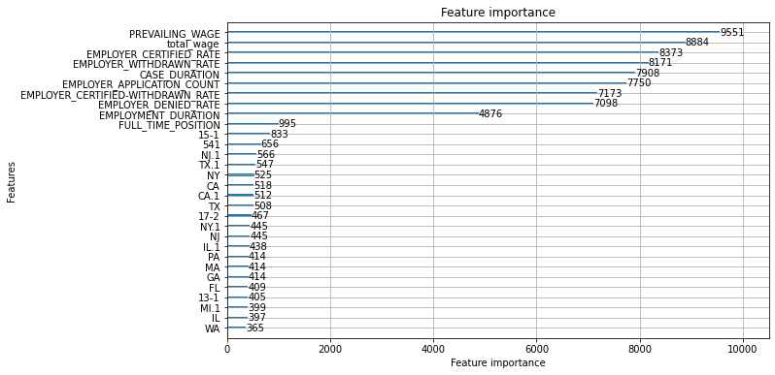
Ensembled Model – OVA
Notes:
Now we look into lightGBM with one-vs-all. Here is the top 30 important features generated by the ensembled model. We now further dig into the top 9 features since they have huge gap between the other features.

Slide 18
Feature Analysis
Use artificial data to observe the impact of features on certified rate.
Look into features with higher importance
Total wage
Prevailing wage
Certified rate
Case duration
Employer previous application count
Employment duration
Notes:
We are going to use artificial data to observe the impact of features on certified rate. Which is to pick some random samples from the test data and fix all the features except changing the feature we want to analyze.

Slide 19
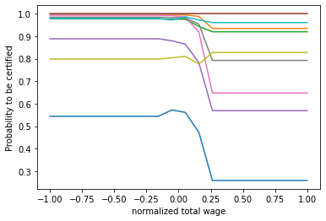
Feature Analysis – Total Wage
Average/Slightly Above Average
Some increase in certified rate
Too large
Decrease in certified rate
Some explanation
May have correlation to other features, causing inconsistent to other features
May be some special position that is easy to be denied
Notes:
The first is the total wage. As you can see from the figure, if your wage is around average or slightly above average, there will be a slight increase in certified probability. But when it is too large, the certified prob will decrease. The reason for the phenomena might be that there is some correlation between wage and other features. When we adjust the wage manually, it will cause inconsistency to other features. And there might be some special position with very high wage that is easy to be denied in our dataset.

Slide 20
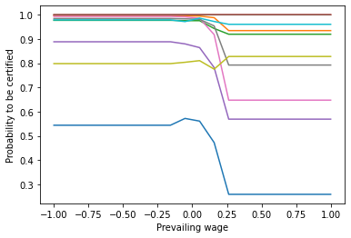
Feature Analysis – Prevailing Wage
Similar to total wage
Notes:
Prevailing wage shows similar trend to the total wage.

Slide 21
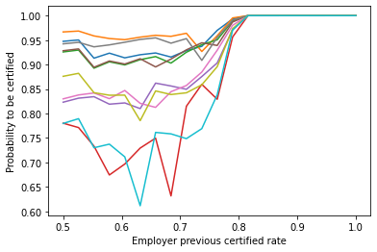
Feature Analysis – Certified rate
When the priori certified rate of the employer increase, the probability of being certified for one person increases.
The company’s priori certified rate matters!!
** By changing the certified rate, we set denied rate to be 1- certified rate and other rates to be 0.
Notes:
We can see that the chance to be certified for a individual is highly related to the emplyer’s total priori certified rate. The company’s priori certified rate really matters in the application.

Slide 22
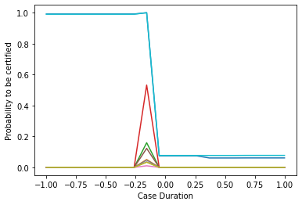
Feature Analysis – Case Duration
Extreme case duration
Either too long or too short
lower chance to be certified
Average duration
Higher chance to be certified
Predict the result
Waiting too long for results: may be denied
Too fast to get the results: may be denied/withdrawn
Notes:
If you have a extreme case duration, the probability to be certified is very low. We can use the result to predict the final status, if your are waiting too long, you might be denied.

Slide 23
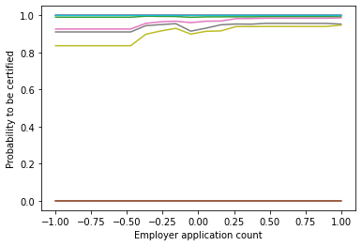
Feature Analysis – Previous application Counts
Slight impact on the final status
More applications before, higher chance to be certified
Notes:
Previous application counts have a slight impact on the final status. We can conclude that more applications before, higher chance to be certified for an employee.

Slide 24
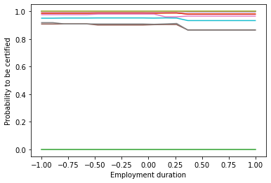
Feature Analysis – Employment Duration
No obvious impact on the certified probability.
Slight decrease when the employment duration is very large.
Analysis:
The application happens in the very beginning of the employment (always in the beginning of OPT with longer employment duration), which would cause high denied rate.

Slide 25
Conclusion
The internal process for LCA application is very complicated.
Tree-based models work better
To increase chance being certified, the company should
Offer reasonable salary, not extremely high
To increase chance being certified, one should:
Choose a big company with higher amount of previous applications
Choose a company with higher priori certified probability
Essentially, one should increase his/her own competency to be accepted by a better company to increase his/her chance to be certified.
Notes:
Flexible models are more suitable to this dataset, e.g. ensembled models.

Slide 26
Weapons of Math Destruction
Definition:
The outcome of a model is not easily measurable, can have negative consequences, or has self-fulfilling feedback loop.
Why our model is not a WMD?
Has measurable outcome: status of an application
No negative consequence: most of the applications are accepted, our model focus on helping those who might not be approved become aware of their risks
No prominent self-fulfilling feedback loop: Whether an H1-B is going to be approved is determined entirely the competency of the employee and the industry demand. These two factors are unlikely to be affected by the prediction of the H1-B application status
Demand & supply: The employment is based on demand and supply.

Slide 27
Future work
Try more models on it to deal with the imbalanced labels.
Dig into the interpretation of the models.
Find correlations between the features to make the model more accurate and reasonable.
This is hard since all the features are in different format and we have done multiple transformation to the original feature.

Slide 28
Statement
All the results in this slides only represent subjective suggestions.

Slide 29
Thank you!

