Slide 1
Class 10 Mathematics Chapter 5 Arithmetic Progression
Subject: Mathematics
Class: 10

Slide 2
LS1
The Pattern in the Pendulum
• Arithmetic Progression
• Consecutive Terms
• Difference of Consecutive Terms
• Constant Difference

Slide 3
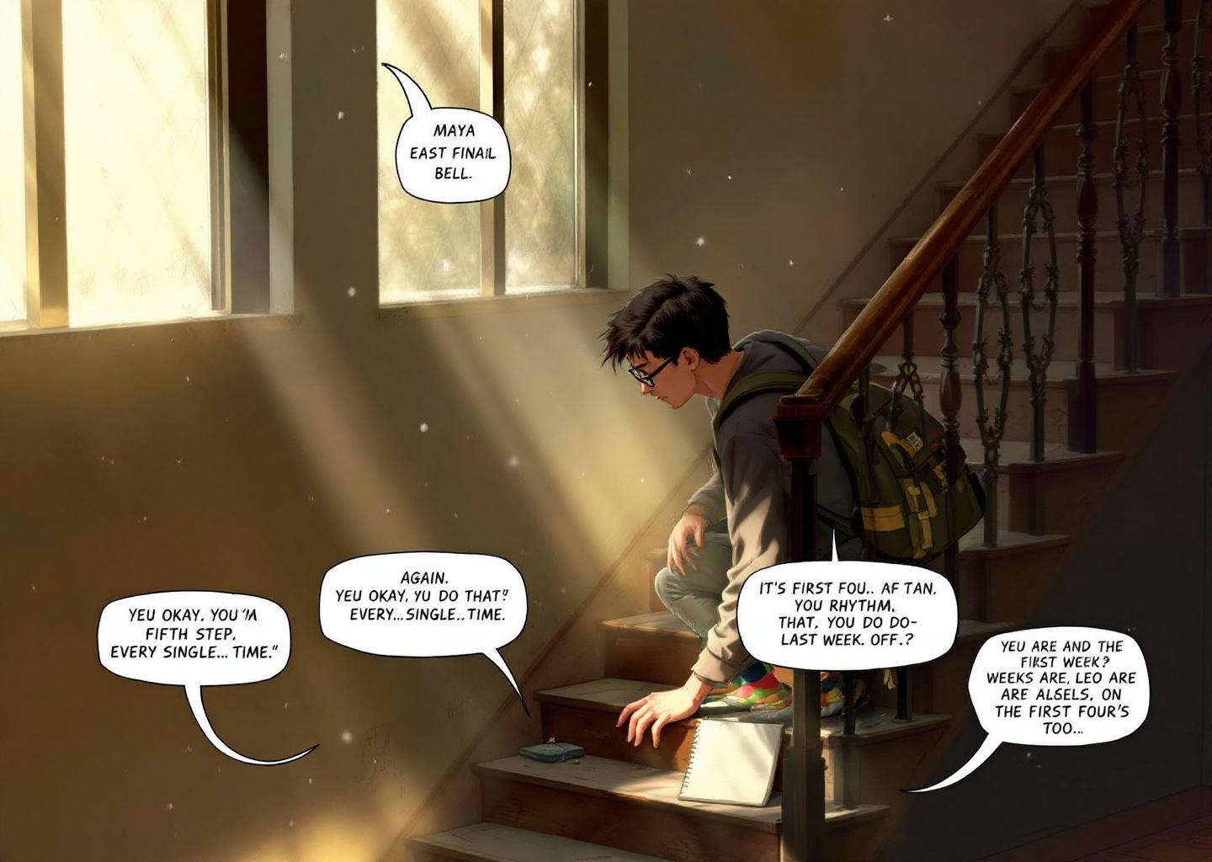
Scene goal: Characters observe a sequence of numbers (5, 9, 13) appearing with a rhythmic pattern, sparking curiosity about the relationship between them without any explanation.

Slide 4
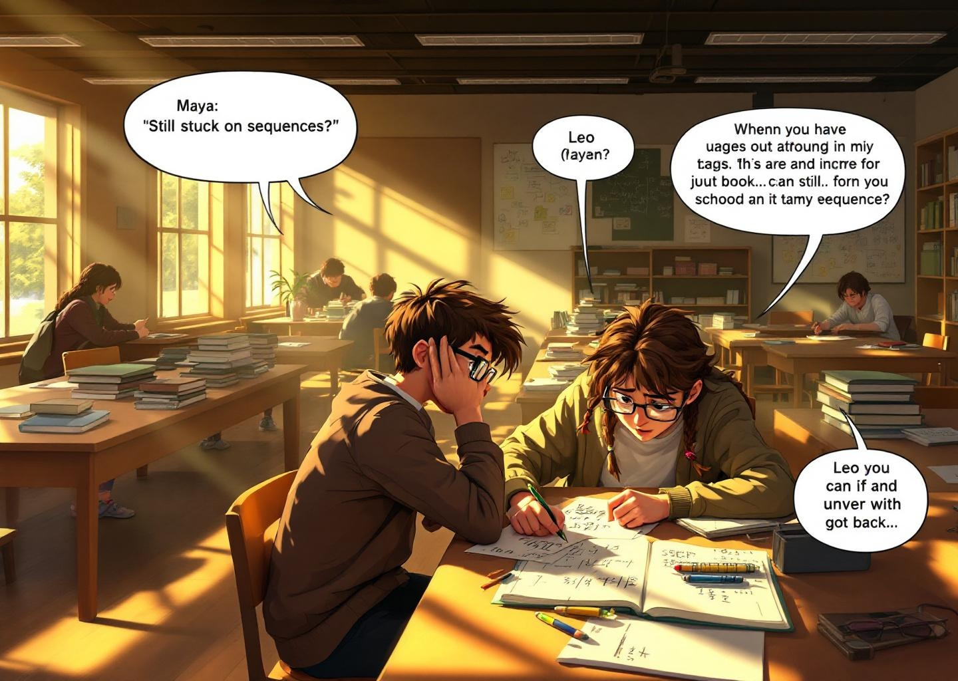
Scene goal: Characters notice the sequence continues (5, 9, 13, 17) and begin to describe the relationship between consecutive terms in plain language, focusing on the consistent increase.

Slide 5
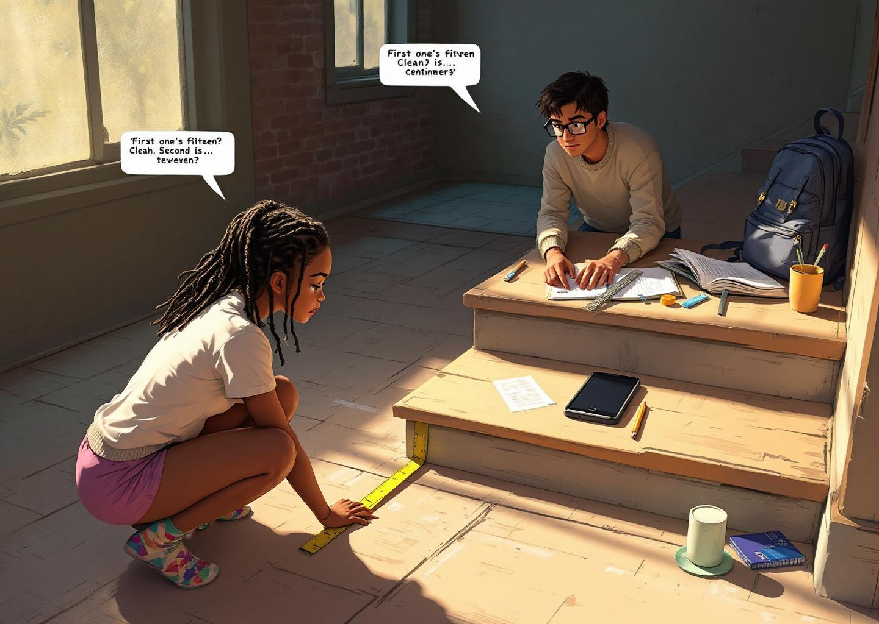
Scene goal: Leo observes the pendulum's arc now touches a new sequence of tiles (3, 7, 11, 15). The characters identify consecutive terms and note the consistent difference between them is the same as before.

Slide 6
Scene goal: The sequence halts at 15, breaking the expected pattern continuation. This introduces doubt about whether the progression is truly arithmetic or something else, prompting questioning of the 'constant difference' assumption.
[Image not found: C:\Users\gvpra\Downloads\Jushwanth\BIA INTERNSHIP\Final_Automation\Automation_prompt_json_generator\outputs\10_mathematics_arithmetic_progression\images\LS1_S4.png]

Slide 7
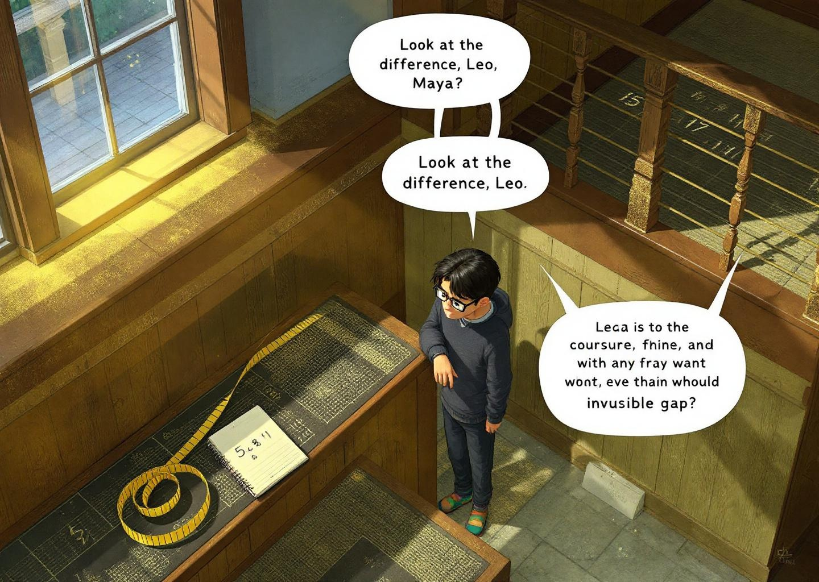
Scene goal: Zara systematically collects the data by recording the sequence, visually highlighting the gaps between terms. This demonstrates systematic observation—the first step in identifying an arithmetic progression before naming it.

Slide 8
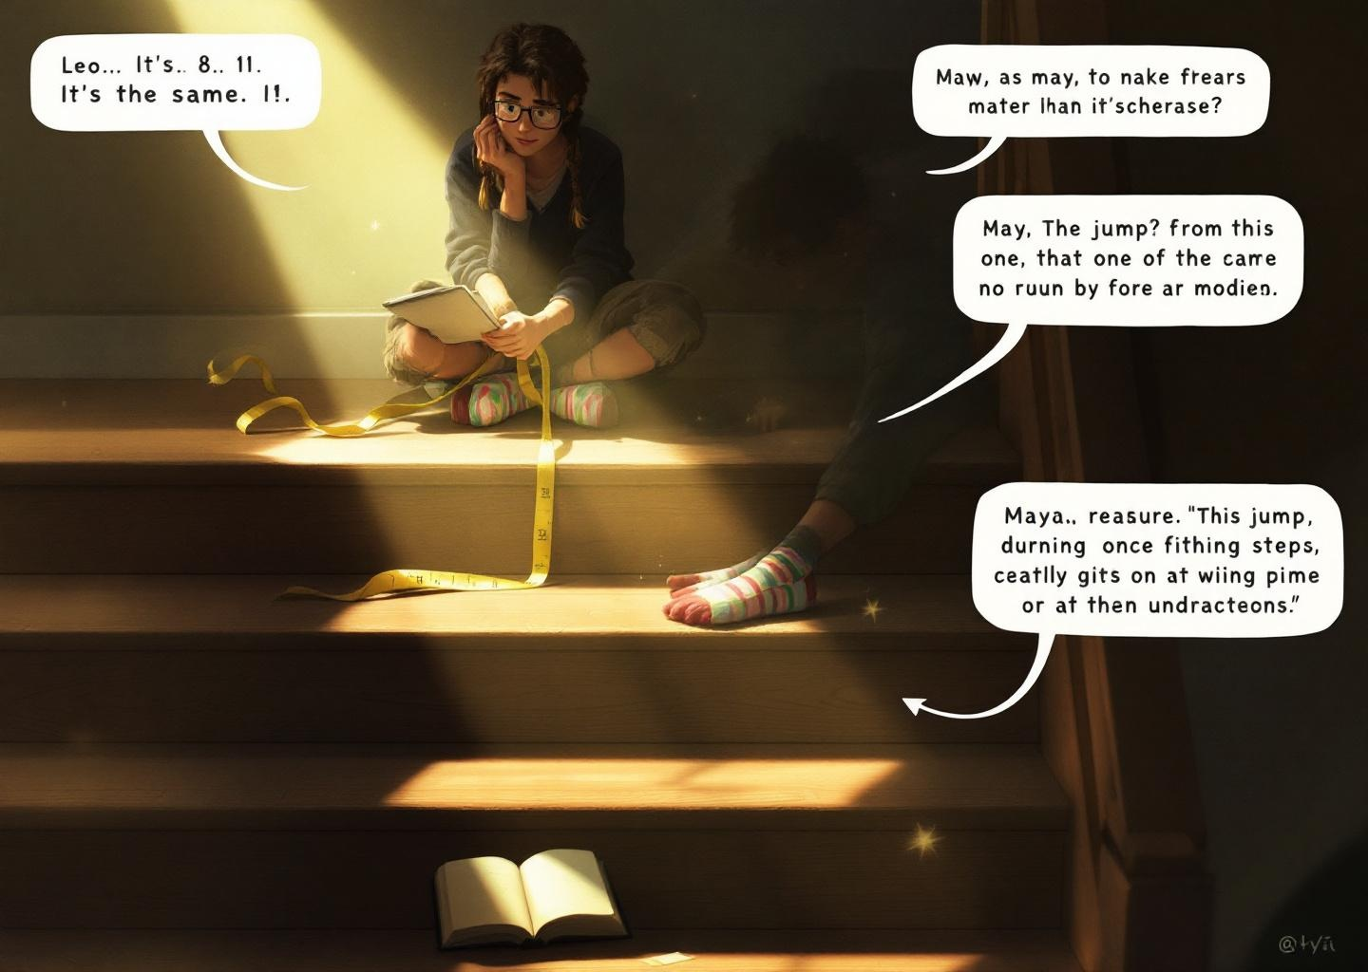
Scene goal: Zara explicitly calculates the difference between consecutive terms (11-7=4, 15-11=4) and observes the constant difference. This formalizes the pattern noticed earlier, moving from observation to verification.

Slide 9

Scene goal: Leo independently validates the constant difference by checking another pair of consecutive terms (7-3=4), confirming the pattern is consistent across the entire sequence. This moves from verification to confident validation.

Slide 10
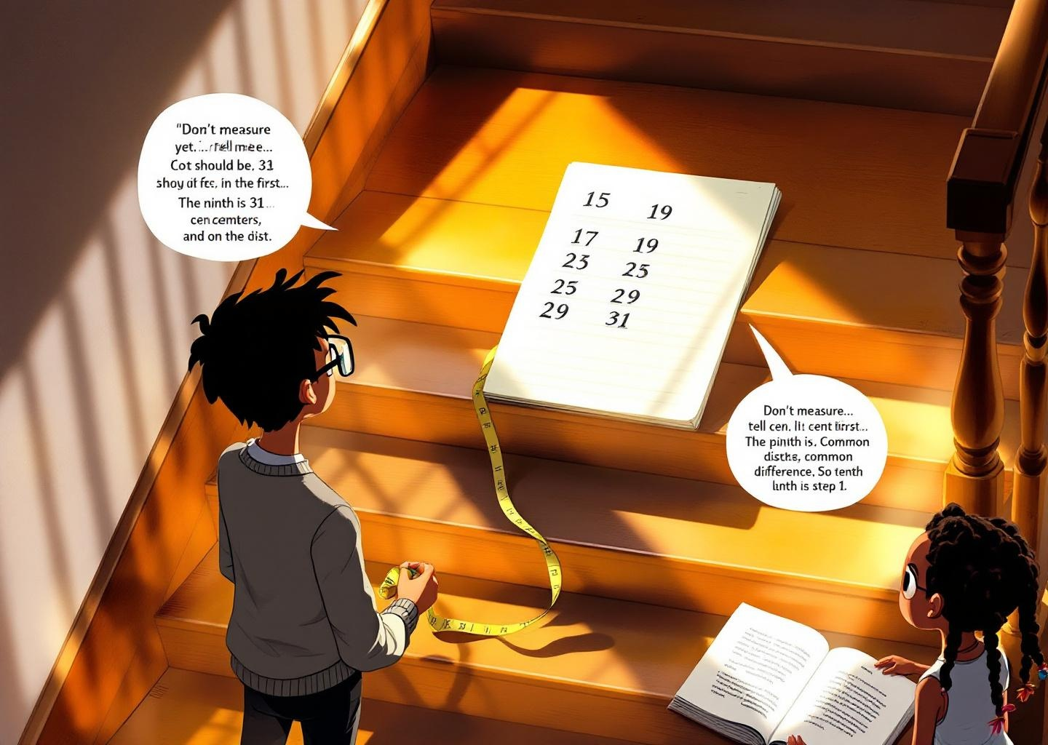
Scene goal: The scene introduces a twist: the pattern prediction (15+4=19) was correct, but the system's reaction—halting and highlighting the predicted term—creates a new problem. This reinforces that finding the constant difference allows accurate prediction, but now the environment responds to that prediction, raising the stakes.

Slide 11
Scene goal: Zara applies the constant difference concept to make a prediction, confirming the pattern continues. Leo's hesitation shows the tension between understanding the rule and trusting it under pressure.
[Image not found: C:\Users\gvpra\Downloads\Jushwanth\BIA INTERNSHIP\Final_Automation\Automation_prompt_json_generator\outputs\10_mathematics_arithmetic_progression\images\LS1_S9.png]

Slide 12
Scene goal: The successful application of the constant difference (adding 4) confirms the pattern, but the pendulum's continued movement escalates the puzzle—implying more terms are needed. The arithmetic progression isn't just identified; it must be followed further.
[Image not found: C:\Users\gvpra\Downloads\Jushwanth\BIA INTERNSHIP\Final_Automation\Automation_prompt_json_generator\outputs\10_mathematics_arithmetic_progression\images\LS1_S10.png]

Slide 13
Scene goal: Zara formally names the pattern as an 'arithmetic progression' and explicitly states the 'constant difference' is 4, moving from observation to definition.
[Image not found: C:\Users\gvpra\Downloads\Jushwanth\BIA INTERNSHIP\Final_Automation\Automation_prompt_json_generator\outputs\10_mathematics_arithmetic_progression\images\LS1_S11.png]

Slide 14
Scene goal: The successful application of the arithmetic progression (3, 7, 11, 15, 19, 23 with constant difference 4) directly causes the payoff—the door opening—reinforcing that pattern recognition solves real problems.
[Image not found: C:\Users\gvpra\Downloads\Jushwanth\BIA INTERNSHIP\Final_Automation\Automation_prompt_json_generator\outputs\10_mathematics_arithmetic_progression\images\LS1_S12.png]

Slide 15
Scene goal: Reflecting on the solved puzzle reinforces the concept: In an arithmetic progression, the difference between consecutive terms is constant. This constant difference is the key to the pattern.
[Image not found: C:\Users\gvpra\Downloads\Jushwanth\BIA INTERNSHIP\Final_Automation\Automation_prompt_json_generator\outputs\10_mathematics_arithmetic_progression\images\LS1_S13.png]

Slide 16
Scene goal: Transitioning to a new challenge reinforces the concept: Different sequences can share the same underlying rule—each is an arithmetic progression defined by a constant difference between consecutive terms.
[Image not found: C:\Users\gvpra\Downloads\Jushwanth\BIA INTERNSHIP\Final_Automation\Automation_prompt_json_generator\outputs\10_mathematics_arithmetic_progression\images\LS1_S14.png]

