Slide 1
Product Manufacture Exploration
Developing Models Predicting Product Failure

Slide 2
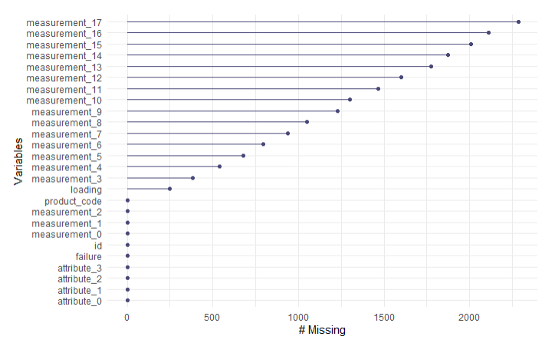
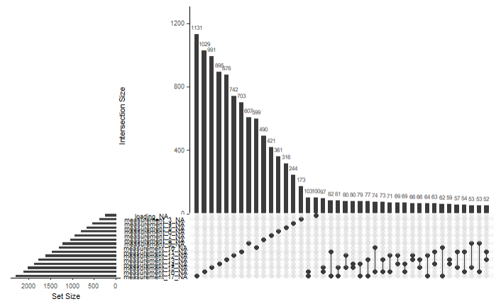
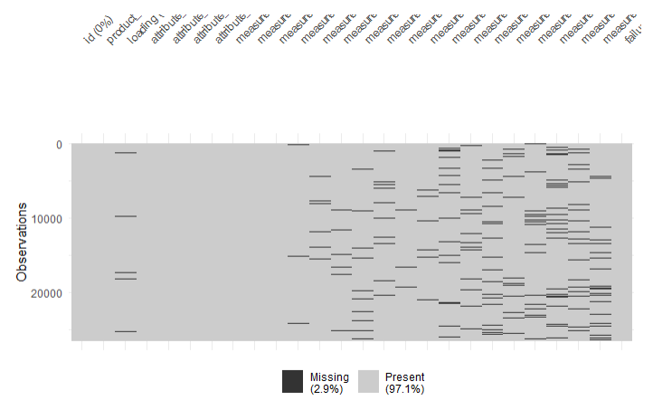
Data Cleaning Strategy
Data cleaning is the preparation of raw data so it is accurate, consistent, and ready for analysis.
As an initial step, missing data was identified and explored for patterns of missingness. Some variables had a higher missingness rate. The missing data was determined to be Missing At Random (MAR).

Slide 3
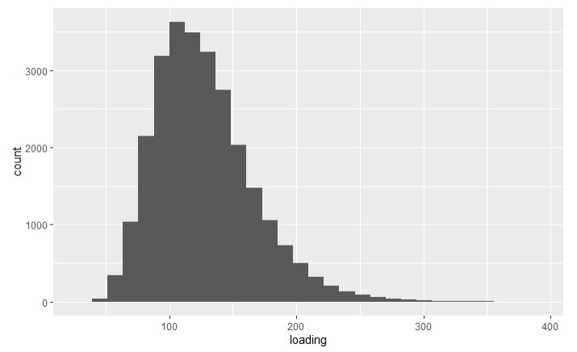
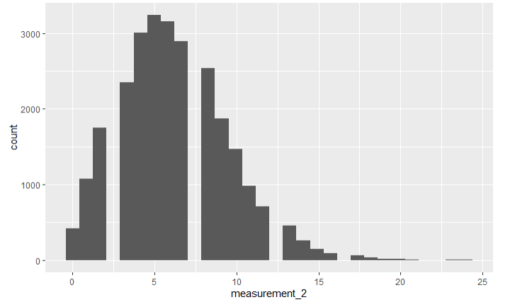
Data Cleaning Strategy
Exploring data distributions for outliers in variables in the dataset
Example data distribution
Anomaly observed; intervals missing, outliers present
The distribution of each numeric variable was explored to pinpoint significant outliers and other anomalies. An example distribution of one of the dataset variables, “loading”, is provided above. Outliers and variable distribution anomalies are noted for the “measurement_2” variable. This variable may be a strong predictor for product failure, as noted later. All other numeric variables showed reasonable distribution profiles. The outliers were filtered out for numeric variables where present, including “measurement_2” .
Notes:
In real life, an investigation into measurement_2 might go further; are these occurring at regular time intervals, does a device not record at certain intervals to under diagnostics, etc.?

Slide 4
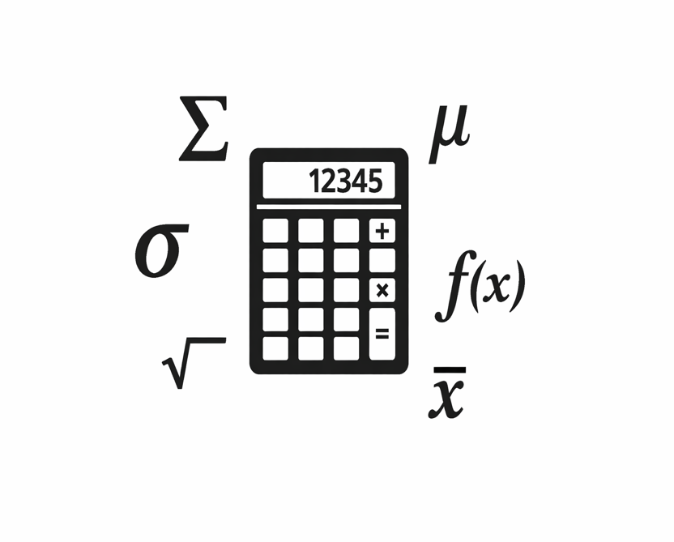
Data Cleaning Strategy
Missing data randomness verified, outliers deleted; data cleaned by imputation
Three ways to clean data:
Column-wise deletion
Row-wise deletion
Imputation
Dataset cleaned by row-wise deletion of outliers, then imputation: prepared/ imputed missing data with statistically formed values

Slide 5
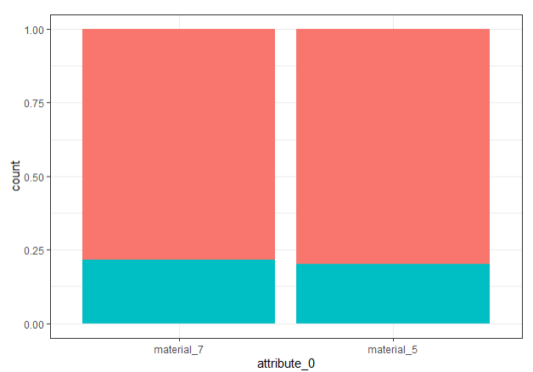
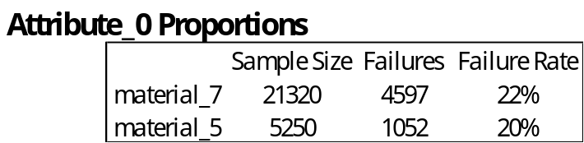
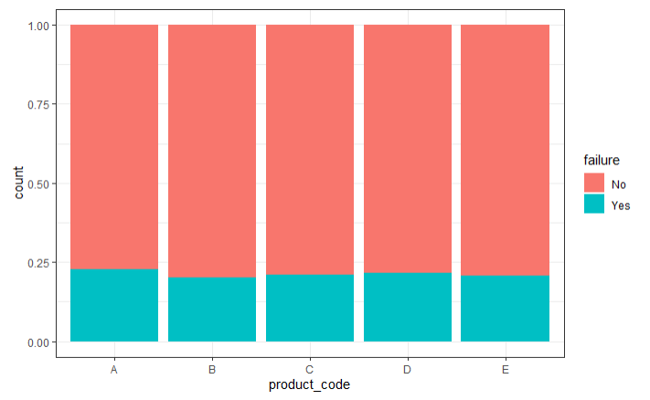
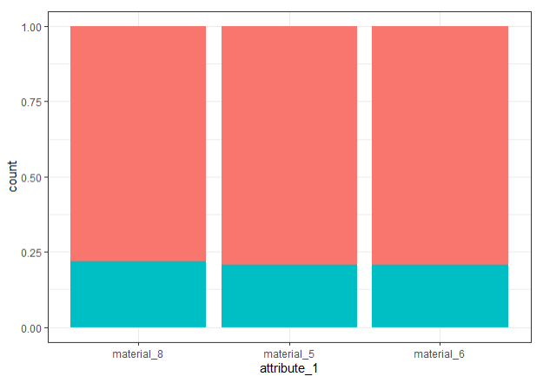
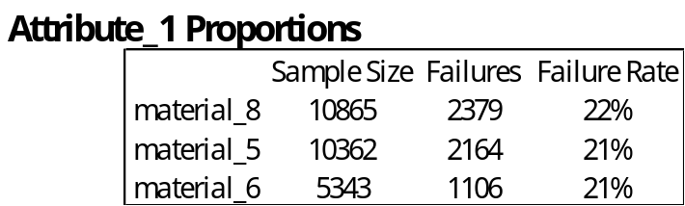
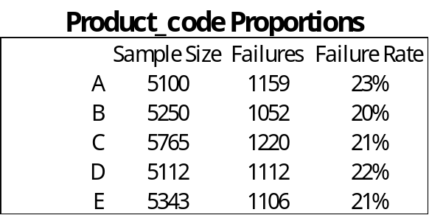
Variable Selection
Identifying Strong Predictors of Failure: Categorical Variables
Product_codeA is the strongest categorical variable predictor of failure

Slide 6
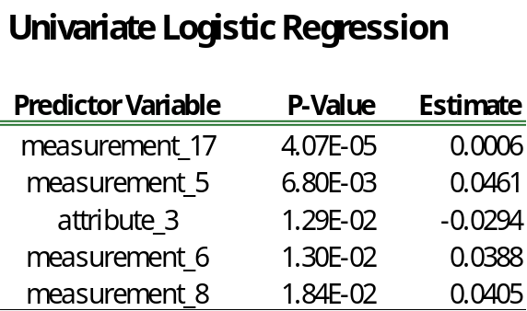
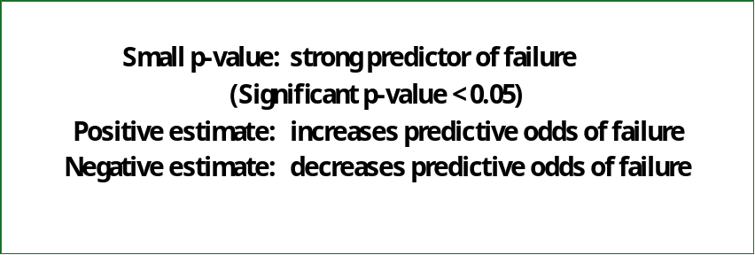
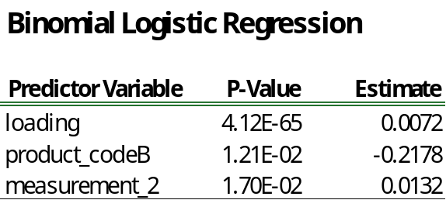
Variable Selection
Identifying Strong Predictors of Failure: Numerical Variables

Slide 7
Summary
Missing data and outliers were identified and explored
  Outliers cleaned by row-wise deletion
  Missing data cleaned by imputation
Potentially strong predictors of product failure to utilize in future prediction models identified as:
  Measurement_2,5,6, 8, and 17
  Attribute_3
  Loading
  Product_codeA

