Slide 1
Product Manufacture Exploration
Predicting Failures of Super Soaker

Slide 2
Overview
Purpose: Predict the product failure of Super Soaker from given data
Prediction models executed include:
Logistic regression XGBoost
Classification tree Neural Network
Random forest
loading > measurement_17 > measurement_8 > measurement_2
Most influential predictor variables:
Train/ test split ratio: 70/30
Balances model learning while reserving a substantial portion for evaluation

Slide 3
Data Limitations and Model Mitigations
Limitation: Missingness
Model Mitigation: Imputation method applied to handle missingness while maintaining data integrity
Limitation: Outliers
Model Mitigation: Evaluated and filtered outliers to reduce influence
Limitation: Class Imbalance/ Skew
Model Mitigation: Used performance metrics of accuracy, sensitivity, and specificity to limit bias

Slide 4
Model Descriptions
Logistic Regression
Estimates the probability of an outcome using weighted predictor variables
Classification Tree
Splits data into decision rules, forming a tree structure that predicts outcomes based on sequential conditions
Random Forest
An ensemble of many decision trees that “vote” on the final prediction
XGBoost
Builds trees sequentially with each correctly the errors of the previous one
Neural Network
Composed of interconnected layers of nodes that learn complex patterns through weighted connections and activation functions

Slide 5
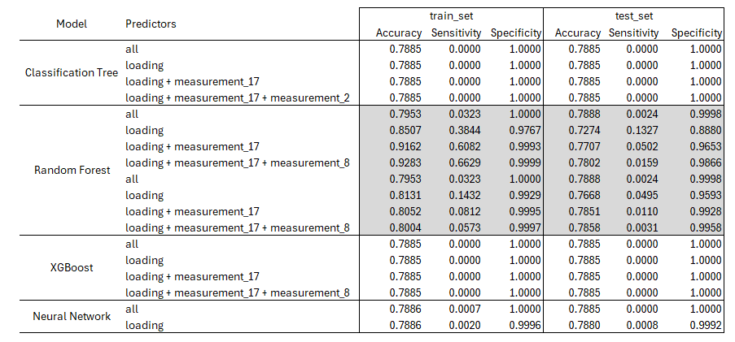
Model Results/ Performance Based on Accuracy

Slide 6
Model Interpretations and Next Steps
Random Forests were the only models achieving reasonable accuracy, reflecting their strength in capturing nonlinear relationships and interactions among predictors
Large gaps between training and testing set performance indicated overfitting, suggesting that models learned “noise” in the training data rather than generalized patterns.
All models struggled with the imbalanced failure outcome, resulting in low sensitivity and a tendency to predict the majority class.
No model demonstrated minority class detection, limiting practical use for identifying true failure cases.
Performance patterns highlight the need for enhanced imbalance handling, such as class weighting, resampling, or alternative algorithms.

Slide 7
Project Summary
Built and evaluated multiple predictive models to classify failure outcomes using a 70/30 train-test split
Addressed key data challenges – missingness, outliers, and a highly imbalanced failure variable (79% nonfailure, 21% failure)
Random Forest models delivered the strongest overall accuracy but showed substantial train-test set gaps, indicating overfitting
All models struggled to detect minority failure cases, limiting sensitivity and practical utility
Findings highlight the need for improved imbalance handling to achieve reliable minority class prediction.

