Slide 1
Project “Library”
https://github.com/benzol45/EPAM_final_project
http://epam-final-project-library.westeurope.cloudapp.azure.com/
Michail kalinin
benzol45@gmail.com

Slide 2
Task
As any user I must be able to :
view books catalog
view book description
search for books by author or title
sort books in the catalog by name, author, rating, publication, or date of publication
select interface language
As an unregistered reader I must be able to :
register new reader account
login in nonblocked account with login & password
I mustn’t be able to order a book
As a reader I must be able to :
place an order for a book from the catalog
view account with my registration information, my ordered books and my given books
cancel my order for a book
view which given me books are overdue and the amount of the fine of them
set a rating for the books I've read
logout

Slide 3
Task
As a librarian I must be able to :
give a book to a reader on subscription or to the reading room from books catalog
set and view the period, for which the book is issued to the reader
view a list of reader’s orders and a list of readers with their subscriptions
give a book to a reader on subscription or to the reading room based on order
I mustn’t be able to give a book to a reader if don’t have free copies
view which books in a list of subscriptions are overdue and the amount of the fine of them
get fine if the reader didn’t return the book within the specified period
view account with my registration information
view information about readers
logout
As an administrator I must be able to :
add books with typing all book’s information into form
add books with filling information by ISBN
delete books
edit information about the book
block or unblock users
set roles to users
view account with my registration information
logout

Slide 4
Requirements
The application must support the use of Cyrillic for:
input/output and storage of information (in the database) recorded in different languages
have multilingual interface and must be possible to switch the interface language
Implement protection against re-sending data to the server when refreshing the page
Authentication and authorization must be implemented in the application
The application must have role-based access rights of system users to program components
Passwords must be stored in encrypted form
The application must have logger sub-system
Input fields must be with data validation
The application must respond correctly to errors and exceptions of various kinds

Slide 5
Project architecture
Presentation Layer
Views
Application Layer
Security
Controllers
Services
Testing
Authentication Provider
Access Control
Unit Tests
Integration Tests
Data Access Layer
Repositories
Entities
Database

Slide 6
Used Technologies
Spring framework:
MVC
REST client
Data JPA
Security
Actuator
Postgree SQL database
Liquibase
Hibernate
Thymeleaf
SLF4J & Logback
JUnit & Mockito
Lombok
Maven
Docker
Hibernate validator
bcrypt password encoder
Swagger (OpenAPI 3.0)

Slide 7
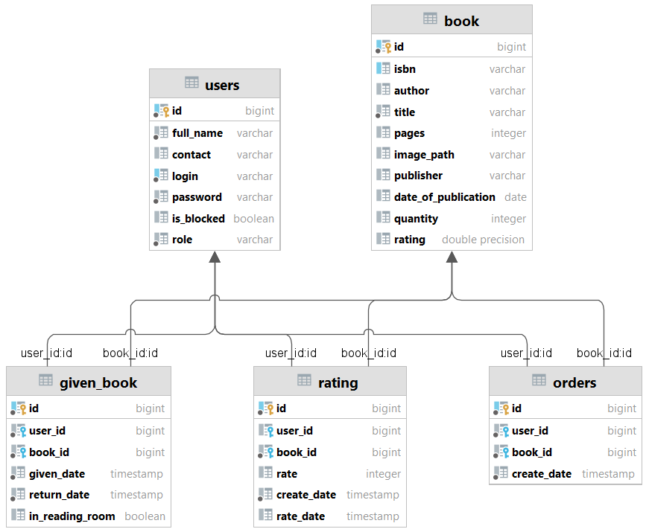
Database schema diagram

Slide 8
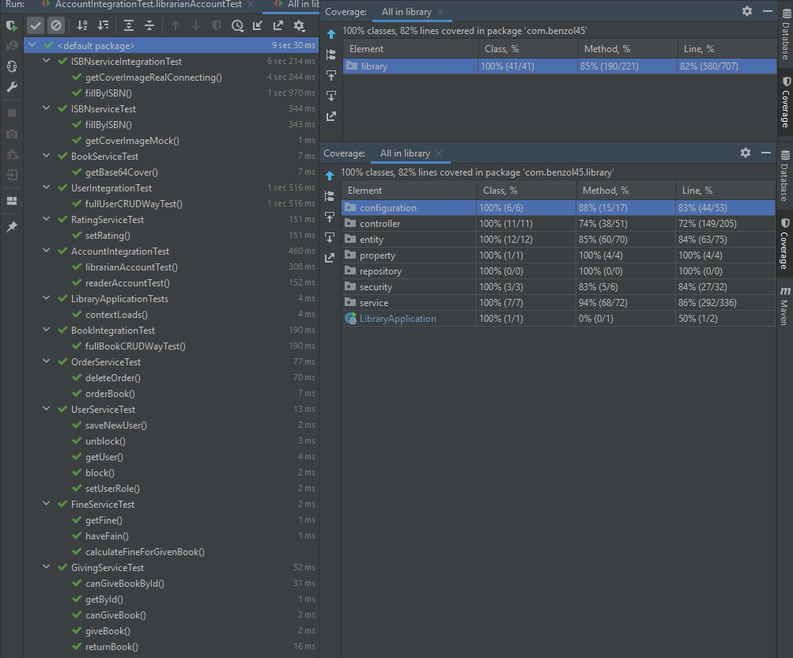
Test coverage
Project code-line coverage 82%
Unit tests JUnit 5 + Mockito
Integration tests
End-to-End tests
@SpringBootTest + MockMVC

Slide 9
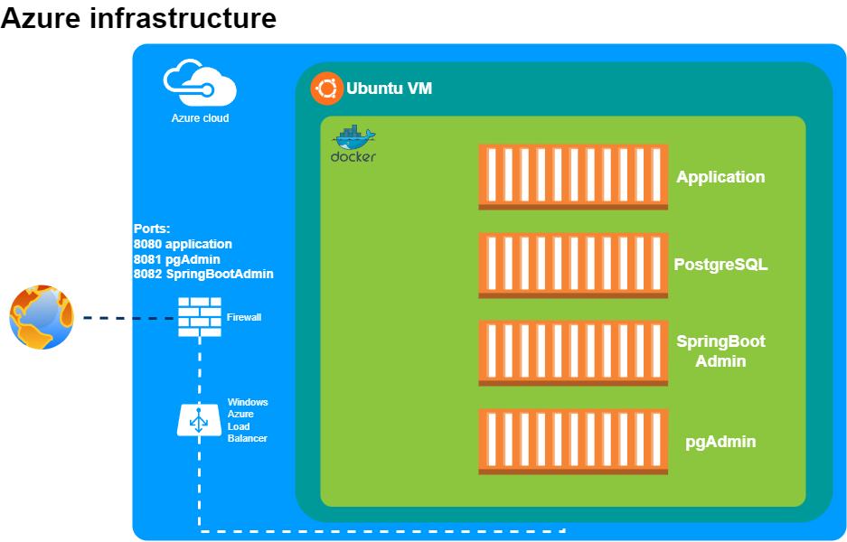

Slide 10
Additional business functionality
Filling book information from ISBN database (openlibrary.org) with cover image.
Base statistical subsystem
Book rating (after returning reader can set rate for a book) with sorting books by rating

Slide 11
Interesting features
Docker
docker-compose
custom service health check
service tools containers
ResourceBundle with two language for
templates
validators messages
classes
Custom DTO validators
LiquiBase for creating tables, indexes and inserting base data
Actuator with
custom HealthIndicator
custom Metric
SpringBootAdmin for represent info from Actuator
EndToEnd tests with SpringBootTest + MockMVC
REST Client for getting info and image from external resource
REST service with Swagger
Custom environment options and property holder
User and Session state listener (success/failure login and logout / session expired)

