Slide 1
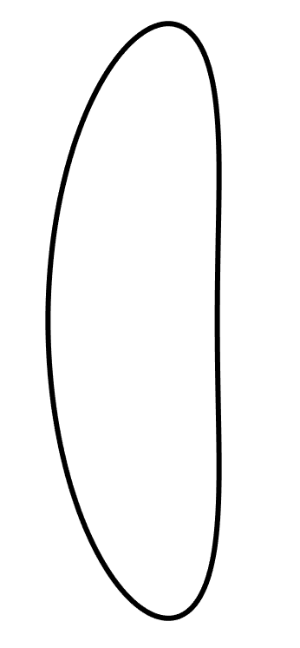
L₁ Lyapunov Orbit
CR3BP

Slide 2
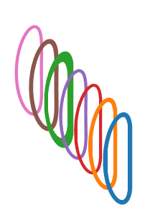
Analogs

Slide 3
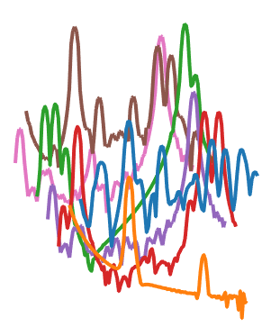
Spectra
Amp.
Freq.

