Slide 1
실험계획법 실습
Ch6. Two-Level Factorial Designs

Slide 2
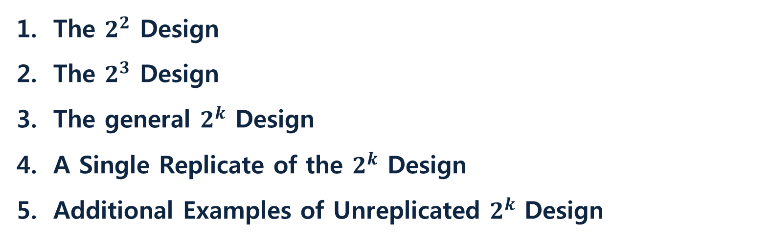
Contents
The $2^{2}$ Design
The $2^{3}$ Design
The general $2^{k}$ Design
A Single Replicate of the $2^{k}$ Design
Additional Examples of Unreplicated $2^{k}$ Design

Slide 3
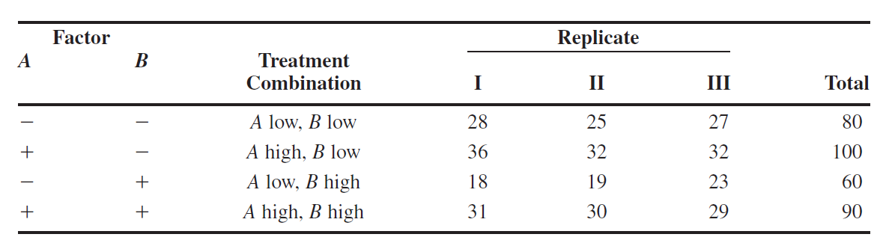

The $2^{2}$ Design
$2^{2}$ factorial design
Where A = reactant concentration, B = catalyst amount; y = recovery

Slide 4
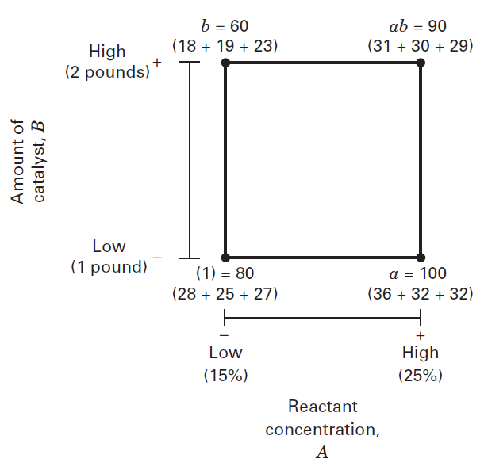
The $2^{2}$ Design
$2^{2}$ factorial design
- 4 treatment combinations
- high level: corresponding lowercase letter
- ab ← both high level
(1) ←both low level
- 4 treatment combinations
(1), a, b, ab ← The effect of Factors: Latin letters: A, B, AB

Slide 5
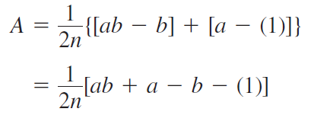
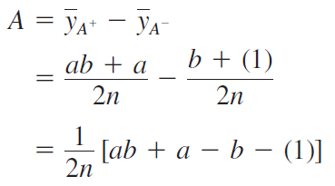
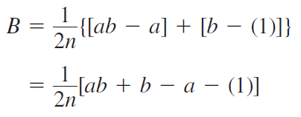
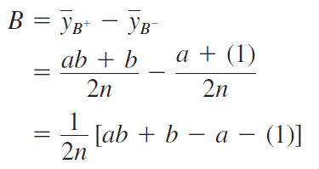
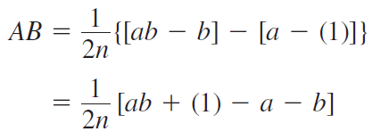
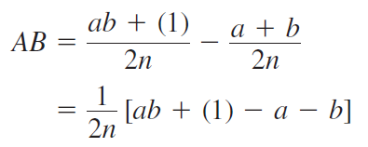
The $2^{2}$ Design
$2^{2}$ factorial design

Slide 6
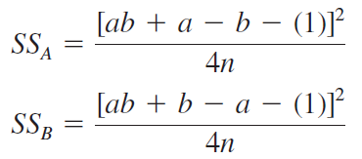
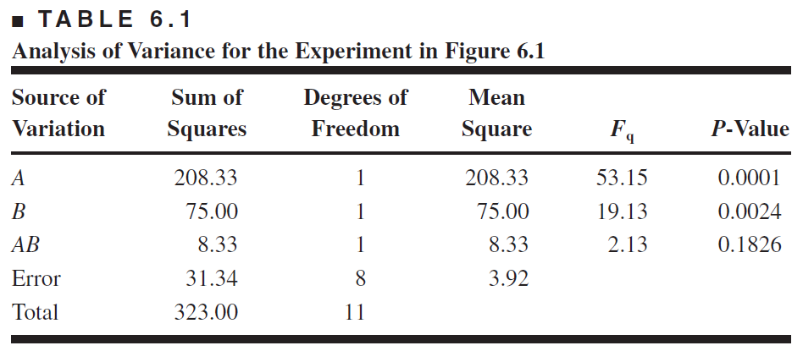



The $2^{2}$ Design
$2^{2}$ factorial design ANOVA

Slide 7
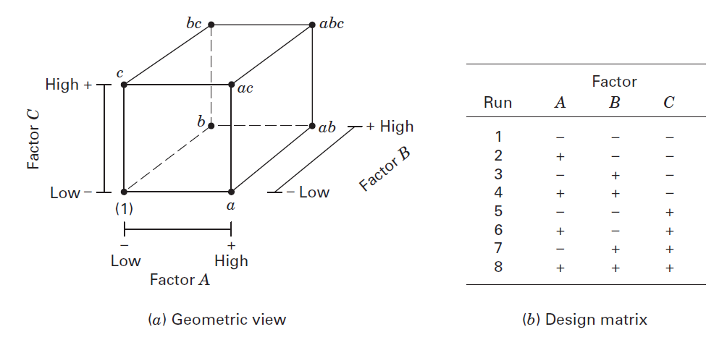

2. The $2^{3}$ Design
$2^{3}$ factorial design

Slide 8
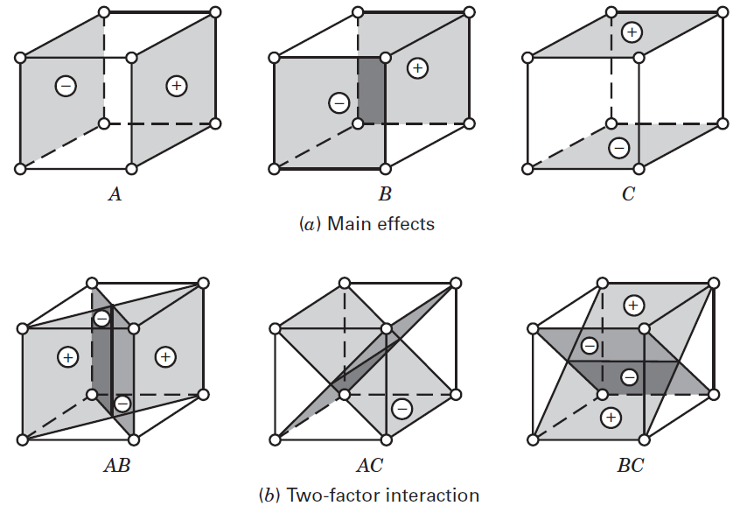
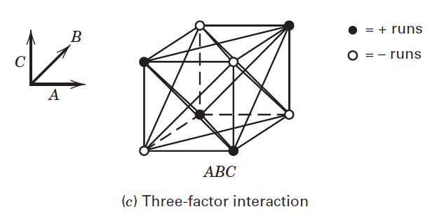
2. The $2^{3}$ Design
Geometric presentation of contrasts corresponding to the main effects and interactions in the $2^{3}$ design

Slide 9
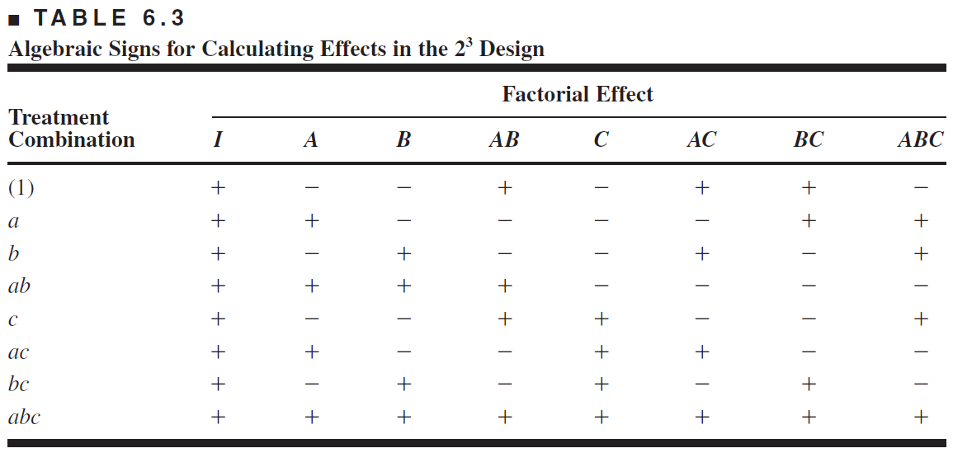
2. The $2^{3}$ Design
$2^{3}$ factorial design

Slide 10




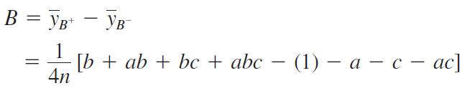

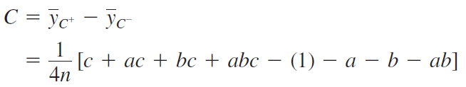
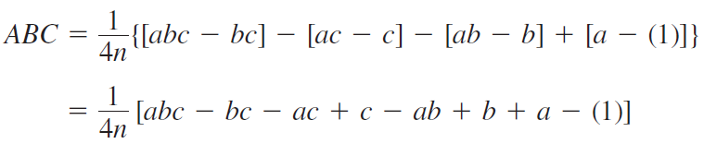
2. The $2^{3}$ Design
$2^{3}$ factorial design

Slide 11
2. The $2^{3}$ Design
EXAMPLE 6.1 using R
# 6.1
A<-factor(c(0,1))
B<-factor(c(0,1))
C<-factor(c(0,1))
rep<-factor(c(0,1))
dat_6.1<-expand.grid(A=A,B=B,C=C,rep=rep)
count<-c(550,669,633,642,1037,749,1075,729,604,650,601,635,1052,868,1063,860)
dat_6.1<-cbind(dat_6.1,count)
fit<-aov(count~A*B*C,data=dat_6.1)
summary(fit)
model.tables(fit)
#qqplot
qqnorm(fit$residuals)
qqline(fit$residuals)

Slide 12
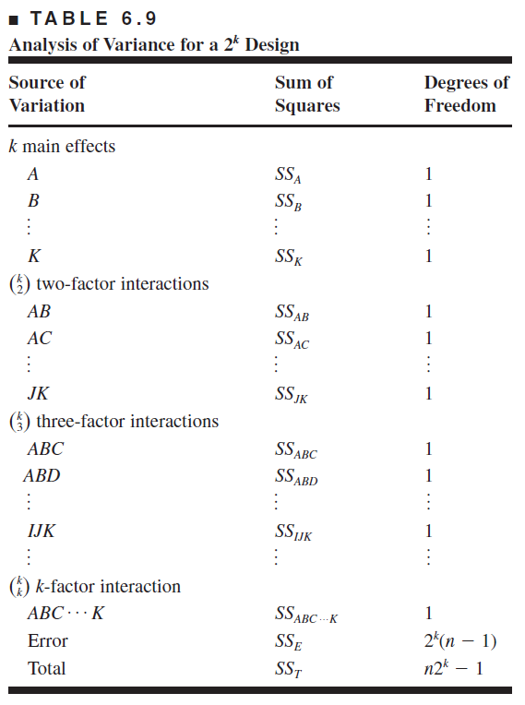
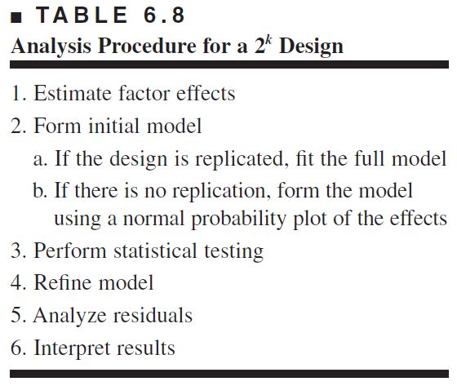

3. The general $2^{k}$ Design
$2^{k}$ factorial design
←ANOVA
←Removing non-significant variables
Graphical analysis: main, interaction
effect plots, and response surface plot
←

Slide 13


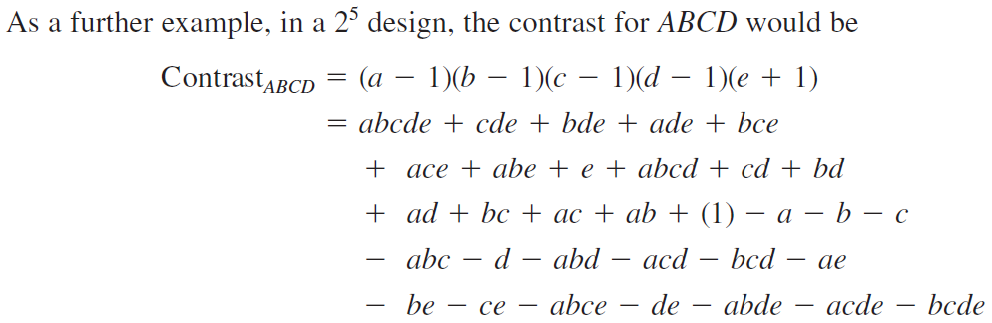
3. The general $2^{k}$ Design
contrast in$2^{k}$ factorial design

Slide 14

4. A Single Replicate of the $2^{k}$ Design
Why A Single Replicate of the $2^{k}$ Design?
These are 2^{k} factorial designs with one observation at each corner of the “cube”
An un-replicated 2^{k} factorial design is also called a “single replicate” of the 2^{k}
These designs are very widely used
Risks…if there is only one observation at each corner, is there a chance of unusual response observations spoiling the results?
Modeling “noise”?

Slide 15
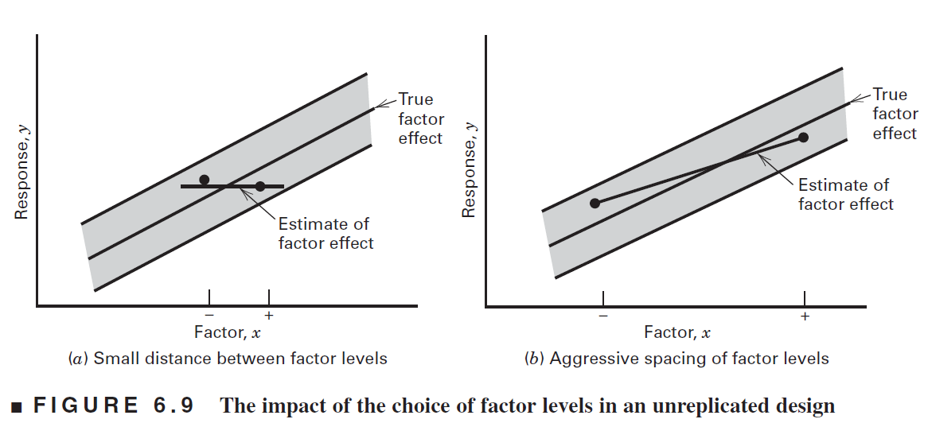

4. A Single Replicate of the $2^{k}$ Design
Unreplicated design
If the factors are spaced too closely, it increases the chances that the noise will overwhelm the signal in the data
More aggressive spacing is usually best

Slide 16
4. A Single Replicate of the $2^{k}$ Design
Unreplicated $2^{k}$ factorial design
Lack of replication causes potential problems in statistical testing
Replication admits an estimate of “pure error” (a better phrase is an internal estimate of error)
With no replication, fitting the full model results in zero degrees of freedom for error
Potential solutions to this problem
Pooling high-order interactions to estimate error
Normal probability plotting of effects (Daniels, 1959)
Other methods…see text

Slide 17
4. A Single Replicate of the $2^{k}$ Design
EXAMPLE 6.2 using R
# 6.2
A<-factor(c(-1,1))
B<-factor(c(-1,1))
C<-factor(c(-1,1))
D<-factor(c(-1,1))
dat_6.2<-expand.grid(A=A,B=B,C=C,D=D)
count<-c(45,71,48,65,68,60,80,65,43,100,45,104,75,86,70,96)
dat_6.2<-cbind(dat_6.2,count)
fit<-aov(count~A*B*C*D,data=dat_6.2)
effect<-fit$effects[-1]/2
model.tables(fit)
## From "stats.stackexchange.com"
x <- expand.grid(c(-1,1), c(-1,1), c(-1,1), c(-1,1))
A <- x[,1]
B <- x[,2]
C <- x[,3]
D <- x[,4]
fa <- expand.grid(c("A", ""), c("B", ""), c("C", ""), c("D", ""))
eff <- numeric(nrow(fa))
names(eff) <- apply(fa, 1, paste, collapse="")
effect <- function (x) {
txt <- names(x)
ntxt <- length(txt)
ans <- numeric(ntxt)
for (i in 1:ntxt) {
y <- paste(strsplit(txt[i], "")[[1]], collapse="*")
z <- eval(parse(text = y))
ans[i] <- sum(z*R)/8
}
names(ans) <- txt
ans
}
y <- effect(eff)
tmp <- qqnorm(y)
qqline(y)
text(tmp$x, tmp$y, names(y), pos=3)
dev.off()
fit.fm <- fit
fit.rm <- aov(R ~ A*C*D, rate)

Slide 18
THANK YOU

