Slide 1

실험계획법 실습
Ch7. Blocking and Confounding in the $2^{k}$ Factorial Design

Slide 2
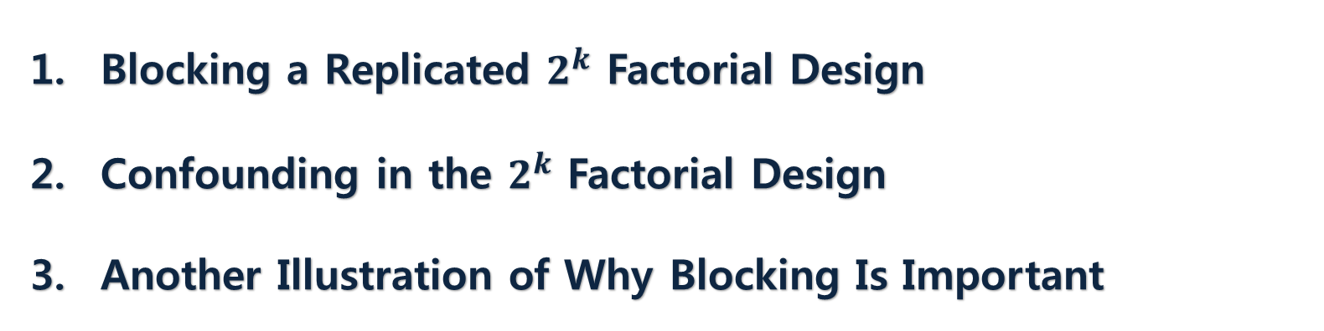
Contents
Blocking a Replicated $2^{k}$ Factorial Design
Confounding in the $2^{k}$ Factorial Design
Another Illustration of Why Blocking Is Important

Slide 3
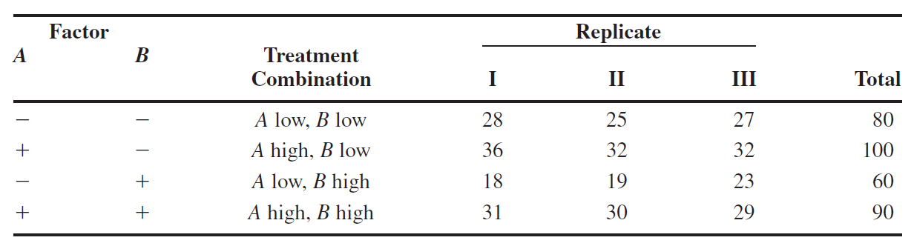

Blocking a Replicated $2^{k}$ Factorial Design
EXAMPLE 7.1

Slide 4
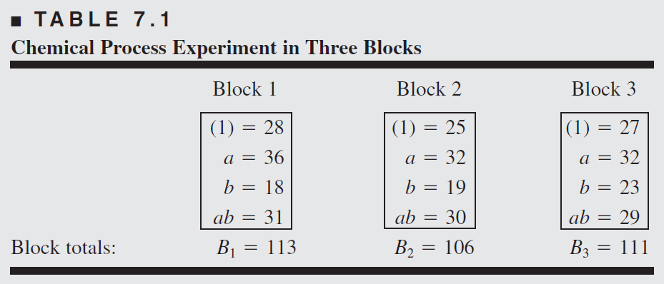
Blocking a Replicated $2^{k}$ Factorial Design
Chemical Process Experiment in Three Blocks

Slide 5
Blocking a Replicated $2^{k}$ Factorial Design
EXAMPLE 7.1 using R
# 7.1
A<-factor(c(-1,1))
B<-factor(c(-1,1))
rep<-factor(c(1,2,3))
dat_7.1<-expand.grid(A=A,B=B,rep=rep)
c_7.1<-c(28,36,18,31,25,32,19,30,27,32,23,29)
dat_7.1<-cbind(dat_7.1,c_7.1)
fit_7.1<-aov(c_7.1~A*B+rep,data=dat_7.1)
summary(fit_7.1)

Slide 6
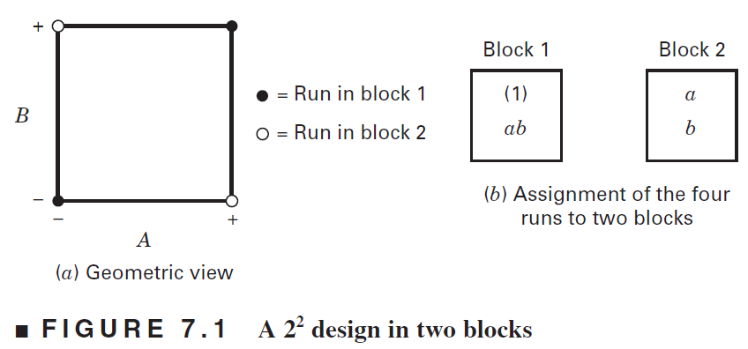
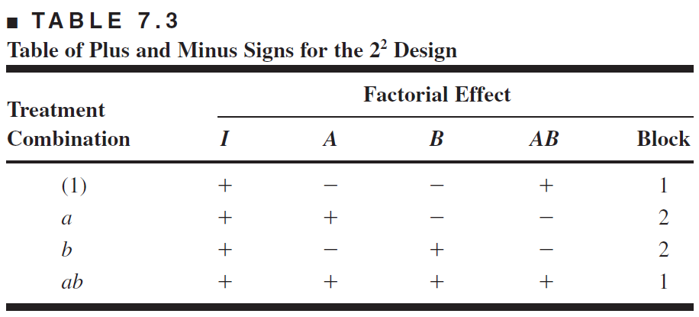
2. Confounding in the $2^{k}$ Factorial Design
A $2^{2}$ design in two blocks

Slide 7
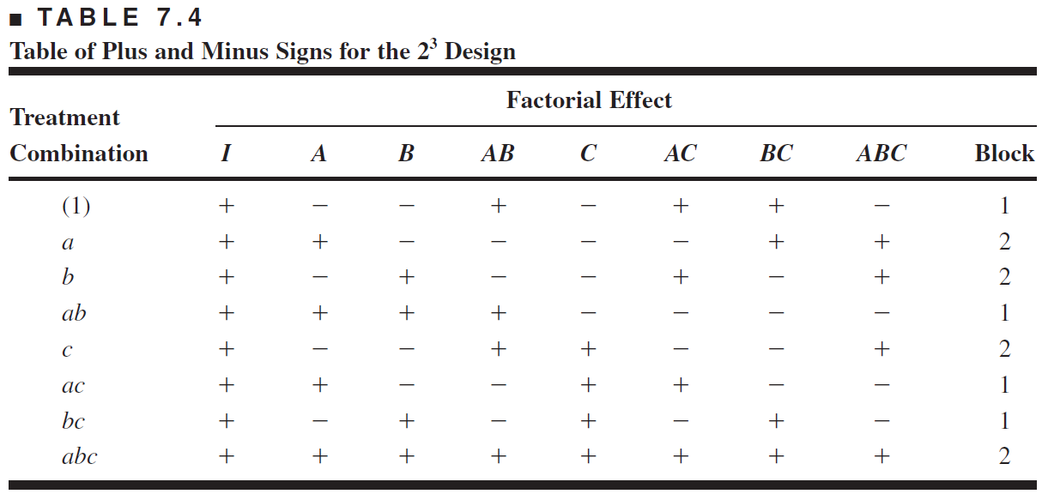
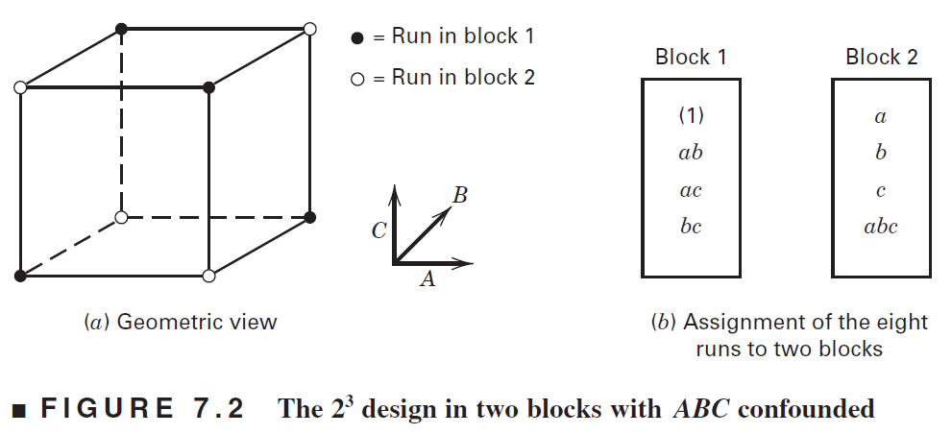
2. Confounding in the $2^{k}$ Factorial Design
A $2^{3}$ design in two blocks

Slide 8


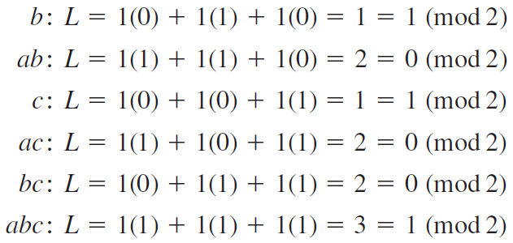
2. Confounding in the $2^{k}$ Factorial Design
Using a defining contrast
Defining Contrast: a linear combination in factorial design with two blocks
EXAMPLE using a defining contrast

Slide 9
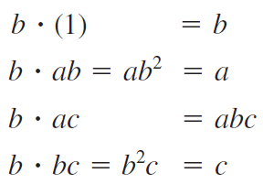
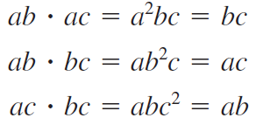
2. Confounding in the $2^{k}$ Factorial Design
Using the Principal Block
Principal Block: the block containing the TC (1)
Theory: Any element, except TC (1), in the principal block may be generated by multiplying two other elements in the principal block modulus 2

Slide 10
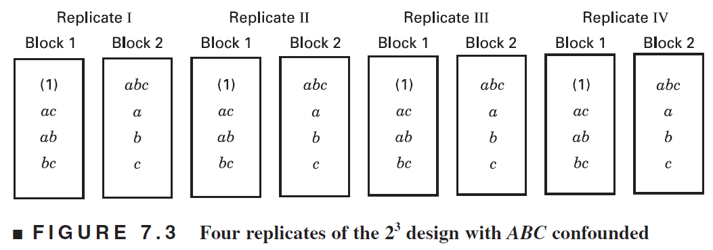
2. Confounding in the $2^{k}$ Factorial Design
Estimation of Error

Slide 11
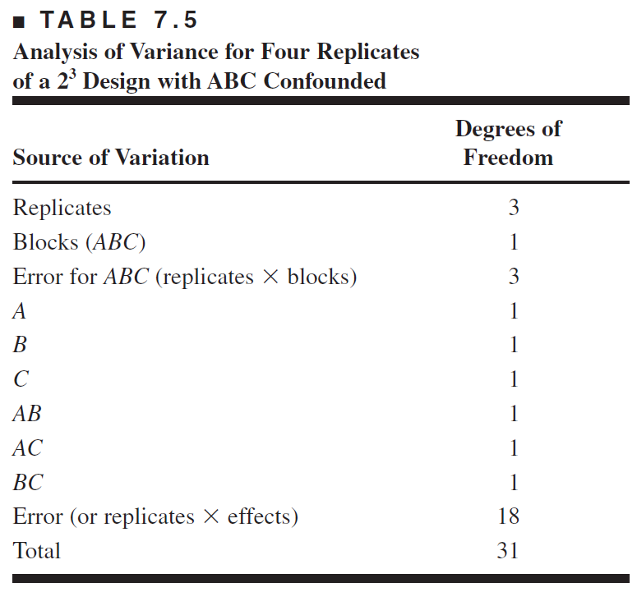
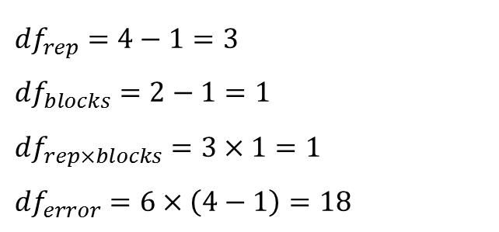
2. Confounding in the $2^{k}$ Factorial Design
Estimation of Error
${df}_{rep}=4−1=3$
${df}_{blocks}=2−1=1$
${df}_{rep×blocks}=3×1=1$
${df}_{error}=6×\left(4−1\right)=18$

Slide 12
2. Confounding in the $2^{k}$ Factorial Design
EXAMPLE 7.2 using R
# 7.2
A<-factor(c(-1,1))
B<-factor(c(-1,1))
C<-factor(c(-1,1))
D<-factor(c(-1,1))
dat_7.2<-expand.grid(A=A,B=B,C=C,D=D)
count<-c(25,71,48,45,68,40,60,65,43,80,25,104,55,86,70,76)
dat_7.2<-cbind(dat_7.2,count)
fit<-aov(count~A*B*C*D,data=dat_7.2)
summary(fit)
x <- expand.grid(c(-1,1), c(-1,1), c(-1,1), c(-1,1))
A <- x[,1]
B <- x[,2]
C <- x[,3]
D <- x[,4]
fa <- expand.grid(c("A", ""), c("B", ""), c("C", ""), c("D", ""))
eff <- numeric(nrow(fa))
names(eff) <- apply(fa, 1, paste, collapse="")
effect <- function (x) {
txt <- names(x)
ntxt <- length(txt)
ans <- numeric(ntxt)
for (i in 1:ntxt) {
y <- paste(strsplit(txt[i], "")[[1]], collapse="*")
z <- eval(parse(text = y))
ans[i] <- sum(z*R)/8
}
names(ans) <- txt
ans
}
y <- effect(eff)
tmp <- qqnorm(y)
qqline(y)
text(tmp$x, tmp$y, names(y), pos=3)
dev.off()

Slide 13
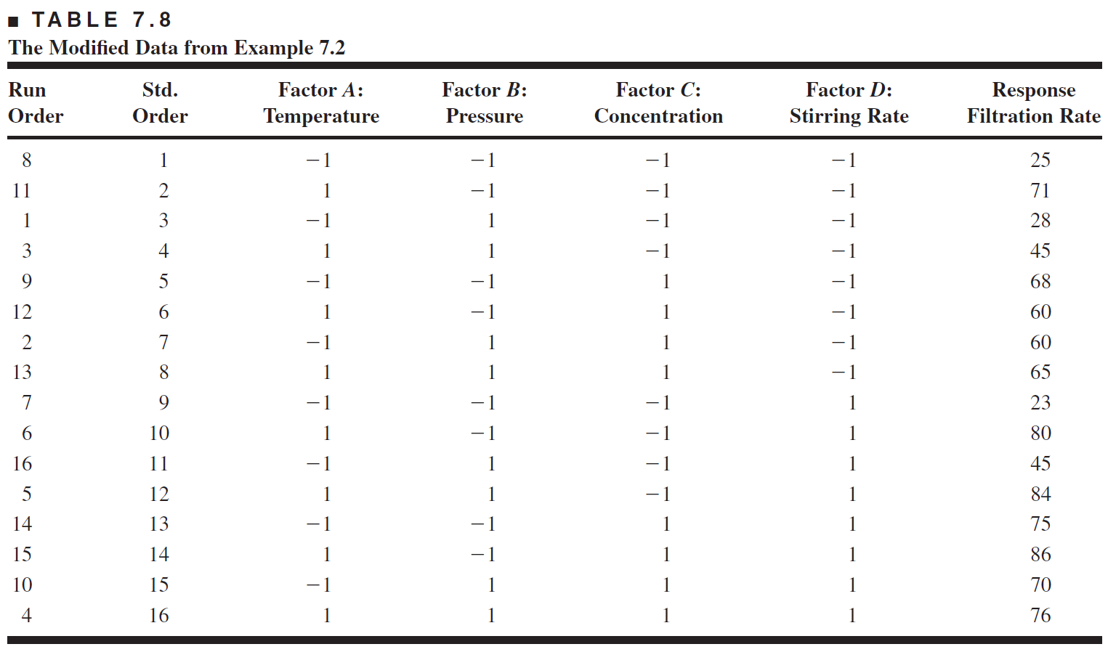
3. Another Illustration of Why Blocking Is Important
Modification of data: reduced 20 to first 8 run order

Slide 14
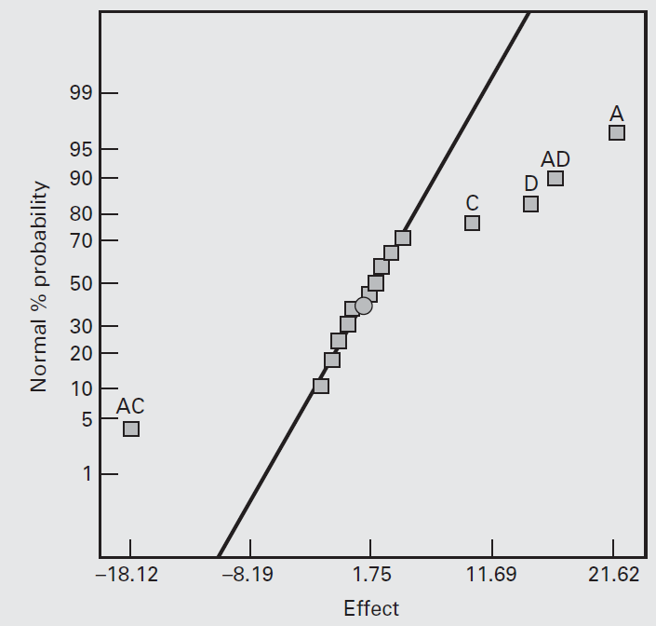
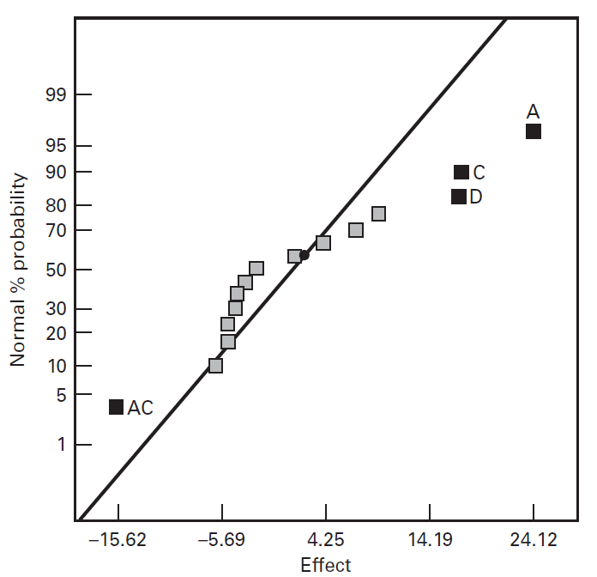
3. Another Illustration of Why Blocking Is Important
Normal Probability plot

Slide 15
3. Another Illustration of Why Blocking Is Important
EXAMPLE 7.2 using R
#7.3
count<-c(25,71,28,45,68,60,60,65,23,80,45,84,75,86,70,76)
dat_7.3<-data.frame(cbind(A=A,B=B,C=C,D=D,count))
fit<-aov(count~A*B*C*D,data=dat_7.3)
y <- effect(eff)
tmp <- qqnorm(y)
qqline(y)
text(tmp$x, tmp$y, names(y), pos=3)

Slide 16
THANK YOU

