Slide 1
실험계획법 실습
Ch8. Two-level Fractional Factorial Designs

Slide 2
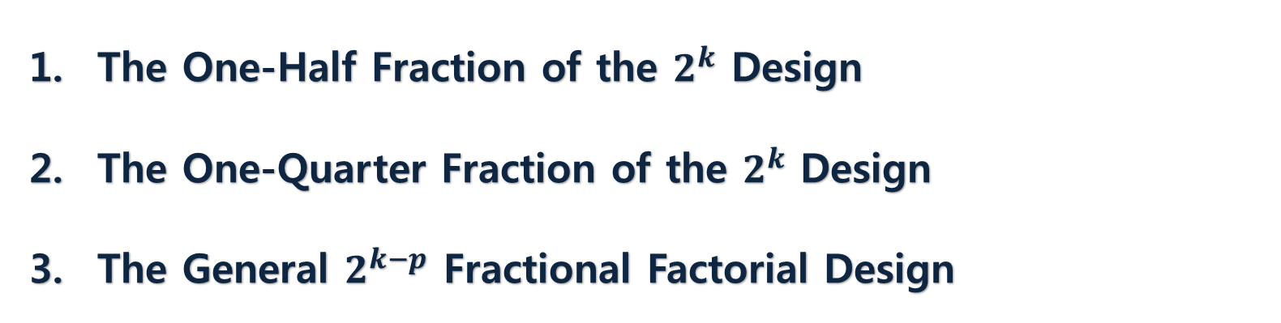
Contents
The One-Half Fraction of the $2^{k}$ Design
The One-Quarter Fraction of the $2^{k}$ Design
The General $2^{k−p}$ Fractional Factorial Design

Slide 3
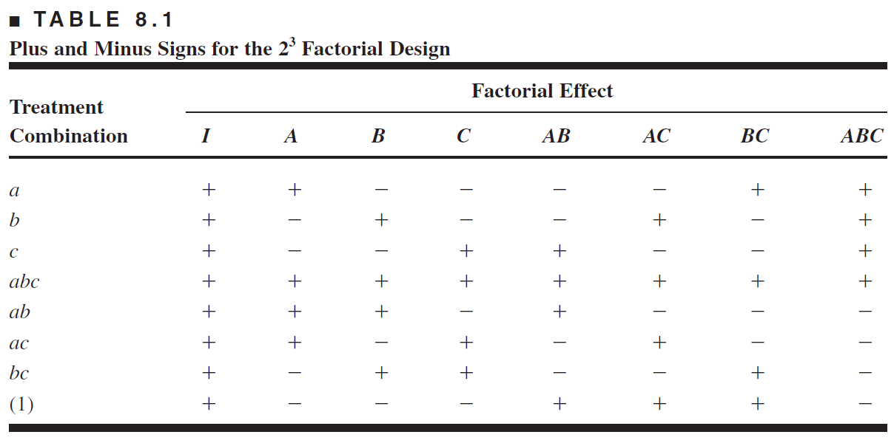

Blocking a Replicated $2^{k}$ Factorial Design
Definitions and Basic Principles
Notation: because the design has $2^{k}/2$ runs, it’s referred to as a $2^{k}−1$
$→$ Formed by selecting TC’s that have ‘+’ in the high-order interaction, which is called the generator of this fraction, which is refer to a word.
generator
word
defining relation

Slide 4
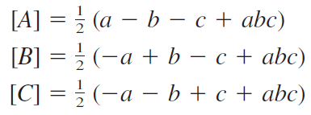
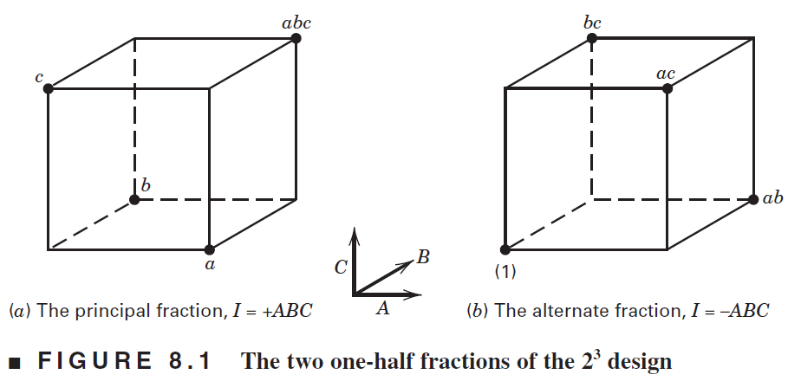
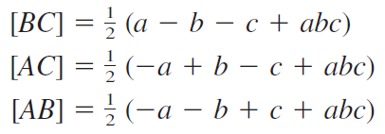
Blocking a Replicated $2^{k}$ Factorial Design
Aliasing in the One-Half Fraction of the $2^{3}$

Slide 5
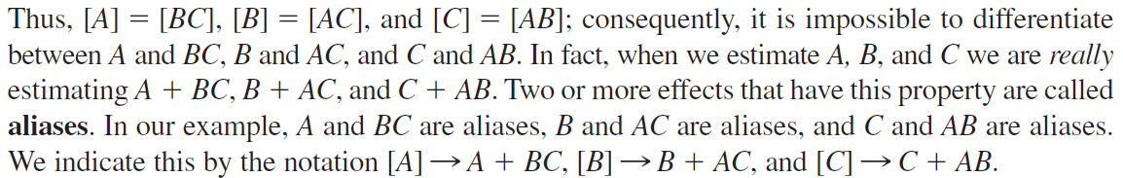



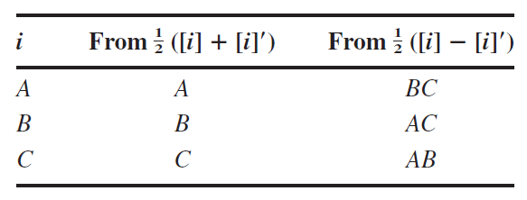

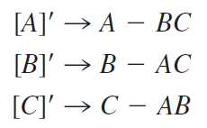


Blocking a Replicated $2^{k}$ Factorial Design
Aliasing in the One-Half Fraction of the $2^{3}$
principal
fraction
alternate (or complementary)
fraction

Slide 6






Blocking a Replicated $2^{k}$ Factorial Design
Design Resolution
Resolution R if no p-factor effect is aliased with another effect less than R – p factors
$→$ The resolution of $2^{k}$ FFD = #letters in the shortest word in defining relation
$Resolution Ⅲ Designs$
$$Main effect=2 factors in teractions \left(aliased\right)$$
$$Example :2_{Ⅲ}^{3−1} (I=ABC)$$
$Resolution Ⅳ Designs$
$$2 factors in teractions=2 factors in teractions \left(aliased\right)$$
$$Example :2_{Ⅳ}^{4−1} (I=ABCD)$$
$Resolution Ⅴ Designs$
$$2 factors in teractions=3 factors in teractions\left(aliased\right)$$
$$Example :2_{Ⅴ}^{5−1} (I=ABCDE)$$

Slide 7
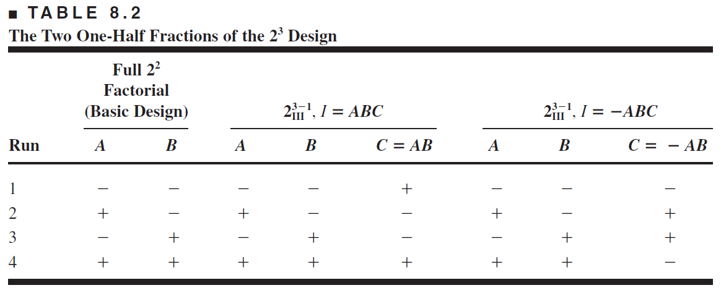
Blocking a Replicated $2^{k}$ Factorial Design
Construction and Analysis of the One-Half Fraction
$2_{Ⅲ}^{3−1} (I=ABC)$ : writing down the full 22 factorial (basic design),
and then equating C = AB. (note that alternative fraction: C = – AB)

Slide 8
Blocking a Replicated $2^{k}$ Factorial Design
EXAMPLE 8.1 using R
#Ex 8.1
A<-factor(c(-1,1))
B<-factor(c(-1,1))
C<-factor(c(-1,1))
D<-factor(c(-1,1,1,-1,1,-1,-1,1))
dat_8.1<-expand.grid(A=A,B=B,C=C)
count<-c(45,100,45,65,75,60,80,96)
dat_8.1<-cbind(dat_8.1,D,count)
fit_8.1<-aov(count~A+B+C+D+A:B+A:C+A:D,data=dat_8.1)
summary(fit_8.1)
mt8.1<-model.tables(fit_8.1,methods="effect")$table
y_8.1<-eff(mt8.1)

Slide 9
Blocking a Replicated $2^{k}$ Factorial Design
EXAMPLE 8.2 using R
#Ex 8.2
A<-factor(c(-1,1))
B<-factor(c(-1,1))
C<-factor(c(-1,1))
D<-factor(c(-1,1))
dat_8.2<-expand.grid(A=A,B=B,C=C,D=D)
E<-factor(c(1,-1,-1,1,-1,1,1,-1,-1,1,1,-1,1,-1,-1,1))
count<-c(8,9,34,52,16,22,45,60,6,10,30,50,15,21,44,63)
dat_8.2<-cbind(dat_8.2,E,count)
fit<-aov(count~A+B+C+D+E+A:B+A:C+A:D+A:E+B:C+B:D+B:E+C:D+C:E+D:E,data=dat_8.2)
summary(fit)
mt8.2<-model.tables(fit,type="effect")$tables
y<-eff(mt8.2)
tmp <- qqnorm(y)
qqline(y)
text(tmp$x, tmp$y, names(y), pos=3)
fit_8.2_2<-aov(count~A+B+C+A:B,data=dat_8.2)
summary(fit_8.2_2)
par(mfrow=c(2,2))
plot(fit_8.2_2)
interaction.plot(dat_8.2$A,dat_8.2$B,response=dat_8.2$count,col=c(1:2))

Slide 10
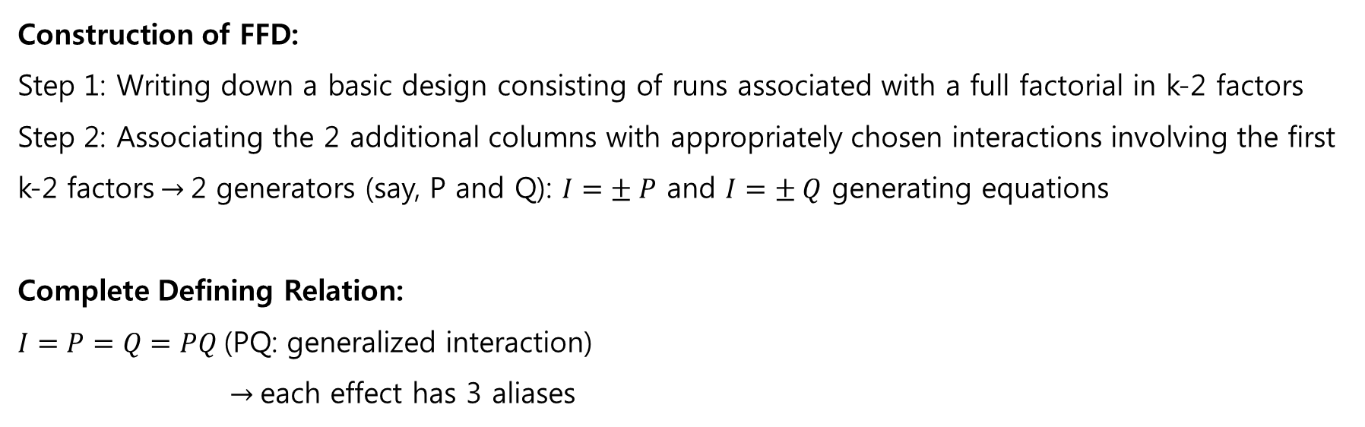
2. The One-Quarter Fraction of the $2^{k}$ Design
The One-Quarter Fraction of the $2^{k}$ Design
Construction of FFD:
Step 1: Writing down a basic design consisting of runs associated with a full factorial in k-2 factors
Step 2: Associating the 2 additional columns with appropriately chosen interactions involving the first k-2 factors$→$2 generators (say, P and Q): $I=± P$ and $I=± Q$ generating equations
Complete Defining Relation:
$I=P=Q=PQ$(PQ: generalized interaction)
$→$each effect has 3 aliases

Slide 11
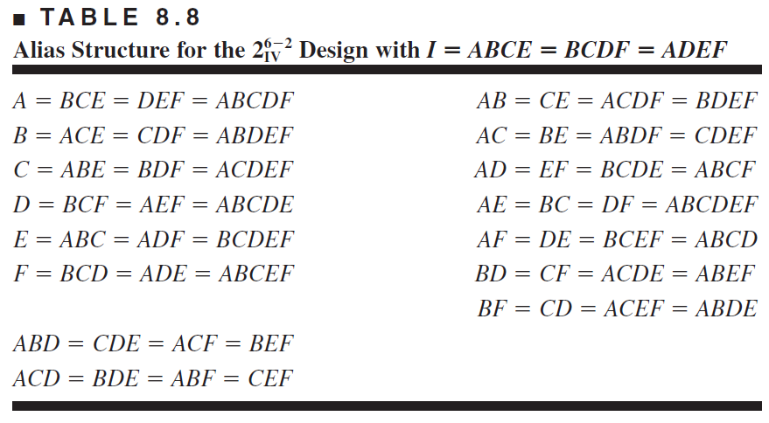
2. The One-Quarter Fraction of the $2^{k}$ Design
$2^{6−2}$design example
I = ABCE and I = BCDF ← design generators
→ complete defining relation: I = ABCE = BCDF = ADEF (i.e., resolution IV)
→ Alias of any effect = effect * word (of defining relation)

Slide 12
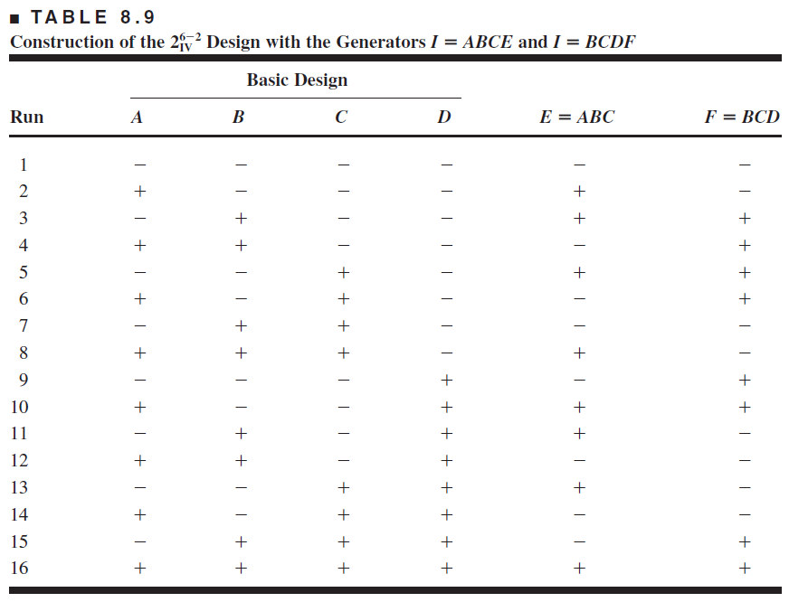
2. The One-Quarter Fraction of the $2^{k}$ Design
$2^{6−2}$design example

Slide 13
2. The One-Quarter Fraction of the $2^{k}$ Design
EXAMPLE 8.4 using R
A<-factor(c(-1,1))
B<-factor(c(-1,1))
C<-factor(c(-1,1))
D<-factor(c(-1,1))
E<-factor(c(-1,1,1,-1,1,-1,-1,1,-1,1,1,-1,1,-1,-1,1))
F<-factor(c(-1,-1,1,1,1,1,-1,-1,1,1,-1,-1,-1,-1,1,1))
dat_8.4<-expand.grid(A=A,B=B,C=C,D=D)
count<-c(6,10,32,60,4,15,26,60,8,12,34,60,16,5,37,52)
dat_8.4<-cbind(dat_8.4,E,F,count)
fit_8.4<-aov(count~(A+B+C+D+E+F)^2+A:B:D+A:B:F,data=dat_8.4)
summary(fit_8.4)
mt8.4<-model.tables(fit_8.4,type="effect")$tables
y<-eff(mt8.4)
tmp <- qqnorm(y)
qqline(y)
text(tmp$x, tmp$y, names(y), pos=3)
interaction.plot(dat_8.4$A,dat_8.4$B,response=dat_8.4$count,col=c(1:2))
fit_8.4_2<-aov(count~A*B,data=dat_8.4)
summary(fit_8.4_2)
par(mfrow=c(2,2))
plot(fit_8.4_2)

Slide 14
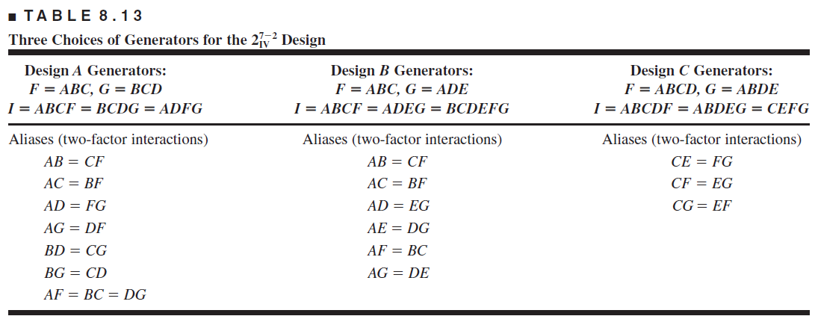
3. The General $2^{k−p}$ Fractional Factorial Design
Choosing a Design
best design

Slide 15
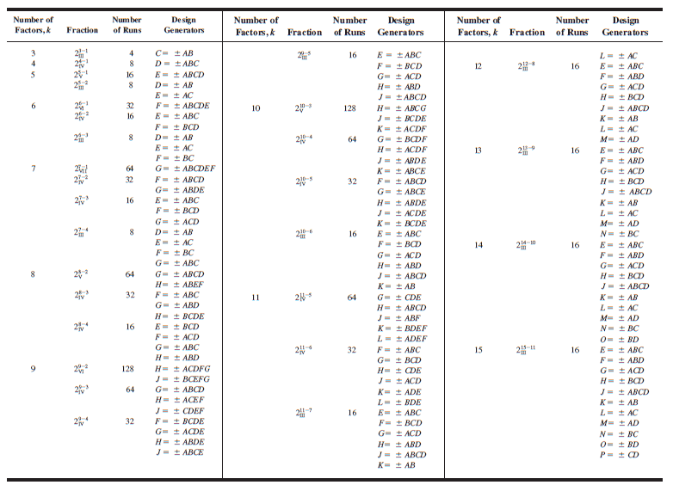
3. The General $2^{k−p}$ Fractional Factorial Design

Slide 16
THANK YOU

