Slide 1
실험계획법 실습
인하대학교 대학원
홍규성

Slide 2
Ch2 Basic Statistical Methods
Basic Statistical Concepts
Sampling and Sampling Distributions
Inference about the difference in Mean, Randomized Designs
Inference about the difference in Means, Paired Comparison Designs
Inference about the variance of
Normal Distribution

Slide 3
Ch2 Basic Statistical Methods
Basic Statistical Concepts
Graphical Description of Variability
Plot
Bar chart
Box plot
Histogram
Probability Distributions
Mean
Variance
Standard Deviation

Slide 4
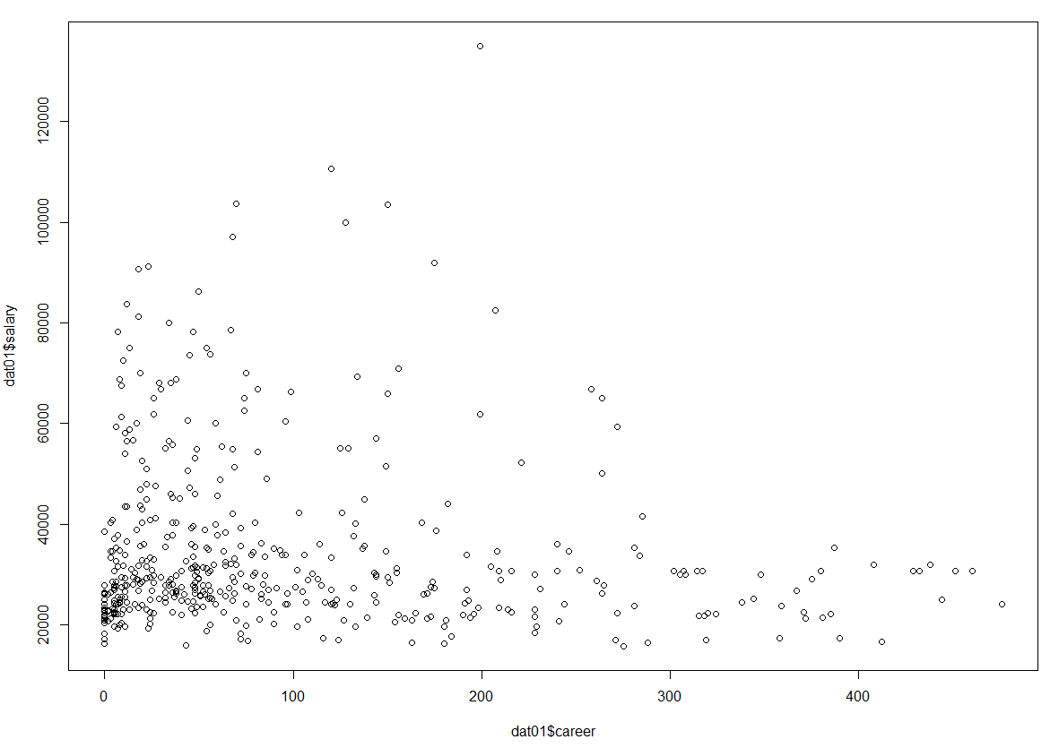
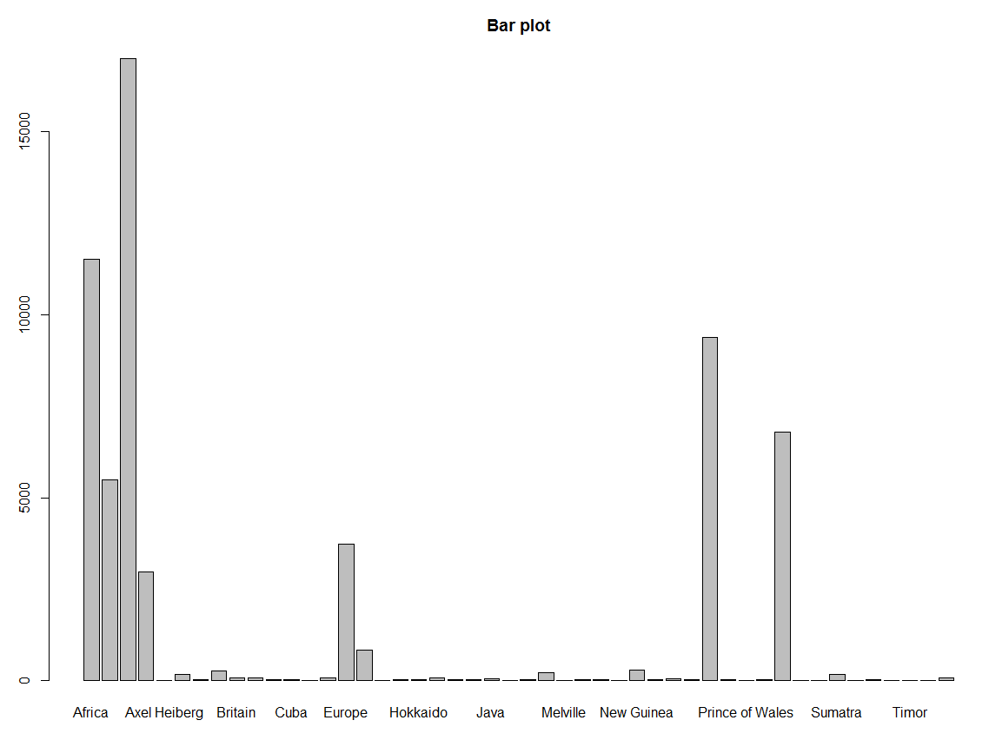
Ch2 Basic Statistical Methods
Basic Statistical Concepts
Graphical Description of Variability
Scatter Plot
Bar chart

Slide 5
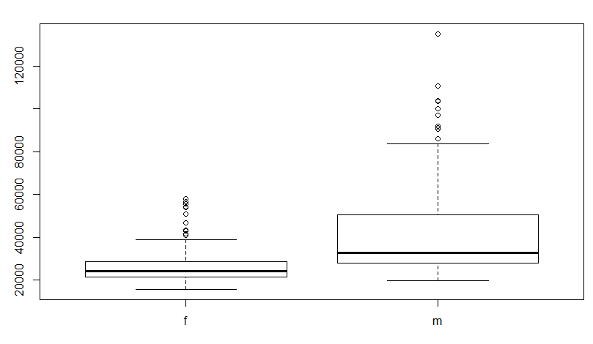
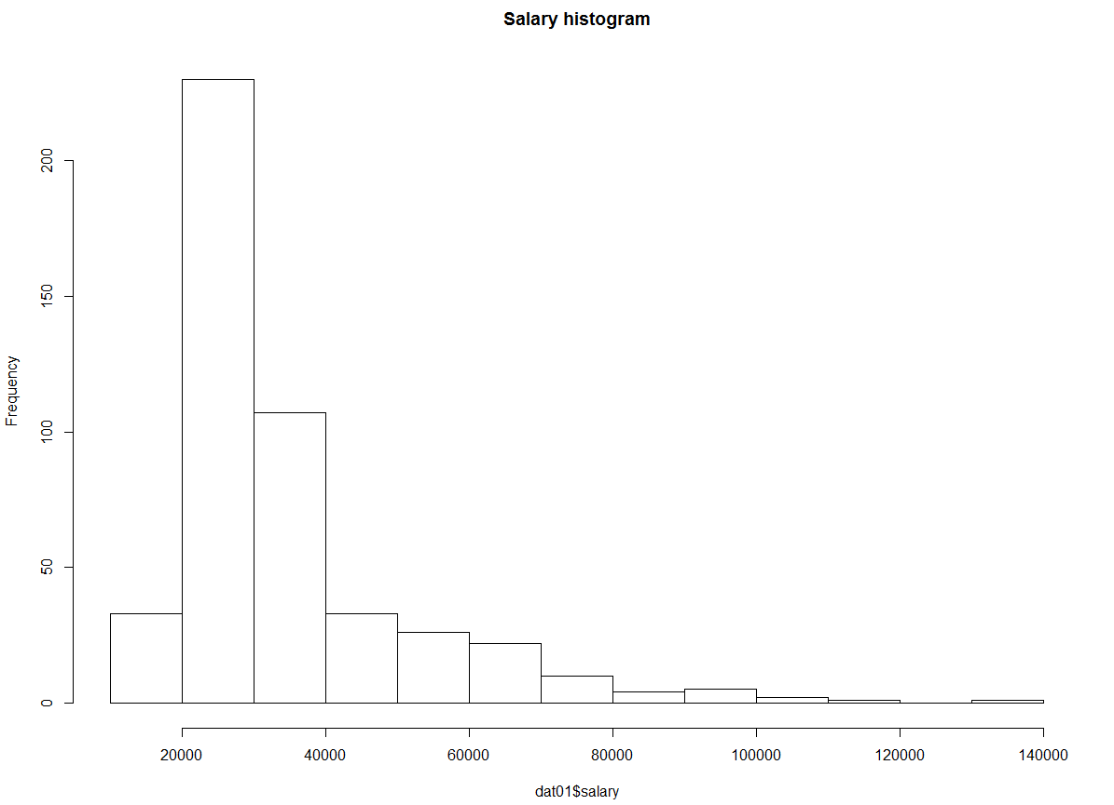
Ch2 Basic Statistical Methods
Basic Statistical Concepts
Box plot
Histogram

Slide 6
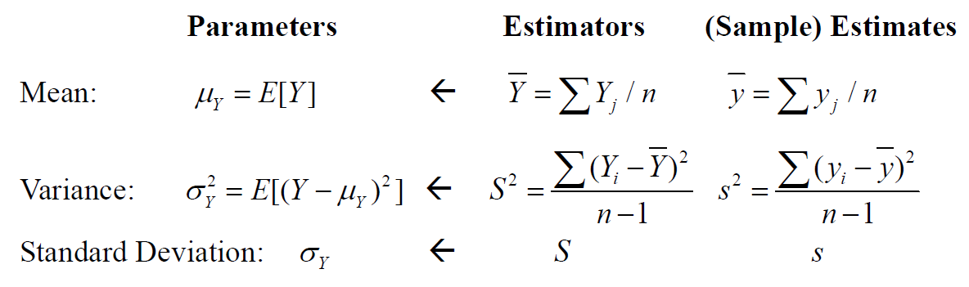
Ch2 Basic Statistical Methods
Sampling and Sampling Distributions
Statistics: Point Estimation

Slide 7
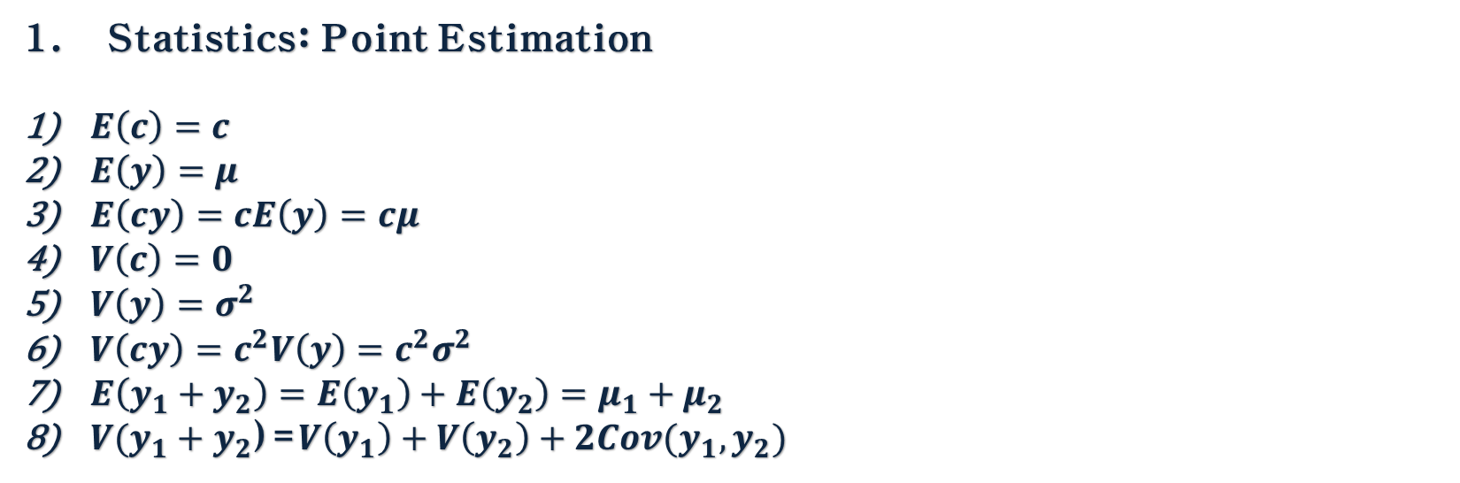
Ch2 Basic Statistical Methods
Sampling and Sampling Distributions
Statistics: Point Estimation
$E\left(c\right)=c$
$E\left(y\right)=μ$
$E\left(cy\right)=cE\left(y\right)=cμ$
$V\left(c\right)=0$
$V\left(y\right)=σ^{2}$
$V\left(cy\right)=c^{2}V\left(y\right)=c^{2}σ^{2}$
$E\left(y_{1}+y_{2}\right)=E\left(y_{1}\right)+E\left(y_{2}\right)=μ_{1}+μ_{2}$
$V(y_{1}+y_{2}$)=$V\left(y_{1}\right)+V\left(y_{2}\right)+2Cov(y_{1},y_{2})$

Slide 8
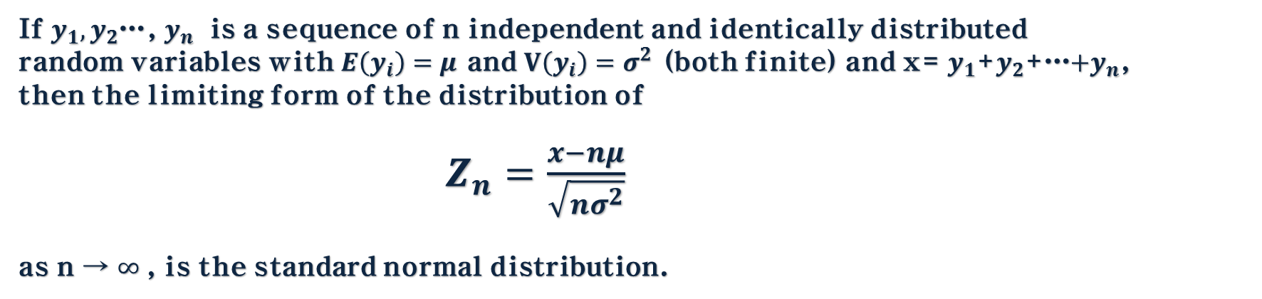
Ch2 Basic Statistical Methods
Sampling and Sampling Distributions
2. The Central Limit Theorem
If $y_{1},y_{2}$…, $y_{n}$ is a sequence of n independent and identically distributed random variables with $E\left(y_{i}\right)=μ$ and $V\left(y_{i}\right)=σ^{2}$ (both finite) and x= $y_{1}$+$y_{2}$+…$+y_{n}$,
then the limiting form of the distribution of
$Z_{n}=\frac{x−nμ}{\sqrt{nσ^{2}}}$
as n → $∞$, is the standard normal distribution.

Slide 9
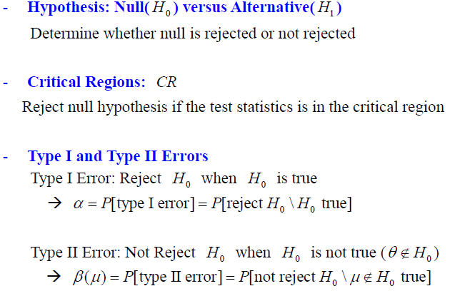
Ch2 Basic Statistical Methods
Inference about the difference in Mean, Randomized Designs
1. Hypotheses Testing

Slide 10
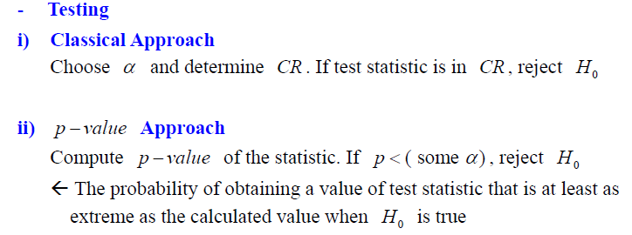
Ch2 Basic Statistical Methods
Inference about the difference in Mean, Randomized Designs
1. Hypotheses Testing

Slide 11
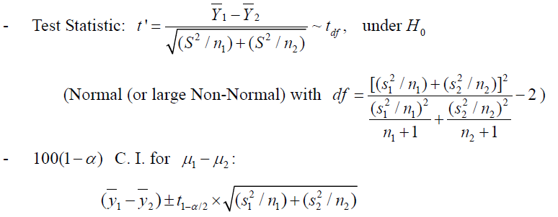
Ch2 Basic Statistical Methods
Inference about the difference in Mean, Randomized Designs
2. The Case Where $σ_{1}^{2}≠σ_{2}^{2}$

Slide 12
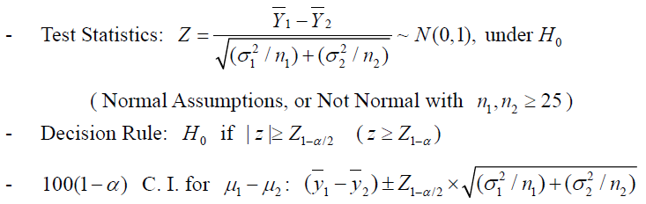
Ch2 Basic Statistical Methods
Inference about the difference in Mean, Randomized Designs
3. The Case Where $σ_{1}^{2}$ and $σ_{2}^{2}$ Are Known

Slide 13
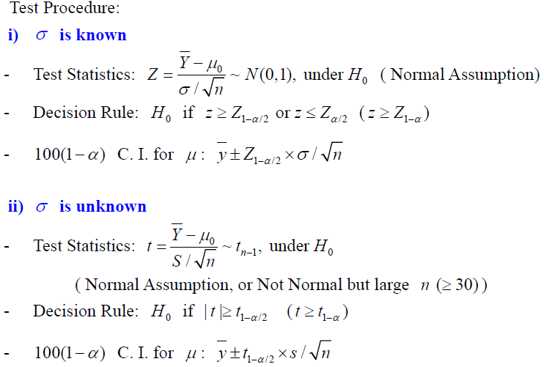
Ch2 Basic Statistical Methods
Inference about the difference in Mean, Randomized Designs
4. Comparing a Single Mean to a Specified Value

Slide 14
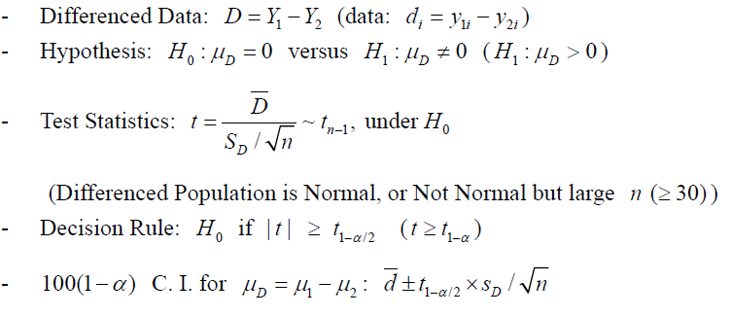
Ch2 Basic Statistical Methods
Inference about the difference in Mean, Paired Comparison Designs
1. The Paired Comparison Problem

Slide 15
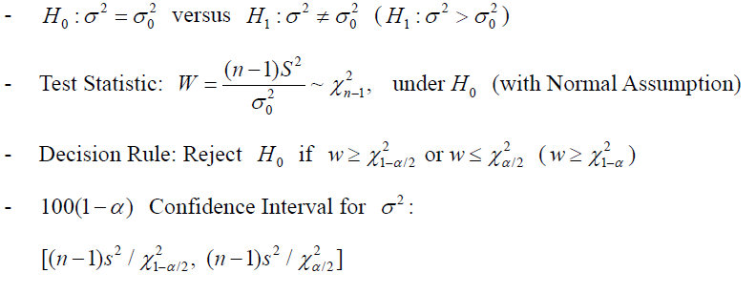
Ch2 Basic Statistical Methods
Inference about the Variances of Normal Distributions
1. Test on a Single Variance

Slide 16
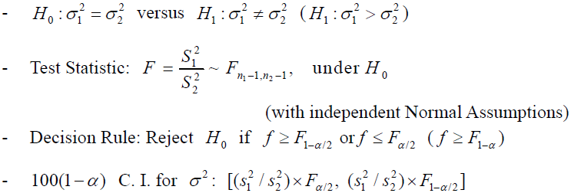
Ch2 Basic Statistical Methods
Inference about the Variances of Normal Distributions
2. Test on Two Variance : Independent Samples

Slide 17
감사합니다.
See You

