Slide 1
실험계획법 실습
인하대학교 대학원
홍규성

Slide 2
Ch3 Analysis of Variance
The Analysis of Variance
Analysis of the Fixed Effects Model
Model Adequacy Checking

Slide 3
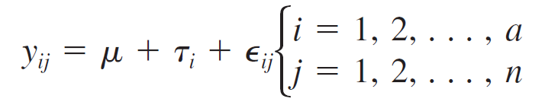

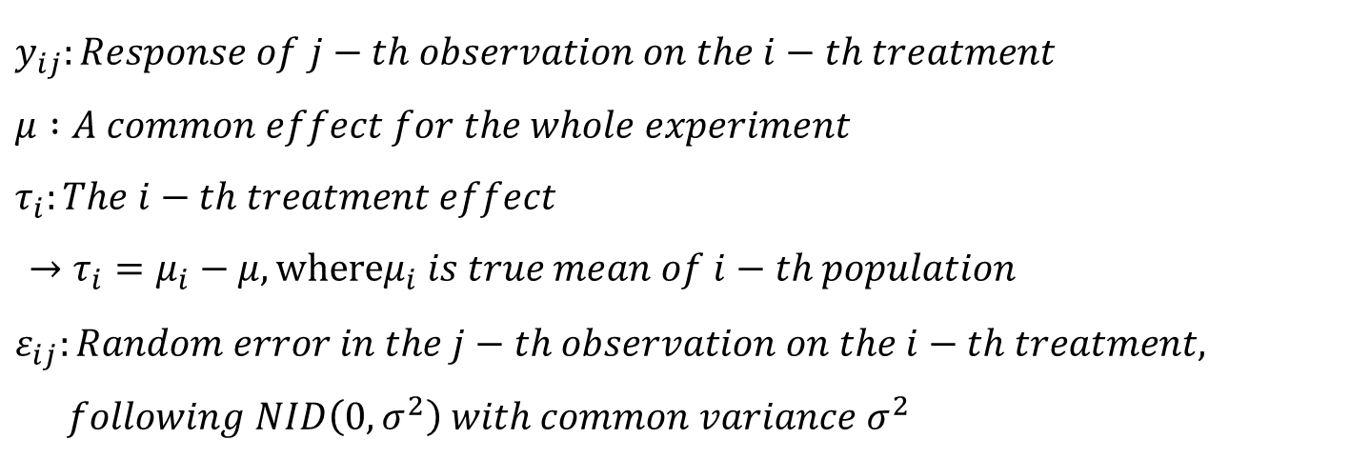
Ch3 Analysis of Variance
The Analysis of Variance
one-way ANOVA
$$Model :$$
$y_{ij}:Response of j−th observation on the i−th treatment$
$μ :A common effect for the whole experiment$
$τ_{i}:The i−th treatment effect$
$→τ_{i}=μ_{i}−μ, whereμ_{i} is true mean of i−th population$
$ε_{ij}:Random error in the j−th observation on the i−th treatment,$
$following NID\left(0, σ^{2}\right) with common variance σ^{2}$

Slide 4
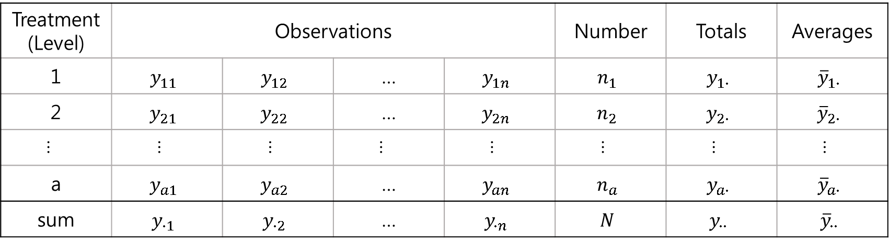
Ch3 Analysis of Variance
The Analysis of Variance
Typical Data for a Single-Factor Experiment
Treatment (Level) | Observations |  |  |  | Number | Totals | Averages
1 | $$y_{11}$$ | $$y_{12}$$ | … | $$y_{1n}$$ | $$n_{1}$$ | $$y_{1∙}$$ | $${\overline{y}}_{1∙}$$
2 | $$y_{21}$$ | $$y_{22}$$ | … | $$y_{2n}$$ | $$n_{2}$$ | $$y_{2∙}$$ | $${\overline{y}}_{2∙}$$
… | … | … | … | … | … | … | …
a | $$y_{a1}$$ | $$y_{a2}$$ | … | $$y_{an}$$ | $$n_{a}$$ | $$y_{a∙}$$ | $${\overline{y}}_{a∙}$$
sum | $$y_{∙1}$$ | $$y_{∙2}$$ | … | $$y_{∙n}$$ | $$N$$ | $$y_{∙∙}$$ | $${\overline{y}}_{∙∙}$$
$$where y_{i∙}=\sum_{j=1}^{n}{y_{ij}},y_{∙∙}=\sum_{i=1}^{a}{(\sum_{j=1}^{n}{y_{ij}})}, N=\sum_{i=1}^{a}{n_{i}}, and {\overline{y}}_{∙∙}=\sum_{i=1}^{a}{n_{i}y_{i∙}/N}=y_{∙∙}/N$$

Slide 5
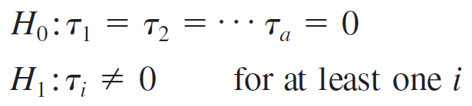
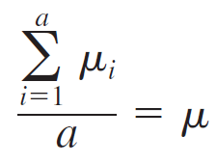
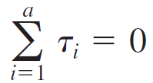

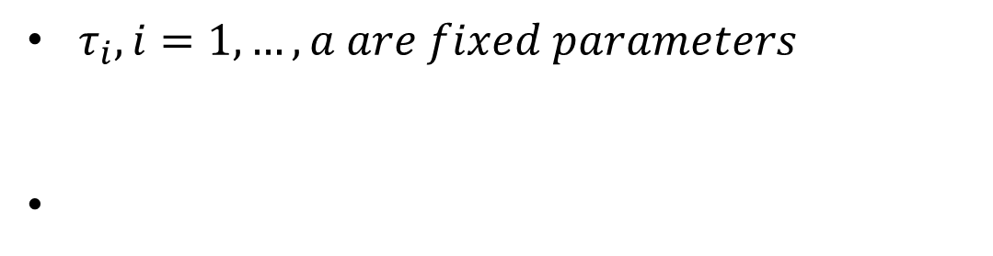

Ch3 Analysis of Variance
The Analysis of Variance
Fixed Effect Model
$τ_{i}, i=1,…,a are fixed parameters$
$$→$$
where

Slide 6

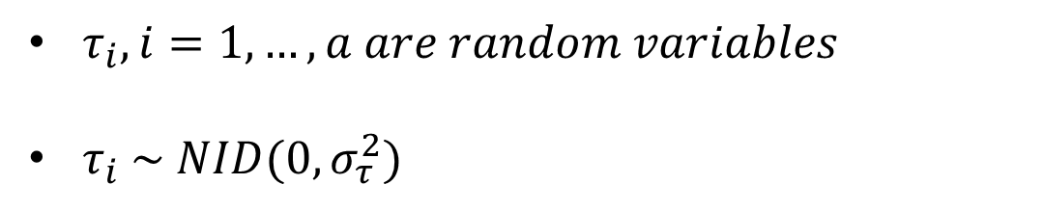
Ch3 Analysis of Variance
The Analysis of Variance
Random Effect Model
$τ_{i}, i=1,…,a are random variables$
$τ_{i} \sim NID(0, σ_{τ}^{2})$

Slide 7
Ch3 Analysis of Variance
Analysis of the Fixed Effects Model
one-way ANOVA

Slide 8
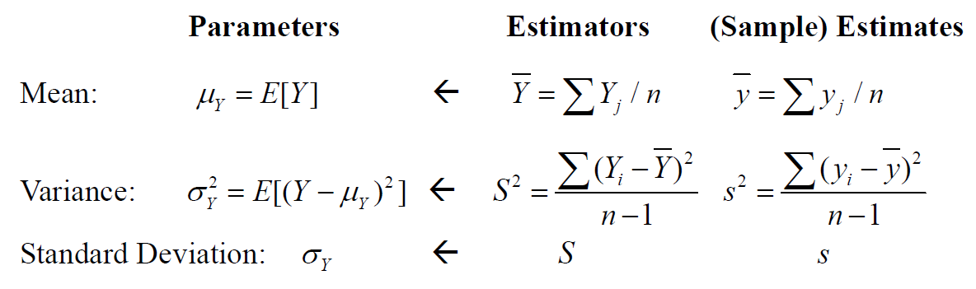
Ch3 Analysis of Variance
Sampling and Sampling Distributions
Statistics: Point Estimation

Slide 9
감사합니다.
See You

