Slide 1
실험계획법 실습
Ch3. Analysis of Variance

Slide 2
Ch3 Analysis of Variance
Contents
The Analysis of Variance
Analysis of the Fixed Effects Model
Constasts
Scheffe’s Method for comparing All Contrasts
Comparing Pairs of Treatment Means
The Random Effects Model

Slide 3
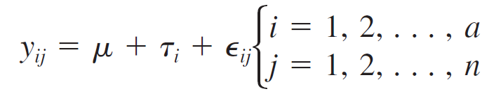

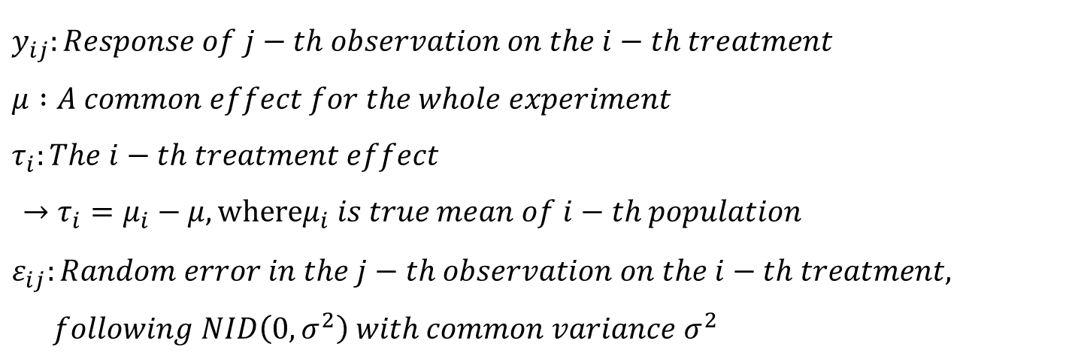
Ch3 Analysis of Variance
1. The Analysis of Variance
one-way ANOVA
$$Model :$$
$y_{ij}:Response of j−th observation on the i−th treatment$
$μ :A common effect for the whole experiment$
$τ_{i}:The i−th treatment effect$
$→τ_{i}=μ_{i}−μ, whereμ_{i} is true mean of i−th population$
$ε_{ij}:Random error in the j−th observation on the i−th treatment,$
$following NID\left(0, σ^{2}\right) with common variance σ^{2}$

Slide 4
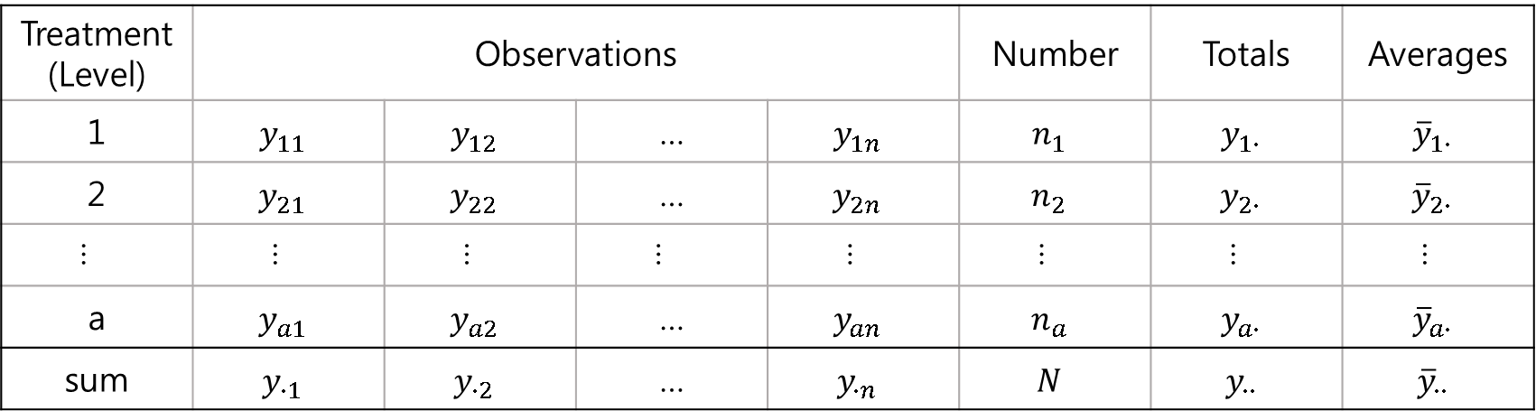
Ch3 Analysis of Variance
1. The Analysis of Variance
Typical Data for a Single-Factor Experiment
Treatment (Level) | Observations |  |  |  | Number | Totals | Averages
1 | $$y_{11}$$ | $$y_{12}$$ | … | $$y_{1n}$$ | $$n_{1}$$ | $$y_{1∙}$$ | $${\overline{y}}_{1∙}$$
2 | $$y_{21}$$ | $$y_{22}$$ | … | $$y_{2n}$$ | $$n_{2}$$ | $$y_{2∙}$$ | $${\overline{y}}_{2∙}$$
… | … | … | … | … | … | … | …
a | $$y_{a1}$$ | $$y_{a2}$$ | … | $$y_{an}$$ | $$n_{a}$$ | $$y_{a∙}$$ | $${\overline{y}}_{a∙}$$
sum | $$y_{∙1}$$ | $$y_{∙2}$$ | … | $$y_{∙n}$$ | $$N$$ | $$y_{∙∙}$$ | $${\overline{y}}_{∙∙}$$
$$where y_{i∙}=\sum_{j=1}^{n}{y_{ij}},y_{∙∙}=\sum_{i=1}^{a}{(\sum_{j=1}^{n}{y_{ij}})}, N=\sum_{i=1}^{a}{n_{i}}, and {\overline{y}}_{∙∙}=\sum_{i=1}^{a}{n_{i}y_{i∙}/N}=y_{∙∙}/N$$

Slide 5
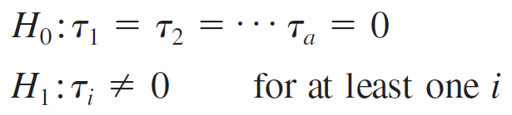
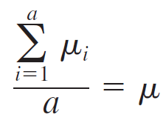
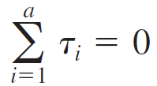

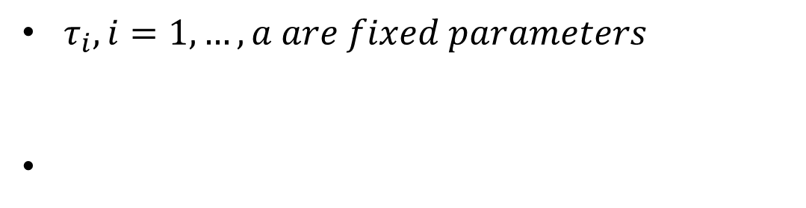

Ch3 Analysis of Variance
2. Analysis of the Fixed Effects Model
Fixed Effect Model
$τ_{i}, i=1,…,a are fixed parameters$
$$→$$
where

Slide 6

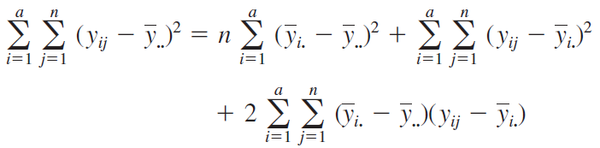




Ch3 Analysis of Variance
2. Analysis of the Fixed Effects Model
Decomposition of the Total Sum of Squares
( )
$$⇒$$
$$({SS}_{T}={SS}_{Treatments}+{SS}_{E})$$

Slide 7
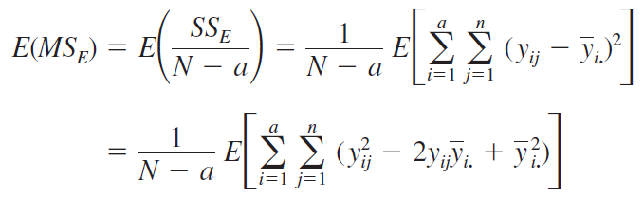
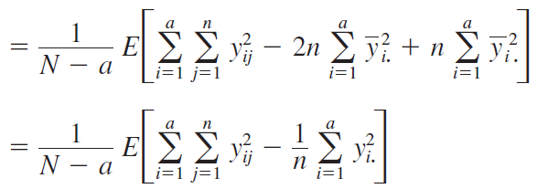
Ch3 Analysis of Variance
2. Analysis of the Fixed Effects Model
Expected values of mean square error

Slide 8
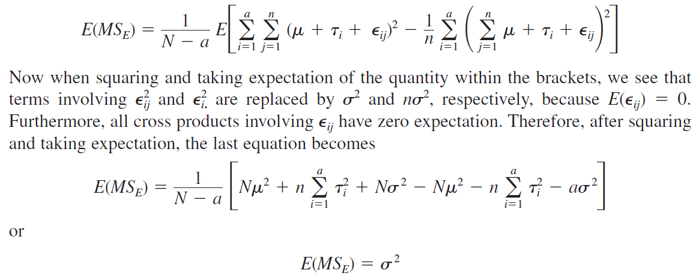
Ch3 Analysis of Variance
2. Analysis of the Fixed Effects Model
Expected values of mean square error

Slide 9
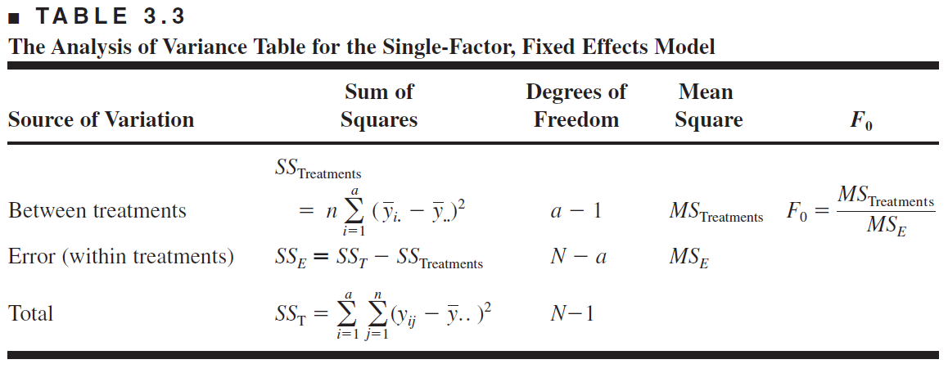
Ch3 Analysis of Variance
2. Analysis of the Fixed Effects Model
ANOVA Table

Slide 10
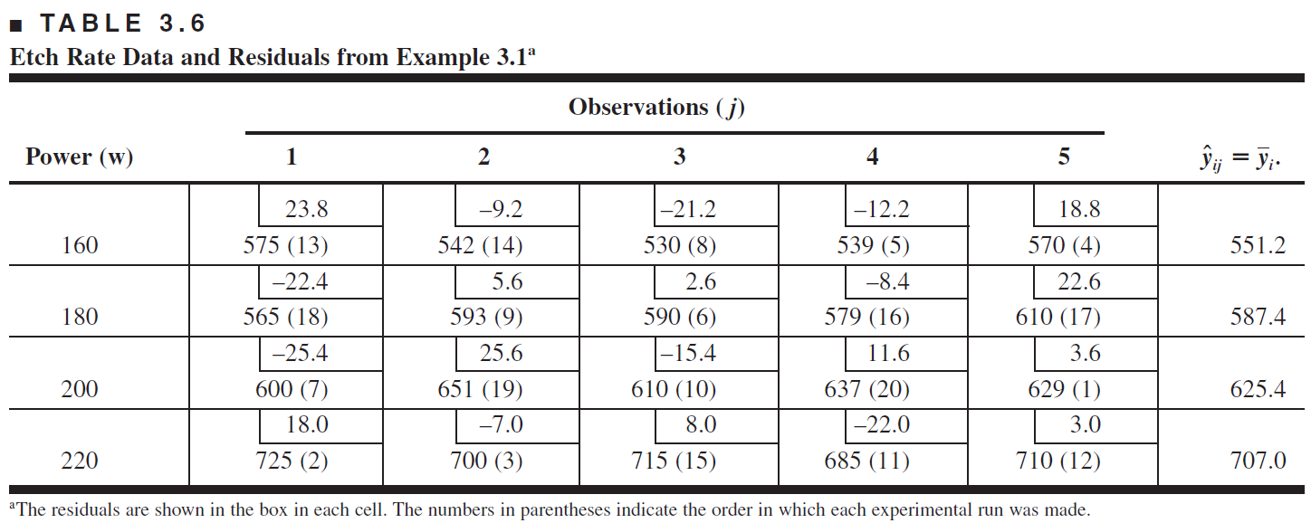
Ch3 Analysis of Variance
2. Analysis of the Fixed Effects Model
Model Adequacy Checking

Slide 11
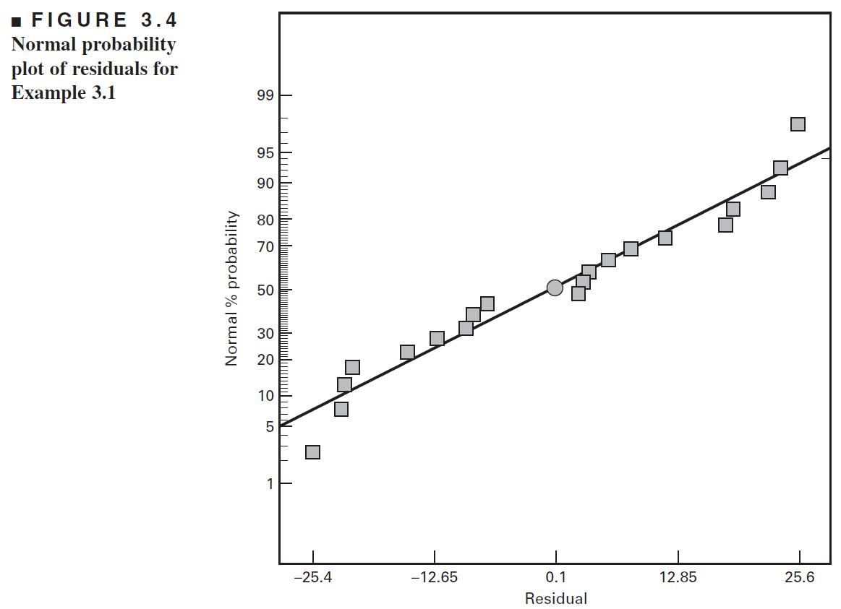
Ch3 Analysis of Variance
2. Analysis of the Fixed Effects Model
Model Adequacy Checking ( normality checking )

Slide 12
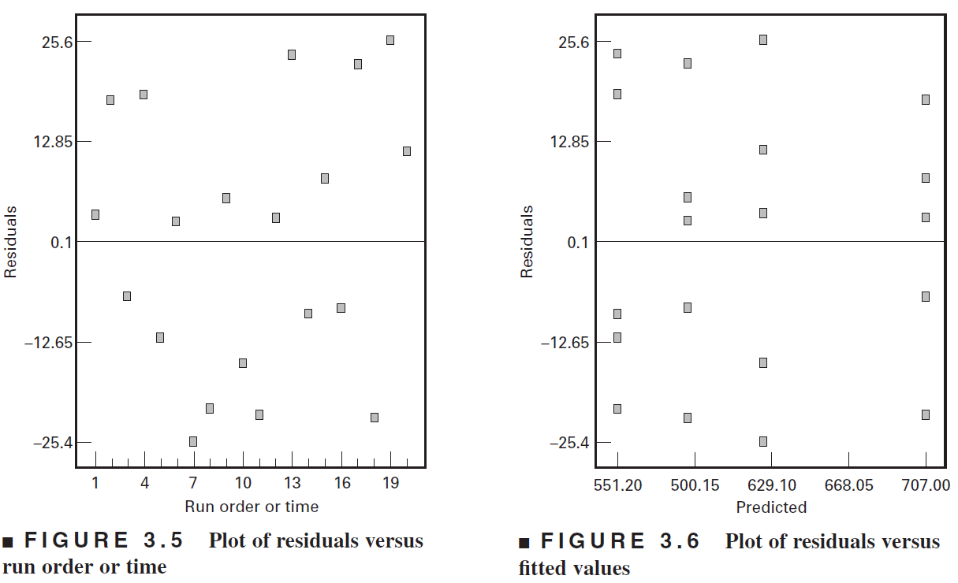
Ch3 Analysis of Variance
2. Analysis of the Fixed Effects Model
Model Adequacy Checking (Residual plot)

Slide 13
Ch3 Analysis of Variance
2. Analysis of the Fixed Effects Model
EXAMPLE 3.1 using R
# Ex 3.1
# preparing data set for Ex 3.1
RF<-factor(c(160,180,200,220))
obs<-c(1,2,3,4,5)
dat_3.1<-expand.grid(obs=obs,RF=RF)
count_3.1<-c(575,542,530,539,570,565,593,590,579,610,600,651,610,637,629,725,700,715,685,710)
dat_3.1<-cbind(dat_3.1,count_3.1)
# box-plot
boxplot(count_3.1~RF,data=dat_3.1,xlab="RF Power",ylab="Etch rate",main="RF Power vs Etch rate")
# fitting anova
fit_3.1<-aov(count_3.1~RF,data=dat_3.1)
summary(fit_3.1)
# Model Adequacy Checking
par(mfrow=c(2,2))
plot(fit_3.1)

Slide 14
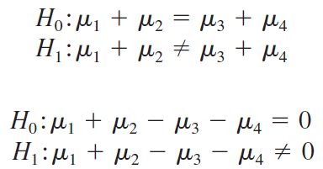
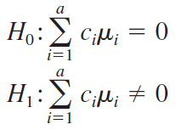




Ch3 Analysis of Variance
3. Contrasts
linear combination of parameters of the form
$$⇒$$
treatment average and variance
average :
variance :

Slide 15
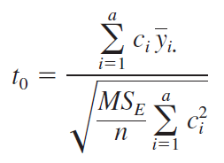
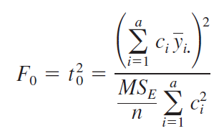




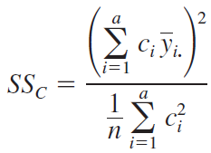
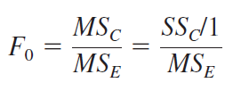
Ch3 Analysis of Variance
3. Contrasts
Statistics to test the hypotheses
Sum of Square contrasts

Slide 16

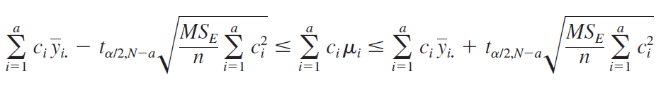

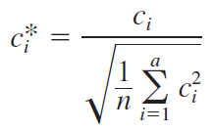
Ch3 Analysis of Variance
3. Contrasts
Confidence Interval for a Contrast
Standardized Contrast

Slide 17


Ch3 Analysis of Variance
3. Contrasts
Orthogonal Contrasts
Two contrasts with coefficients $\{c_{i}\}$ and $\{d_{i}\}$ are orthogonal
for an unbalanced design

Slide 18
Ch3 Analysis of Variance
3. Contrasts
EXAMPLE 3.6 using R
# Ex 3.6
# H0 : mu1=mu2 H0:mu1+mu2=mu3+mu4 H0:mu3=mu4
# make contrast
contrasmatrix<-cbind(c(1,-1,0,0),c(1,1,-1,-1),c(0,0,1,-1))
contrasts(dat_3.1$RF)<-contrasmatrix
# result for t-value anova
summary.lm(aov(count_3.1~RF,data=dat_3.1))

Slide 19
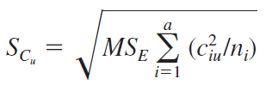


Ch3 Analysis of Variance
4. Scheffe’s Method for comparing All Contrasts
Scheffe’s Method
Suppose that a set of m contrasts in the treatment means
standard error :
Critical value :
test the hypothesis

Slide 20


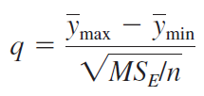
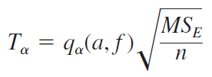

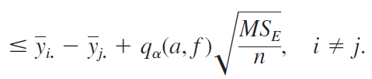
Ch3 Analysis of Variance
5. Comparing Pairs of Treatment Means
Tukey’s Test
hypothesis :
studentized range statistic :
test statistic :
confidence intervals :

Slide 21
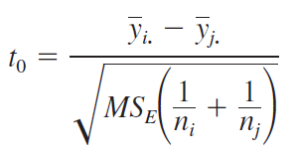





Ch3 Analysis of Variance
5. Comparing Pairs of Treatment Means
The Fisher Least Significant Difference (LSD) Method
hypothesis :
$$⇒$$

Slide 22
Ch3 Analysis of Variance
5. Comparing Pairs of Treatment Means
EXAMPLE 3.7 3.8 using R
# Ex 3.7
install.packages("agricolae")
library(agricolae)
# using scheffe in agricolae
fit_sch<-scheffe.test(fit_3.1,"RF",group=F)
# using TukeyHSD
fit_tuk <- TukeyHSD(x=fit_3.1, "RF", conf.level=0.95)
# using TukeyHSD another function in agricolae
fit_tuk2<-HSD.test(fit_3.1,"RF",group = F)
# Ex 3.8
# using LSD in agricolae
fit_lsd<-LSD.test(fit_3.1,"RF",group=F)
# using pairwise.t.test
fit_lsd2<-pairwise.t.test(dat_3.1$count_3.1,dat_3.1$RF, p.adjust="none")

Slide 23
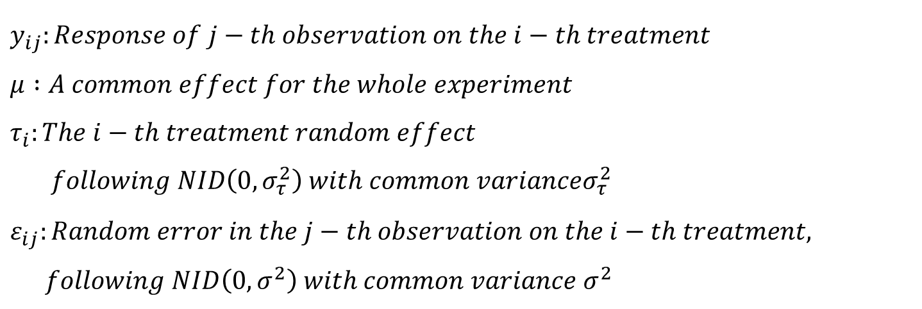
Ch3 Analysis of Variance
6. The Random Effects Model
A Single Random Factor
$$Model :$$
$y_{ij}:Response of j−th observation on the i−th treatment$
$μ :A common effect for the whole experiment$
$τ_{i}:The i−th treatment random effect$
$following NID\left(0,σ_{τ}^{2}\right) with common varianceσ_{τ}^{2}$
$ε_{ij}:Random error in the j−th observation on the i−th treatment,$
$following NID\left(0, σ^{2}\right) with common variance σ^{2}$

Slide 24

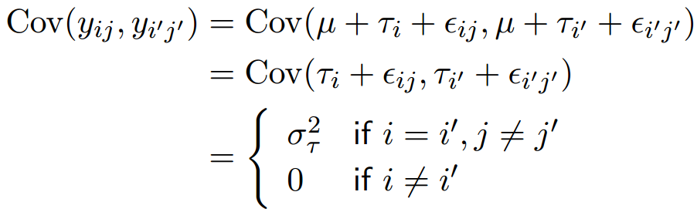
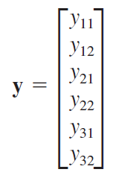
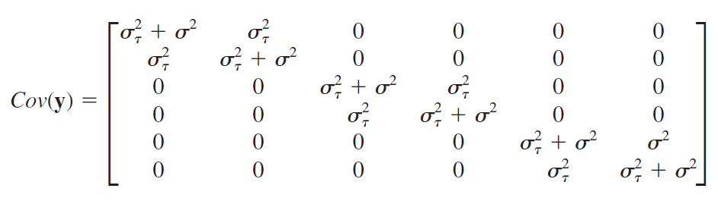
Ch3 Analysis of Variance
6. The Random Effects Model
Variance Components
Covariance matrix

Slide 25
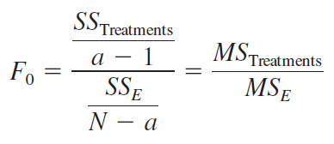


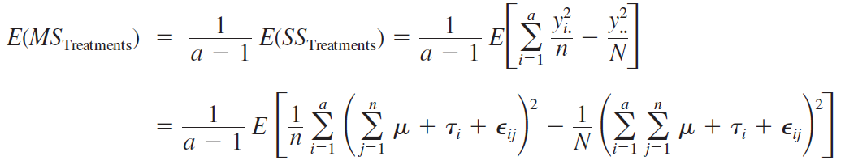


Ch3 Analysis of Variance
6. The Random Effects Model
Analysis of Variance for the Random Model

Slide 26
Ch3 Analysis of Variance
6. The Random Effects Model
EXAMPLE 3.11 using R
# Ex 3.11
# preparing data set for Ex 3.11
bat<-factor(c(1,2,3,4))
obs_3.11<-c(1,2,3,4)
dat_3.11<-expand.grid(bat=bat,obs=obs_3.11)
count_3.11<-c(98,91,96,95,97,90,95,96,99,93,97,99,96,92,95,98)
dat_3.11<-cbind(dat_3.11,count_3.11)
# fitting anova
fit_3.11<-aov(count_3.11~bat,data=dat_3.11)
summary(fit_3.11)

Slide 27
THANK YOU

