Slide 1
실험계획법 실습
Ch4. Experiments with Blocking Factors

Slide 2
Contents
The Randomized Complete Block Design
Some Other Aspects of the RCBD
The Latin Square Design

Slide 3
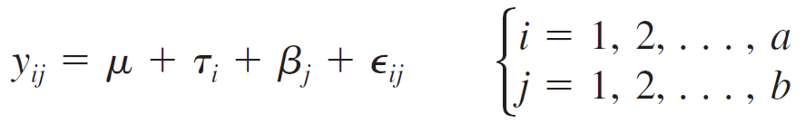
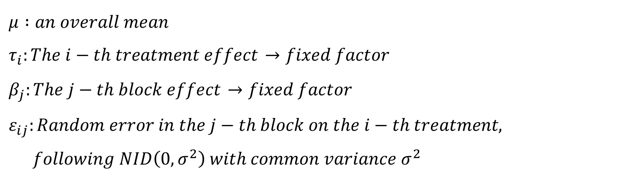

1. The Randomized Complete Block Design
Statistical Analysis of the RCBD
$$effect model :$$
$μ :an overall mean$
$τ_{i}:The i−th treatment effect$ $→fixed factor$
$β_{j}:The j−th block effect$ $→fixed factor$
$ε_{ij}:Random error in the j−th block on the i−th treatment,$
$following NID\left(0, σ^{2}\right) with common variance σ^{2}$

Slide 4
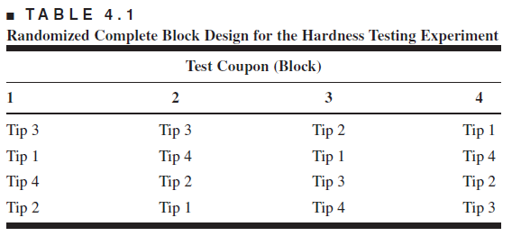
1. The Randomized Complete Block Design
The Hardness Testing Example
Notice the two-way structure of the experiment
Once again, we are interested in testing the equality of treatment means, but now we have to remove the variability associated with the nuisance factor (the block)

Slide 5
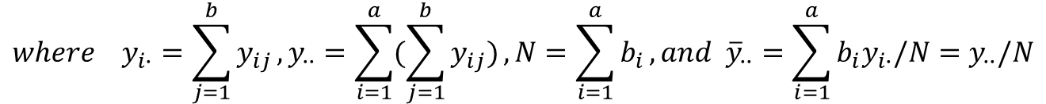
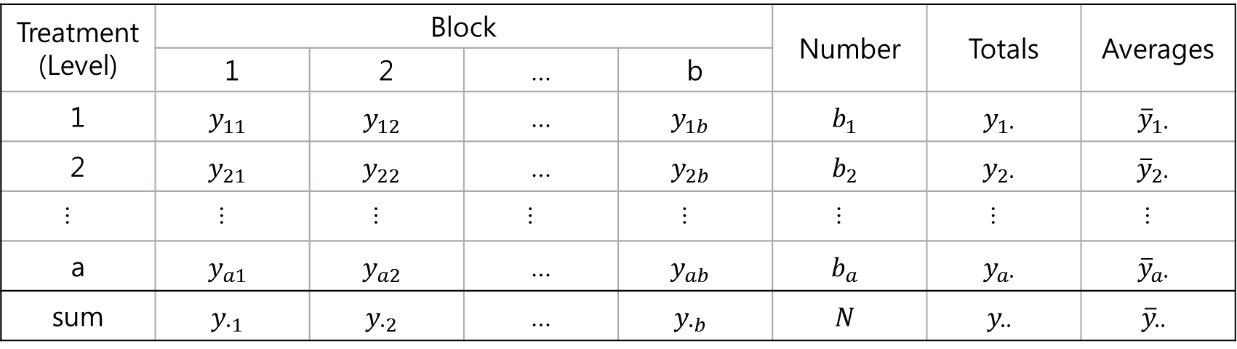
1. The Randomized Complete Block Design
Typical Data for a Block design
Treatment (Level) | Block |  |  |  | Number | Totals | Averages
 | 1 | 2 | … | b
1 | $$y_{11}$$ | $$y_{12}$$ | … | $$y_{1b}$$ | $$b_{1}$$ | $$y_{1∙}$$ | $${\overline{y}}_{1∙}$$
2 | $$y_{21}$$ | $$y_{22}$$ | … | $$y_{2b}$$ | $$b_{2}$$ | $$y_{2∙}$$ | $${\overline{y}}_{2∙}$$
… | … | … | … | … | … | … | …
a | $$y_{a1}$$ | $$y_{a2}$$ | … | $$y_{ab}$$ | $$b_{a}$$ | $$y_{a∙}$$ | $${\overline{y}}_{a∙}$$
sum | $$y_{∙1}$$ | $$y_{∙2}$$ | … | $$y_{∙b}$$ | $$N$$ | $$y_{∙∙}$$ | $${\overline{y}}_{∙∙}$$
$$where y_{i∙}=\sum_{j=1}^{b}{y_{ij}},y_{∙∙}=\sum_{i=1}^{a}{(\sum_{j=1}^{b}{y_{ij}})}, N=\sum_{i=1}^{a}{b_{i}}, and {\overline{y}}_{∙∙}=\sum_{i=1}^{a}{b_{i}y_{i∙}/N}=y_{∙∙}/N$$

Slide 6
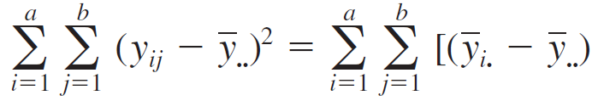

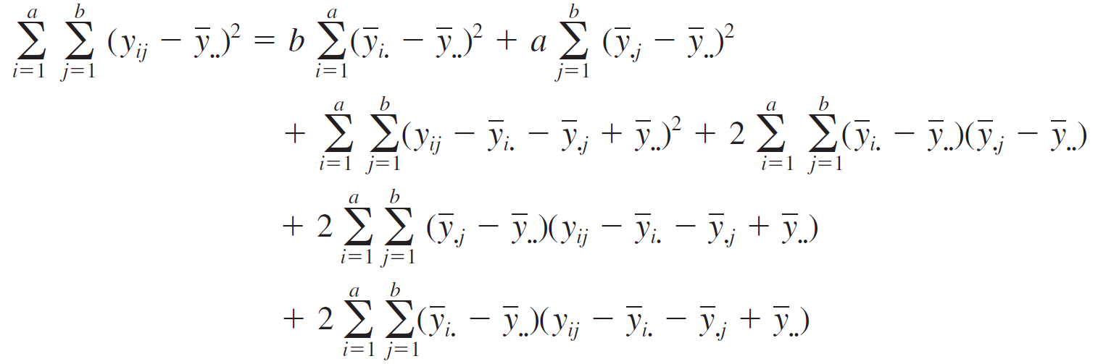
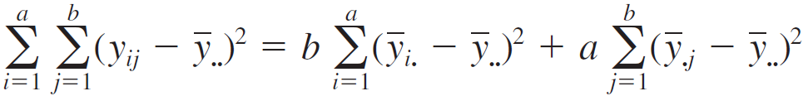
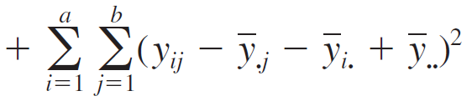
1. The Randomized Complete Block Design
Decomposition of the Total Sum of Squares

Slide 7
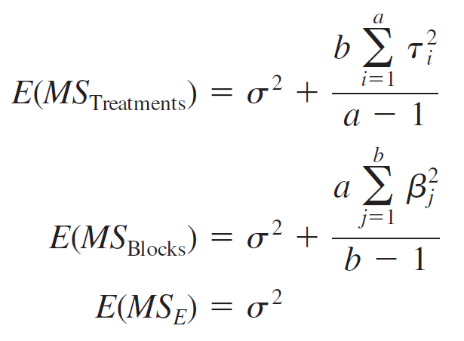
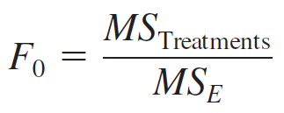

1. The Randomized Complete Block Design
Expectation of Mean Square

Slide 8
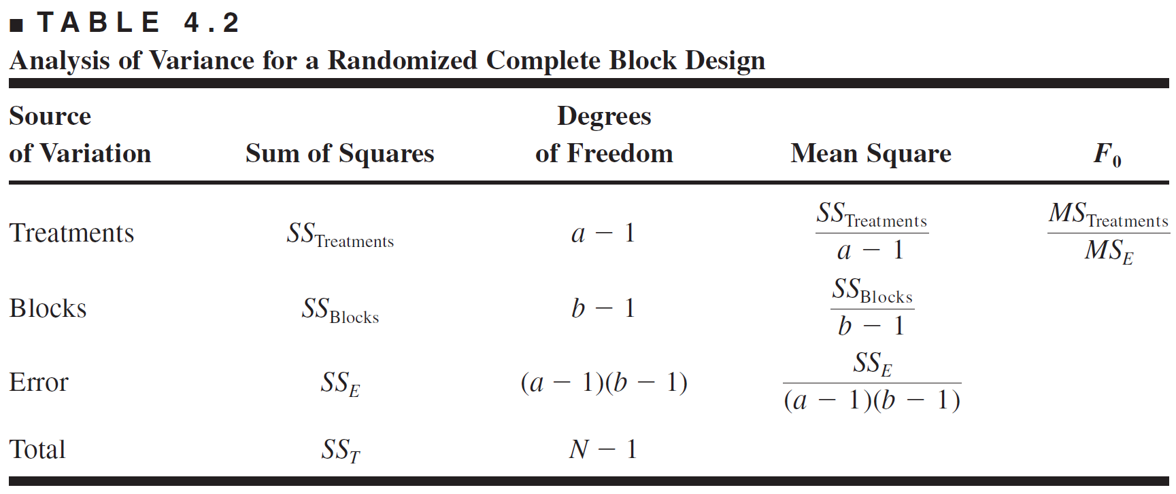
1. The Randomized Complete Block Design
ANOVA for RCBD

Slide 9
1. The Randomized Complete Block Design
EXAMPLE 4.1 using R
# Ex 4.1
PSI<-factor(c(8500,8700,8900,9100))
block<-factor(c(1,2,3,4,5,6))
dat_4.1<-expand.grid(PSI=PSI,block=block)
c_4.1<-c(90.3,92.5,85.5,82.5,89.2,89.5,90.8,89.5,98.2,90.6,89.6,85.6,93.9,94.7,86.2,87.4,87.4,87.0,88.0,78.9,97.9,95.8,93.4,90.7)
dat_4.1<-cbind(dat_4.1,c_4.1)
# fitting anova
fit_4.1<-aov(c_4.1~PSI+block,data=dat_4.1)
summary(fit_4.1)
lsd_4.1<-LSD.test(fit_4.1,"PSI",group=F)
# Model Adequacy Checking
par(mfrow=c(2,2))
plot(fit_4.1)

Slide 10
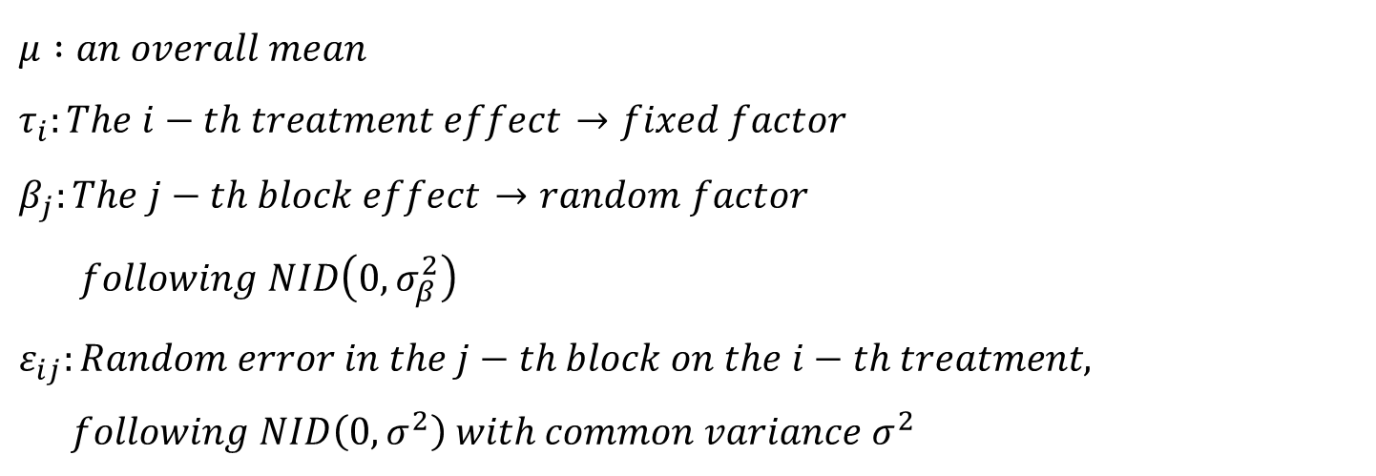
2. Some Other Aspects of the RCBD
Random Treatments and Blocks
$$effect model :$$
$μ :an overall mean$
$τ_{i}:The i−th treatment effect$ $→fixed factor$
$β_{j}:The j−th block effect$ $→random factor$
$following NID\left(0, σ_{β}^{2}\right)$
$ε_{ij}:Random error in the j−th block on the i−th treatment,$
$following NID\left(0, σ^{2}\right) with common variance σ^{2}$

Slide 11
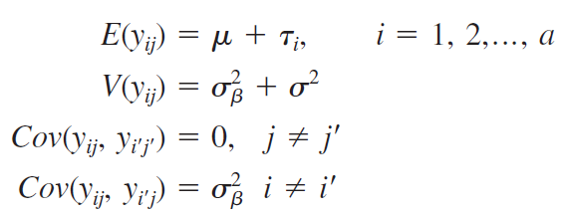

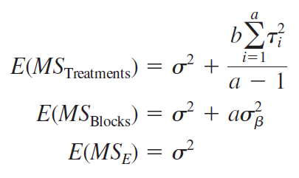


2. Some Other Aspects of the RCBD
Random Treatments and Blocks
$$⇒$$

Slide 12
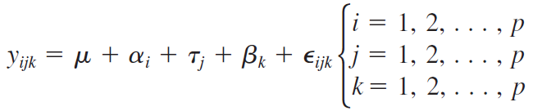

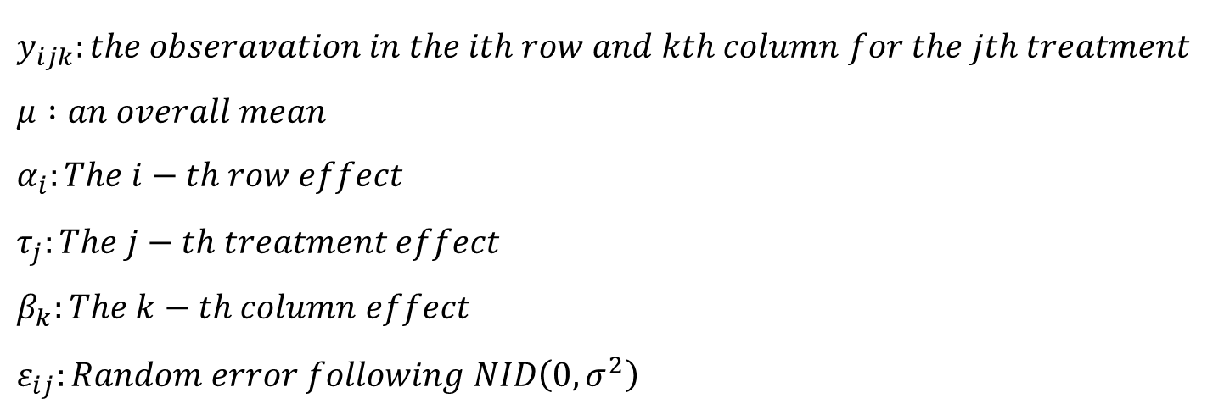
3. The Latin Square Design
Statistical model for a Latin square
$$effect model :$$
$y_{ijk}:the obseravation in the ith row and kth column for the jth treatment$
$μ :an overall mean$
$α_{i}:The i−th row effect$
$τ_{j}:The j−th treatment effect$
$β_{k}:The k−th column effect$
$ε_{ij}:Random error following NID\left(0, σ^{2}\right)$

Slide 13
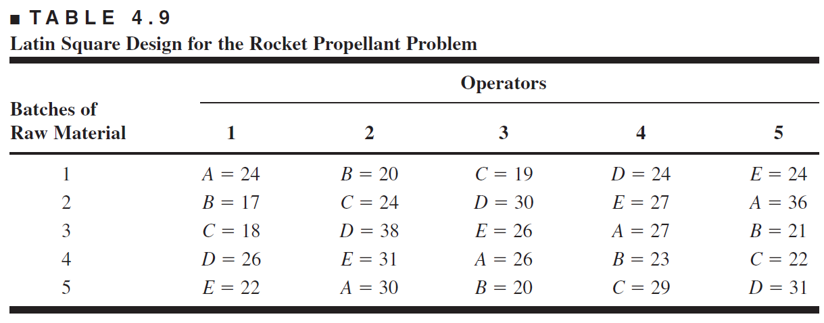
3. The Latin Square Design
Latin Square Design Example

Slide 14
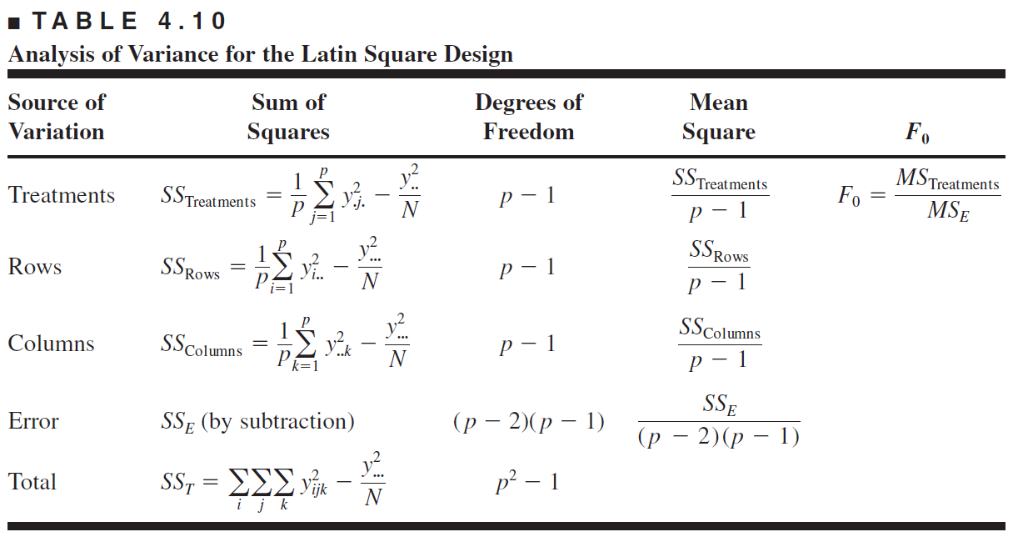
3. The Latin Square Design
ANOVA for Latin Square Design

Slide 15
3. The Latin Square Design
EXAMPLE 4.3 using R
# Ex 4.3
RM<-factor(c(1,2,3,4,5))
OP<-factor(c(1,2,3,4,5))
dat_4.3<-expand.grid(RM=RM,OP=OP)
c_4.3<-c(-1,-8,-7,1,-3,-5,-1,13,6,5,-6,5,1,1,-5,-1,2,2,-2,4,-1,11,-4,-3,6)
LA<-c('A','B','C','D','E','B','C','D','E','A','C','D','E','A','B','D','E','A','B','C','E','A','B','C','D')
dat_4.3<-cbind(dat_4.3,LA,c_4.3)
# fitting anova
fit_4.3<-aov(c_4.3~LA+RM+OP,data=dat_4.3) #treat + row +col
summary(fit_4.3)
lsd_4.3<-LSD.test(fit_4.3,"LA",group=F)
# Model Adequacy Checking
par(mfrow=c(2,2))
plot(fit_4.3)

Slide 16
THANK YOU

