Slide 1
Convolutional Neural Networks
18010374 김범석

Slide 2
CONTENTS
1. Convolutional Layers
- Image Tensors
- Correlation
- Window Extraction
- Computations
2. Pooling Layers
- Max/Average Pooling
- Padding
- Strides
3. Convolutional Neural Networks

Slide 3
Convolutional Layers

Slide 4
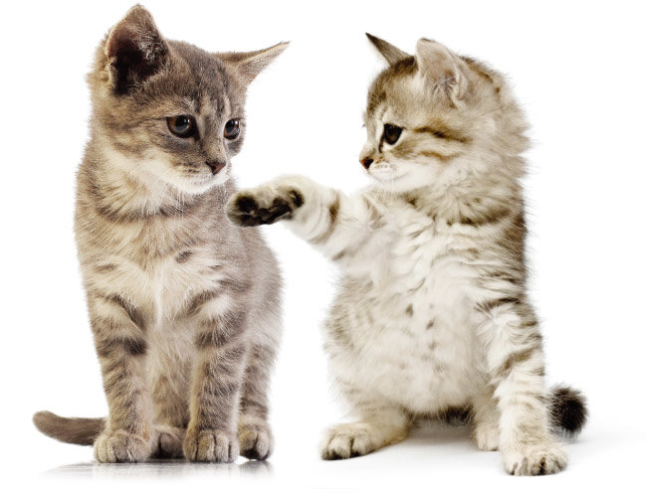

Slide 5

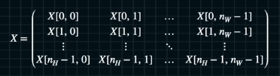
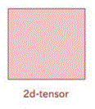
Image Tensors

Slide 6


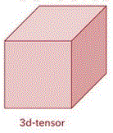

Image Tensors

Slide 7
Correlation
Convolutional vs Correlational

Slide 8


Correlation

Slide 9
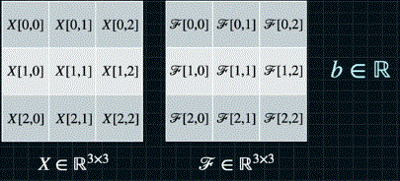
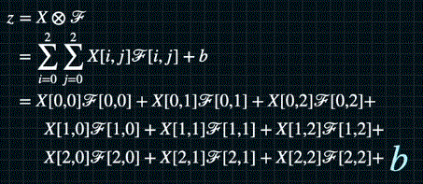
Correlation

Slide 10
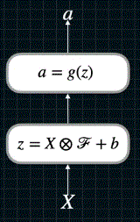

Correlation
activation function
$$≈$$
affine function
input image

Slide 11



Window Extraction(1D)
input
window
generalization

Slide 12
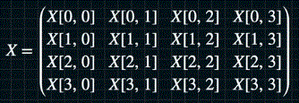
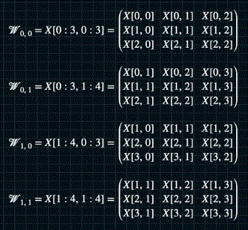

Window Extraction(2D)
input
window
generalization

Slide 13

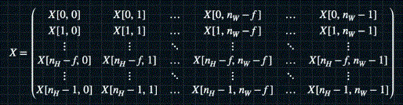
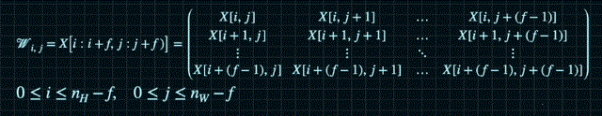
Window Formularization

Slide 14
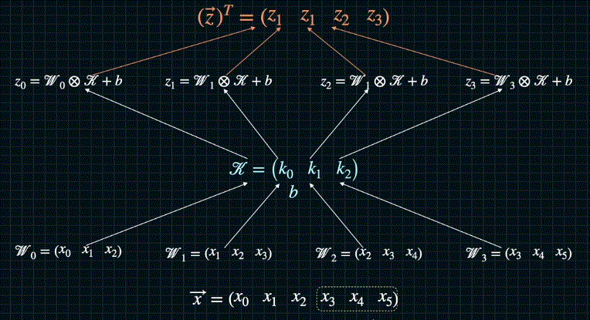
Computations of Convolutional Layers(1D)
correlation

Slide 15

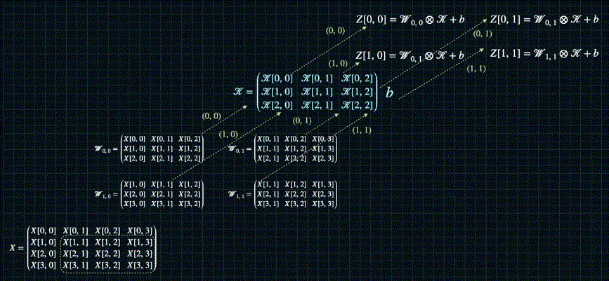
Computations of Convolutional Layers(2D)
correlation

Slide 16
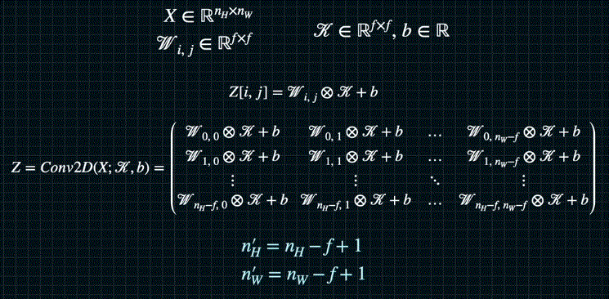
Computations of Convolutional Layers(2D)

Slide 17

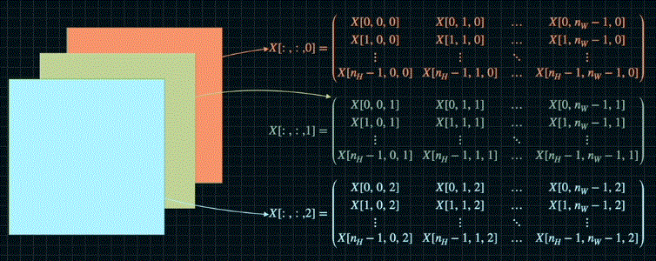
Computations of Convolutional Layers(3D)

Slide 18
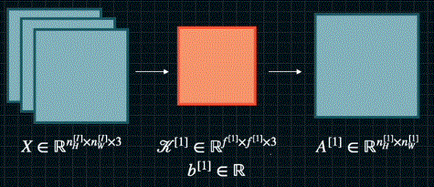
Computations of Convolutional Layers(3D)
correlation

Slide 19
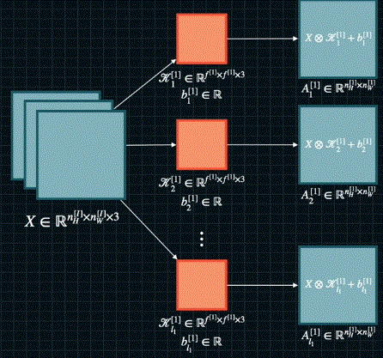
Computations of Convolutional Layers(3D)
filter bank

Slide 20
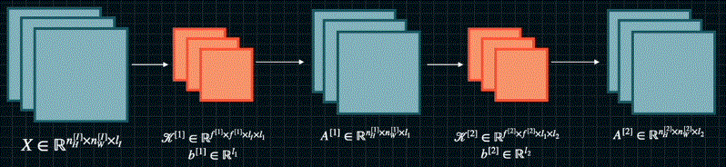
Computations of Convolutional Layers(3D)

Slide 21
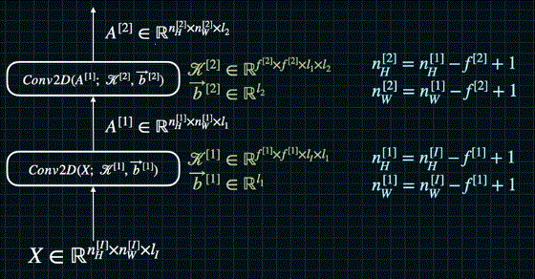
Cascaded Conv Layers

Slide 22
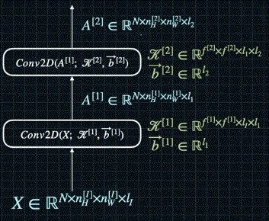
Cascaded Conv Layers

Slide 23
Pooling Layers

Slide 24
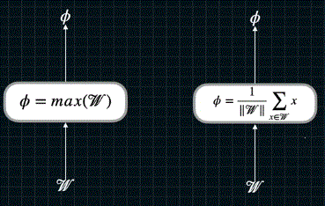
Max/Average Pooling
max pooling
average pooling

Slide 25
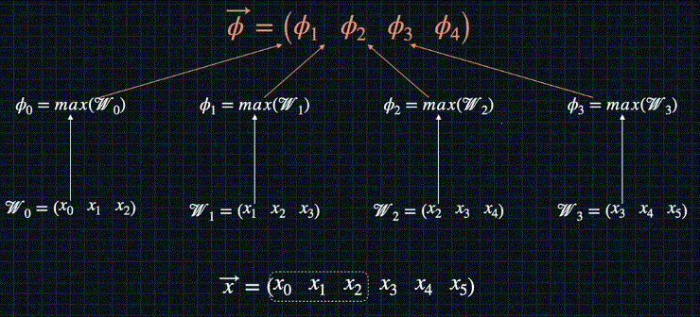
Max/Average Pooling(1D)

Slide 26
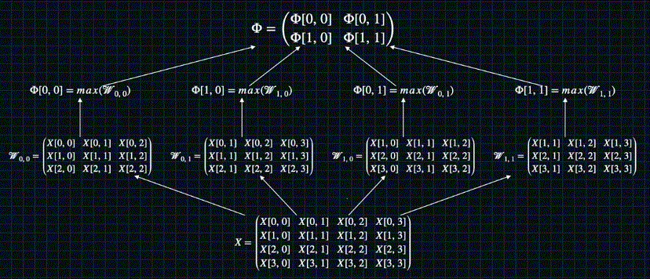
Max/Average Pooling(2D)

Slide 27
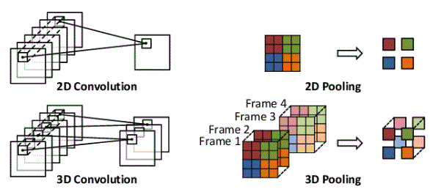
Max/Average Pooling(3D)

Slide 28
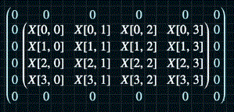

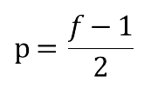
Padding
$$p=\frac{f-1}{2}$$

Slide 29

Strides
1
2

Slide 30

Output size
p : pooling size
f : filter size
s: stride size

Slide 31
Convolutional Neural Networks

Slide 32
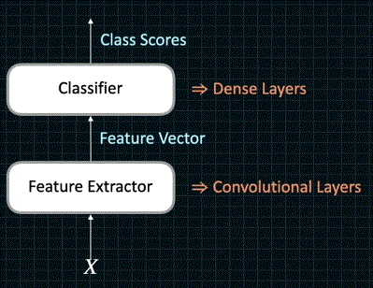
Convolutional Neural Networks

Slide 33

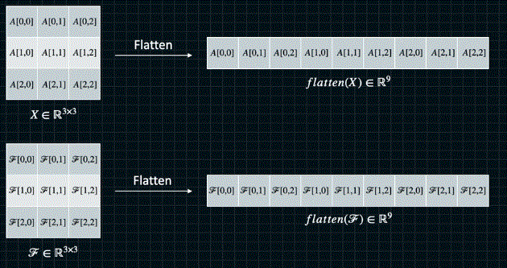

Flatten Layer
$$⋯⋯$$

Slide 34
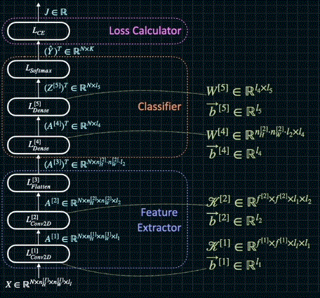
Convolutional Neural Networks

