Slide 1
Lab 1 – K-Means Clustering
Dan Feldman
CS PhD Student, Viterbi School of Engineering
University of Southern California

Slide 2
Background
Astrophysics, California Institute of Technology (long ago)
Data Scientist/Engineer at tech startup, Retention Science (not so long ago)
CS PhD (2nd year), USC (now)
Current research focus lies at the intersection of active learning and knowledge capture/representation:
How do we efficiently share data, information, and knowledge between humans?
How do we efficiently share data, information, and knowledge between humans and machines?
How do we capture procedural knowledge (know-hows)?

Slide 3
Lab Goals
Knowledge
Why?
Information
Where? When? How?
Data
What data do we have?

Slide 4
Lab Goals – Day 1, Part 1
Knowledge
Set up our environment
Write code to load/save data
Write utility functions to visualize/explore various types of data
Why?
Information
Where? When? How?
Data
Identify what we have

Slide 5
Lab Goals – Day 1, Part 2
Knowledge
Implement K-Means
Visualize K-Means
Implement K-finder for K-Means (time-permitting)
Why?
Information
Identify patterns
Data
Identify what we have

Slide 6
Environment Setup
Install Anaconda (https://www.anaconda.com/distribution/#download-section)
Create working directory, e.g.: /path/to/data_mining
Go to that folder and clone GitHub repo: git clone https://github.com/dnfeldman/soongsil
Go to cloned repository
Create Conda environment and install dependencies: conda env create -f environment.yml
Activate Conda environment: conda activate soongsil_data_mining
Make Conda Env visible to Jupyter kernels: python -m ipykernel install --user --name soongsil_data_mining --display-name soongsil_data_mining
Start Jupyter notebook: jupyter notebook
Verify everything works (execute first cell in the notebook)

Slide 7
Dataset Overview
Inspired by Yelp dataset (https://www.yelp.com/dataset/challenge)
Users (users.csv), Businesses (businesses.csv), Ratings (ratings_{train|validate|test}.csv)
Users
Businesses
Ratings
Uid, Bid, Rating

Slide 8
Utilities
[done] Write a function to load CSV files (can use built-in CSV library)
[done] Write a function that selects specific columns from a CSV
[ ] Write a function that filters rows based on some condition
[ ] Write a function that accepts a 2d array and writes it to a CSV file
[done] Write a function that, given 3 arrays (X, Y, colors), returns an image of scatterplot (matplotlib)

Slide 9
K-Means (Homework)
[almost done] Implement K-Means
[ ] Implement a function that, after every iteration of K-Means, generates an image of current cluster assignments, cluster centers, and displays (for each cluster) current error rate (can use legend for that)
[ ] Implement a function that takes an array of images and saves them as a .gif file

Slide 10
Lab Goals – Day 2, Part 1
Knowledge
Build user behavioral model
Use the model to predict user business ratings
Validate how well our model performs
Predict the future
Information
Identify patterns
Data
Identify what we have

Slide 11
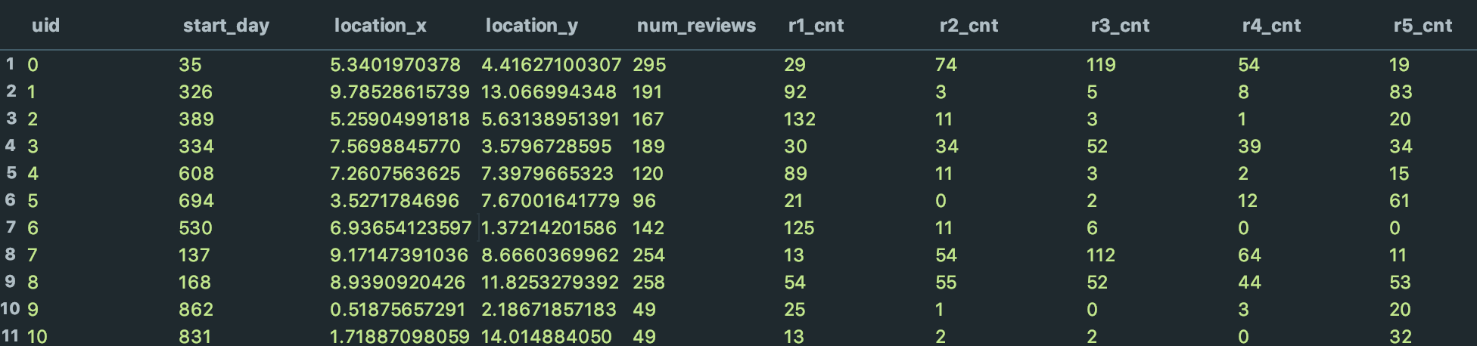
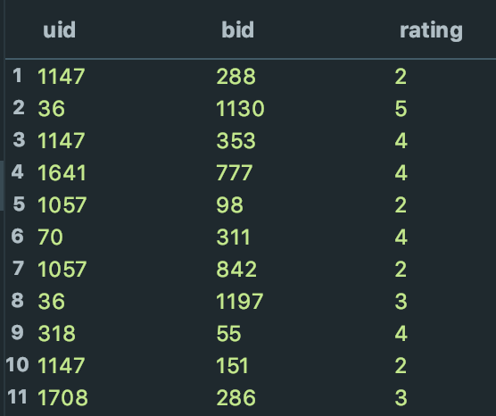
Data Overview
users.csv
ratings_train.csv

Slide 12
Data Overview
users.csv
identify patterns
Normally distributed around 3s
Either 1s or 5s, or both
Uniform

Slide 13
Data Overview
users.csv
identify patterns
Normally distributed around 3s
Either 1s or 5s, or both
Uniform

Slide 14
Data Overview
users.csv
identify patterns
Normally distributed around 3s
Either 1s or 5s, or both
Uniform

Slide 15
Data Overview
users.csv
identify patterns
Normally distributed around 3s
Either 1s or 5s, or both
Uniform
If we can identify different types of users, we can use user type’s behavior to predict the ratings
hypothesis

Slide 16
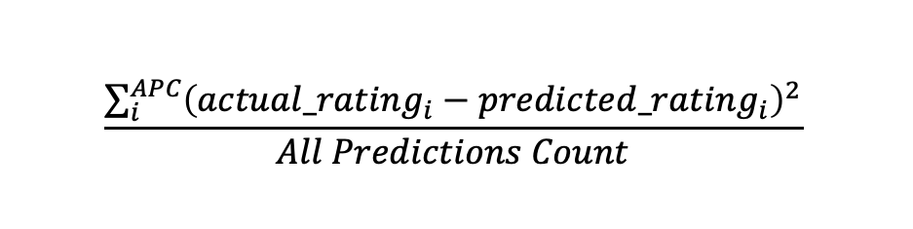
Implementing Model-Based Recommendations
Prerequisites: How do we know how good our model is?
1. Implement a method to calculate Root Mean Square Error (RSME):
$$\frac{\sum_{i}^{APC}{{\left(actual_rating_{i}−predicted_rating_{i}\right)}^{2}}}{All Predictions Count}$$
2. Implement a method to print error counts (no need to plot it):
[0 – 1)
222
[1 – 2)
111
[2 – 3)
55
[3 – 4)
22
[4 – ∞)
9

