Slide 1
Data analysis on Crime Data
Heesu Yeom (Hallym univ. senior)
Jeongmyeong Choi (Hallym univ. senior)
Jongyoon Chae (Konkuk univ. junnior)
Beomseok Cho (Konkuk univ. junnior)
Hyojin Cho (Konkuk univ. junnior)
Jaeyoung Kim (Hallym univ. senior)
Data from :
https://data.lacity.org/A-Safe-City/Crime-Data-from-2010-to-Present/63jg-8b9z

Slide 2
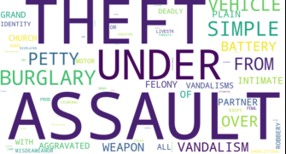
WHY?

Slide 3
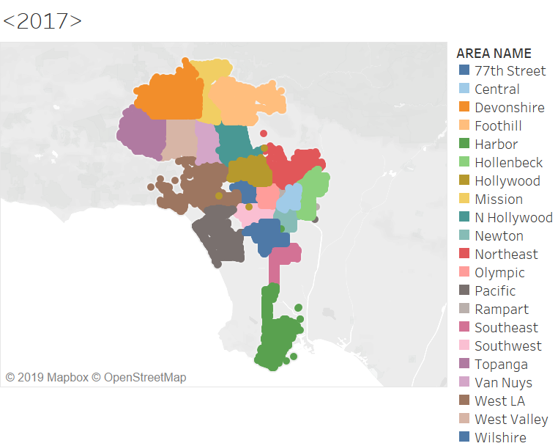

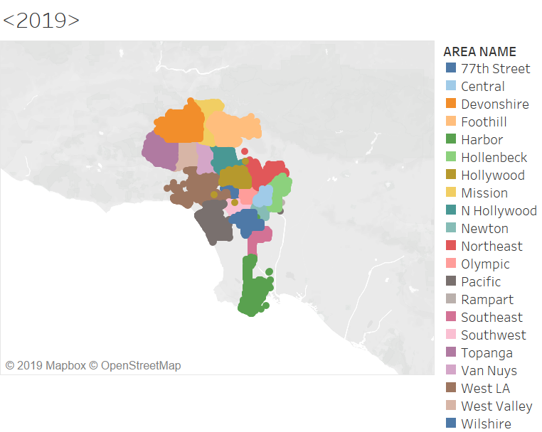
Data Reliability

Slide 4
Data Analysis (1)

Slide 5
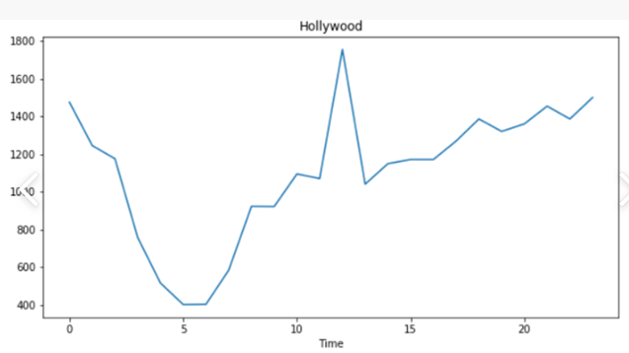
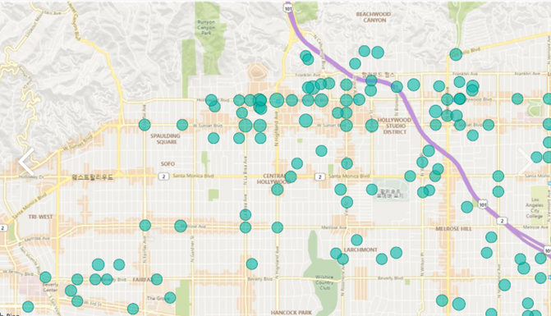
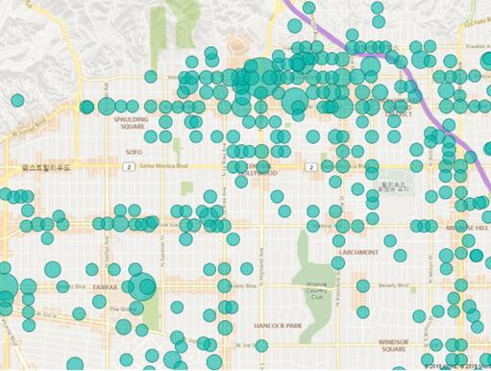
Data Analysis (2)
06:00 am
12:00 pm

Slide 6
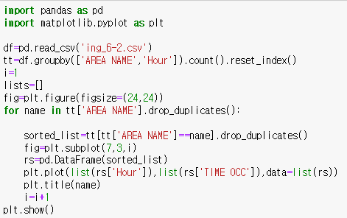
Data Analysis (2)-1

Slide 7
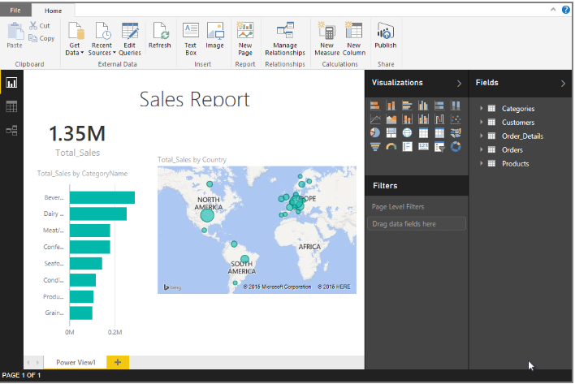
Data Analysis (2)-2
06:00 am
12:00 pm

Slide 8
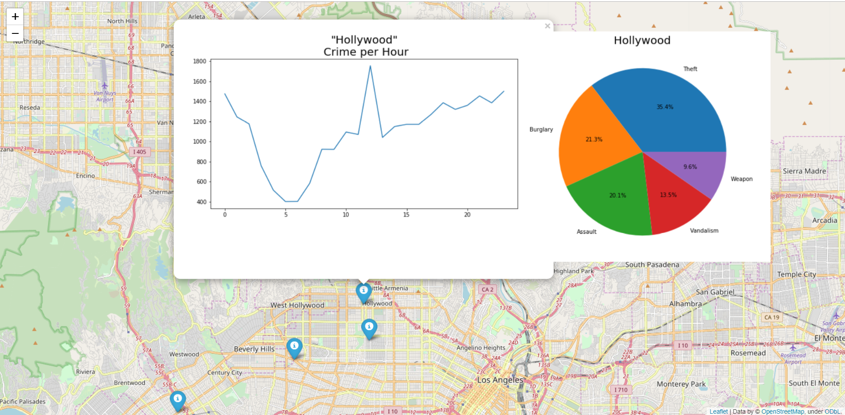
Data Analysis (3)

Slide 9
HOW IS IT USEFUL?
- Helps visitors to be safe :
- Useful information to place officers efficiently

Slide 10
HOW IS IT USEFUL?
- Helps visitors to be safe :
- Useful information to place officers efficiently

Slide 11
Furthermore
How can it be developed more?

Slide 12
THANK YOU

