Slide 1
Data analysis on Crime Data
T. Insight.
Heesu Yeom (Hallym univ. senior)
Jeongmyeong Choi (Hallym univ. senior)
Jongyoon Chae (Konkuk univ. junnior)
Beomseok Cho (Konkuk univ. junnior)
Hyojin Cho (Konkuk univ. junnior)
Jaeyoung Kim (Hallym univ. senior)
Data from :
https://data.lacity.org/A-Safe-City/Crime-Data-from-2010-to-Present/63jg-8b9z

Slide 2
Index
Word Cloud
Data Reliability
Data preprocessing using python / Represent using R
Data analysis
Development potential

Slide 3
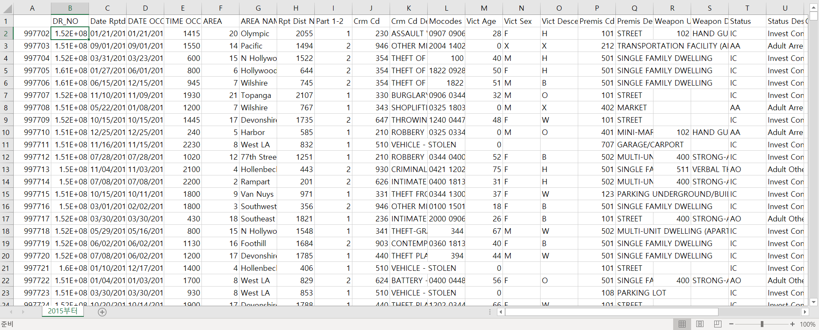
Crime Data On LA

Slide 4
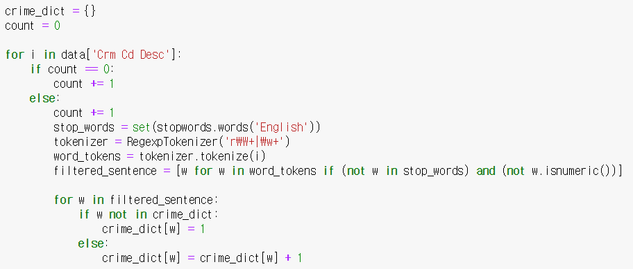
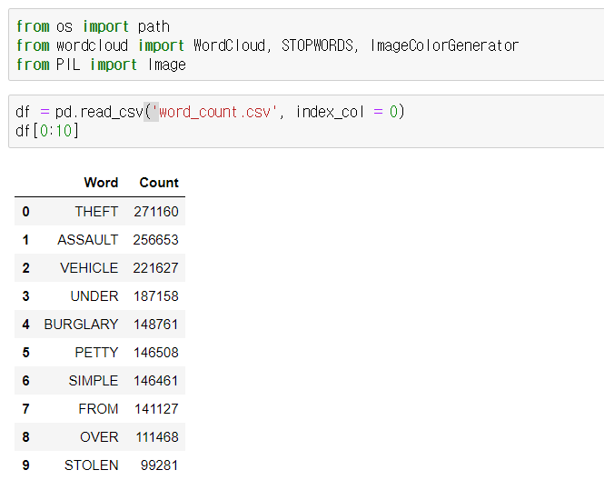
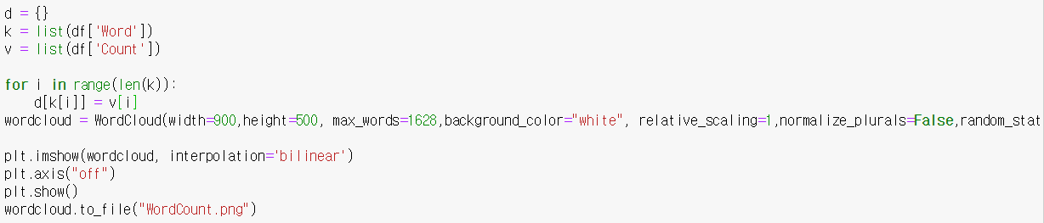
Python Code

Slide 5
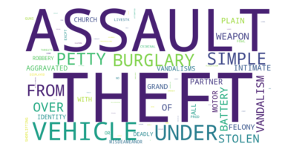
Word Cloud

Slide 6
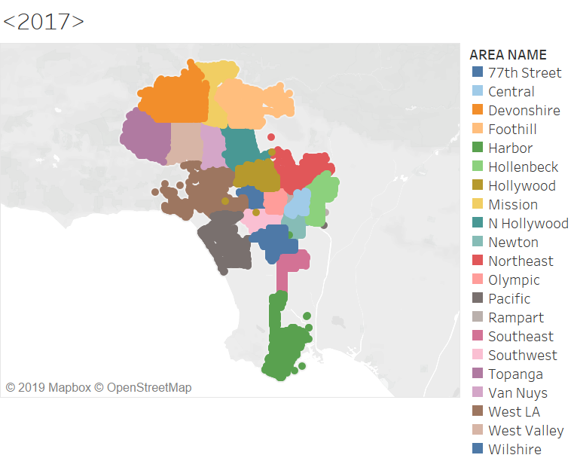

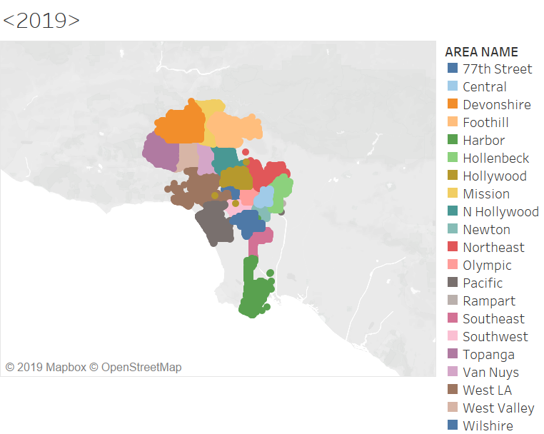
Data Reliability

Slide 7
Data Analysis (1)

Slide 8
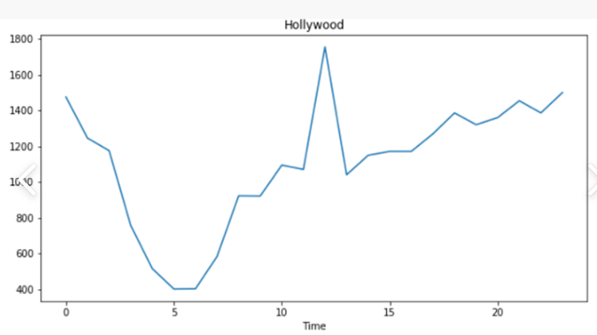
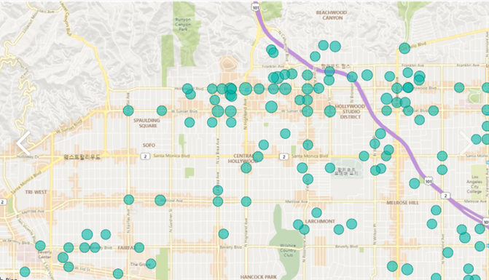
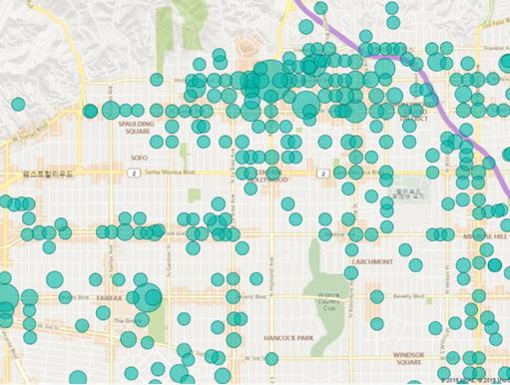
Data Analysis (2)
06:00 am
12:00 pm

Slide 9
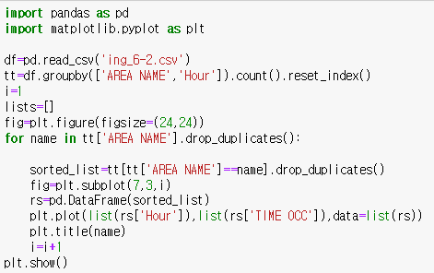
Data Analysis (2)-1

Slide 10
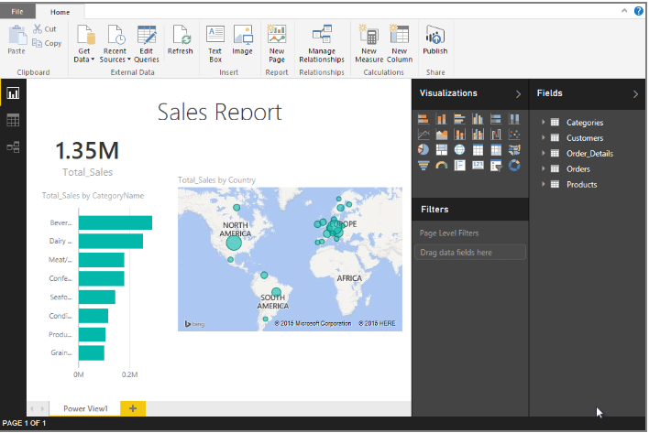
Data Analysis (2)-2
06:00 am
12:00 pm

Slide 11
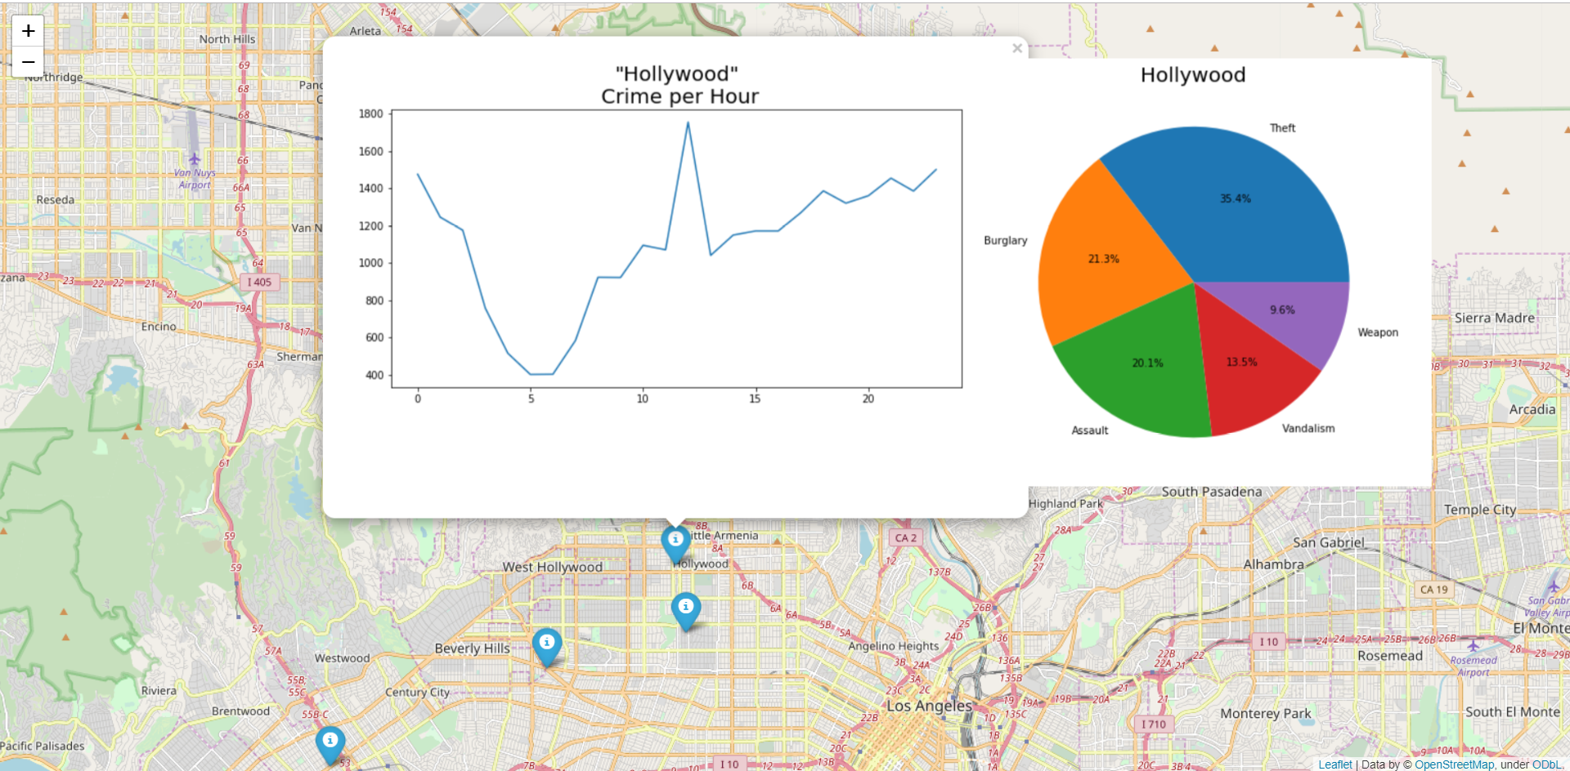
Data Analysis (3)

Slide 12
How Is It Useful?
- Helps visitors to be safe :
- Useful information to place officers efficiently

Slide 13
Furthermore
How can it be developed more?

Slide 14
THANK YOU

